Slide 1
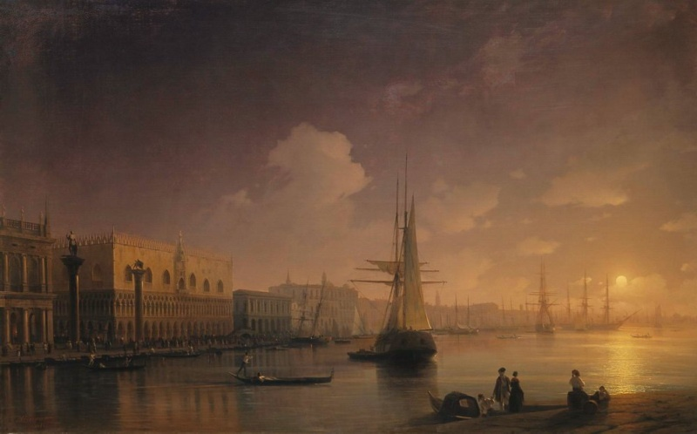
Ivan Konstantinovich
Aivazovsky
Venetian Night

Slide 2
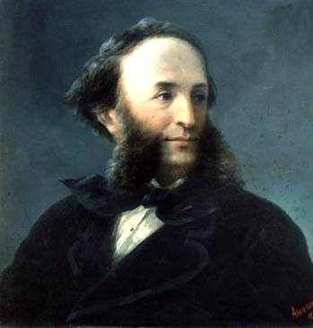
Biography Aivazovsky
Biography Aivazovsky
Ivan aivazovsky was born july 17, 1817 in feodosia in the family of armenian businessman, later went bankrupt.

Slide 3
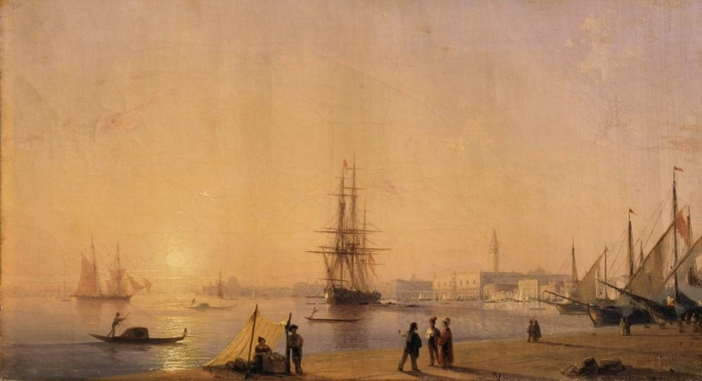
First, he studied in high school in Simferopol, and then in 1833 he entered the St. Petersburg Academy of Arts, where from 1833 to 1839, he studied
Venice 1844

Slide 4
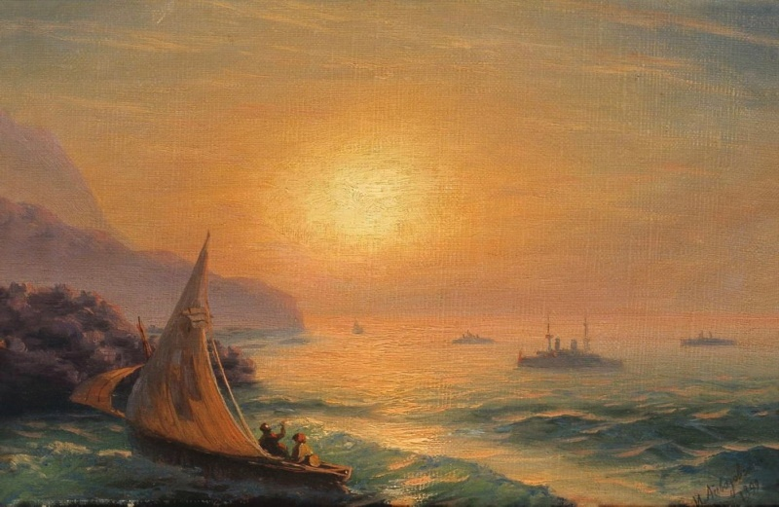
Sea Aivazovsky appears as though the basis of nature, in his portrayal of the artist manages to show the beauty of the life of the mighty elements.
Sunset at Sea 1899

Slide 5
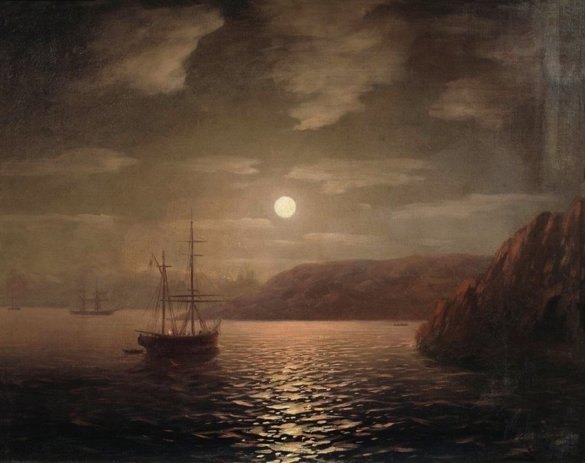
Ivan Aivazovsky died April 19, 1900.

Slide 6
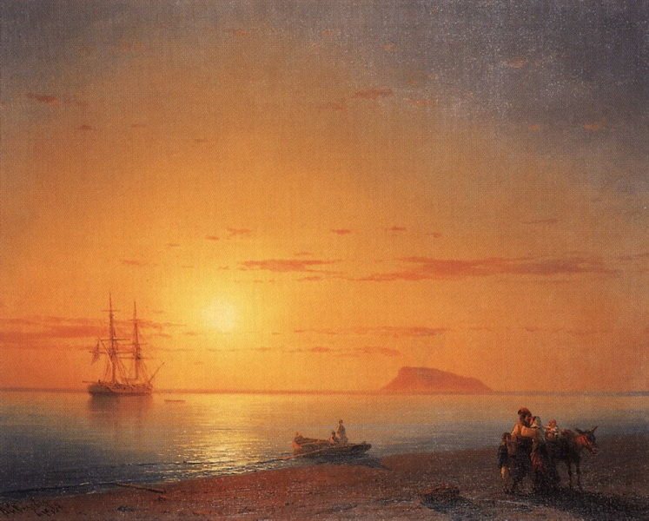
Seashore. farewell 1868

