Slide 1
Superstition

Slide 2
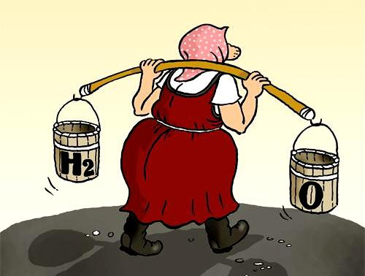
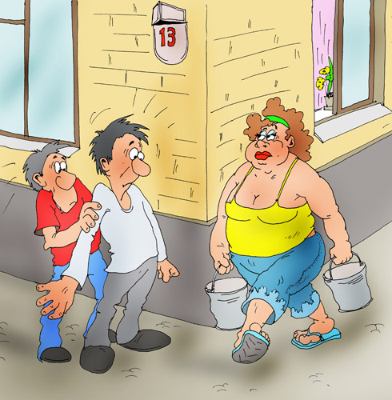
If you meet woman with
An empty bucket, You will
have bad luck.

Slide 3
You will have visitors , if you see a spider in your house.

Slide 4
In Turkey if a black cat crossed the road , you will have bad luck. But if you touch your hair you will have good luck.

Slide 5
If you put the keys on the table, you will have a quarrel.

Slide 6
If the baby looks like a mother , he will have good luck.

Slide 7
You will have bad day , if the morning you meet the first a woman.

Slide 8
If the bird flew into the house , you will have news.

Slide 9
If your ears itch , will be a snowstorm.

Slide 10
If you look in a broken mirror , you will have bad luck.

Slide 11
