Slide 1
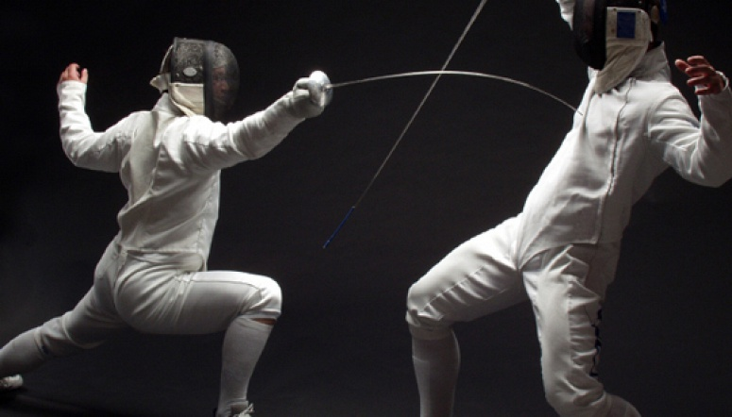

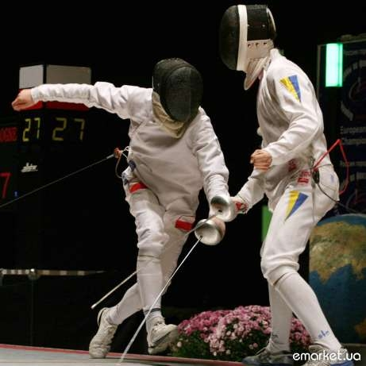
Fencing

Slide 2




Fencing is the activity of fighting with blades. The most common version of fencing today, also called olympic fencingor competitive fencing, is divided into three weapon categories: foil, sabre and épée. Classical fencing uses the same three weapons, but approaches fencing as a martial art.
Competitive fencing is one of five sports which has been featured at every one of the modern Olympic Games, the other four being Athletics, Cycling, Swimming, and Gymnastics.

Slide 3
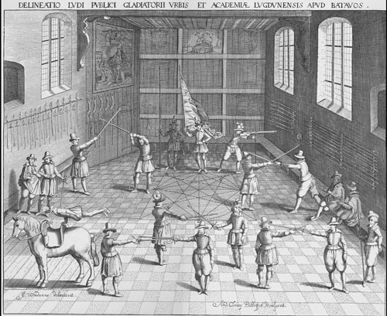
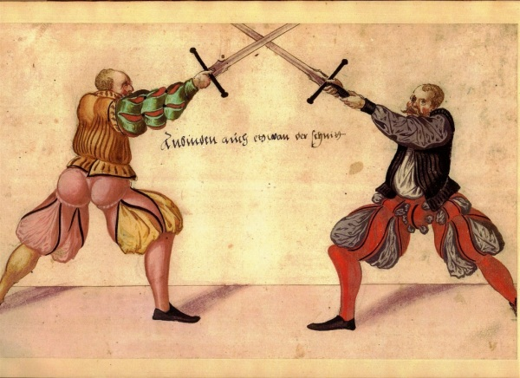
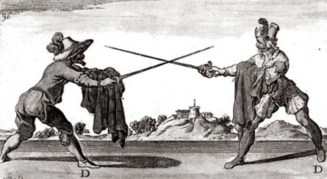
History
The ancestor of modern fencing originated in Spain, where several books on fencing were written. Treatise on Arms was written by Diego de Valera between 1458
and 1471 and is one of the oldest surviving manuals on western fencing shortly before dueling came under official ban by the Catholic Monarchs. In conquest, the Spanish forces carried fencing around the world, particularly southern Italy, one of the major areas of strife between both nations.
The mechanics of modern fencing originated in the 18th century in an Italian school of fencing of the Renaissance, and, under their influence, was improved by the French school of fencing. The Spanish school of fencing stagnated and was replaced by the Italian and French schools.

Slide 4
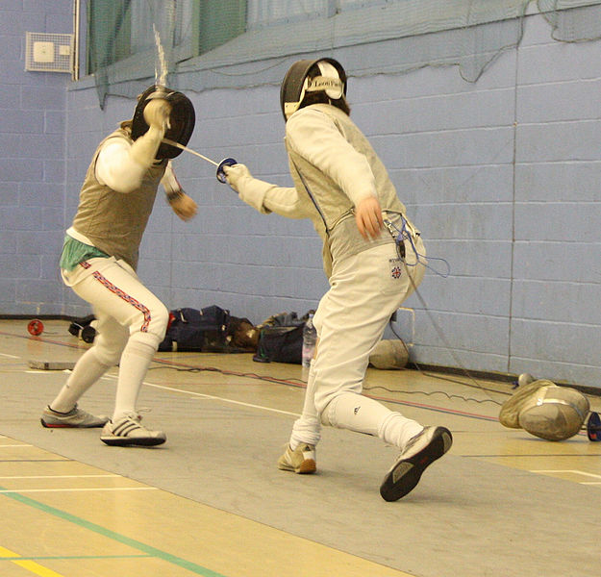
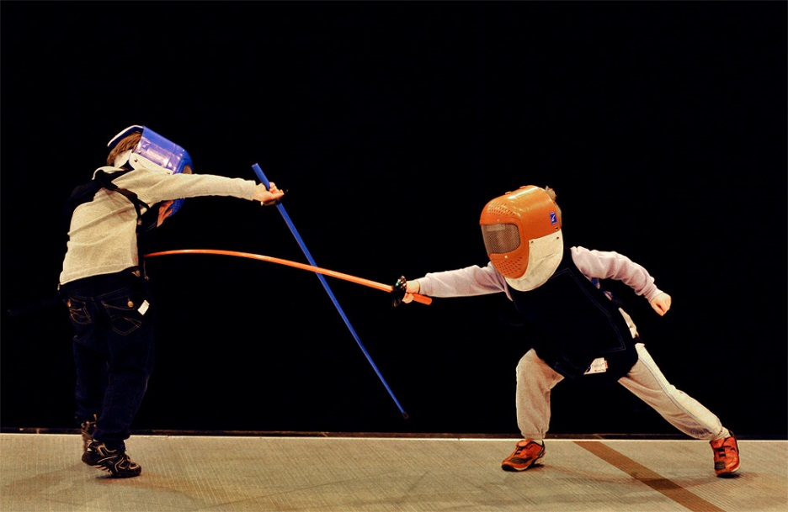
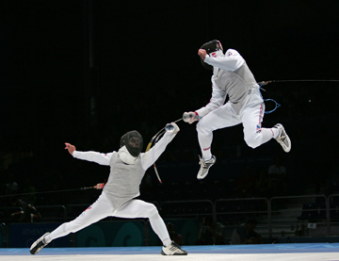
Universities and schools
Fencing has a long history with universities and schools for at least 500 years. At least one style of fencing, Mensur in Germany, is practiced only within universities. University students compete internationally at the World University Games. The United States holds two national level university tournaments including the NCAAchampionship and the USACFC National Championships^{[8]} tournaments in the USA and the BUCS fencing championships in the United Kingdom.
Equipment costs and the relatively small scale of the sport limits university fencing to a small number of schools. National fencing organizations have set up programs to encourage more students to fence. Examples include the Regional Youth Circuit program^{[9]} in the USA and the Leon Paul Youth Development series in the UK.

Slide 5
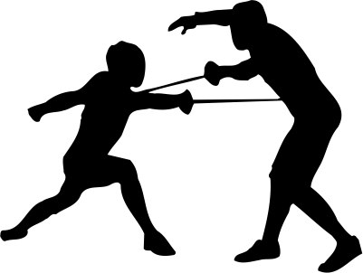
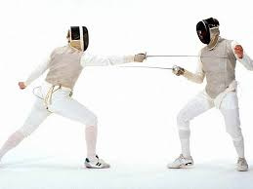
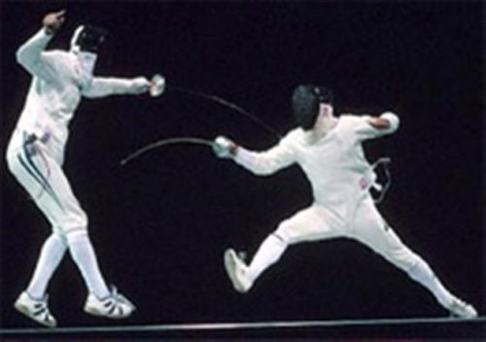
In recent years, attempts have been made to introduce fencing to a wider and younger audience, by using foam and plastic swords, which require much less protective equipment. This makes it much less expensive to provide classes, and makes it easier to take fencing to a wider range of schools than traditionally has been the case. There is even a competition series in Scotland – the Plastic-and-Foam Fencing FunLeague – specifically for Primary and early Secondary school-age children using this equipment.

Slide 6
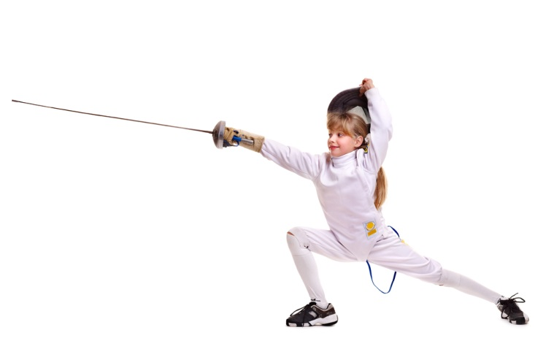
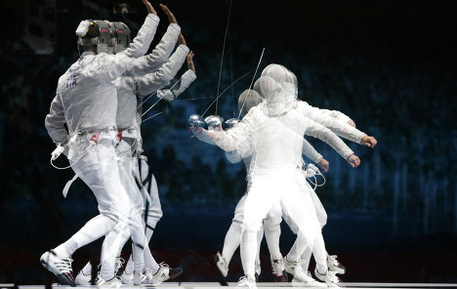
The UK hosts two national competitions in which schools compete against each other directly: the Public Schools Fencing Championship, a competition only open to Independent Schools, and the Scottish Secondary Schools Championships, open to all secondary schools in Scotland. It contains both teams and individual events and is highly anticipated. Schools organise matches directly against one another and school age pupils can compete individually in the British Youth Championships.
Many universities in Ontario, Canada have fencing teams that participate in an annual inter-university competition called the OUA Finals.

Slide 7
Thank you!

