Slide 1
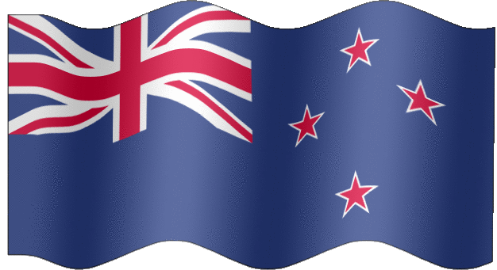
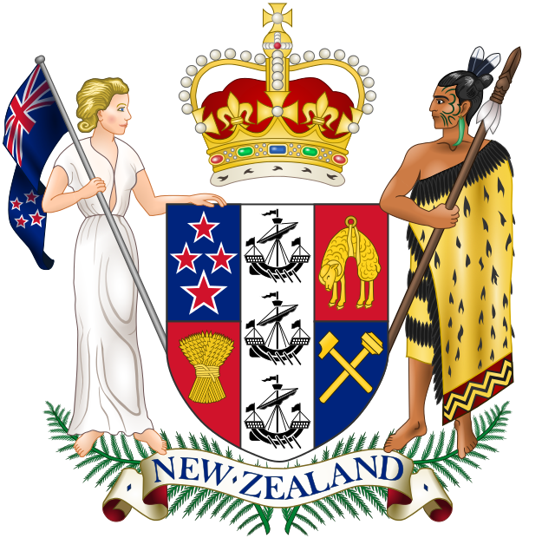
Flag and Emblem of New Zealand

Slide 2
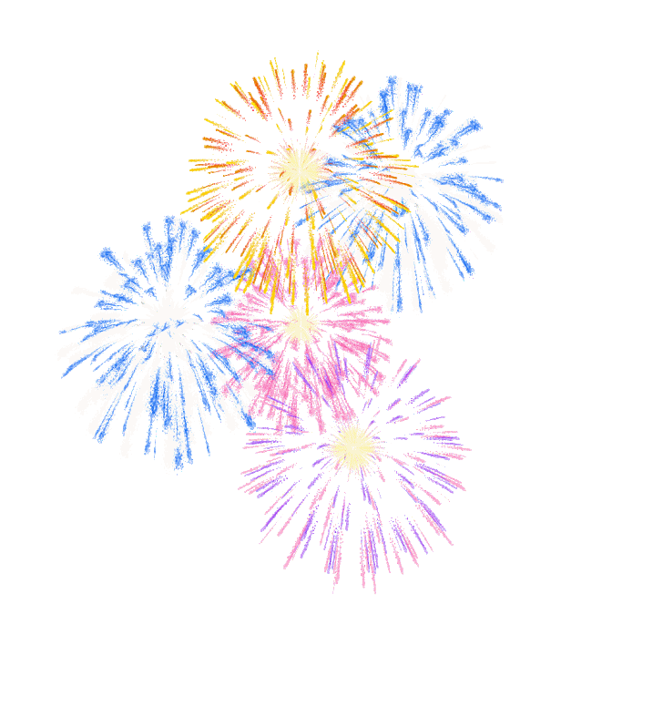
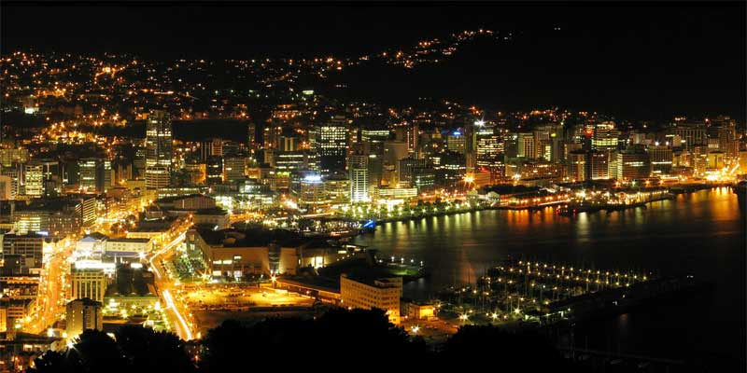
Independence Day is celebrated
on September, 26

Slide 3
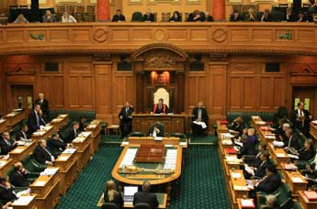
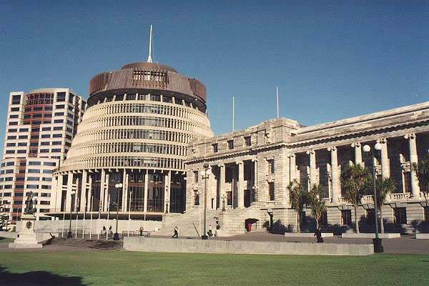
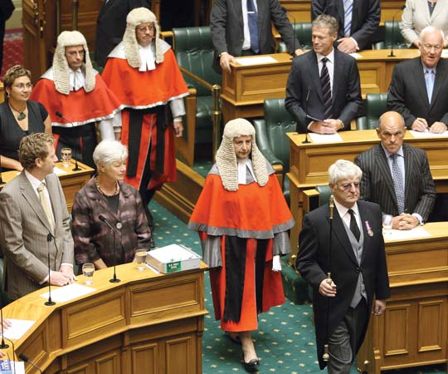
Government type is parliamentary democracy. Administrative division is the following: 93 counties, 9 districts, and 3 town districts.

Slide 4
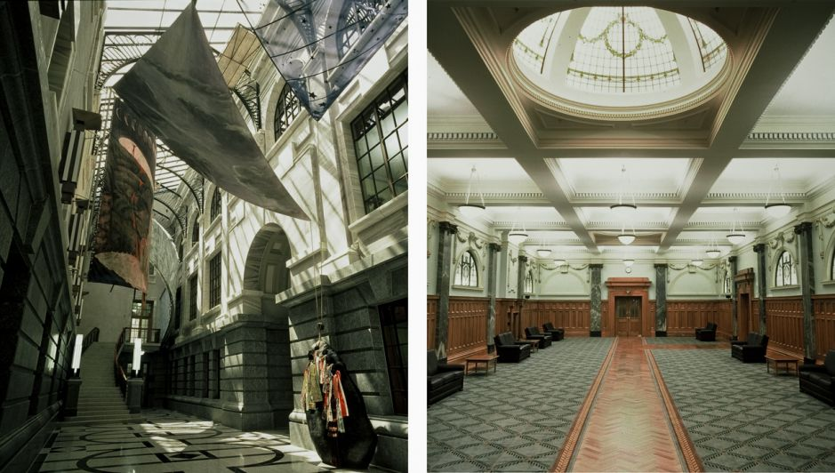
New Zealand Parliament Refurbishment

Slide 5
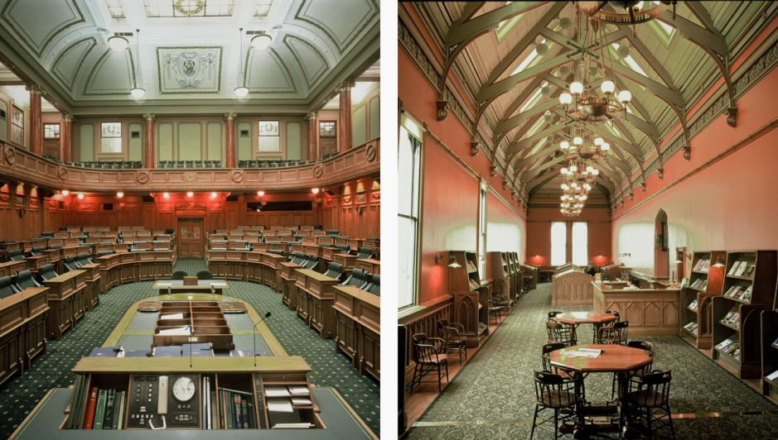
New Zealand Parliament Refurbishment

Slide 6
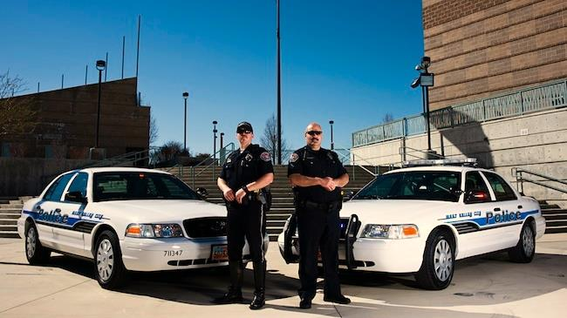
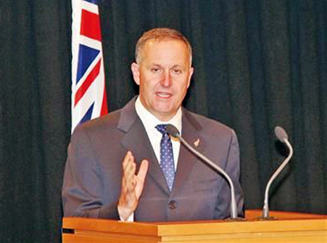
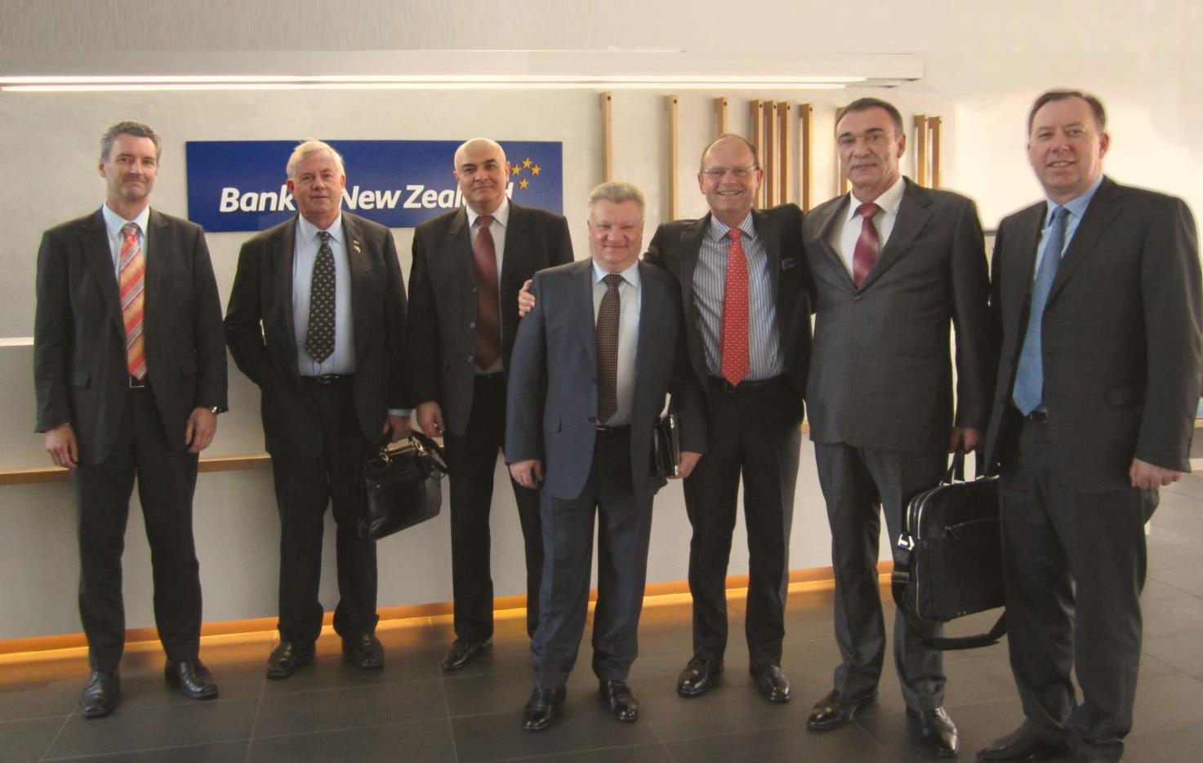
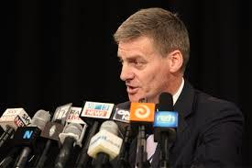
Legal system is based on the English law, with special land legislation and land courts for Maoris.

Slide 7

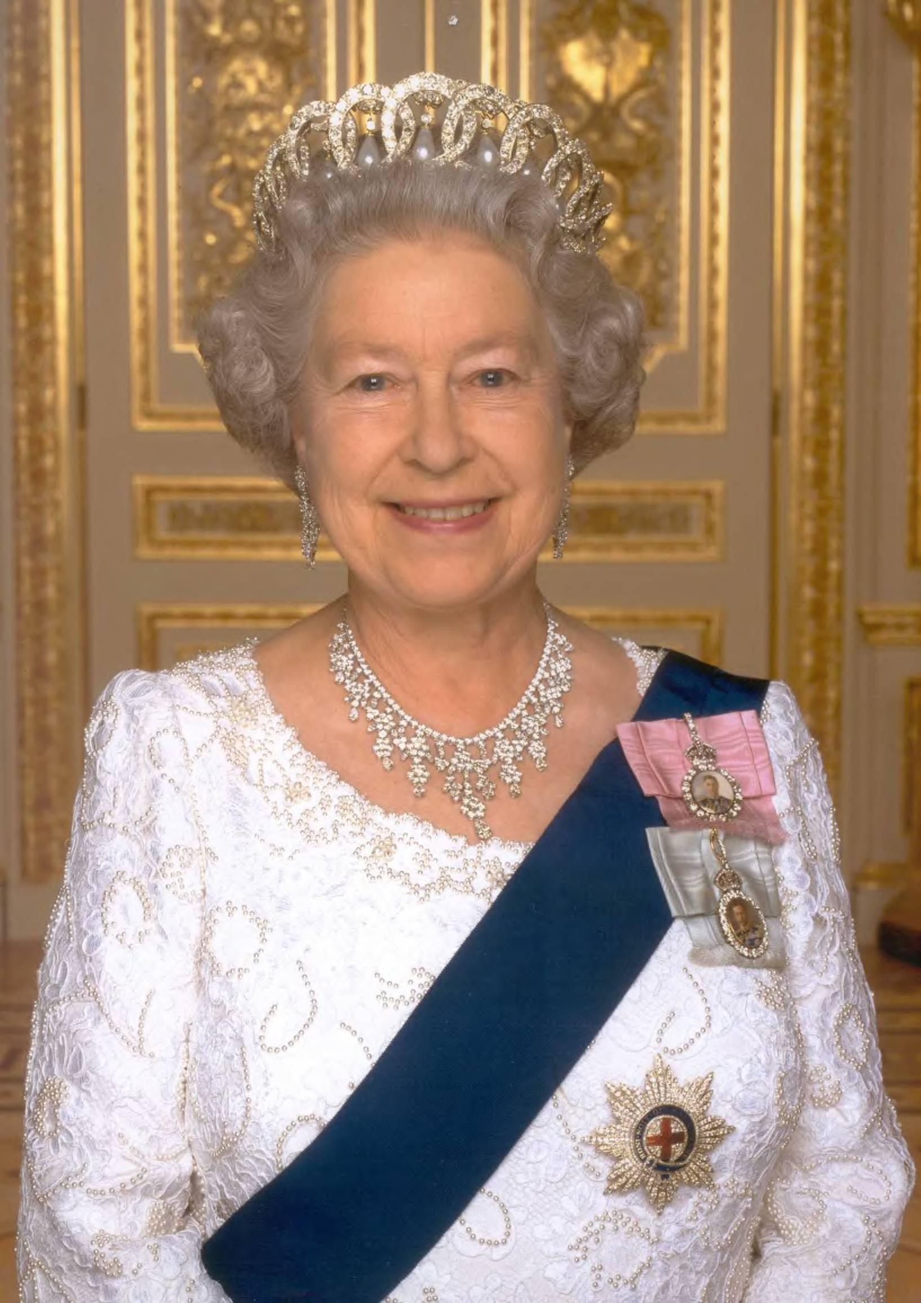
Since 6 February 1952 the chief of the state is Queen Elizabeth II, represented by Governor General Dame Silvia Cart-wright since 4 April 2001.

Slide 8
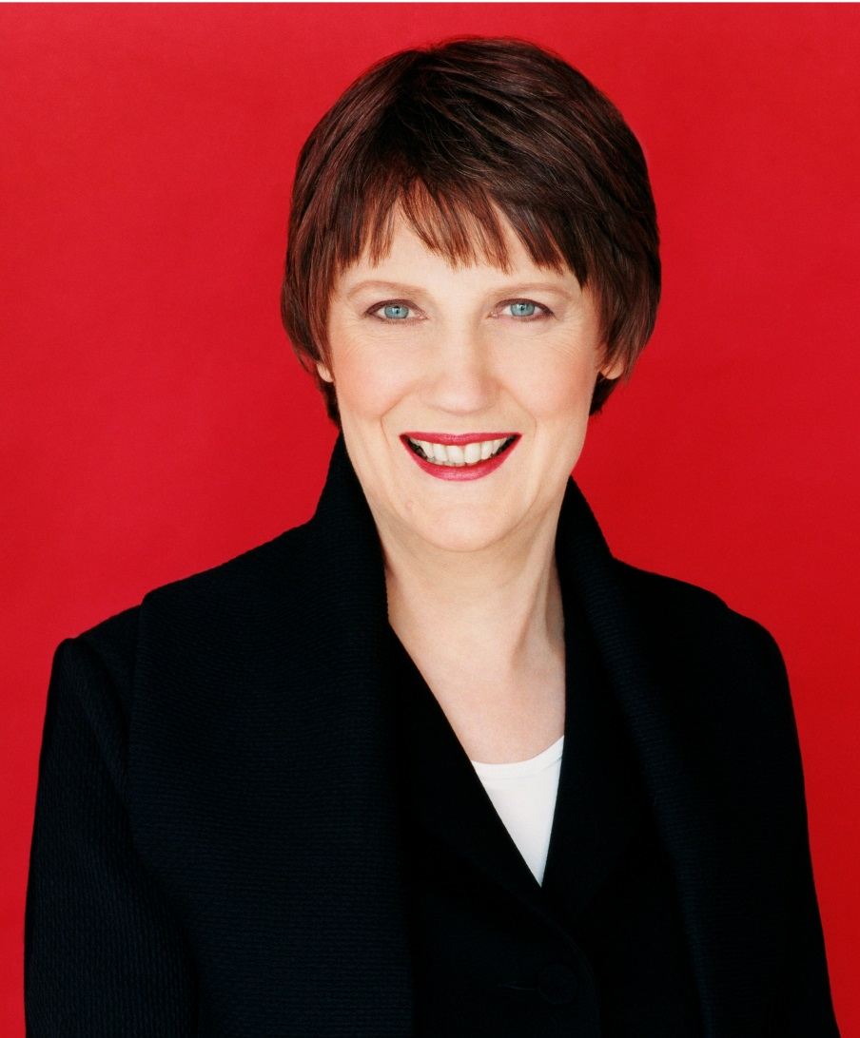
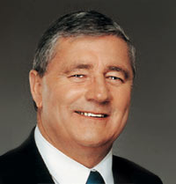
Since 10 December 1999, the Head of the government is Prime Minister Helen Clark and Deputy Prime Minister James Anderton.

Slide 9

Since 1984 the government has accomplished major economic restructuring, transforming New Zealand from an agrarian economy to a more industrialized, free market economy that can compete globally.

Slide 10
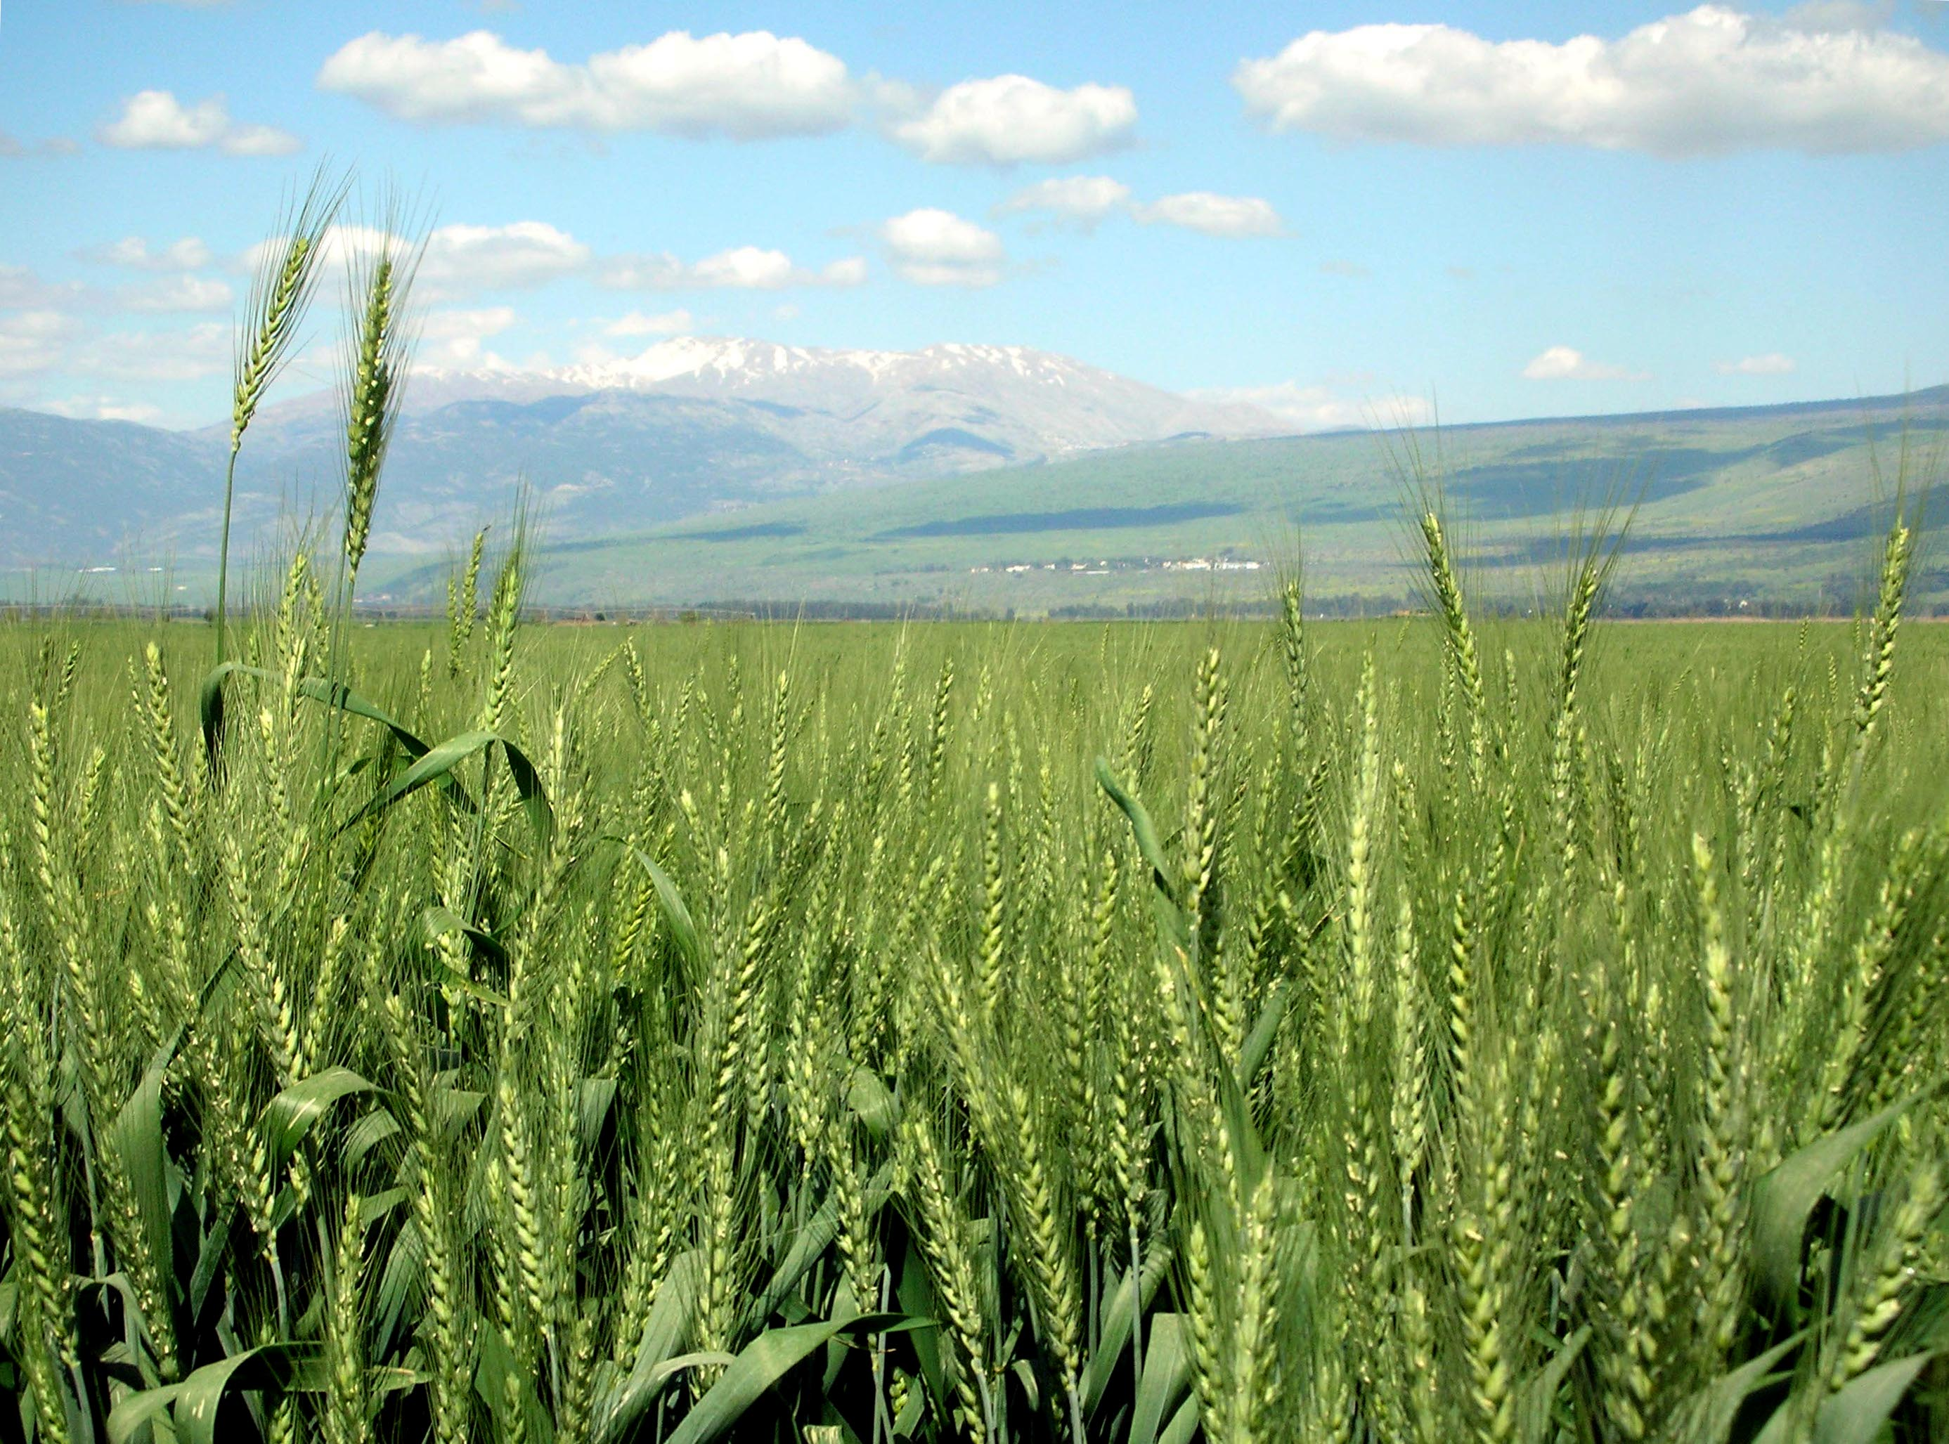
New Zealand is heavily dependent on trade — particularly in agricultural products.

Slide 11
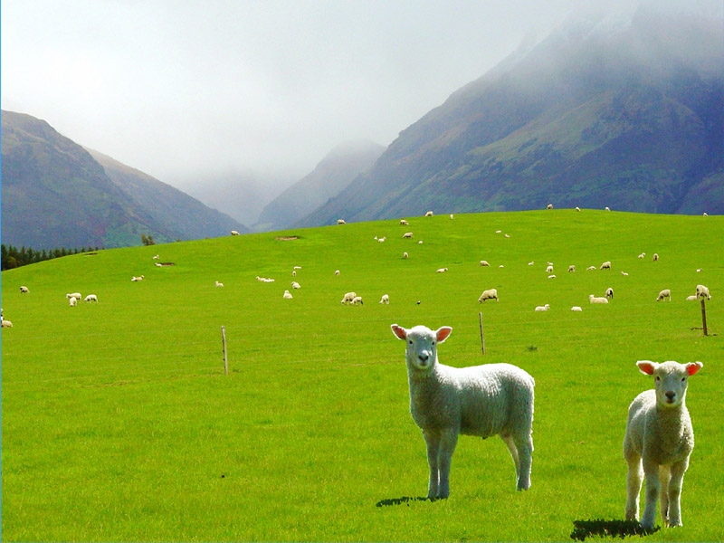
The main industries are mining, food processing, wood and paper products, textiles, machinery, transportation equipment.

Slide 12
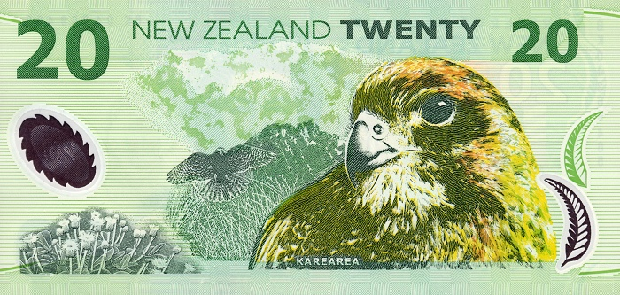
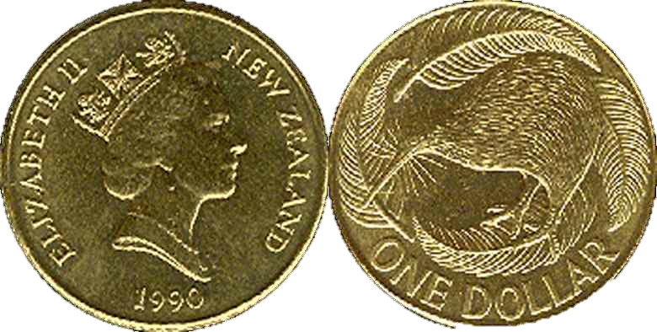
New Zealand's currency is New Zealand dollar.

