Slide 1
Location and climate of the United States

Slide 2
Location
Located in the Western Hemisphere, mostly in the continent of North America. United States consists of 48 contiguous states with each other in the "mainland" and 2 states that do not have a common border with the rest: Alaska - located in the northwest of the continent of North America (not to be confused with the Alaska Peninsula, which is much smaller), and Hawaii in the Pacific Ocean. In addition, in the United States includes the District of Columbia and incorporated territory of Palmyra Atoll.

Slide 3
In the south of the US borders with Mexico, to the north - with Canada. The US also has a maritime border with Russia. On the territory of the US west by the Pacific Ocean in the east - the Atlantic, in the south-eastern United States is the Gulf of Mexico, Alaska Peninsula in the north bordering the Arctic Ocean.

Slide 4
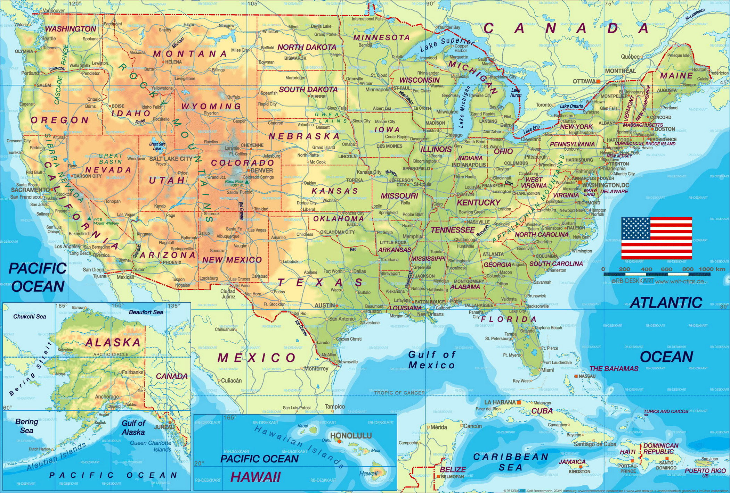

Slide 5
Climate
Due to the large size of the country, its extent and the wide variety of geographical features in the US can be found areas with virtually any climatic characteristics. Type of climate within a single zone can vary significantly depending on the terrain, proximity to the ocean and other factors. The favorable climate has had a considerable influence on the settlement of the continent by Europeans and largely contributed to the US occupation of leading positions in the world.

Slide 6
Thanks for watching
V.MAZUR

