Slide 1

9 things you need to know about the French author...

Slide 2


1. Jules Verne was born on 8 February 1828 in Nantes, France, the eldest of five children.
2. Verne turned to stock-broking to support himself.

Slide 3

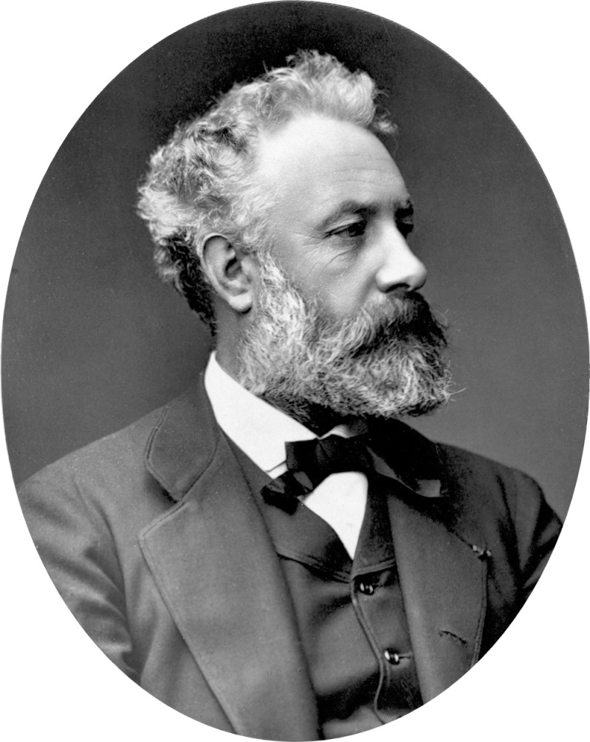
3. At 19 Verne went to Paris to become a lawyer, despite hoping to become a lawyer. His father, who hoped he would take over the family legal practice, cut off his son’s allowance when he discovered his story-writing.

Slide 4

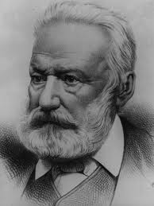
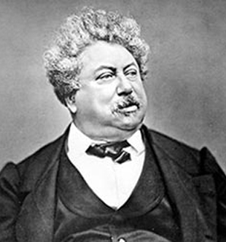
4. He met playwright Victor Hugo and Alexandre Dumas, writer of The Three Musketeers, who offered him writing advice.

Slide 5

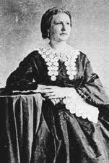
5. Verne married Honorine de Viane, a young widow with two daughters, when he was 28. They had a son, Michel, four years later.

Slide 6


6. Verne had begun writing for operattas, but was having less success with his stories, with a number of works turned down by publishers. But his fortunes improved when he met Hugo’s publisher Pierre-Jules Hetzel.

Slide 7

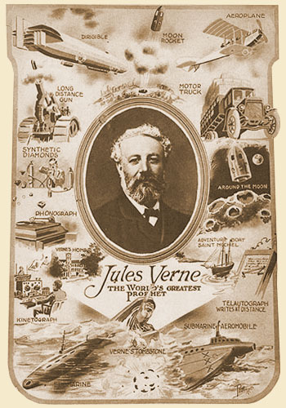
7. His first book, Five Weeks in a Balloon, was published in 1863. After this he retired from stockbroking and became a full-time author.

Slide 8


8. Verne went on to write science-fiction and adventure classics Journey To The Centre Of The Earth, Twenty Thousand Leagues Under The Sea and Around The World In 80 Days among the more than 80 books, short stories, essays, poems and plays he wrote in his lifetime.

Slide 9

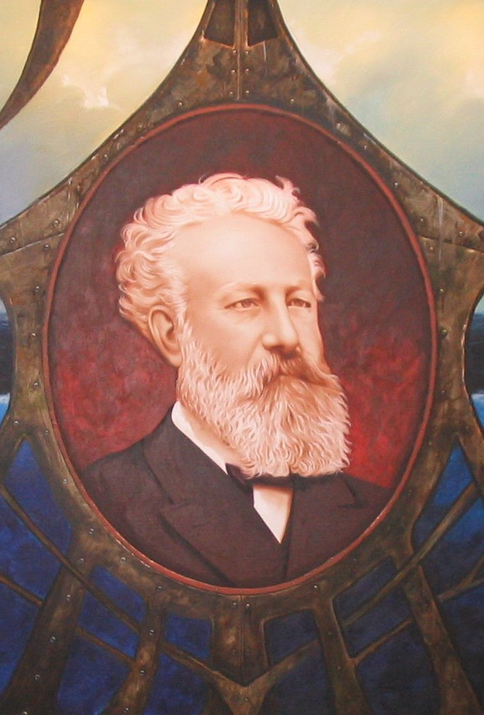
9. He died on 24 March 1905, but one of his works would be published 84 years later, after his great-grandson discovered the manuscript for Paris in the 20th Century in a safe. Originally written in 1863 about a man living in a world of skyscrapers, high-speed trains, cars and calculators, his publisher had thought the story too pessimistic and refused to print it.

Slide 10

Thank you for attention!

