Slide 1
Рainting
Prepered
Natalia Semenyik

Slide 2
Painting
Painting - the kind of fine art associated with the transmission of visual images of paint on the surface of a solid or flexible, and works of art created in this way.

Slide 3
Genre painting:
"Options" painting
Like other forms of art, painting can perform cognitive, aesthetic, religious, ideological, social, educational and documentary features.
Historical painting
genre
still life
Portrait (official portrait, Portrait of the actor in the role, Children Portrait, Political plortret, Natrunnyy portrait)
drive
Animalistic genre
Marina (nautical theme)
Kaprichcho (genre)
Animation
iconography
landscape
Religious painting (biblical studies)

Slide 4
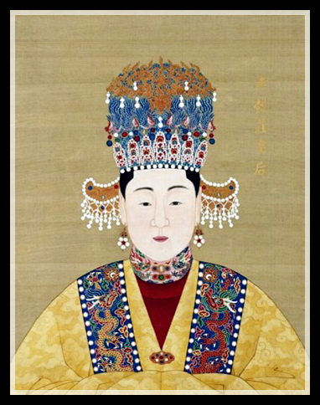
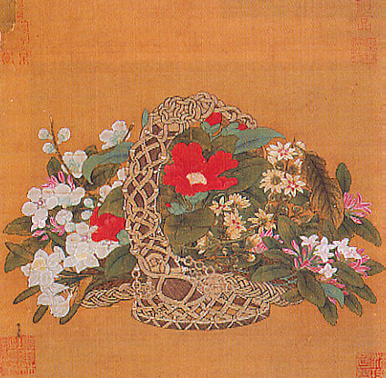
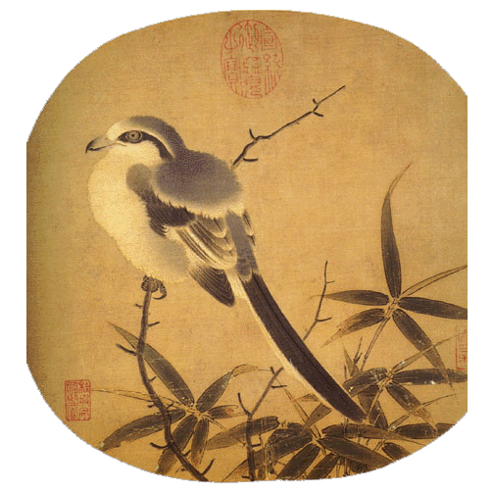
Chinese Painting (Guohua)
Basket of flowers
Empress
Bird and Bamboo

Slide 5
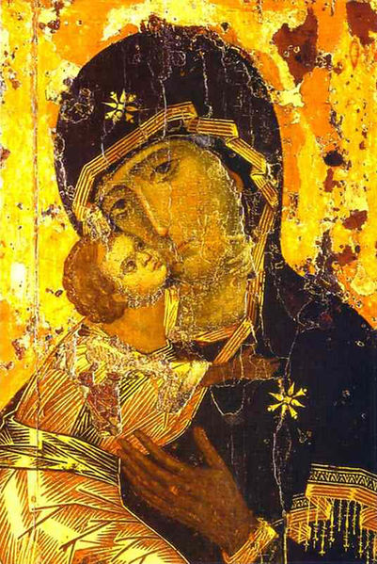
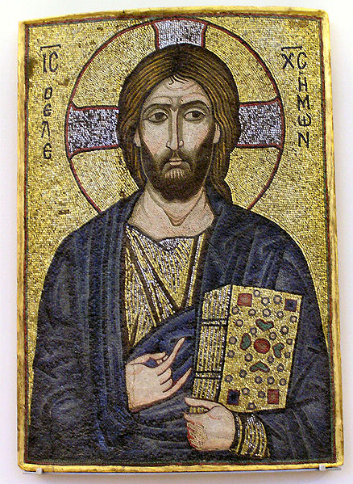
Icons
Vladimir Icon of the Mother of God Vyshgorodska (12th century master of Constantinople)
Christ. Mosaic icon. Bode muzey.Berlin.

Slide 6
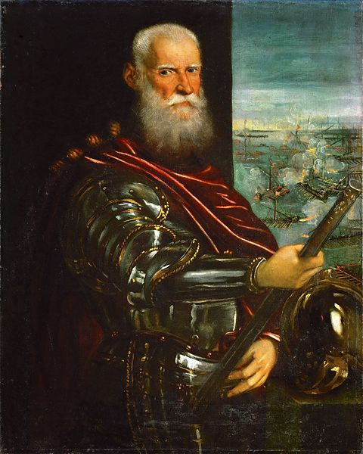
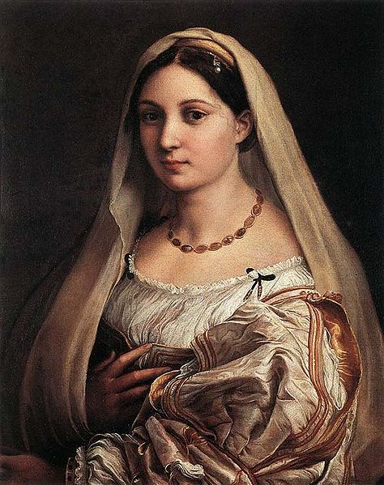
High Renaissance. Italy. Portraits
Tintoretto.Dozh Sebastian Venier.
Rafael.Donna Velata

Slide 7
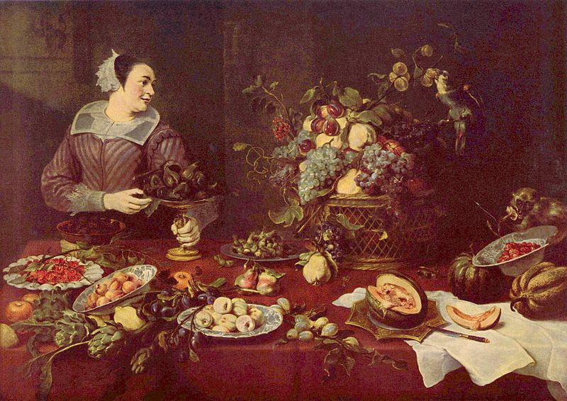
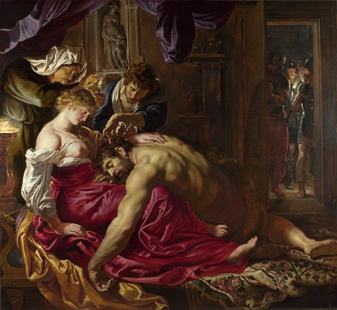
Baroque
Snyders. Fruit lavka.Prado, Madrid.
Rubens. Samson and Delilah. Of London.

Slide 8
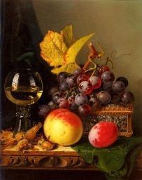
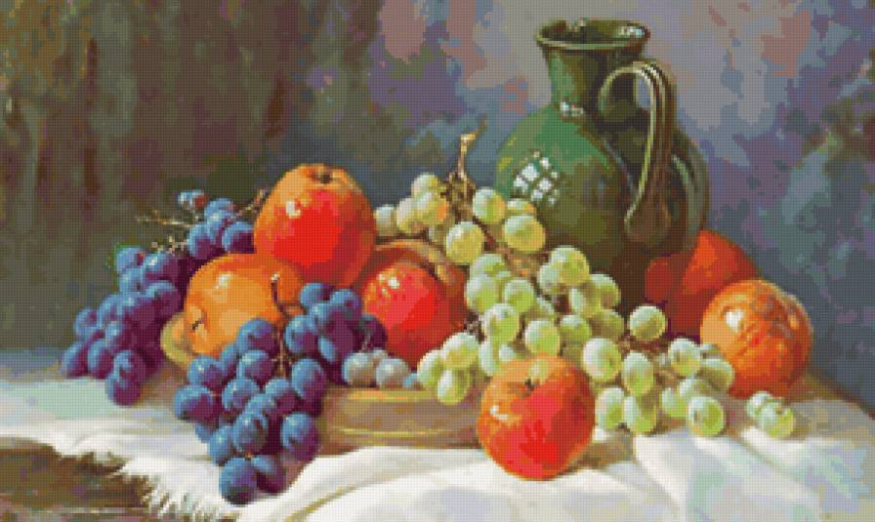
Still life

Slide 9
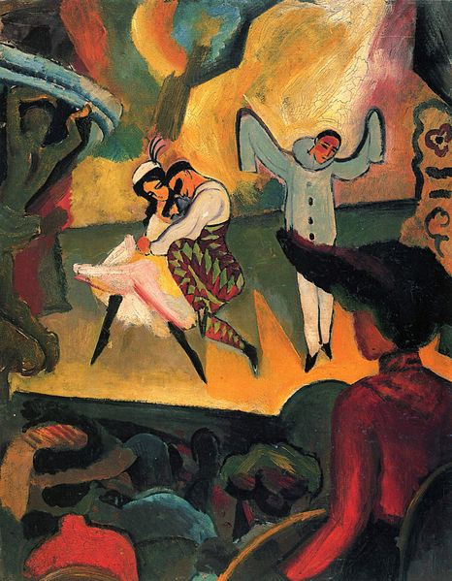
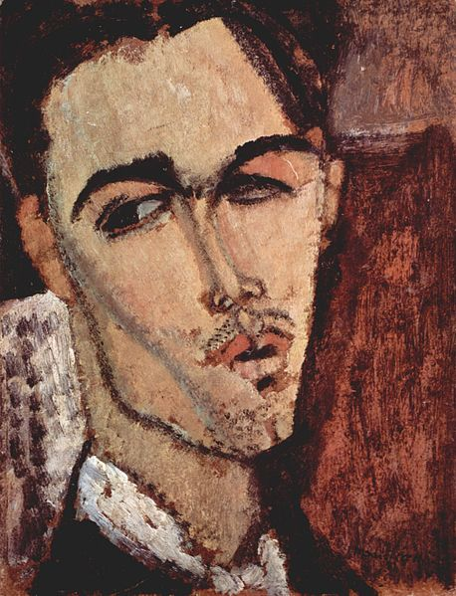
Expressionism
Amedeo Modigliani. "Portrait of Celsus Laga"
August Macke. "Russian Ballet"

