Slide 1

Music
performed 8-C student in class
Laskava Valeria

Slide 2

Notion music
Music-art, artistic material which is sound, specially organized in time.

Slide 3
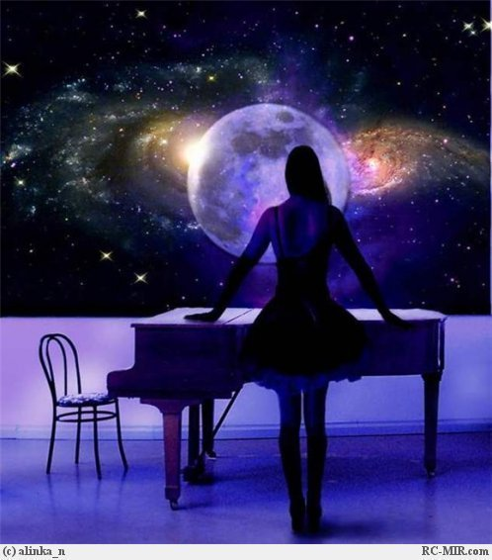

My notion music
I understand music as a State of mind, expressing loneliness or joy

Slide 4
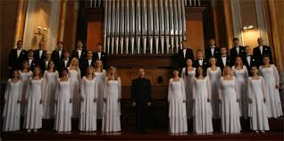
Genres
According to the method of execution: vocal, vocal and instrumental, solo;

Slide 5

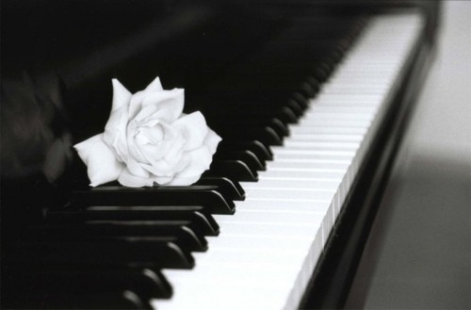
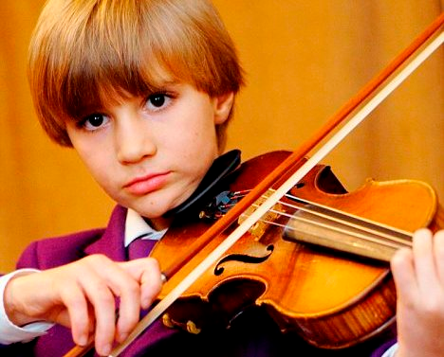
content: lyric, epic, dramatic;

Slide 6
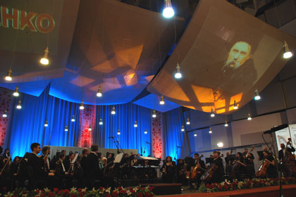


At the place and conditions of performance: Theater, concerts, Chamber music, film music, etc.

Slide 7
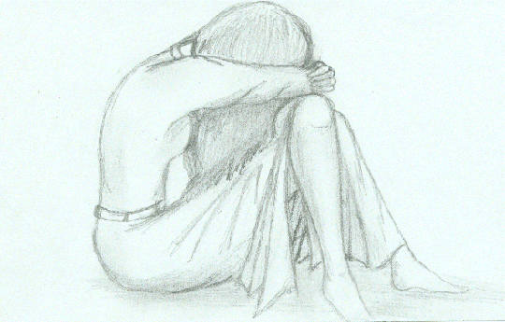
music is the only thing that calms me down

Slide 8
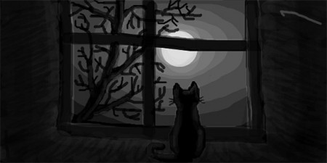
consoles

Slide 9


Slide 10


