Slide 1
Sport in society

Slide 2
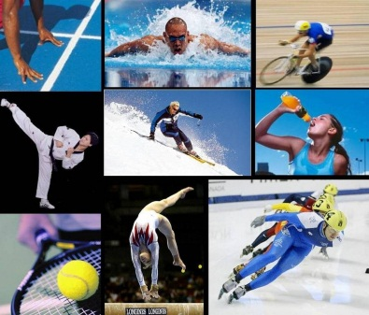
There are a lot of things people can do in free time. Somebody play some musical instruments, someone draws or paints, others take photos. A lot of people prefer going in for sports. Sport is all forms of usually competitive physical activity which, through casual or organized participation, aim to use, maintain or improve physical ability and skills while providing entertainment to participants, and in some cases, spectators. Going in for spot is very important because it helps us to be healthy and keep our body fit.

Slide 3
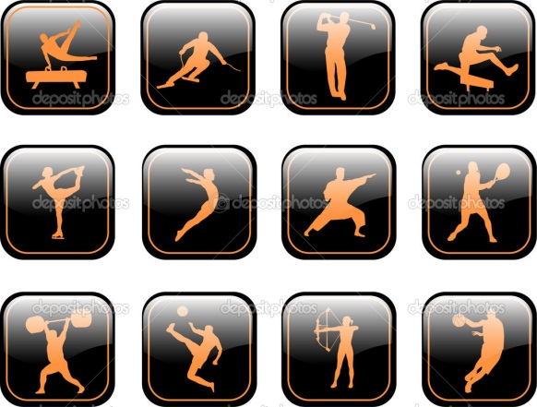
There are different kinds of sport, so everybody can choose the sport which he/she likes the best.
People can do some sport as a hobby or they can go in for sports professionally.
There are a lot of pros and cons of being a professional sportsman. The main pros are fame and money. But there are a lot of situations, when people try to get better results with the help of using illegal methods, which is a big cons.

Slide 4
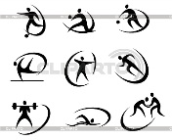
Sportsman who train a lot can get very good results in different competitions, so they can be proved of their achievements. Also they can leave some memories for other generations. But a lot of this people think nothing but training and when their career ends, they are very lonely.

Slide 5
Sport is very good for our health but many sportsman overstrain during the preparation for some competitions and they are suffering from physical injuries and they muscles get deformed.

Slide 6
A lot of different sport competitions are held all over the world every day. The most famous competitions are Olympic Games. It has being held since the ancient times. There are a plenty of differences between ancient and modern Olympic Games.

Slide 7
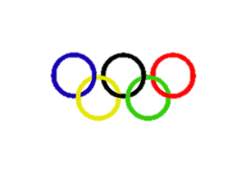
The modern OG, as the ancient OG are held every four years but the modern competitions are divided into Winter and Summer Olympic Games.

Slide 8
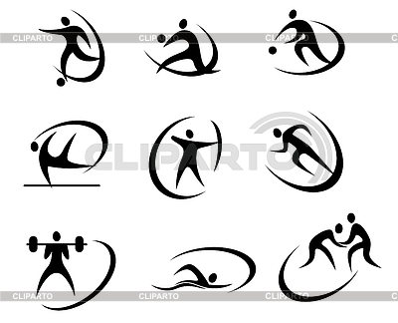
The competitions in ancient times were held in one and same place in the open area but nowadays they are held in different countries and it is held in stadiums. Also during the ancient OG sportsman could compete only in ten kinds of sport.

Slide 9
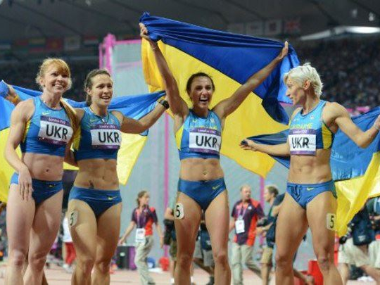
During the ancient OG sportsman completed nude, nowadays they wear special uniform.
Also in the past woman couldn’t take part in this competitions but now they can.

Slide 10
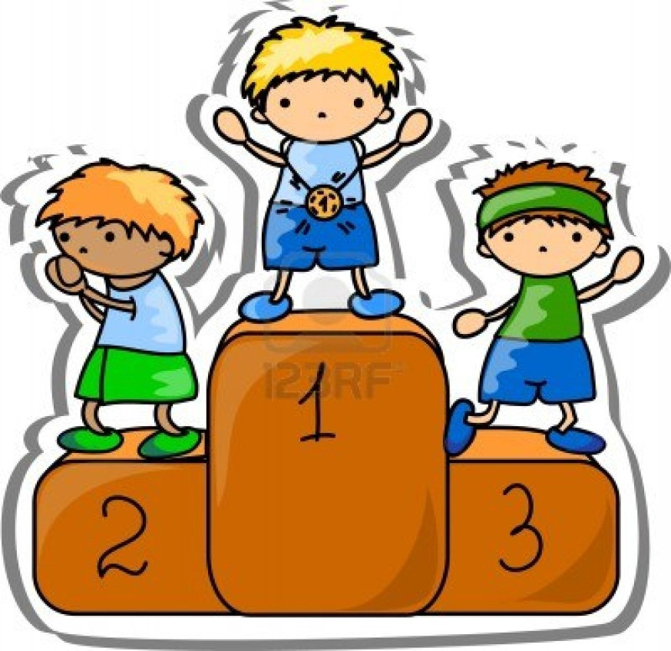
The Olympic champions of modern OG get gold medal for the firth place, silver for the second place and bronze for the third. The winners of the ancient OG got a wreath of olive leaves.

Slide 11
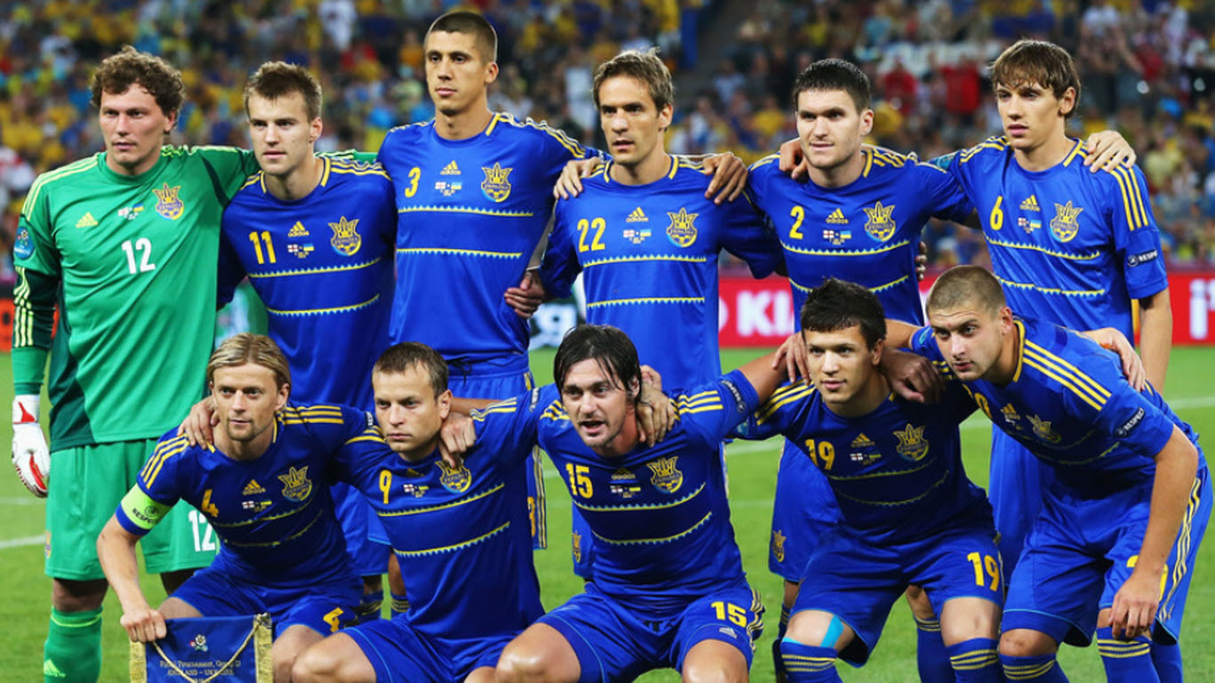
One of the most popular sports in Ukraine is football. Many people enjoy watching football matches on the TV.

Slide 12
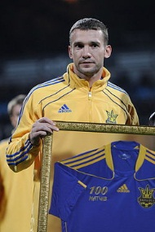
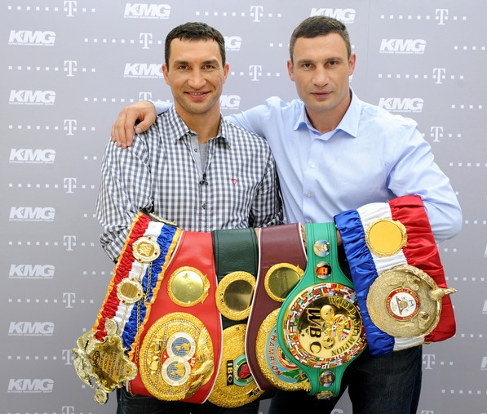
Our country can be proud of such great sportsman as Volodimir, Vitalij Klichko and Andriy Shevchenko.

Slide 13
Sport is really important in the life of each person. Somebody goes in for it, somebody watch it on TV. But everybody enjoys it very much.

