Slide 1
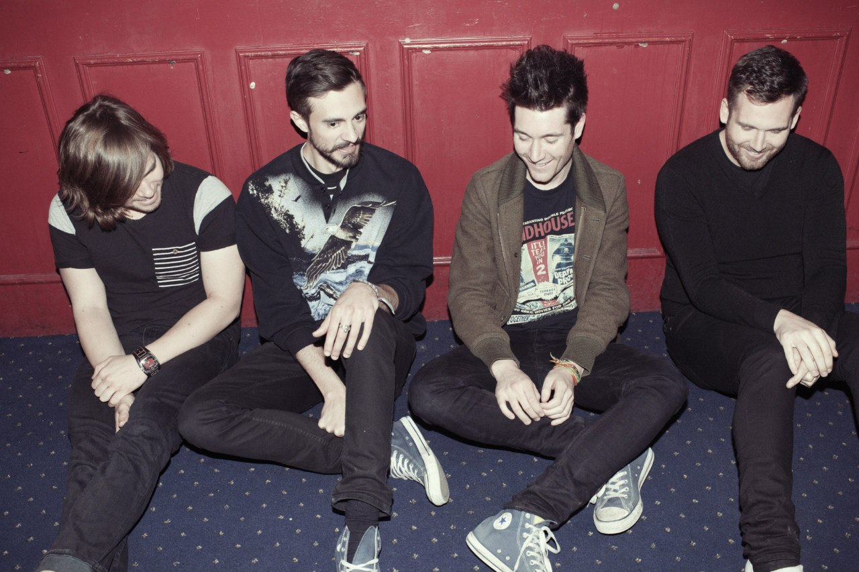
BΔSTILLE

Slide 2
Bastille are an English indie-rock band formed in London in 2010. They began as a solo project by singer-songwriter Dan Smith, who later decided to form a band.

Slide 3
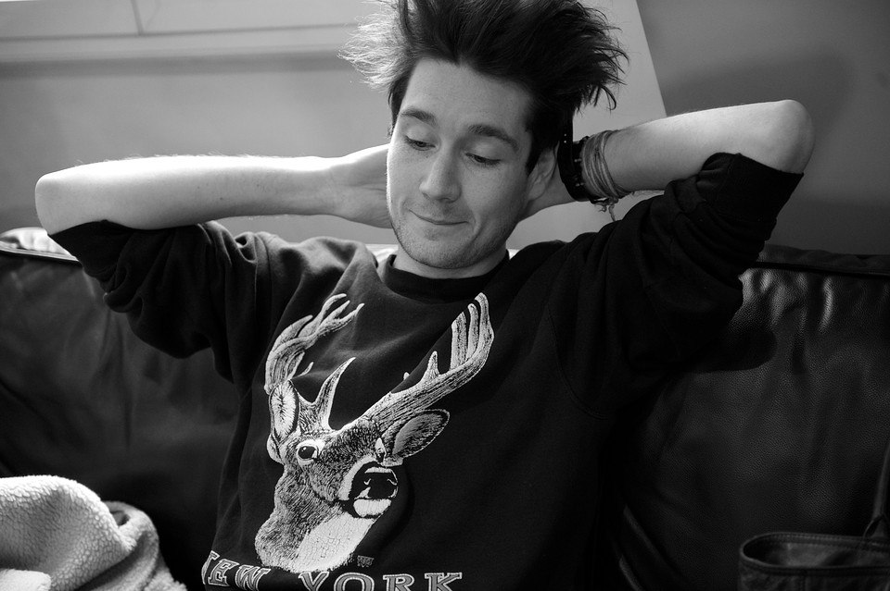
The name of the band derives from Bastille Day – an event celebrated on Daniel Smith's birthday, 14 July.

Slide 4
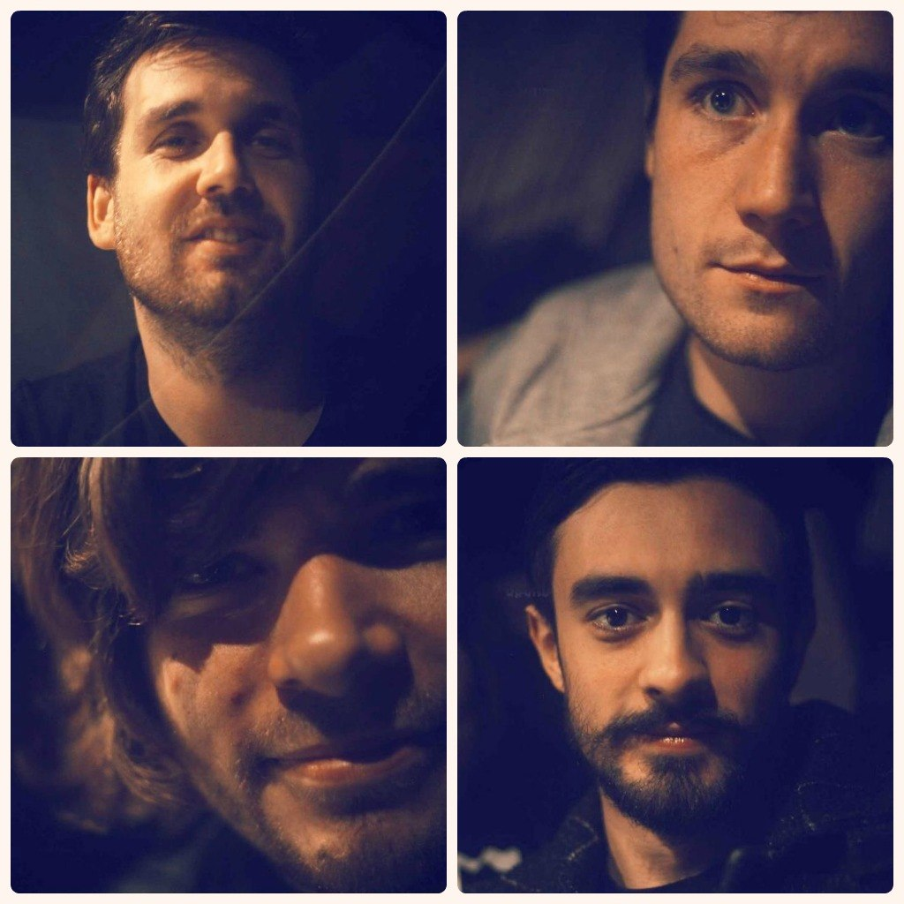
The four-piece consists of members Daniel Smith, Chris Wood, William Farquarson and Kyle Simmons.

Slide 5
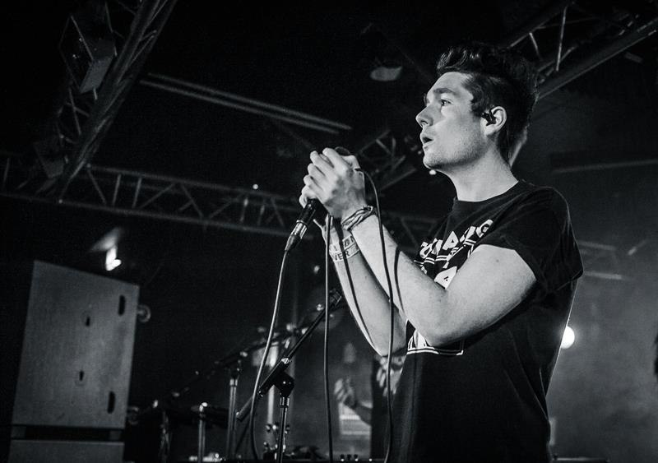
In February 2013, ahead of the release of their debut album, the band's fourth single, "Pompeii", was released to huge demand, charting at number two in the UK.Their first studio album, titled Bad Blood, was released in March 2013 and debuted atop the UK Albums Chart.

Slide 6
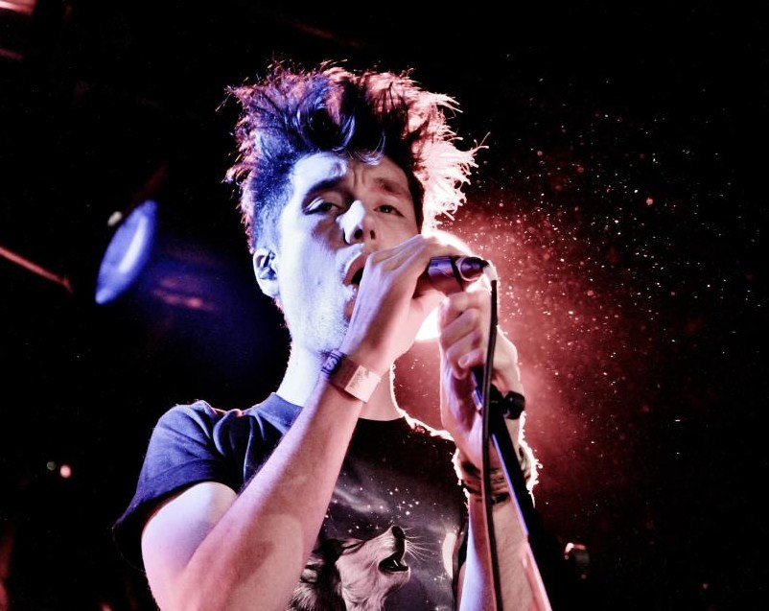
Bastille debuted in June 2010 with their limited edition single featuring the two tracks "Flaws" and "Icarus". Released through London-based independent record label, 'Young & Lost Club', only 300 copies were pressed. This was followed by the release of the EP Laura Palmer later in 2011.

Slide 7
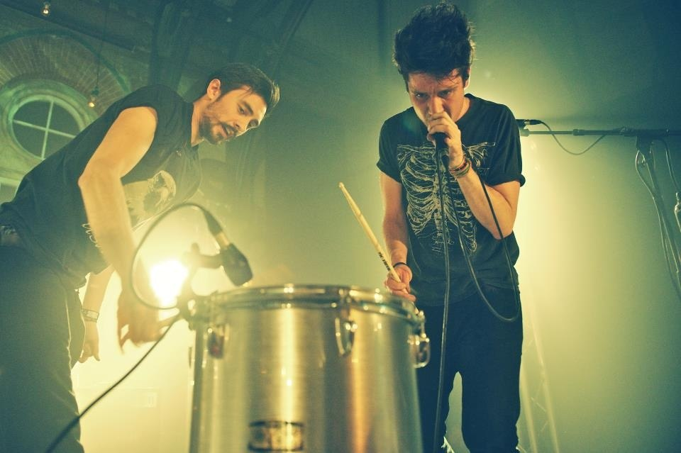
After debuting further tracks online through sites such as YouTube and MySpace, the band received a great amount of media attention and fans.

Slide 8
The group subsequently secured a few support slots, and later performed at major UK festivals including Glastonbury, the Isle of Wight and Blissfields. Their music has also been used to a large extent on the TV soap Hollyoaks, featuring most of their tracks from their Bad Blood album being used in 2013.

Slide 9
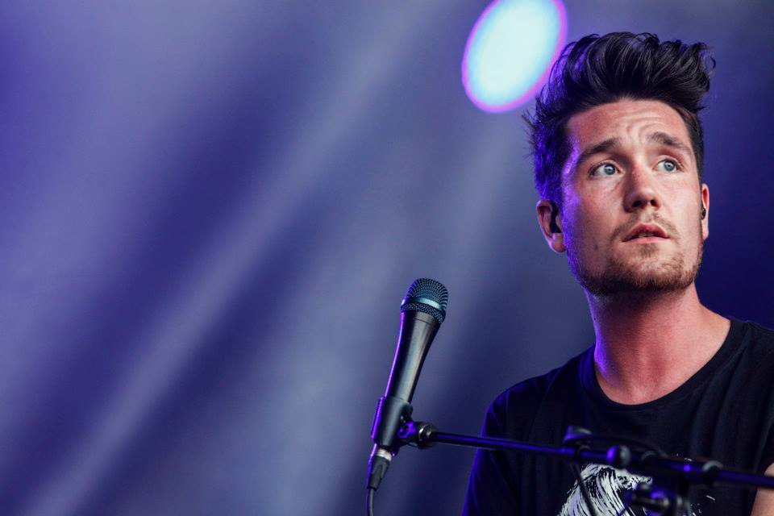
Their third single, a re-release of their first 7" non-album single "Flaws", was a commercial success, earning the group their first position in the UK Top 40, debuting at number-twenty-one. In February 2013, Bastille confirmed the release of the fourth single to be taken from Bad Blood.

Slide 10
"Pompeii" was positively reviewed by critics, reaching number two in the United Kingdom. Their debut album followed a week later at the end of their Bad Blood Tour, and placed at number one in the UK Albums Chart. On 11 March, Bastille were announced to be playing at Leeds and Reading Festival in August 2013.

Slide 11
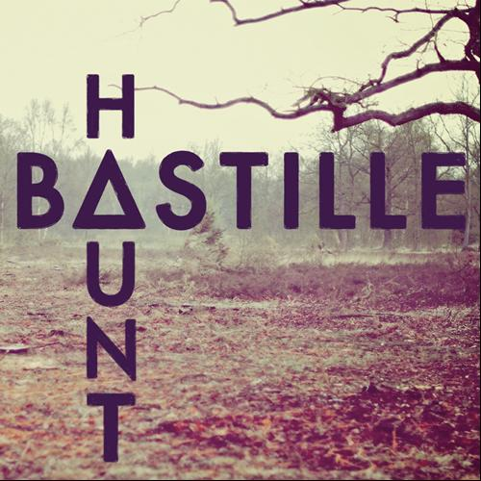
In May 2013, Bastille released their Haunt EP in the US via iTunes. On 24 August 2013, Things We Lost in the Fire was released as sixth and the last single from the band's debut album.

Slide 12
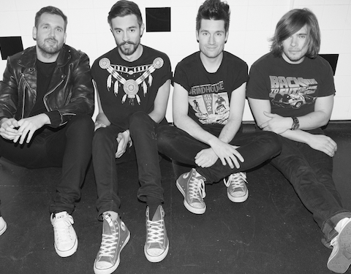
On 3 September 2013, Bastille released their "Bad Blood" album in the US via iTunes.

Slide 13
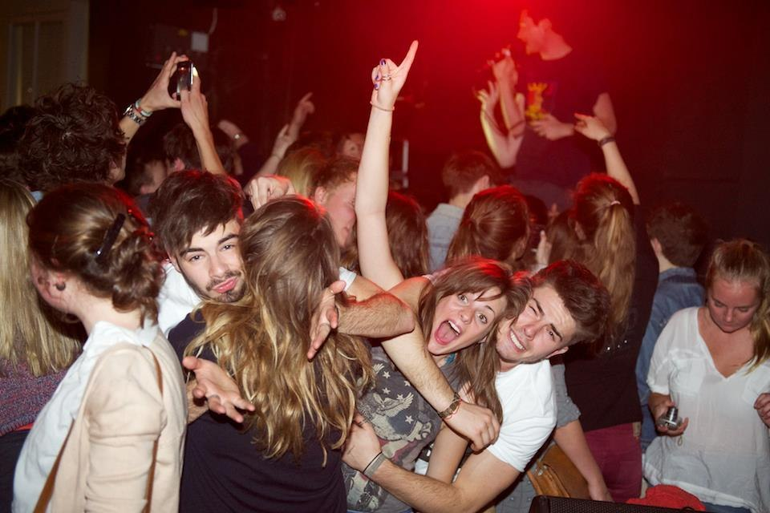
On 9 October 2013, Bastille released a new single, "Of the Night", which is a mash-up of the songs "The Rhythm of the Night" by Corona and "Rhythm Is a Dancer" by Snap!.

Slide 14
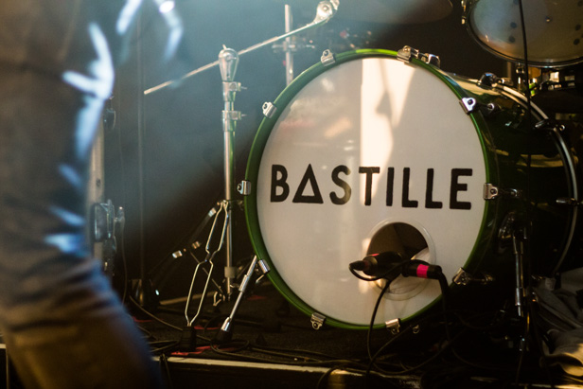
The single debuted at number two the UK Top 40. It is featured on their next collection album, All This Bad Blood, released on November 25, 2013.

