Slide 1


Our favorite book
We are delighted reading we like to read books about the adventures of the great men and famous travelers, stories about animals and birds, fairy tales and fables. We read many interesting books, but our favorite book "The Adventures of Tom Sawyer" by Mark Twain.

Slide 2

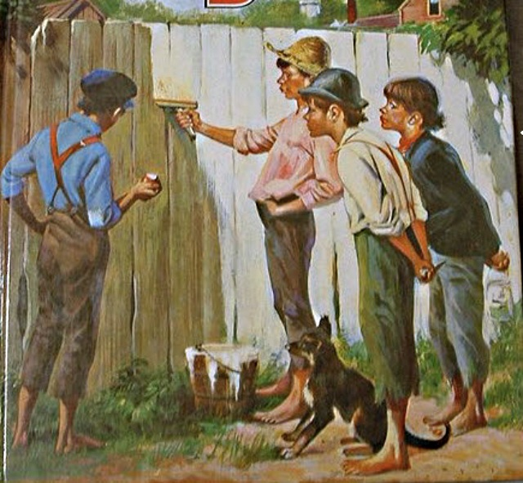
This well known book is popular with the children all over the world. The main character of the book is Tom Sawyer, who lived in a small town on the Mississippi River. He was a boy with a wild imagination. He liked to play games with his friends. They often dreamed of different adventures. Tom was sometimes naughty and never quiet. But his friends liked him because he was kind and brave. Besides, he was noble.

Slide 3

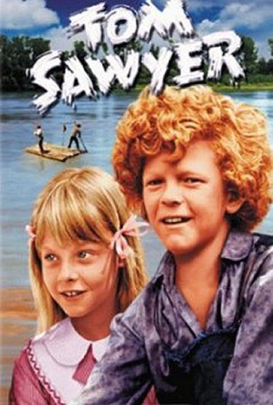
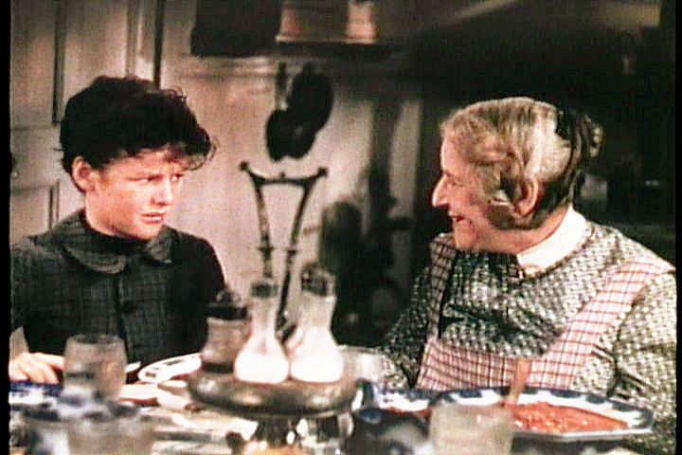
We liked the book about Tom Sawyer, because he was always bright and full of ideas. Tom teaches us to be generous, kind and brave. It also teaches us to be a true friend. We learned a lot about the lives of children in America with this book.

