Slide 1
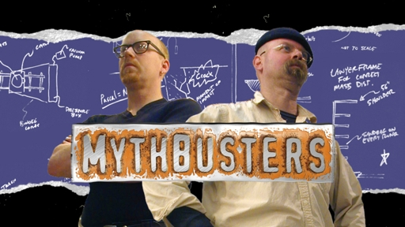
Разрушители Легенд

Slide 2
"MythBusters" - American popular science television program on channel Discovery Channel. Transmission are experts in special effects Jamie Hyneman and Adam Savage, using their skills and experience to experimental verification of various tales, rumors, urban legends and other creatures of popular culture. Filming the program are usually held in the San Francisco.

Slide 3
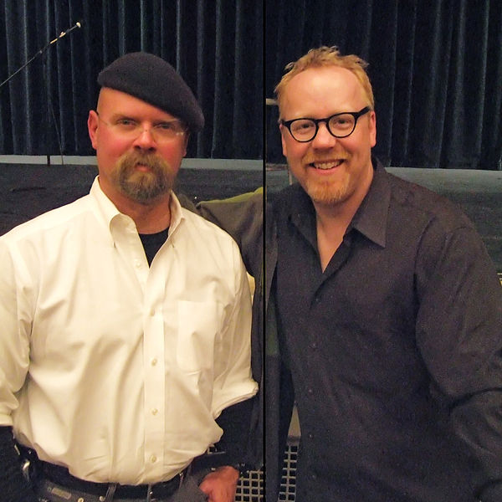
Jamie Hyneman Adam Savage

Slide 4
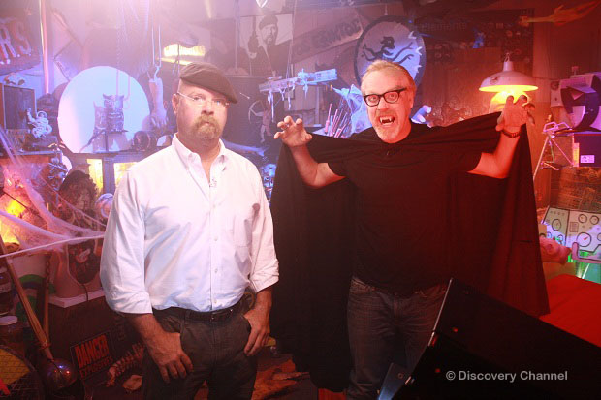

Slide 5
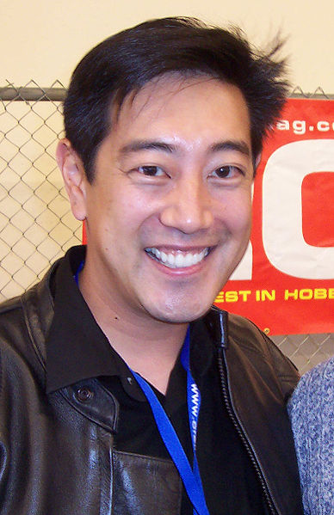
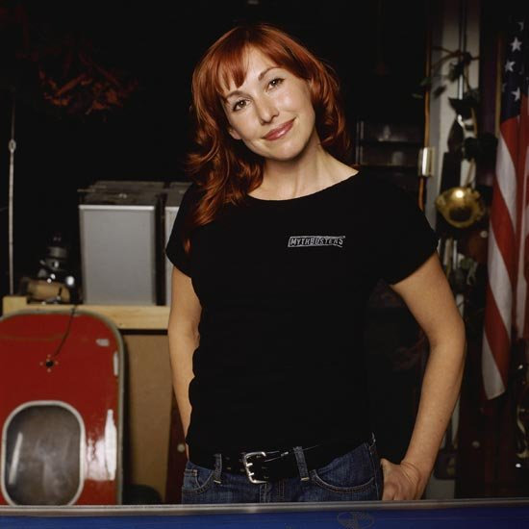
Main assistants
Grant Imahara Kari Byron

Slide 6
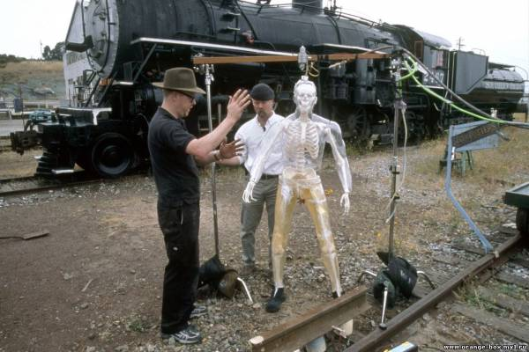
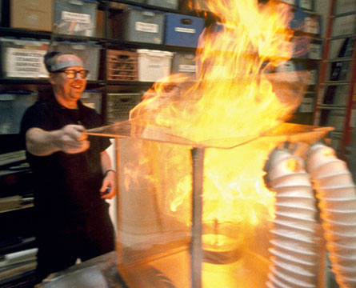
Examples studied legends

Slide 7
