Slide 1
Презентація на тему:
«Британський фільм»
Підготувала
учениця 6 класу
Чортківської гімназії
Імені Маркіяна Шашкевича
Гулька Марія

Slide 2
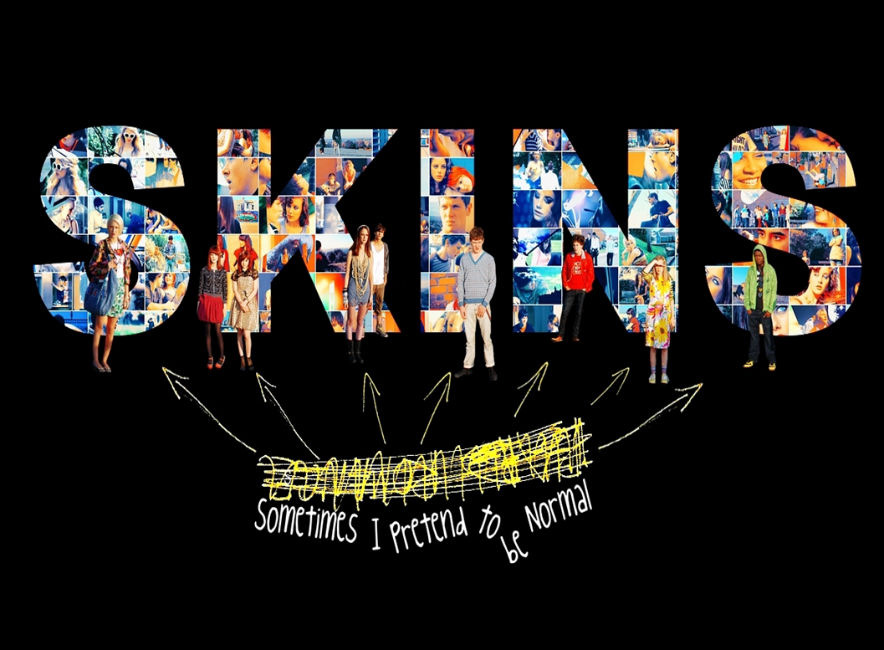
Skins
Skins is a British teen drama that follows the lives of a group of teenagers in Bristol, South West England, through the two years of sixth form. Its controversial storylines have explored issues such as dysfunctional families, mental illness, adolescent sexuality, substance abuse, death and bullying. The show was created by father-and-son television writers Bryan Elsley and Jamie Brittain for Company Pictures and premiered on E4 on 25 January 2007.
The show went on to be a critical success as well as a ratings winner within its target demographic. Over its initial six-year run, Skins proved to be atypical of ongoing drama series in that it replaced its primary cast every two years. Plans for a film spin-off were first discussed in 2009, but ultimately did not come to fruition. Instead, a specially-commissioned seventh and final series of the show was broadcast in 2013, featuring some of the cast from its 2007–10 run. The show's name comes from the rolling papers known as "skins".

Slide 3
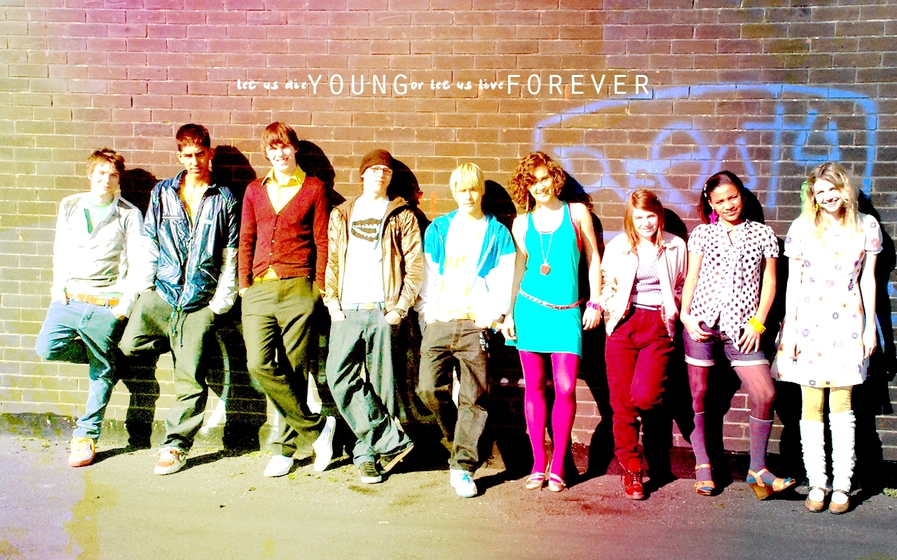
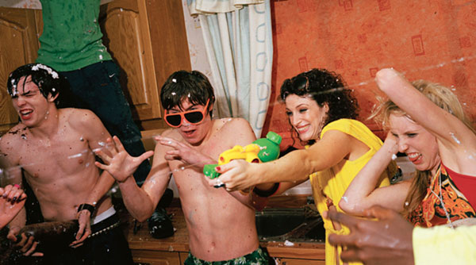
First generation
Tony Stonem is an attractive, intelligent and popular boy. His manipulative ways often go unnoticed by many, and are a catalyst for the majority of the events in the series. Sid Jenkins is Tony's best friend, but has an entirely opposite personality. He lacks confidence, is socially uneasy and struggles with school work. Tony's girlfriend is Michelle Richardson a girl who can never stay angry at his mischievous behaviour for long. Outwardly, Michelle appears shallow, vain and conceited, but she works hard, has a strong interest in French and Spanish, and is very emotionally mature. She is friends with Cassie Ainsworth, an eccentric girl who suffers from an eating disorder. Cassie attempts to hide her own struggles with mental health while her flamboyant parents ignore her in favour of their new baby.
. Chris Miles is the party animal of the group. He has a difficult home life; he lost his brother to a hereditary subarachnoid haemorrhage at a young age, and is living alone due to his ambivalent father and absent mother. He has a crush on his psychology teacher Angie. Jal Fazer is a sensible girl with a talent for playing the clarinet. Her runaway mother has left Jal to live with her famous musician father and aspiring rapper brothers. She is best friends with Michelle. Maxxie Oliver is openly gay and has a passion for dance. He is portrayed as attractive, seductive and talented, and is well accepted by most of his friends and family. His best friend Anwar Kharral has a slightly off-the-wall personality, and is known for his silly antics and sense of humour. While he takes a pick-and-choose approach to Islam, and has no qualms about indulging in premarital sex and usage of alcohol and drugs in spite of his religion's policies against them, he has some difficulty fully accepting Maxxie's sexuality.

Slide 4
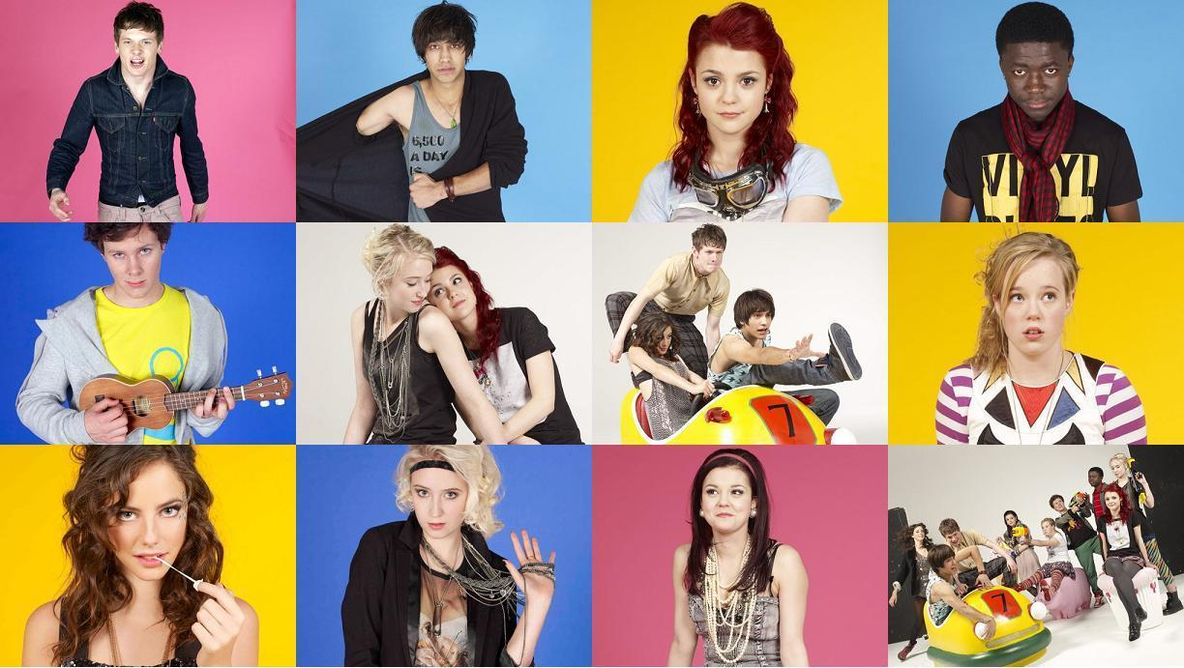
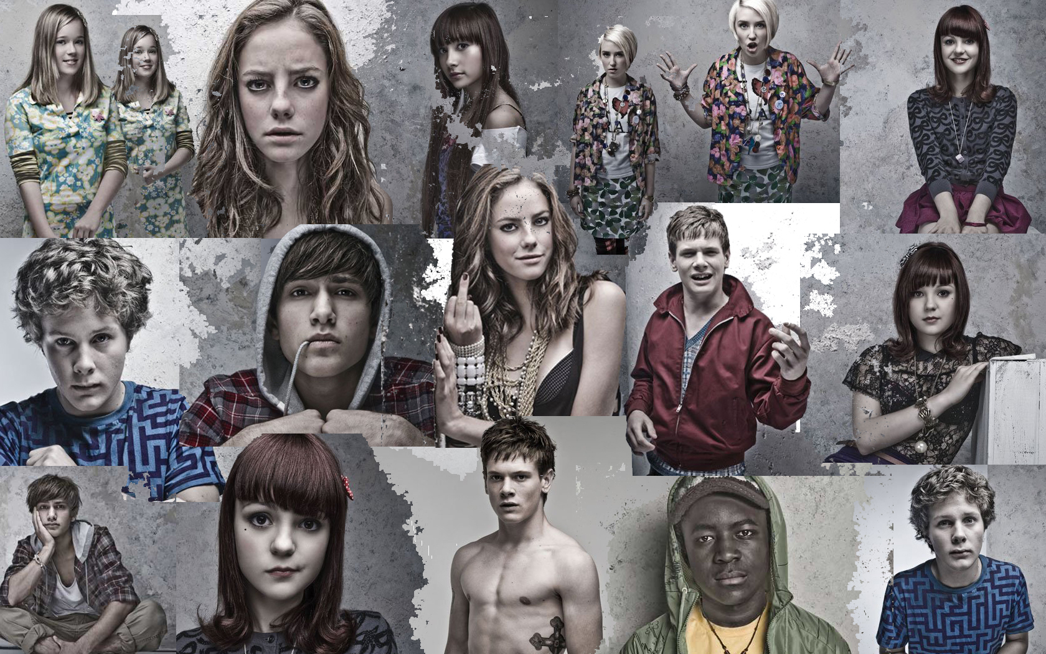
Second generation
Effy Tony's younger sister, becomes the lead character for the second generation. Effy is pretty, popular and, like her brother, a natural leader. She is also quiet and distant, attempting to keep her own troubles hidden. Pandora Moon is her friend, having appeared for the first time in a second series episode. She is innocent to the sexual and narcotic world in which Effy indulges, but is ready and willing to explore it. Thomas Tomone is an immigrant from DR Congo, with a morally upright outlook and good-hearted nature, and his storyline sees him becoming romantically involved with Pandora. James Cook ,Freddie Mclair and JJ Jones have been best friends since childhood. Though Cook is charismatic and sociable, he is also boisterous and not afraid of authority. His womanising drives many of the events in the series..
JJ's autism makes it difficult for him to fit in socially, but he has learnt to use magic tricks to make friends. His friends view him kindly but with a degree of amusement and sometimes irritation, but he knows Cook and Freddie will always take care of him. He is the kindest of the three, and by far the least worldly. Katie and Emily Fitch are very different identical twin sisters. Katie thinks of herself as something of a WAG and wants to usurp Effy's place as queen bee of the group. Katie's homophobic attitudes cause problems between them, as Emily comes to terms with her homosexuality. The quieter of the two, Emily is used to being in her sister's shadow, and is sulky but perceptive. She is in love with Naomi Campbell, a fiery, politically charged and passionate young woman with idealistic views and an abundance of ambition.

Slide 5
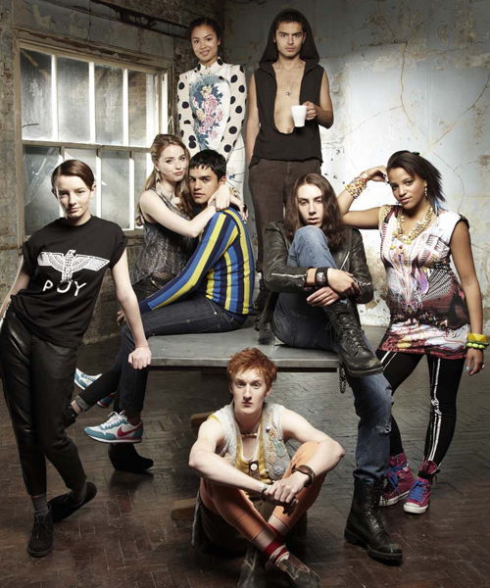
Third generation
Franky Fitzgerald is seen as an outsider, having arrived to her first year at Roundview three weeks late upon moving to Bristol from Oxford. She is an intelligent and creative girl, but is seen by others as strange, largely due to her androgynous dress sense. Alo Creevey something of an optimist, loves his dog and his van foremost. He is best friends with Rich Hardbeck a boy from a very middle-class home who immerses himself in heavy metal subculture. He uses musical elitism as a means to cover up his own shyness when, among other things, interacting with girls. Mini McGuinness, Liv Malone, Grace Blood are best friends. By the time Franky arrives, image-conscious Mini has already established herself as Roundview's new "queen bee". She obscures her own insecurities (such as her body image, and her virginity), and is cruel to Franky and others. Of her two friends, Liv is the more devoted to Mini, and is more worldly and sexually voracious. By contrast, Grace—sweet, kind, and positive in her outlook—begins to disassociate herself from Mini after seeing Franky's example, and in the first episode establishes a friendship with outsiders Franky, Alo and Rich. Mini's boyfriend is Nick Levan. His popularity makes him something of a status symbol for Mini, but his feelings for her are shallow and uncomplicated. His brother Matty has strained relationships with his family, engages in criminal behaviour, and lives rough following an altercation with their father. In series six, the group be friend Alex Henley, who is gay and in particular forms a close friendship with Liv.

Slide 6

Television ratings
The pilot episode of Skins averaged 1.5 million viewers. The ratings for the second series which launched peaked at 884,000 viewers, which gave it 5.9% audience share and taking 60% of the 16–24 demographic, however this was still more than 500,000 viewers down on its series one premiere. The series finale attracted an audience of 740,000 on E4, equating to a 4.65% share of the audience.The start of the third series drew in 877,000 viewers, proving popular with its key audience demographic of younger people—56.2% of viewers were aged between 16 and 34. Series 4 premiered with 1.5 million viewers across E4 and E4+1, the highest rated episode since series 1.

Slide 7
