Slide 1

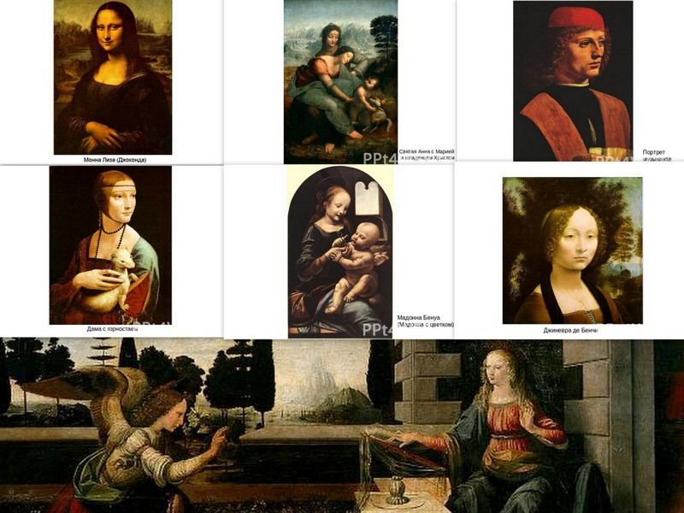
Project work about leonardo da Vinci and his works
Made by pupil of 10A
From
Juliana Urshedzhuk

Slide 2
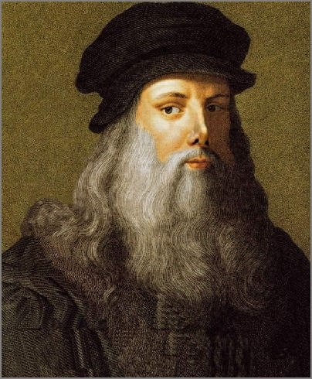
Leonardo di ser Piero da Vinci
(April 15, 1452 – May 2, 1519, Old Style)
was an Italian Renaissance polymath: painter, sculptor, architect, musician, mathematician, engineer, inventor, anatomist, geologist, cartographer, botanist, and writer.

Slide 3
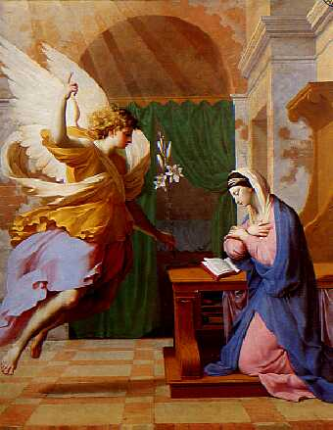
Early works
Leonardo's early works begin with the Baptism of Christ painted with Verrocchio, his teacher.
The Virgin Mary is sitting or kneeling to the right of the picture, on the left an angel is giving a lily.

Slide 4
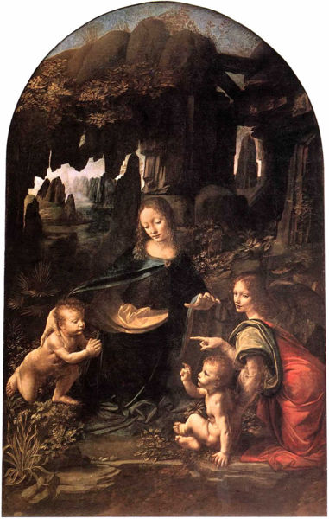
Virgin of the Rocks

Slide 5
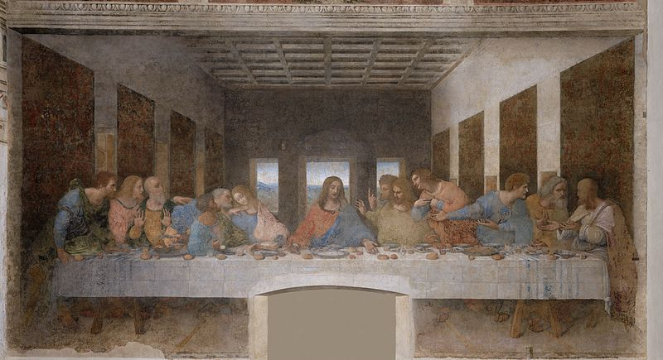
Last supper

Slide 6
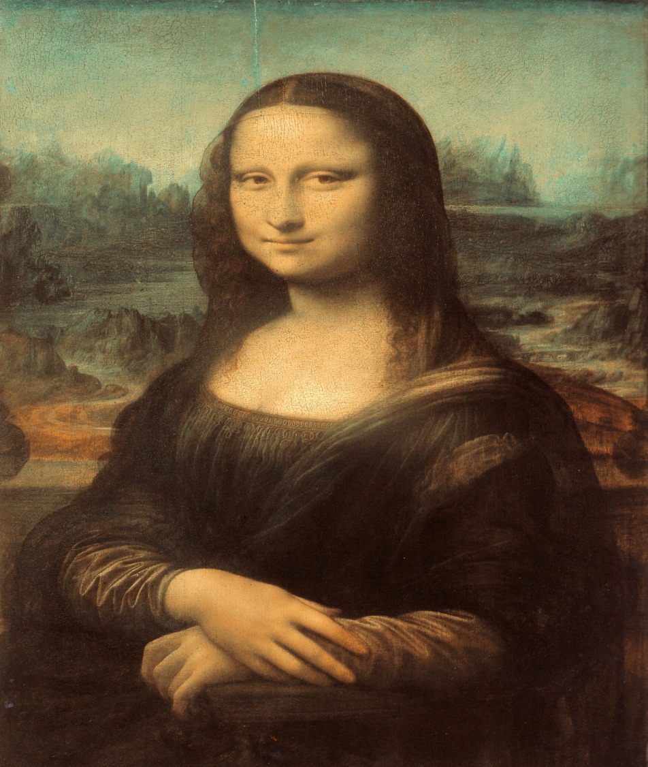
Among the works created by Leonardo in the 16th century is the small portrait known as the Mona Lisa or "la Gioconda", the laughing one. In the present era it is the most famous painting in the world. Vasari said that "the smile was so pleasing that it seems divine rather than human; and those who saw it were amazed to find that it was as alive as the original"

Slide 7
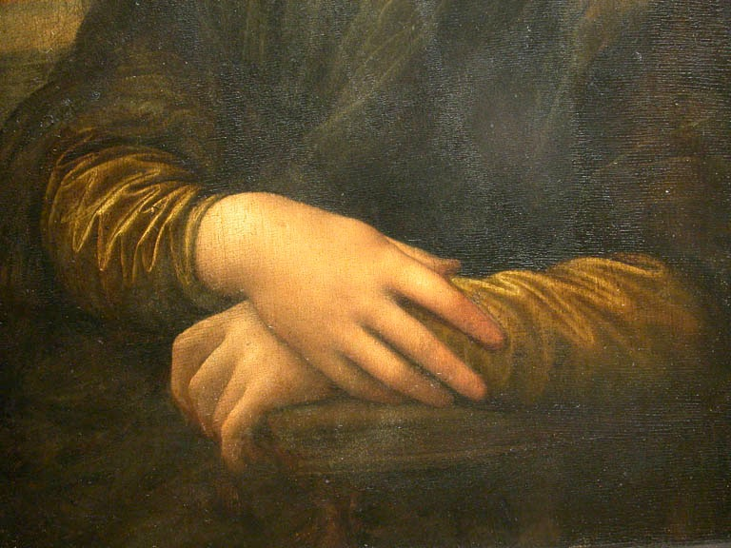
Detail of Lisa's hands, her right hand resting on her left. Leonardo chose this gesture rather than a wedding ring to depict Lisa as a virtuous woman and faithful wife. And according to some reports Leonardo da Vinci spent nearly 12 years, drawing lips "Mona Lisa."

Slide 8
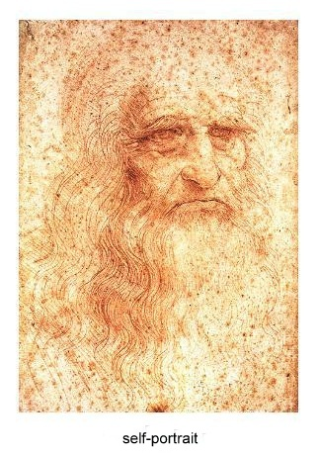
Interest in Leonardo has never diminished. The crowds still queue to see his most famous artworks, T-shirts bear his most famous drawing, and writers continue to marvel at his genius and speculate about his private life.

Slide 9
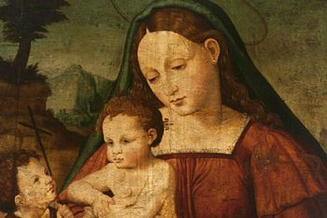
Among the qualities that make Leonardo's work unique are the innovative techniques, his detailed knowledge of anatomy, light, botany and geology, his interest in physiognomy. All these qualities come together in his most famous painted works, the Mona Lisa, the Last Supper and the Virgin of the Rocks.
Mary Magdalene with her son

Slide 10
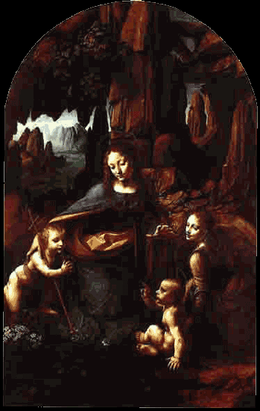
" ... Leonardo can be considered, quite rightly, to have been the universal genius… Man is as uncomfortable today, faced with a genius, as he was in the 16th century. Five centuries have passed, yet we still view Leonardo with awe’’.
( Liana Bortolon )
Virgin of the Rocks

