Slide 1
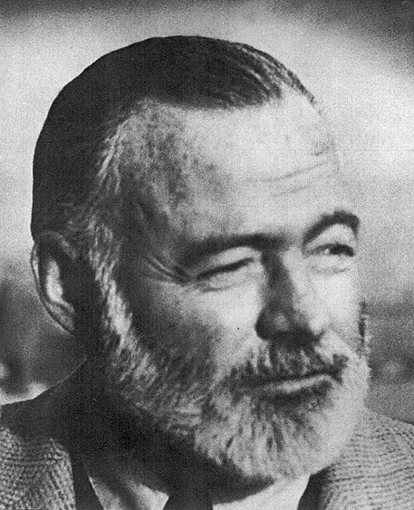
A Biography of Ernest Hemingway

Slide 2
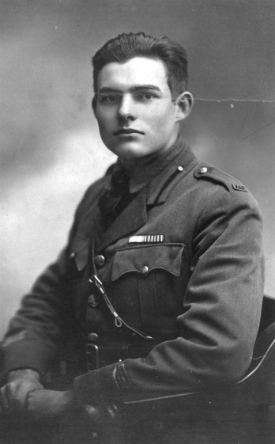
Who Is Ernest Hemingway?
Born into a strict, Protestant family
Famous and well accomplished author (49 short stories and over 10 novels)
Nobel Peace Prize winner
Avid hunter and fisher
Considered a hero of WWI
Committed suicide in Idaho (1961)
Used the experiences of his life to create literary masterpieces during the Modernism Era

Slide 3
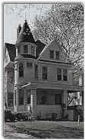
Hemingway’s Personal Life
Born Ernest Miller Hemingway on July 21st, 1899
Grew up in Oak Park, Illinois – upper middle class
Father was a doctor and mother was a singer
He had four sisters and one brother
The community had a large Protestant population
Hemingway about his community: “Wide lawns and narrow minds.”(The Hemingway Resource Center)
Enjoyed hunting and fishing (inspiration for many stories/novels) with his father when his mother wasn’t introducing him to music and literature

Slide 4
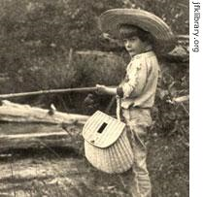
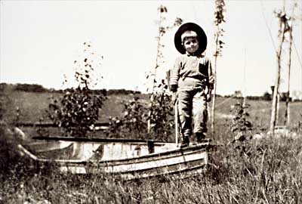
Hemingway’s Personal Life (cont.)
Rumored that his mother often dressed him in female clothes
Worked as a reporter for the Kansas City Star (1917)
WWI Ambulance Driver (1918)
Celebrated as a war hero upon his return home
Reporter for Toronto Star (1920)
Married Hadley Richardson and moved to Paris, France (1921)
Father committed suicide in 1929, Ernest does the same in 1961 (Idaho)

Slide 5
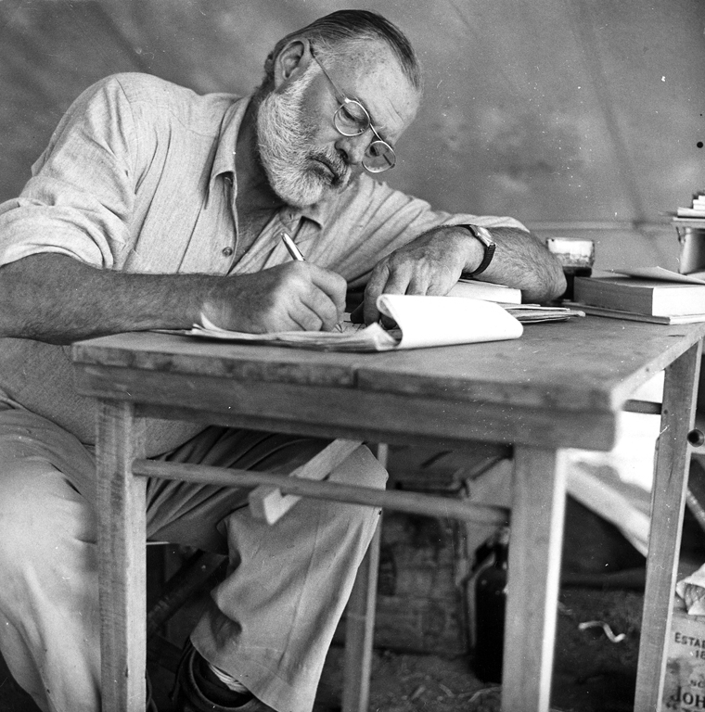
Hemingway’s Professional Life
Wrote forty-nine short stories and published six best-selling novels:
The Sun Also Rises
A Farewell To Arms
For Whom The Bell Tolls
The Old Man and The Sea
To Have and Have Not
A Moveable Feast

Slide 6
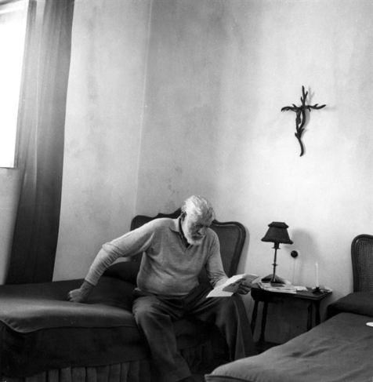
Hemingway’s Professional Life (cont.)
Popular characters in his works: soldiers, hunters, bullfighters, and primitive people.
Themes of his work: Courageous and honest people losing hope in a modern, hectic society
Possibly reflects his own outlook concerning his place in the world
His writing is very dry and descriptive with little plot – draws heavily from past experience
His alcoholism and depression contributed to his eventual suicide
He shot himself in Ketchum, Idaho (1961)

