Slide 1
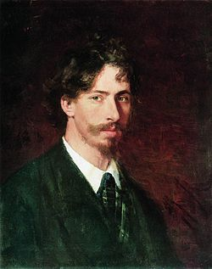
Ilya Yefimovich Repin
Was a leading Russian painter and sculptor of the Peredvizhniki artistic school. An important part of his work is dedicated to his native counry,Ukraine. His realistic works often expressed great psychological depth and exposed the tensions within the existing social order. Beginning in the late 1920s, detailed works on him were published in the Soviet Union, where a Repin cult developed about a decade later. He was held up as a model "progressive" and "realist" to be imitated by "Socialist Realist" artists in the USSR.

Slide 2
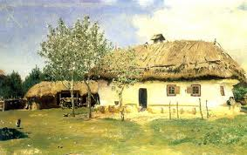
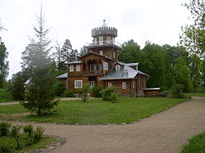
Repin was born in the town of Chuguyev, near Kharkov Governorate, in the heart of the historical region called Sloboda Ukraine. His parents were Russian military settlers. In 1866, after apprenticeship with a local icon painter named Bunakov and preliminary study of portrait painting, he went to Saint Petersburg and was shortly admitted to the Imperial Academy of Arts as a student. From 1873 to 1876 on the Academy's allowance, Repin sojourned in Italy and lived in Paris, where he was exposed to French Impressionist painting, which had a lasting effect upon his use of light and colour.
Repin's country house in Zdrawneva, Belarus, now a museum.

Slide 3
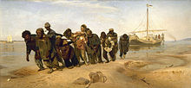
“Barge Haulers on the Volga”
1870–1873

Slide 4
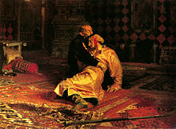
"Ivan the Terrible and His Son Ivan"
1870–1873

Slide 5
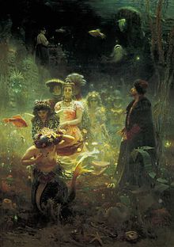
Sadko
1876

Slide 6
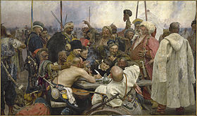
“Reply of the Zaporozhian Cossacks to Sultan Mehmed IV of the Ottoman Empire”
1880

Slide 7
Professor Dmitri Ivanovich Mendeleev University of Edinburgh in the mantle
1885

Slide 8
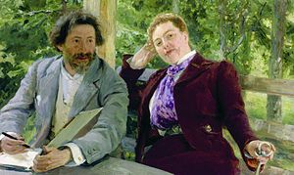
Portrait of Nordman-Severovoy
1903

Slide 9
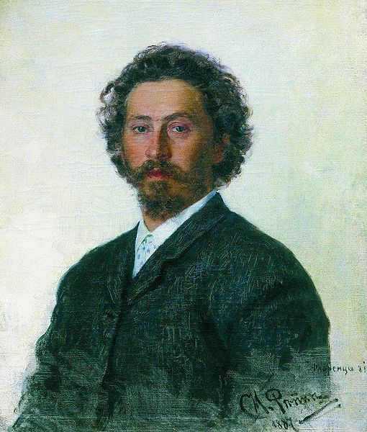
In 1930, he died in Kuokkala, Finland. After the Continuation War, Finland ceded Kuokkala to the Soviet Union, which renamed it Repino which is a municipal settlement in Kurortny District of the federal city of St. Petersburg. Penaty is part of the World Heritage Site Saint Petersburg and Related Groups of Monuments.

Slide 10
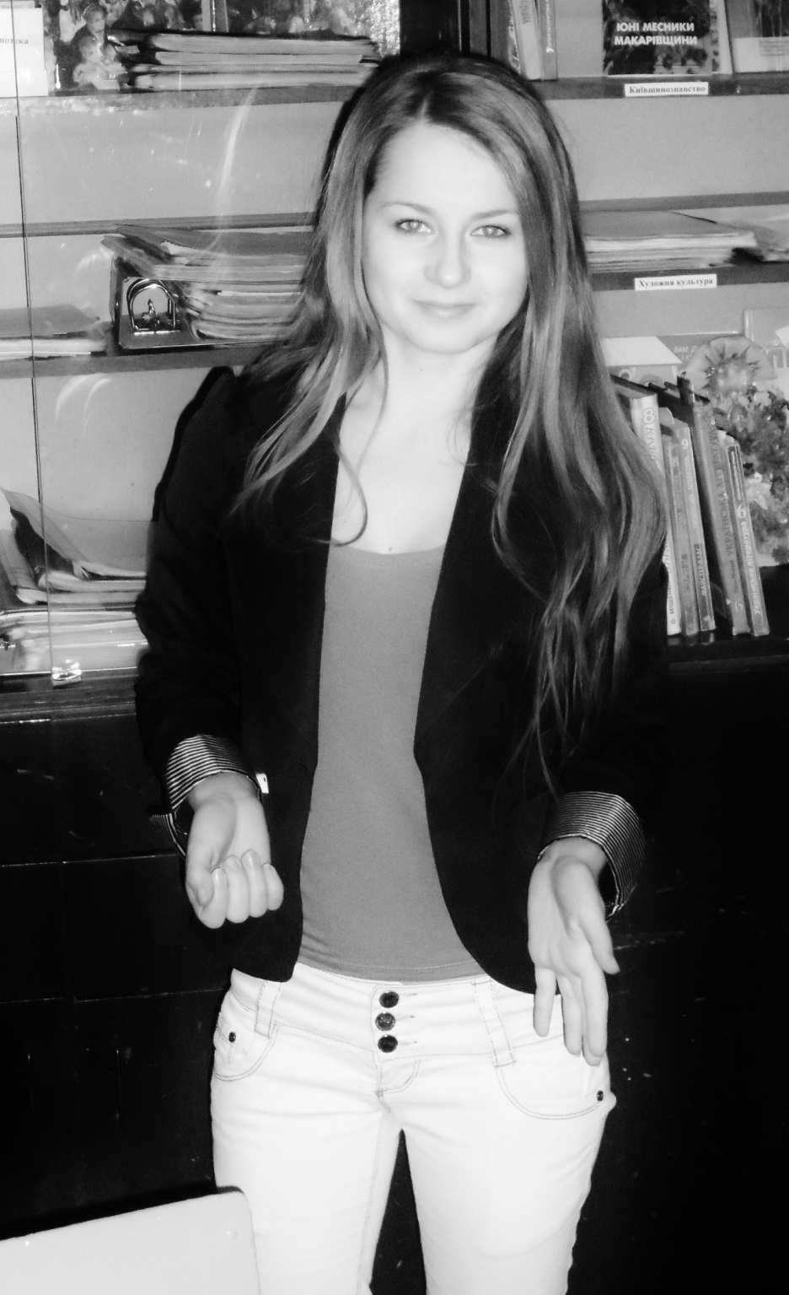
Project made by Aja Stetsenko

