Slide 1
First Inhabitants of Ukraine
Oleksandr Petrenko
10th Form

Slide 2
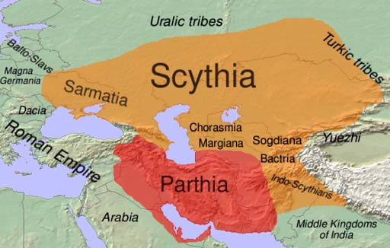
In The Beginning
Archeological finds show that the earliest inhabitants of Ukraine were Neolithic tribes in the Dnipro and Dniester valleys.
The first organized society in the region were the Scythians, who had tamed horses and used this mobility to rule most of the region north of the Black Sea.

Slide 3
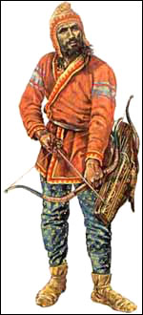
Warfare
The Scythians were barbaric and aggressive warriors. They “fought to live and lived to fight” and “drank the blood of their enemies and used the scalps as napkins”. Ruled by small numbers of closely allied élites, Scythians had a reputation for their archers, and many gained employment as mercenaries. Scythian élites had kurgan tombs.
Scythians also had a reputation for the use of barbed and poisoned arrows of several types.

Slide 4
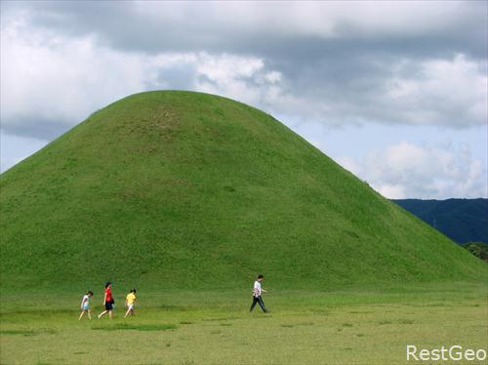
Archaeology and Kurgans
Archaeological remains of the Scythians include kurgan tombs, gold, silk, and animal sacrifices, in places also with suspected human sacrifices.
Large burial mounds (some over 20 metres high), provide the most valuable archaeological remains associated with the Scythians.

Slide 5
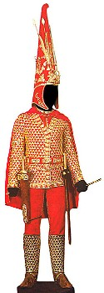
Clothing
Scythian women wore long, loose robes, ornamented with gold.
Men and women warriors wore variations of long and shorter boots and moccasin-like shoes. Women wore also soft shoes with gold plaques.
Men and women wore belts. Warrior belts were made of leather, often with gold.

