Slide 1

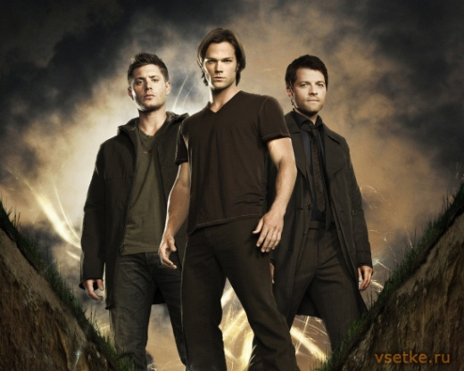
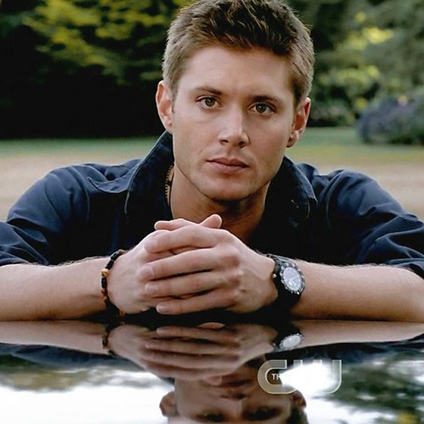
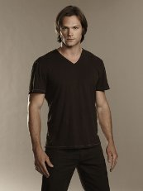
Supernatural
The series tells of the fantastic adventures of brothers Winchester - Sam and Dean. In ancient black car Chevrolet Impala 1967 they travel the US and successfully investigate strange paranormal phenomena, most of which are based on American urban stories, legends.
The brothers did not like. When they were children, their mother died under mysterious and strange circumstances. Since then, Sam and Dean's father devoted his life to finding devil that blame for the death of his wife.
The children grew up and began to help him. But Sam, becoming quite an adult, he decided that do not have to fight with mystical powers. He wanted to start a normal life, go to university.
But Sam's life like a whirlwind burst brother Dan. He told Sam that their father was gone, but left their important message. Sam agreed to the trip, but not more than a few days. Only here a couple of days will be enough. The normal life of these brothers was not destined to live. They need to find their father and solve the mystery of her mother. They had to open a dangerous and incomprehensible world of werewolves, ghosts and various rebel dead, killing all around. A lot of them risk their lives when faced

Slide 2

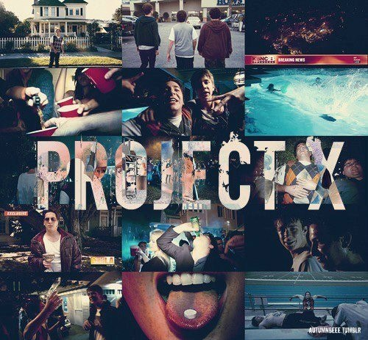
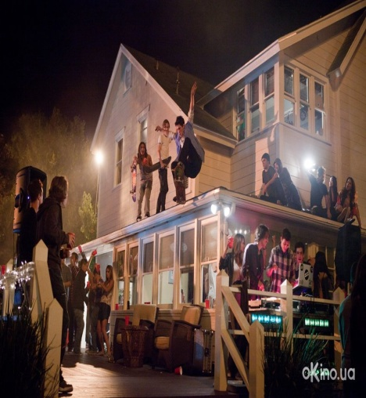
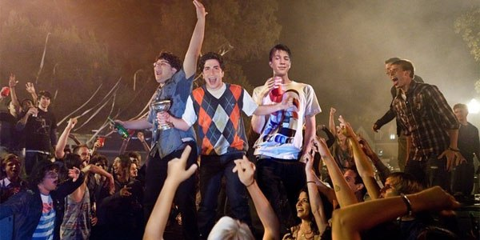
Projek X
Feature film "Project X: greedily" created in the US in 2012. The director of this comedy was funny Nurizade Nima, who took this picture on a script by Michael Bacall. The painting "Project X: greedily" out funny, interesting moments, driving scenes and starts muzykoy.No as an American youth comedy, humor and American. If you used the effect of amateur shooting, so that all that is reality. Well played young artists - Thomas Mann, Oliver Cooper and Jonathan Daniel Brown, perfectly included in your images.
The film "Project X: greedily": Thomas turns 17 years old. In honor of this event friends Thomas - Costa and JB decided to hold a birthday party cool. On the weekend of Thomas's parents left, forbidding him to arrange any activities. But friends of Thomas still persuaded him to hold small Sabantuy, 50 person maximum ... Costa Friend Share unbeknownst Thomas in the whole internet invitation and were about two thousand people but they all went to perekosyak and burned half the area it's standing !

Slide 3
Fine Stars
Supernatural
The Fast and the Furious
Projekt X
How hurtuvavsya Style

Slide 4
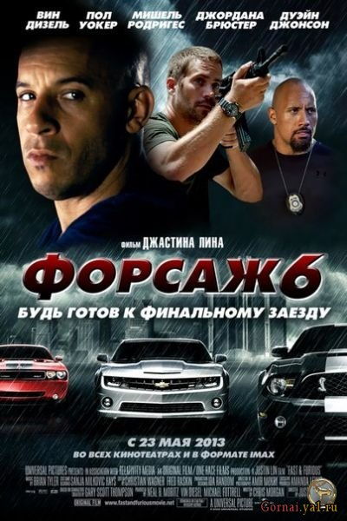
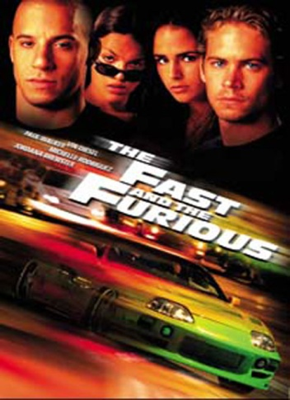
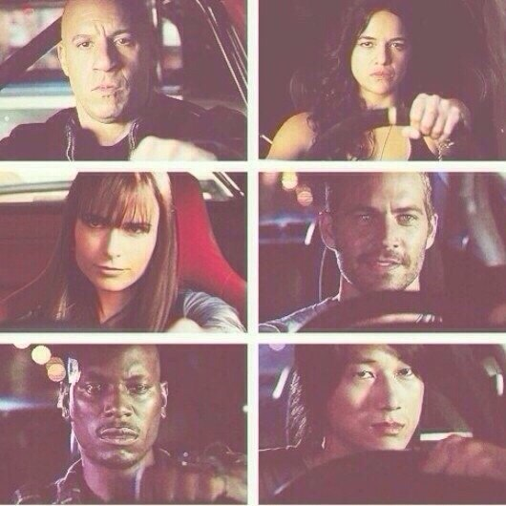
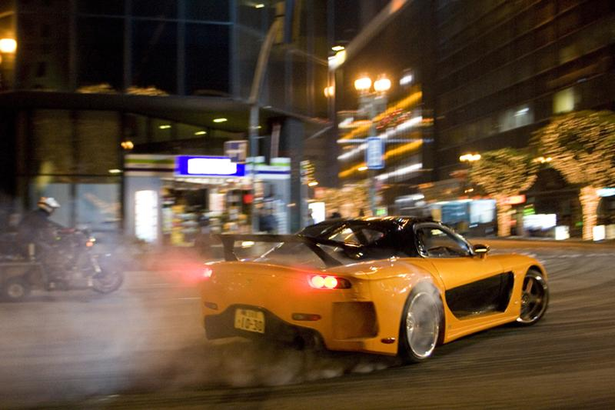
The Fast and the Furious
Brian falls in love with Miyu sister Dominique, which only exacerbates the situation. Guilt Dominica is becoming more apparent. Dominic takes him to the team that he took part in competitions which take place in the desert called "Race War" in which Jesse puts his wheelbarrow at stake and loses its Tran. Realizing that wheelbarrow lost his father, he went to an unknown destination. Tran required to give him a wheelbarrow and accuses Dominique is that he passed his cops, Dominic comes into a rage and beats Tran. At night, Dominic wants to go trick. It does not stop no lack of Jesse, not pleas of his sister Mia. He Vince, Leonomi and Letti leave. Despite feeling Brian recognized Mia that he cop and her brother want to save. Truck drivers were now ready to bloom. Along with it, he goes in search of houses. After trying to rob a truck Dominic team fail. The driver was armed and vidstrilyuyetsya from looters. Vince got in the truck and got cut wounds on his hands from rope and a hole in the side of the driver shot with a shotgun. The driver clears the way Letti. For it back Leon. The driver disables Dominica car, but to help naspily Brian and Mia. Brian Vince makes of trucks and trying to help. We drive Dominic and Brian on the phone helicopter is revealing itself. The helicopter takes Vince and Dominic, Mia, Leon and Letti go home on a wheelbarrow Leon. Dominic sends Letti and Leon in a safe place, and he wants to go far to look for Jesse Tran did not get to it. Appears Brian and does not leave him saying that the police find Jesse before. At this point, the house of Jesse arrives and apologizes in Dominica. There Tran and his brother Lance and kill Jesse. Brian and Dominic rush in pursuit of them. Dominique Lance throws off a cliff and kill Brian Tran. Then Dominic and Brian arrange a race in which almost get a train, but the time to pass before him. Then Dominique hits the truck and the car breaks down, but he is still alive. Brian gives him the keys to his Toyota Supra instead of which blew Tran. And Dominic leaves. After the scene titles shown as Dominic travels to Mexico.

Slide 5

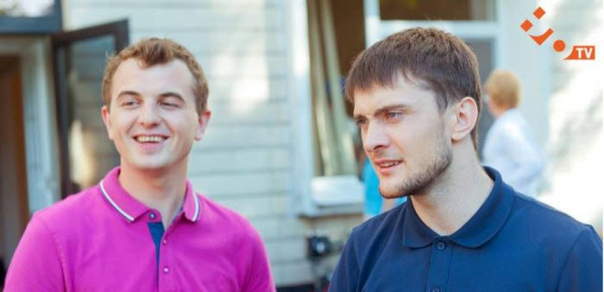
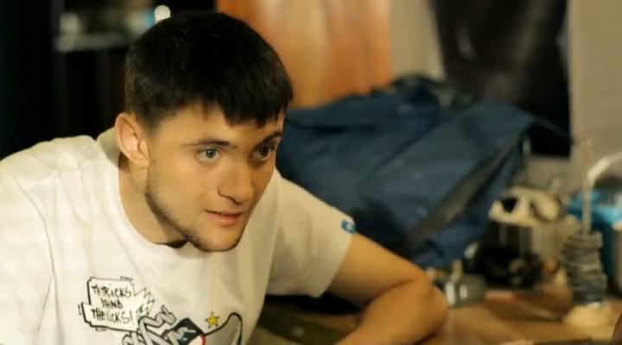
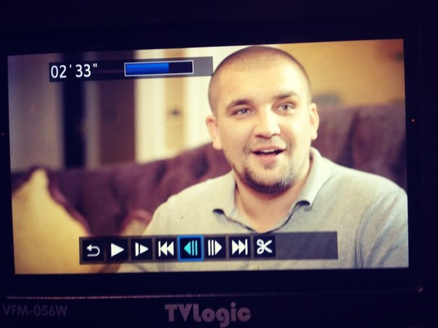
How hurtuvavsya Style
"How hurtuvavsya Style" - a new comedy TV series Ukrainian production. The main characters - a boy-students living in the hostel. One of them, Alexander Yarmak loves rapping. Makes it its extraordinary texts cluttered room in student dormitory. The guy said that the rapper should be clear position in their tracks, not a bunch of unnecessary showing off. Sasha helps to make a career of the famous artist, his friend Eugene Gus. Their duet Gus - Producer and Yarmak - artist. In the first selection goes questionable places for performance because frequent funny situations. Once he agrees with one brother a girl with whom he slept, to speak at one event. As it turns in a conversation, it is the Jews. Sanya to such participation in the festival "type Hanukkah Hipo-hop party." Choosing the guys a little, besides hanging debt paying hostel. The matter is complicated by the fact that it is on the carpet brutally cruel Lidia Ivanovna - wardress former colonies, to talk about their latest mischief. Recently guys missed a hostel and decided to scare the commandant, wearing rubber masks. Then she was gone. Uladnavshy this episode, the guys start to prepare the speech, which promised to pay for the "thing". After the performance of boys expelled from vtryshyya holidays. Such situations on the show a lot. For those who like to make fun of young people and their jokes, comedy will like.

