Slide 1
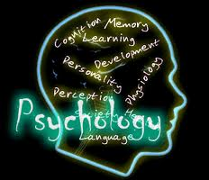
HISTORY OF PSYCHOLOGY
Science about the soul: with what all began?

Slide 2
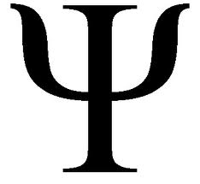
Psychology in the Antiquity
Today, psychology is largely defined as "the study of behavior and mental processes". Philosophical interest in the mind and behavior dates back to the ancient civilizations of Egypt, Greece, China and India.

Slide 3
Egypt
Many cultures throughout history have speculated on the nature of the mind, soul, spirit, etc. For instance, in Ancient Egypt, the Edwin Smith Papyrus contains an early description of the brain, and some speculations on its functions (though in a medical/surgical context). Though other medical documents of ancient times were full of incantations and applications meant to turn away disease-causing demons and other superstition, the Edwin Smith Papyrus gives remedies to almost 50 conditions and only 1 contains incantations to ward off evil. It has been praised as being similar to what is today considered common knowledge, but must be recognized as having originated in a very different context.

Slide 4
Greece
Ancient Greek philosophers, from Thales (fl. 550 bc) through even to the Roman period, developed an elaborate theory of what they termed the psuchẽ (from which the first half of "psychology" is derived), as well as other "psychological" terms – nous, thumos, logistikon, etc.[1] The most influential of these are the accounts of Plato (especially in the Republic),[2] Pythagoras and of Aristotle (esp. Peri Psyches, better known under its Latin title, De Anima).[3] Hellenistic philosophers (viz., the Stoics and Epicurians) diverged from the Classical Greek tradition in several important ways, especially in their concern with questions of the physiological basis of the mind.[4] The Roman physician Galen addressed these issues most elaborately and influentially of all. The Greek tradition influenced some Christian and Islamic thought on the topic.

Slide 5
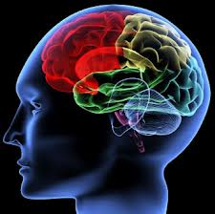
Asia
In Asia, China had a long history of administering tests of ability as part of its education system. In the 6th century AD, Lin Xie carried out an early experiment, in which he asked people to draw a square with one hand and at the same time draw a circle with the other (ostensibly to test people's vulnerability to distraction). Some have claimed that this is the first psychology experiment, and, therefore, the beginnings of psychology as an experimental science.
India, too, had an elaborate theory of "the self" in its Vedanta philosophical writings.

Slide 6
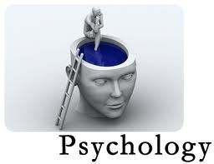
Abu Zayd al-Balkhi
He was among the first, in this tradition, to discuss disorders related to both the body and the mind, arguing that "if the nafs [psyche] gets sick, the body may also find no joy in life and may eventually develop a physical illness." Al-Balkhi recognized that the body and the soul can be healthy or sick, or "balanced or imbalanced." He wrote that imbalance of the body can result in fever, headaches and other bodily illnesses, while imbalance of the soul can result in anger, anxiety, sadness and other nafs-related symptoms. He recognized two types of what we now call depression: one caused by known reasons such as loss or failure, which can be treated psychologically; and the other caused by unknown reasons possibly caused by physiological reasons, which can be treated through physical medicine.

Slide 7
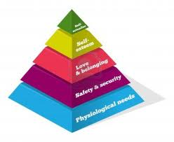
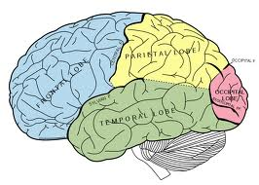
Beginnings of Western psychology
Many of the Ancients' writings would have been lost had it not been for the efforts of the Christian, Jewish and Persian translators in the House of Wisdom, the House of Knowledge, and other such institutions, whose glosses and commentaries were later translated into Latin in the 12th century. However, it is not clear how these sources first came to be used during the Renaissance, and their influence on what would later emerge as the discipline of psychology is a topic of scholarly debates.

