Slide 1
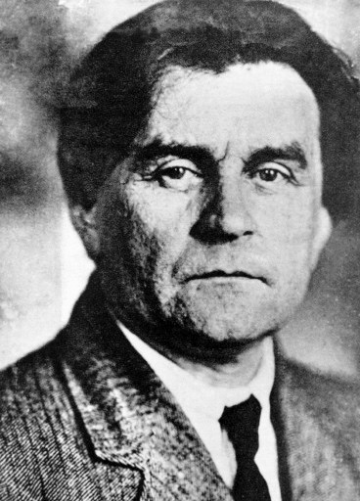
Kazimir Malevich

Slide 2
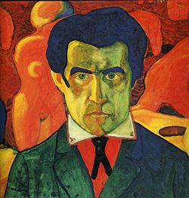
Kazimir Malevich was born in the Kyiv Governorate of the Russian Empire. His parents, Seweryn and Ludwika Malewicz, were ethnic Poles, and he was baptised in the Roman Catholic Church. His father was the manager of a sugar factory. Kazimir was the first of fourteen children, although only nine of the children survived into adulthood. Until age 12 he knew nothing of professional artists, though art had surrounded him in childhood. He delighted in peasant embroidery, and in decorated walls and stoves. He himself was able to paint in the peasant style. He studied drawing in Kyiv from 1895 to 1896.

Slide 3
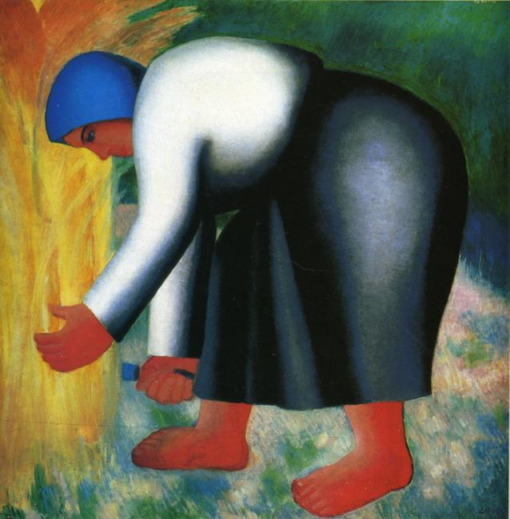
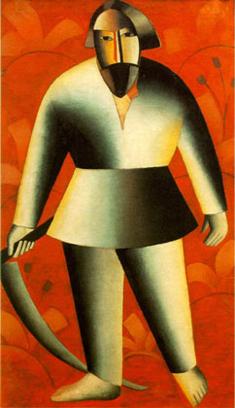
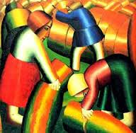
In 1910, Malevich was fascinated by the works of the French Fauves. Primarily A Matisse, Marc A., J. Rouault ...
Impressions wizard reflected in his series of the 1910s, which can be called peasants

Slide 4
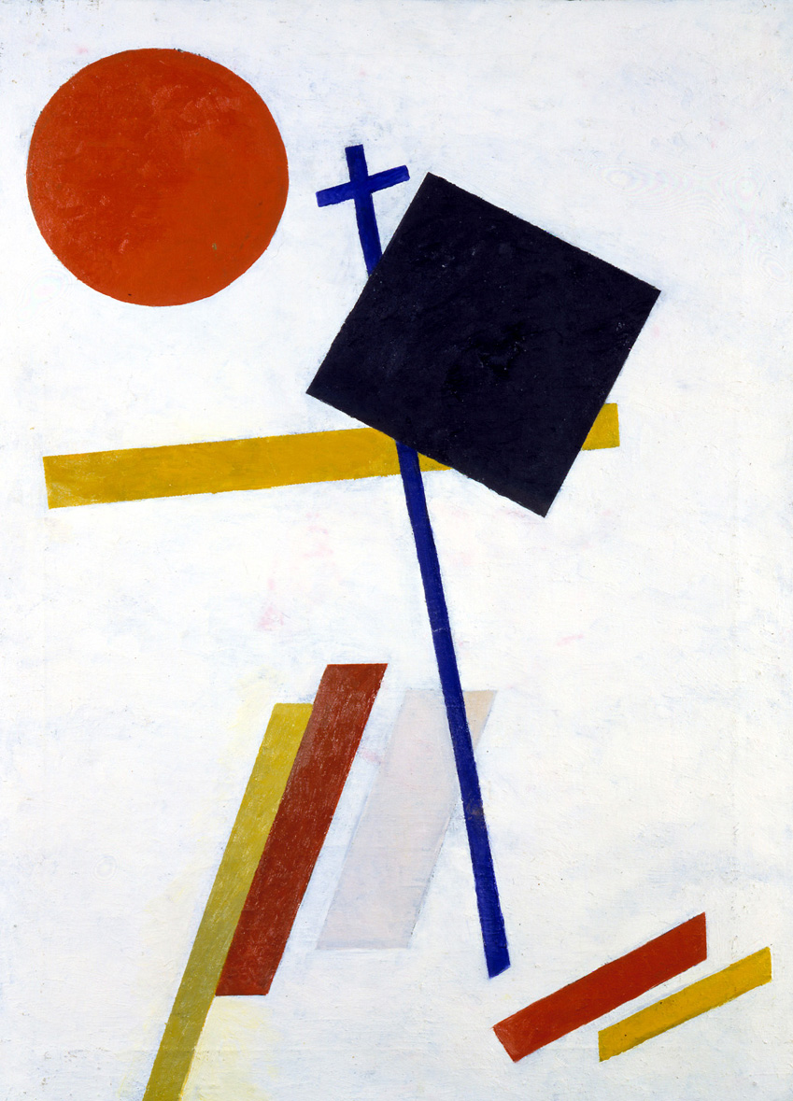
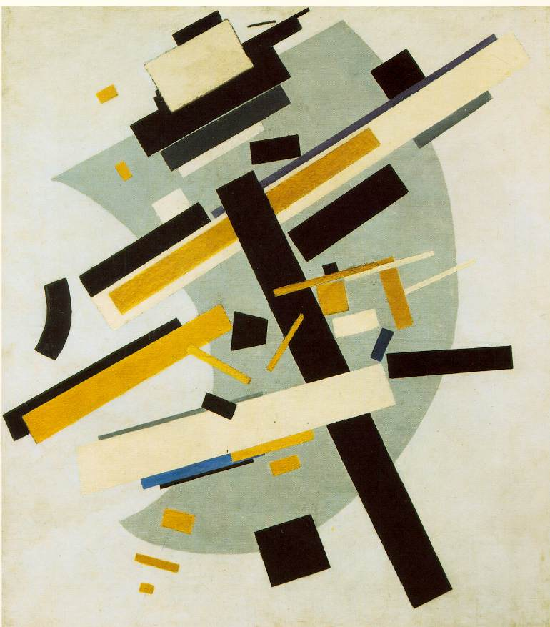
In December 1915 in St. Petersburg opened an exhibition called outrageous "0.10" (zero, ten "). Last Futurist Exhibition. The word "last" in the title of the exhibition, according to organizers, was to mark the completion of a futuristic period. The name "0.10", linked to the idea of reducing all Malevich subject forms to zero and the transition "as zero."

Slide 5
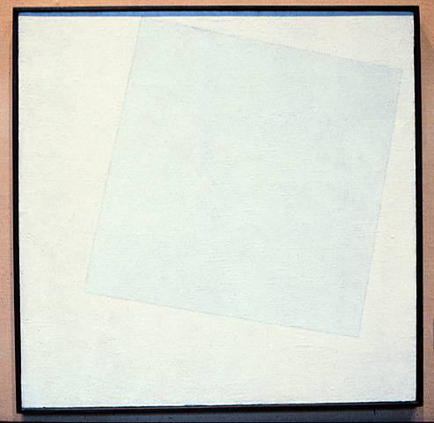
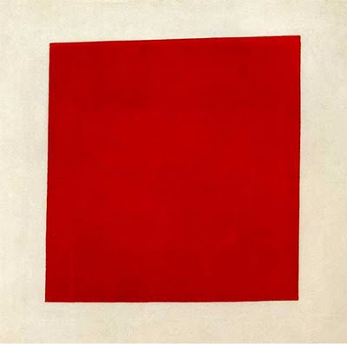
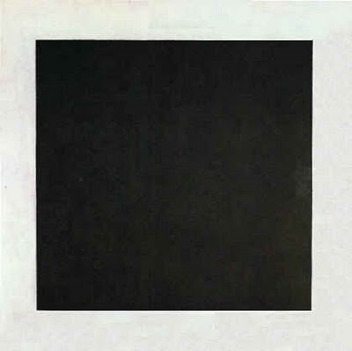
The concept and meaning of Suprematism , which invested Malevich in major works of his style - three "square " - black , red, white . , Fully - formulated and explained in the theoretical works of the artist. Without them it is impossible to obtain an adequate understanding of the work of the master . He states bluntly : " Suprematism is divided into three stages according to the number of squares - black, red and white .

