Slide 1
Culture, customs and traditions of Sweden

Slide 2
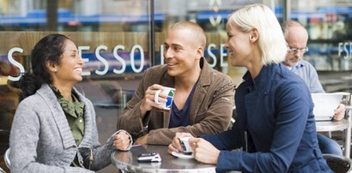
Swedish mentality
Swedes are scrupulous persons, they are punctual and discreet without express violent emotions. Speaking in the group, if they did not give the other people the right to call his name - they resent. They consider better express patriotism actual deeds to the people than "dance around the National Flag" rallies and demonstrations. Swedes have aristocratic character, modesty and freedom – they don’t take any pressure. Swedes are silent and suffer from complexes, shy, afraid to make new acquaintance, restrained in an already established relationship, envious, moderate in all, law-abiding citizens. The Swedes do not want to put themselves in a very positive light because it does not require self-assertion. Strong sense of national pride is in the soul of every Swede, but they do not express it openly, considering it is too unseemly emotional behavior.

Slide 3
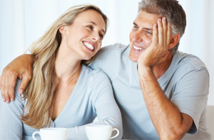
Gender relations
Great success has reached the feminist movement. Women are almost completely equated himself in the rights and responsibilities with men, sharing some of his responsibilities with them. Swedish women more fully than in other country are involved in labor. The Cabinet of Ministers of Sweden is consisted of 50% of the women. Even among the priests they meet more frequently. According to the Law of Succession men and women in the royal family have the same right of succession to the throne. A woman plays a major role in the marriage. Man along with a woman engaged in children and housework. Women can go to restaurants, cafes, pubs alone and invite gentlemen to dance.

Slide 4
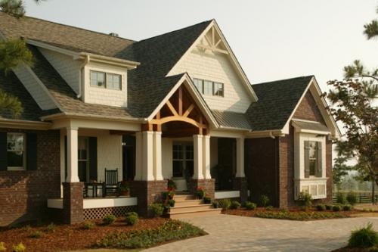
Housing and interior
Most city dwellers live in apartment buildings, the wealthier inhabitants - in individual one-and two-story cottages. There are popular one-or two-story house, consisting of several single-family sections between which are built garages. Each section has a separate entrance. The ground floor features a kitchen-dining room and living room where the family spends his free time and hosts. On the second floor we can see
bedroom and children's
room. In families with
many children, they can
sleep on a bunk bed.

Slide 5
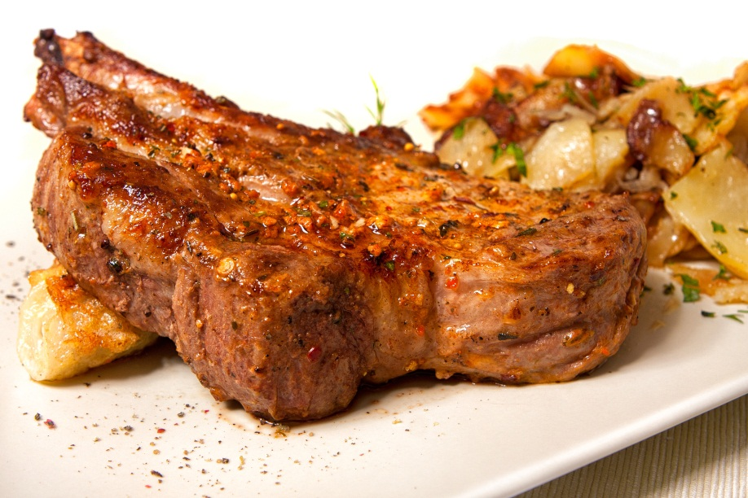
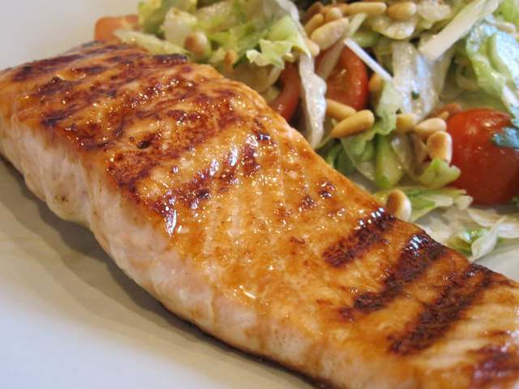
Food
An important role in the nutrition of the Swedes playes milk and dairy products, meat, fish. Swedes eat 3 times for a day: a light breakfast - before work, a hot breakfast in the lunch break - lunch and finally dinner - middag - at home, after work. For lunch, usually served salad and hot meat or fish dish with a boiled potatoes, mineral water or light beer. On Thursdays, many Swedes traditionally eat pea soup. Among the workers and students are popular sausages, hamburger steak with mashed potatoes. Bread consumed in limited quantities. They consume a variety of cheeses. Swedes drink coffee 5-6 times a day.

Slide 6
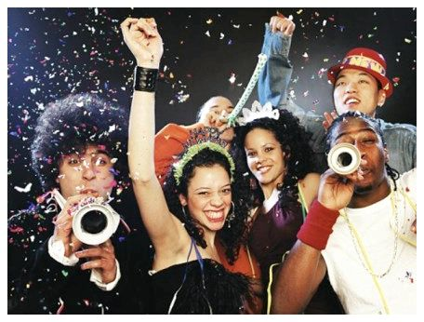
Holidays in Sweden
There are a lot of different events. There are traditional for all European countries, religious holidays, there are some pagan, when are performed different festivals and sporting events. In addition to national holidays in some cities and provinces marked “their" special holidays. The most popular holiday is Christmas. Preparing for Christmas begins in mid-December, when the squares and public gardens are decorated. First day Swedes spend with family. On the festive table traditional baked ham, and of course, coffee and homemade cookies. During the second day of
Christmas people attend public
performances or concerts. New Year usually meet at a
restaurant, and young people are
often on the streets, playing in the
snow, lighting sparklers, shooting
firecrackers and scaring masks. In the spring days of Easter, citizens
usually leave the city. Youth sent to the
north of the country, where there is
snow skiing. May Day is celebrated as a civic holiday, the Day of International Solidarity of Workers.

Slide 7
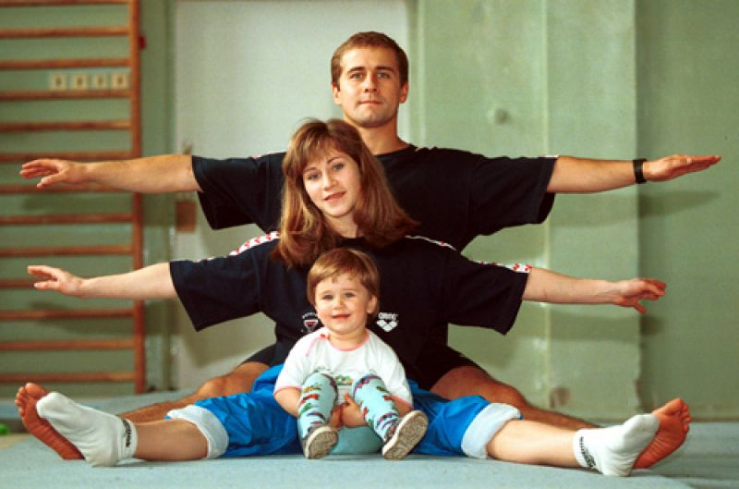
Sport life
In Sweden, the culture of sport are hightly developed, why it is so famous for its athletes. Bjorn Borg is the most popular Swedish athlete.
Teams of Sweden achieved great success in ice hockey, tennis, table tennis, football and other sports. Life of Swedes can not be imagined without sport. There are a lot of gymnasiums, football stadiums, swimming pools, skating rinks, ski slopes. Sweden - the birthplace of gymnastics, the most popular activity is cross-country skiing and ice hockey. It is estimated that one in five Swedes engaged in any kind of sport. Juniors of high school are required to pass a special exam in swimming, for which they must overcome10 km in the pools. All boys and girls can swim.

Slide 8
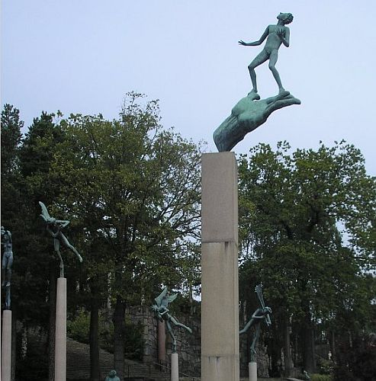
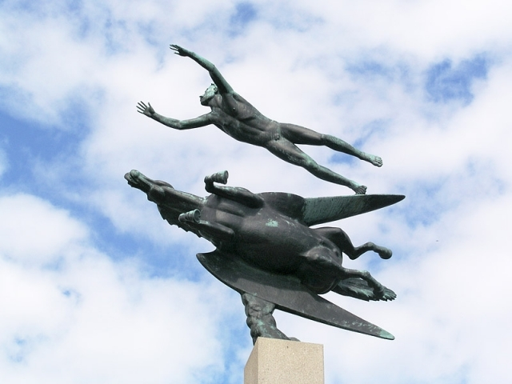
Fine art and sculpture
The most famous Swedish is Carl Milles (1875-1955). The park's museum, located in the Stockholm contains dozens of his sculptural ensembles. There are such sculptures, as "Man and Pegasus" and "The Hand of the Creator", affecting imagination of the sculptor and his great skills. In Stockholm, Gothenburg and many other cities Milles created monumental sculptures, fountains, which have become emblems of these cities. He has created a gallery of prominent public figures, such as Engelbrecht Engelbrektsson and Gustav Vasa, whose names are associated with the turning points of Swedish history.

Slide 9
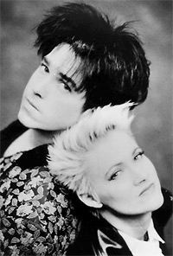
Music
In the history of art, a special place belongs to the work of original poet and singer – Carl Michael Bellman. Jussi Bjorling (1911-60) was one of the world's leading tenors. He made his debut at the Stockholm opera when he was 20 years old. A famous group was Roxette. A charming duo of musicians and singers Per Gessle and Marie Fredriksson appeared on the international music market in 1986, the Group has repeatedly won first place in the charts in Europe and the U.S., and her albums went on all continents and sold over 40 million copies.

Slide 10
Thank you for watching!

