Slide 1
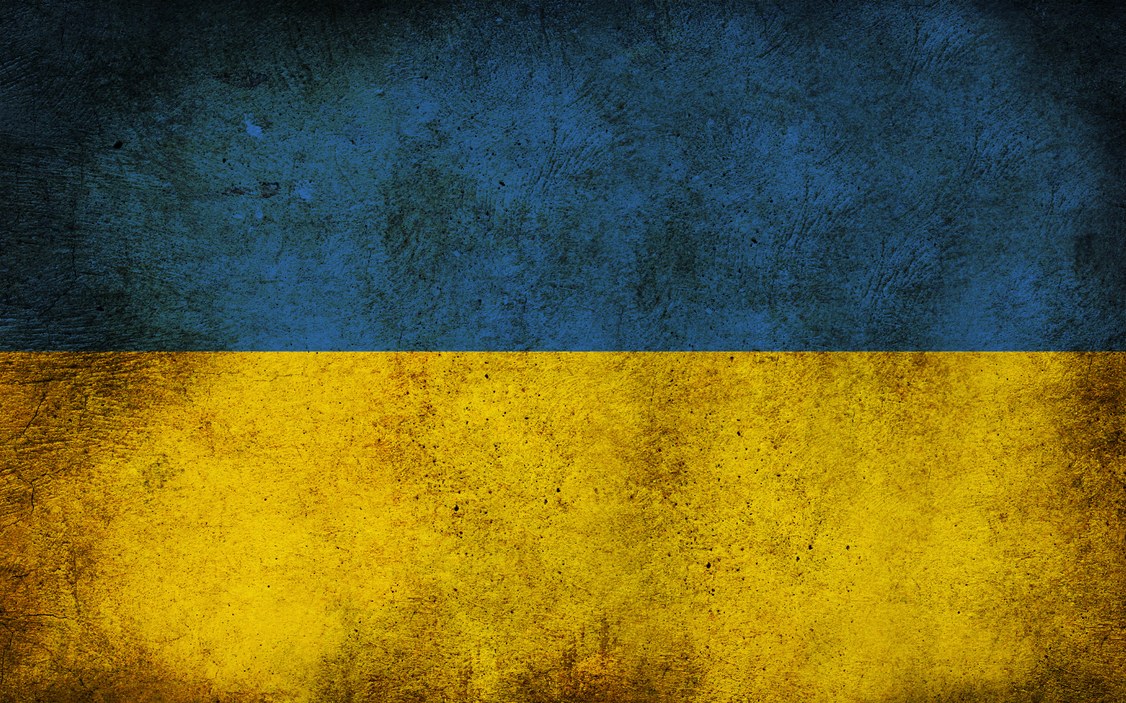
Rock groups of America
Підготував Венцеславський Данило

Slide 2
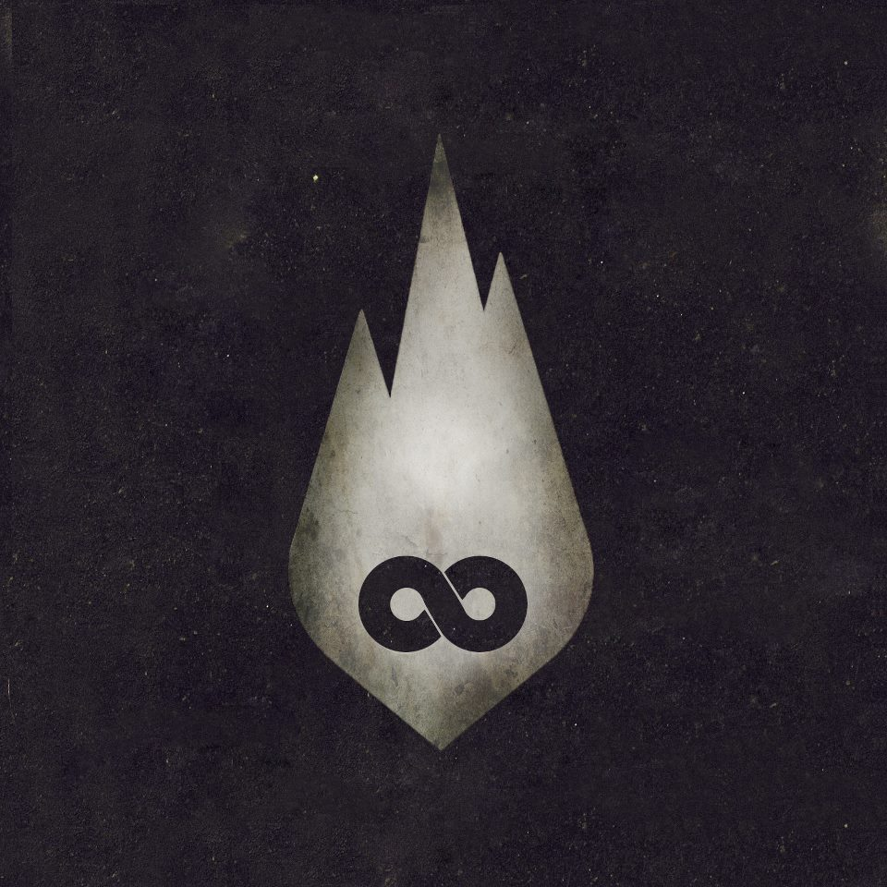
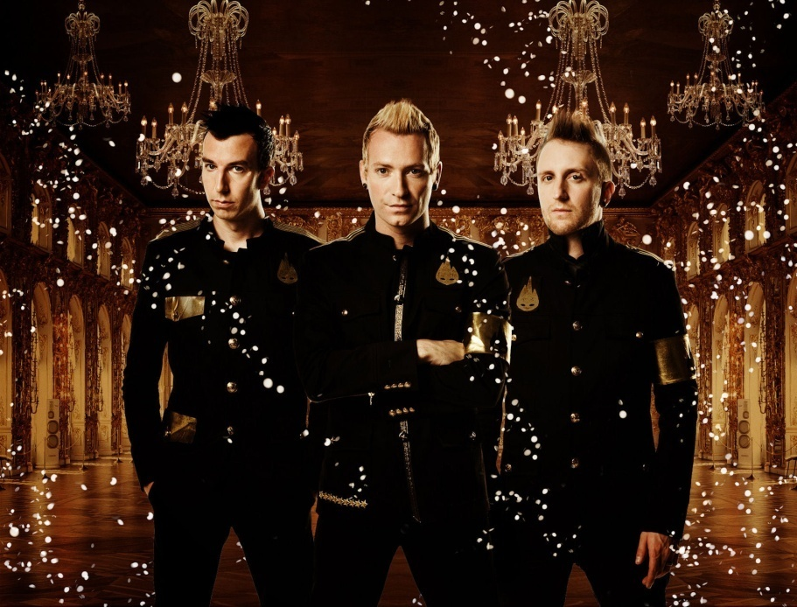
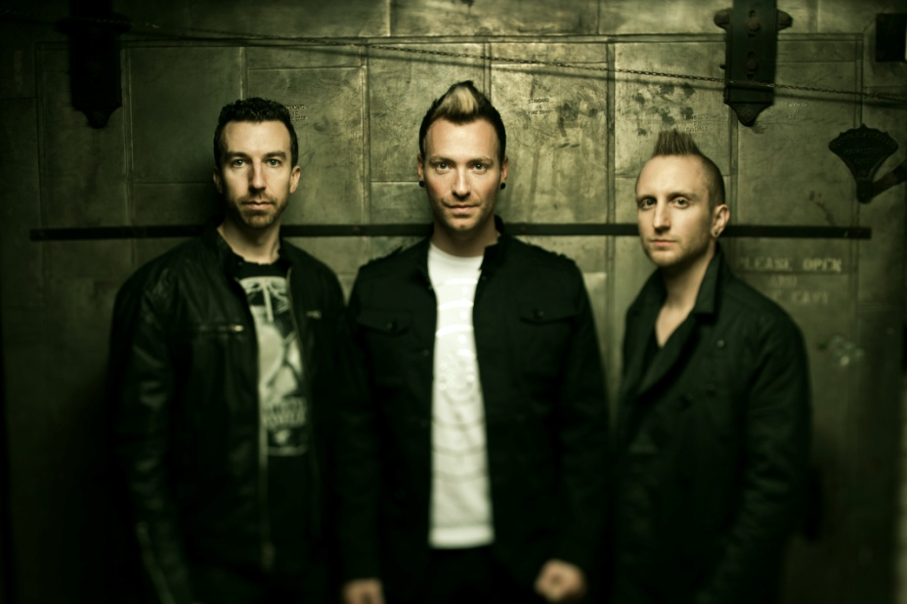


Thousand
Foot
Krutch
2009
2013
Thousand Foot Krutch is a Canadian Christian rock band formed in 1995. They have released eight albums, most recently being The End Is Where We Begin in 2012.
Genres: Christian rock, nu metal, rap metal, hard rock.
Years active: 1995–present.
Soundtracks: 1. 2005 “Supernatural”. 2. 2010 “Metro 2033”. 3. 2012 “NHL 13”.

Slide 3

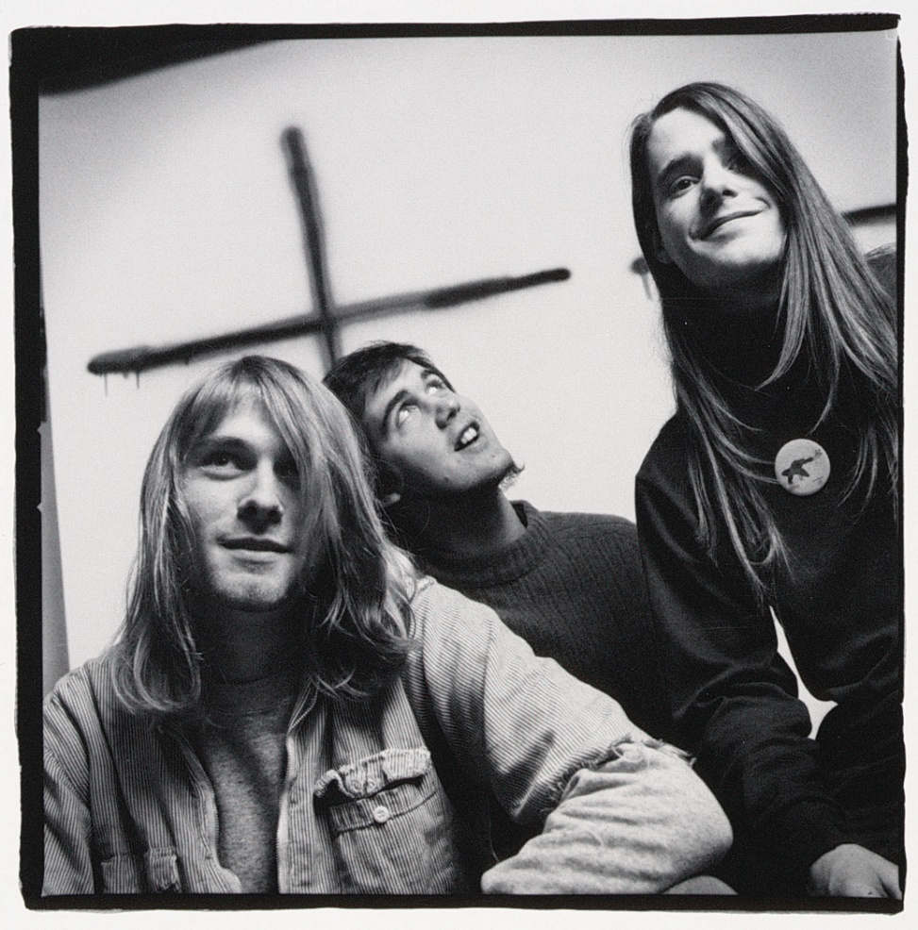
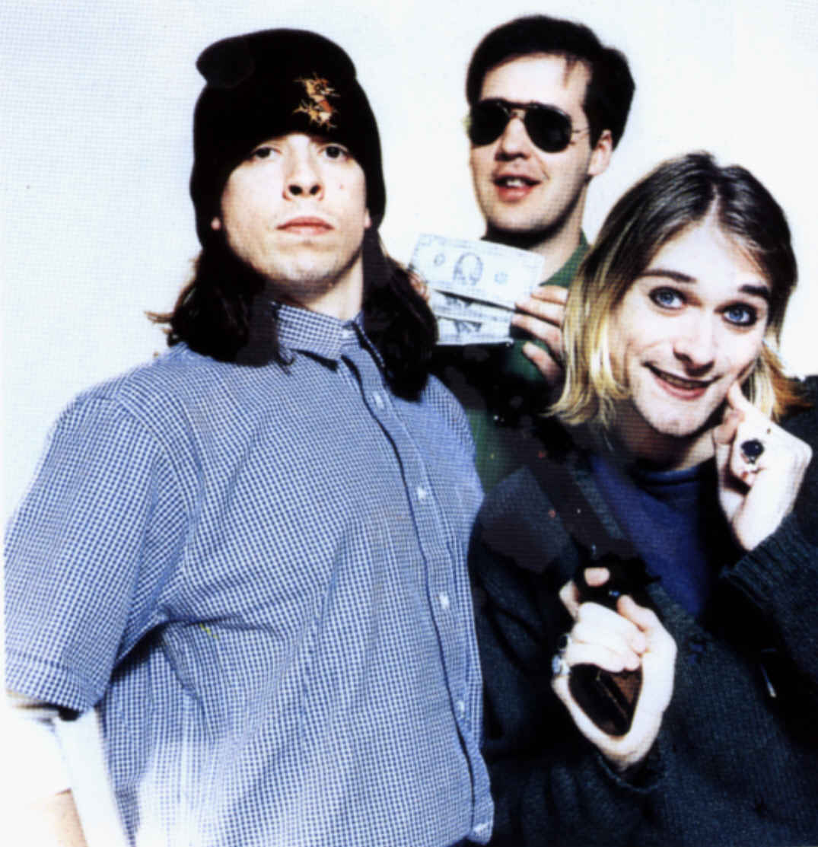
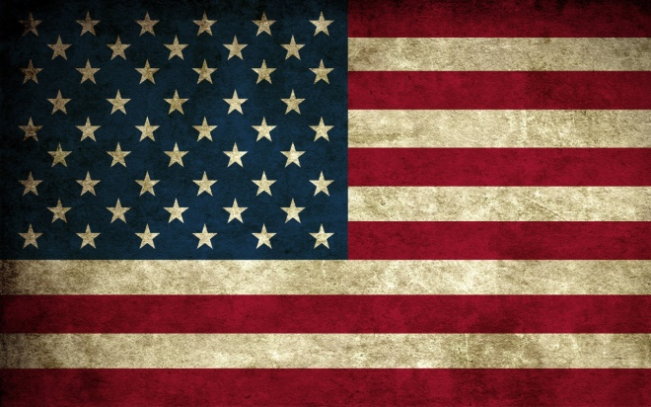
Nirvana
1994
1987
Nirvana was an American rock band formed by singer/guitarist Kurt Cobain and bassist Krist Novoselic in Aberdeen, Washington in 1987.
Years active: 1987–1994.
Genres: Alternative rock, grunge.
This was a legendary group. Many generations grew under the songs of Nirvana. Post mortem Kurt, a group disintegrated.
Soundtracks: 1. 1997 “Nirvana”. 2. 2000 “Traffic”.
Kurt died, but Krist and David created a new group…

Slide 4
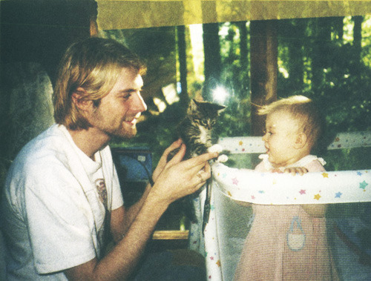
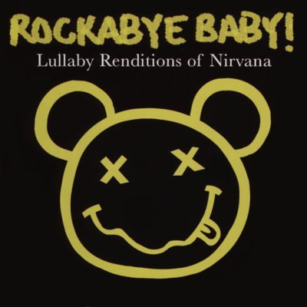
Nirvana for children
Nirvana for children – Heart-Shaped Box

Slide 5
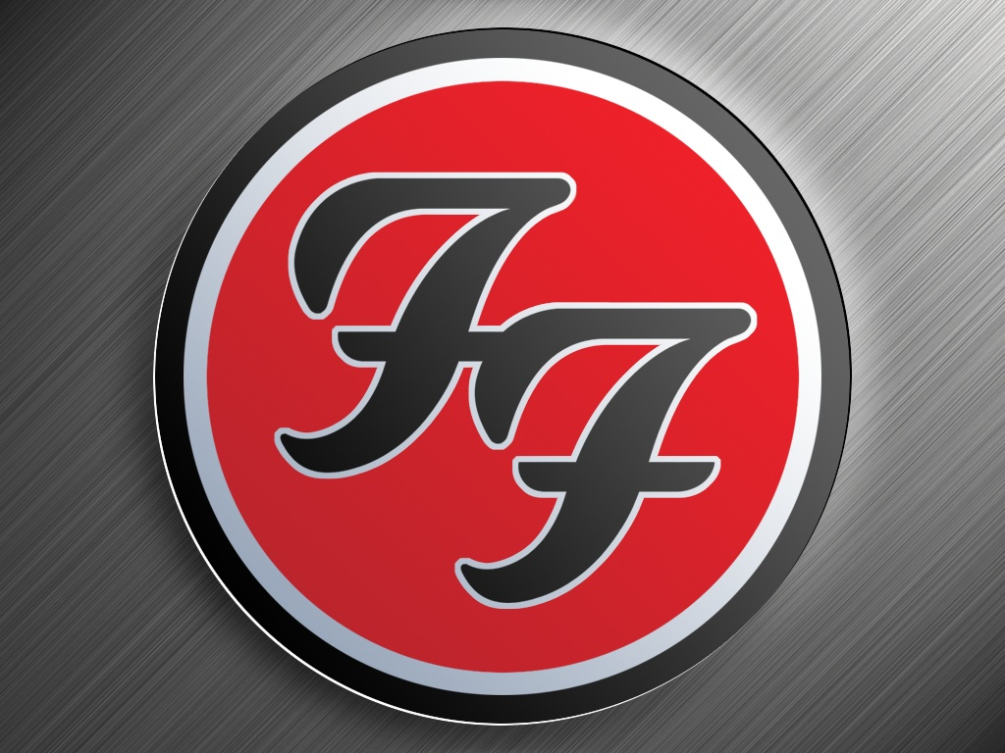
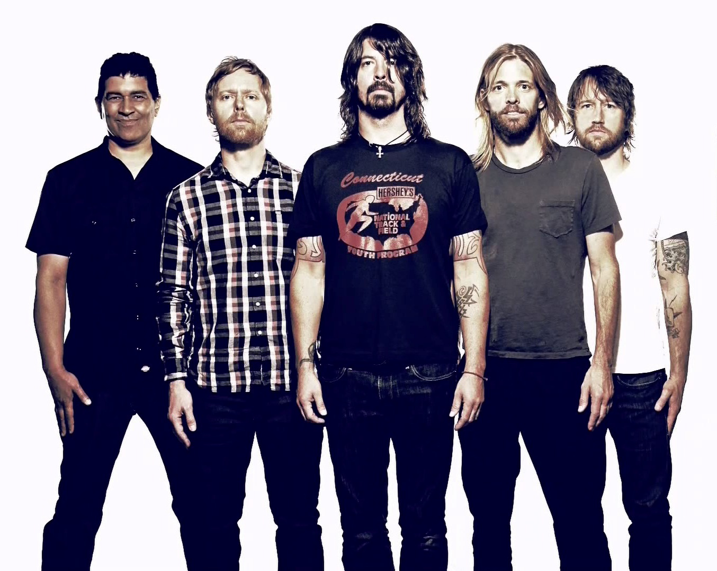

Foo Fighters
2013
Kurt died, but Krist and David created a new group…
The Foo Fighters are an American rock band, formed in Seattle in 1994. It was founded by Nirvana drummer Dave Grohl as a one-man project following the death of Kurt Cobain and the resulting dissolution of his previous band.
Years active:1994-present
Genres: Alternative rock, post-grunge, hard rock, grunge (early)

