Slide 1
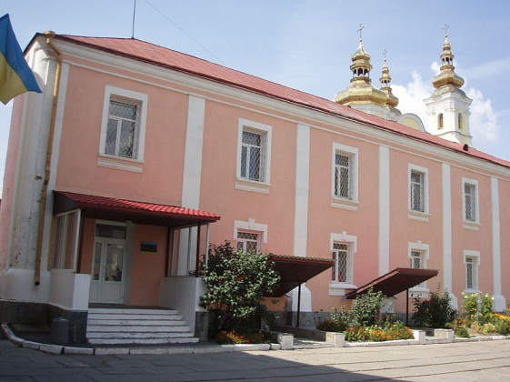
Vinnytsa Regional Museum of Art

Slide 2

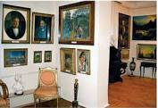
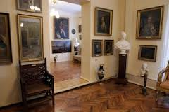
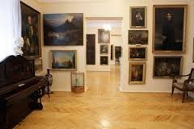
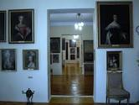
The collection of Vinnitsa regional art museum founded in 1918-1920 during the nationalization of works of art from private collections Vinnytsia intellectuals and wealthy citizens as well as palaces Podolsk magnates – Potocki , Shcherbatov , Grokholsky, Czartoryski and others. Subsequently, the artwork came to the museum of the revolution, and in the thirties of the twentieth century to the newly established museum.

Slide 3
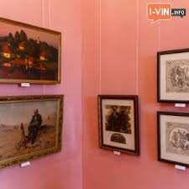
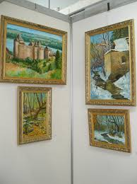
During the years 1925-1927 increased with valuable exhibits - the works of famous artists, products of arts and applied art. The largest number of works of art came in early 1920 with Nemiriv, Palace of Princess Shcherbatov - 25 boxes of paintings and sculpture collection.
Over the last 20 years of art museum funds were enriched more than 6,000 exhibits, including paintings, drawings, sculpture, decorative and applied art.

Slide 4
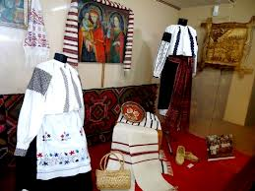
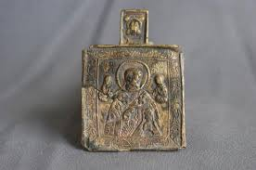
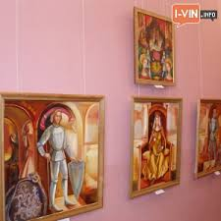
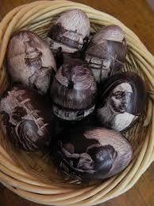
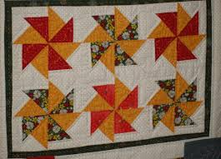
A new exhibition of the museum is the only exposition space in six halls, shows visitors around 300 exhibits, provides a striking panorama of our artistic, historical past and present. The museum collection of Vinnitsa Regional Art Museum 7315 exhibits XVII-XX centuries.

Slide 5
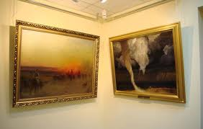
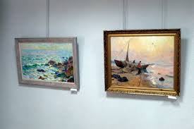
What to see:
Works by artists such as T. Rombouts, F. Vouverman, E. Berthier, Marcello Bacharelli, J. Lampi the Elder, R. Schuster, B. Rohde, A. Schreier, L. Maya, O. Frommel, Alexander Roslin, M. Kvadal, G. Kyuhelhen, J. Mizevych, J. Jasinski, P. Stahevych, V. Smokovskyy, L. Horowitz, J. Simler, T. Holpayn, Ilya Repin, V. Polenov, Art Masterpieces, K. Savitsky, I. Kazakov, I. Svetlitskogo, E. Bukovetsky, A. Kaigorodov, P. Nilus, Olexa Nowakowski, V. Orlov, A. Manevichi, G. Holovkov and other famous artists, including and modern.

Slide 6
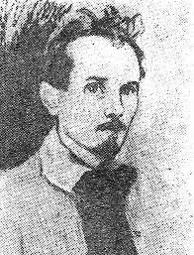
Gregory Svetlitsky

Slide 7
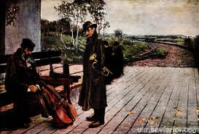
Moonlight in pictures Svetlitskogo extremely diverse: it is sparkling like an emerald ("Night at Saltanivtsi," "Moonlight in Ukraine"), then lit a delicate bluish-silvery, almost white light ("Light Night"), it is hardly noticeable for eye bluish-green hues of brilliant, pure tone pervades the entire surrounding landscape, creating an amazingly beautiful symphony of color. This is a beautiful picture of his "moon came up," and others.

Slide 8
Can a long history of its monthly variation nights of amazing musicianship. "Inn", "Spring Night", "mounted a month," "a clear night," "The July night", "night fragrant," "Moonlight," "Moonlight," "Moonlight Sonata," "Winter's Night", "Caucasian night "," midnight "," Berezki in the moonlight "

Slide 9
His great works and sketches "Traffic light", "Berezki in the moonlight" (almost miniature), "Lilac", "The Last Ray", "Old House" and many other reasons - all deeply felt and skilful hand of a talented master sent for canvas, paper, cardboard, passed various types of art techniques: oil, watercolor, pastel, tempera.

Slide 10
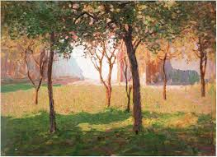
Most of the art works of Gregory Petrovich full genuine lyric poetry. And in the big picture, "the moon came up," and in small landscapes "Berezki in the moonlight" and "Road spark" a lot of feeling, soul, love and high painting skills - because they are true pieces of art that capture, care encourage the viewer.

