Slide 1
Marc Jacobs

Slide 2
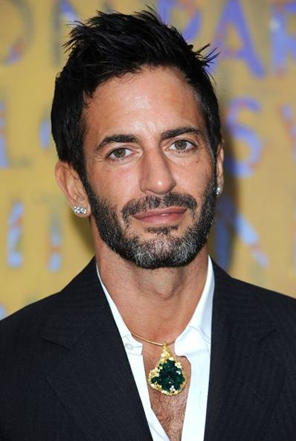
Designer Marc Jacobs
Marc Jacobs (born April 9, 1963) is an American fashion designer. He is the head designer for Marc Jacobs and Marc by Marc Jacobs, a diffusion line, with over 200 retail stores in 80 countries. He was the creative Director of French design house Louis Vuitton from 1997 to 2013. Jacobs was on Time magazine's "2010 Time 100" list of 100 most influential people in the world.

Slide 3
Сareer
Early career Marc Jacobs in the fashion industry was his job as a salesman in the new York avant-garde clothing boutique Charivari. Subsequently he was educated designer at Parsons New school for design in new York and, while still a student at parsons in 1984 he won the Perry Ellis Golden thimble award and the Chester Weinberg Golden thimble award and design student of the year". then he created and successfully implemented its first line manually linked sweaters branded label Sketchbook, Reuben Thomas. Celebrity brought him a revolutionary rough collection for Perry Ellis brand in 1993. In 1992 he won the "designer of the year" from the American Council of fashion designers (in the category "women's collection"). in 1994 he created his first menswear collection.

Slide 4
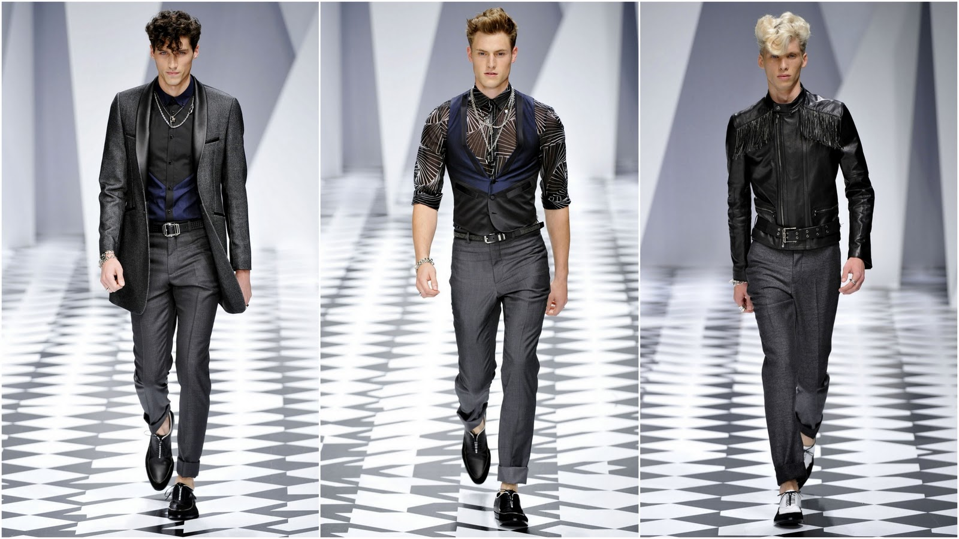
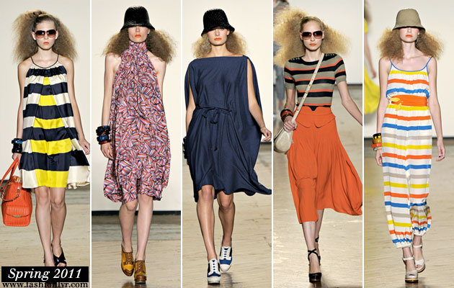
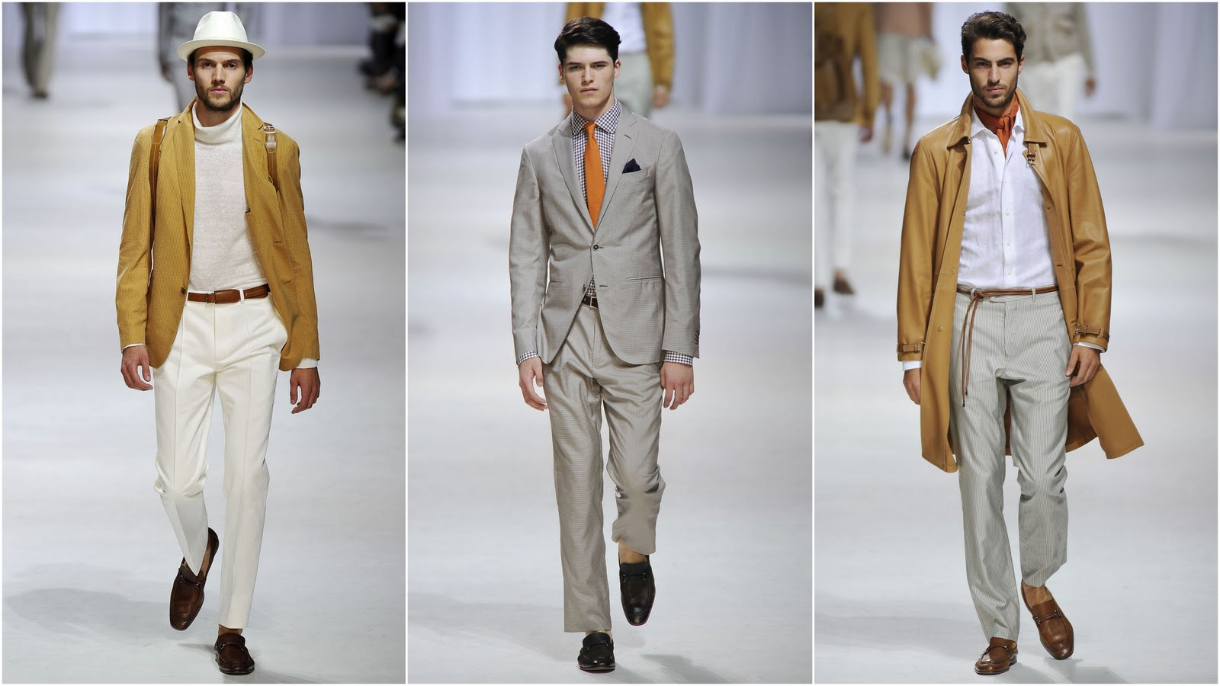
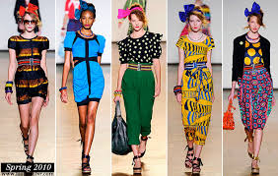

Slide 5
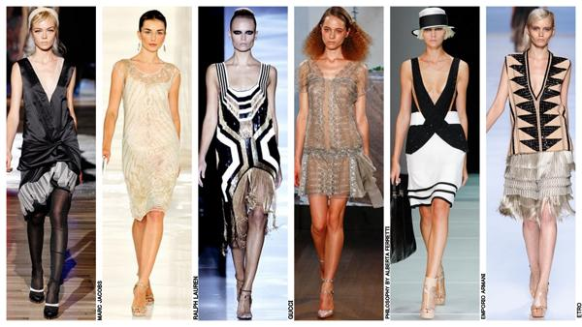
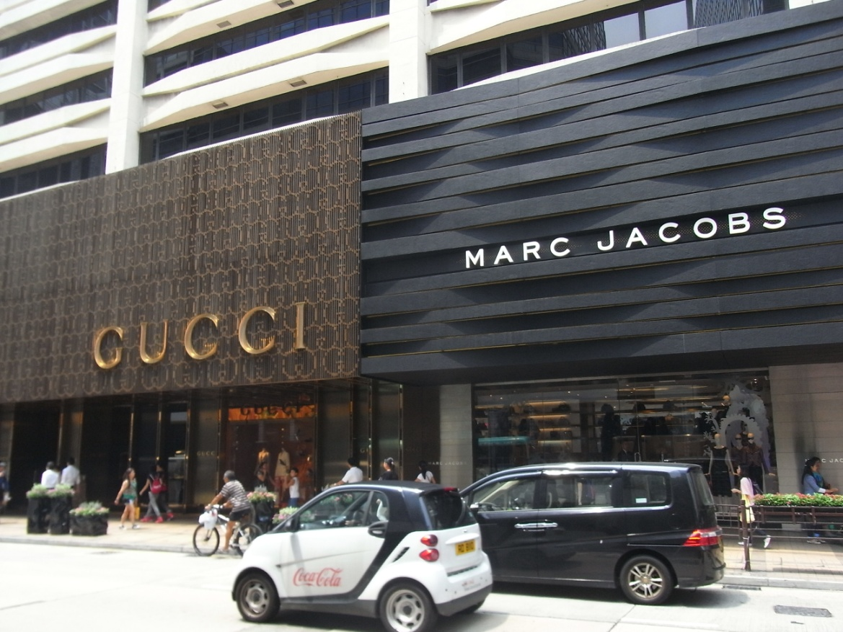
Business
The company has three lines: Marc Jacobs Collection
Marc by Marc Jacobs - Youth,
and the most popular. Little Marc kids.

