Slide 1
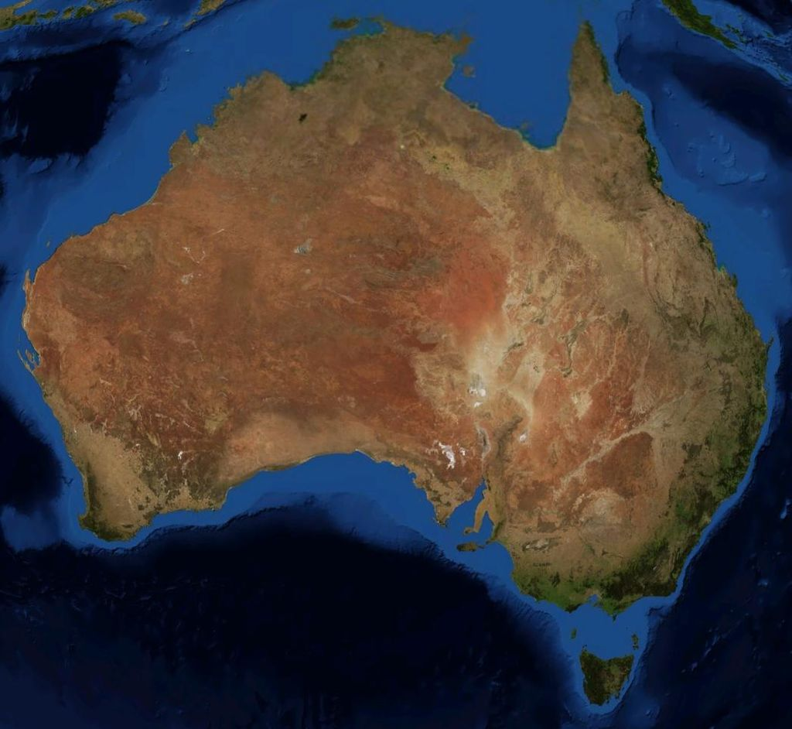
Location and climate of Australia

Slide 2
Australian Geography is very unique, not least because of the state that borders coincide exactly with the boundaries of the Australian mainland. The continent is located in the southern hemisphere. Absolutely unbelievable, but the Australian border - is fully oceanfront. Australia has no borders with any country in the world, and stunning beaches washed by the Indian Ocean on the south and west and the Pacific Ocean to the east.
The structure of the state are such as island of New Guinea and Tasmania. The nearest major administrative territory of Australia - New Guinea, separated from the mainland five hundred kilometers of water surface Timor Sea, another state - Indonesia - removed almost 2,000 kilometers from Australia.

Slide 3
Australia is the smallest continent with an area of about seven thousand kilometers long coastal area in 37 thousand kilometers. When you look at a map, Australia in its shape resembles a haystack, a little flattened at the top (in the north), the Gulf of Carpentaria and bottom having a small tunnel from the Great Australian Bight. Long millennia continent was at a distance from the rest of the world's land area, but because here the most ancient types of animals, such as egg-laying - the echidna, platypus, marsupials - koalas, kangaroos. ?? The structure includes six states of Australia: Queensland, Victoria, Western Australia, South Wales, Tasmania, South Australia and two mainland type: North and Federal capital.

Slide 4
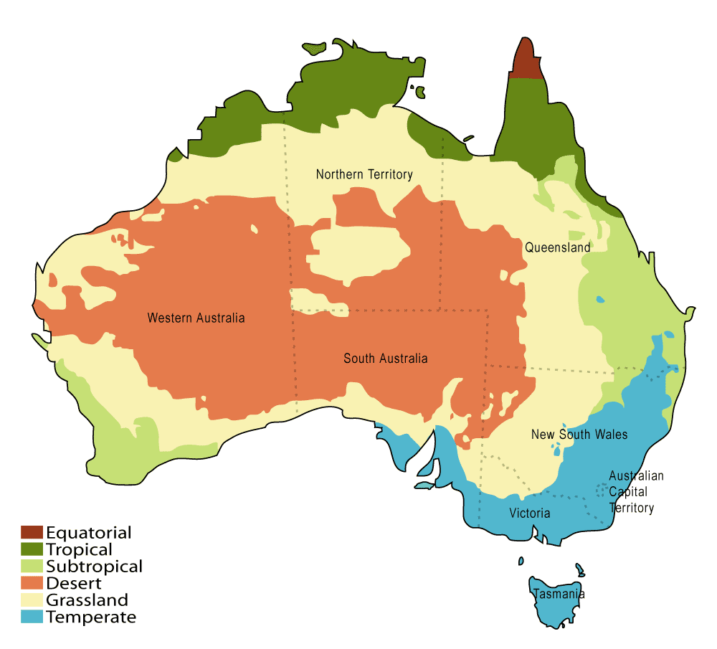
Climate

Slide 5
The climate of the continent is unique. The first thing to say that Australia - a country winds. At the same time the territory is arid regions in the north, wet - in the east and south. The amount of rainfall varies greatly depending on the season. Although it is not so important, the main thing in Australia is always warm and a lot of the sea.

Slide 6
Thanks for watching!
V. MAZUR

