Slide 1

The cuisine of the United States.
American cuisine — is various styles of cooking in the USA. American cuisine - mixed up with some culinary traditions of the American Indians and immigrant cultures

Slide 2
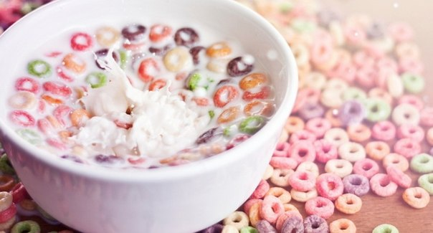
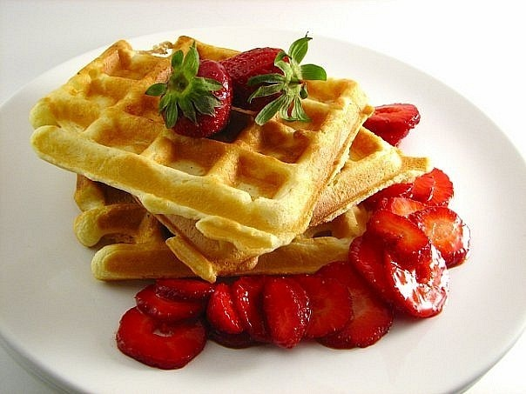
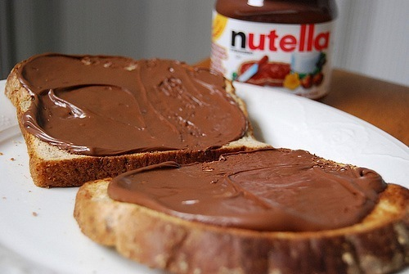
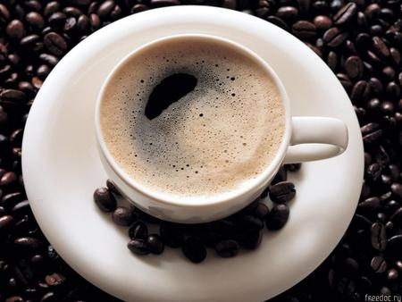
Day begins with a cup of coffee or juice and flakes with milk or toasts and wafers with jam or peanut butter

Slide 3

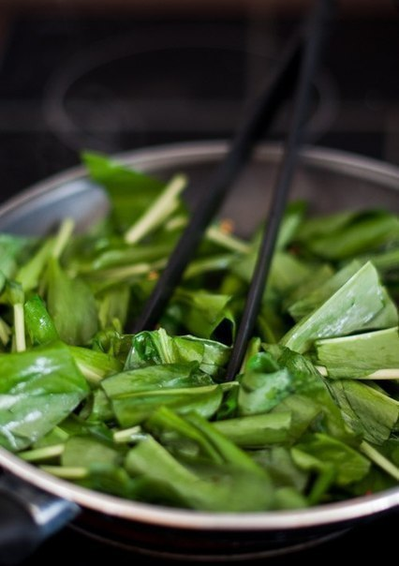
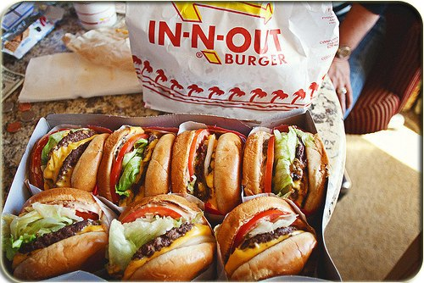
For a breakfast and a lunch with cooking of especially don't trouble. Sandwich - the most popular version of a house lunch. Still it can be salad. They drink Coca-cola or Ice-tea

Slide 4
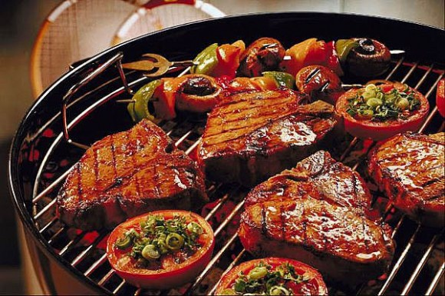
For a supper to prepare a barbecue from beef on a grill, chicken meat or pork with sauces and spice

Slide 5
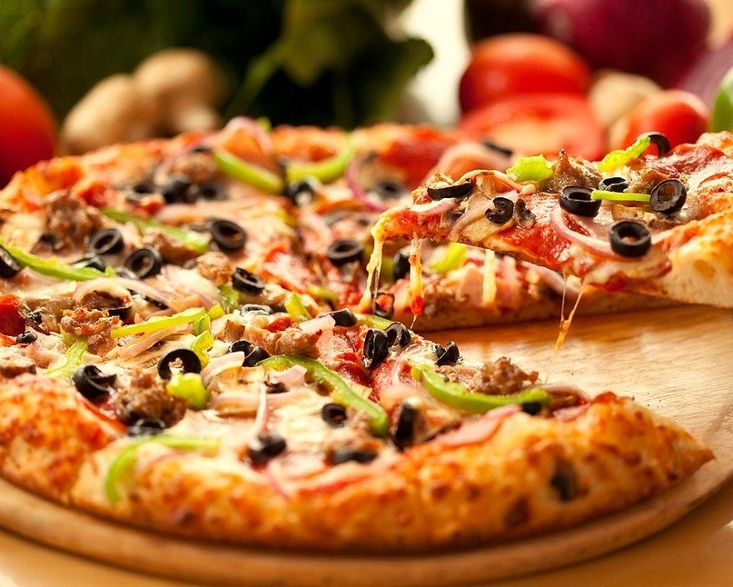
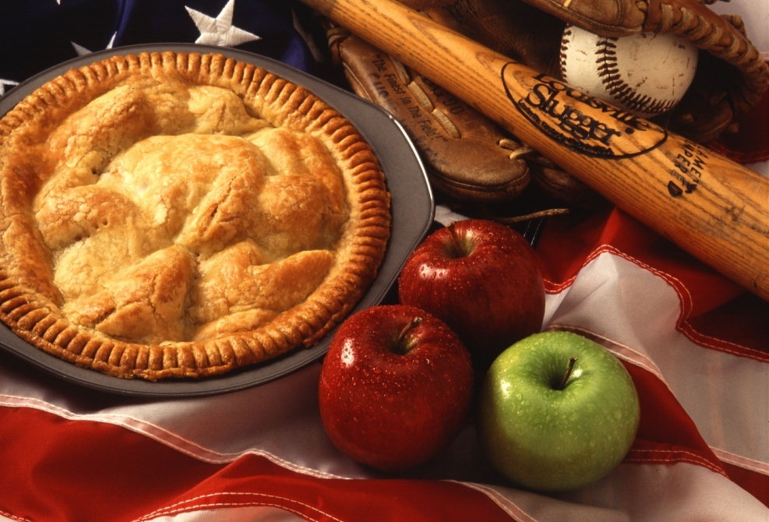
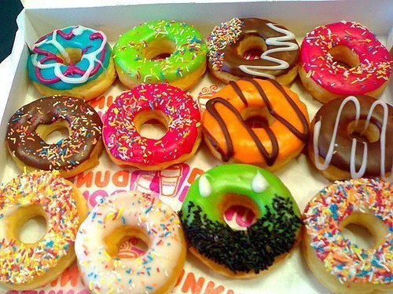
Americans very love apple-pies, donuts and fast-food. Because some American people is fat.

