Slide 1
Dance as the lifestyle

Slide 2
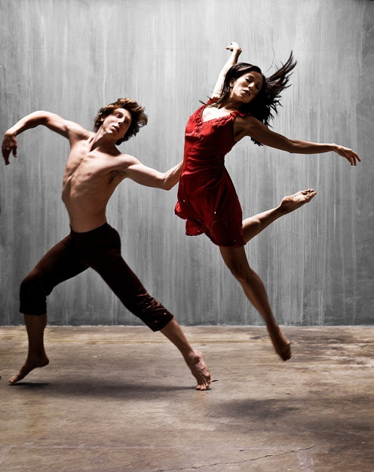
Introduction
Dance is a type of art that generally involves movement of the body, often rhythmic and to music. It is performed in many cultures as a form of emotional expression, social interaction, or exercise, in a spiritual or performance setting, and is sometimes used to express ideas or tell a story.

Slide 3
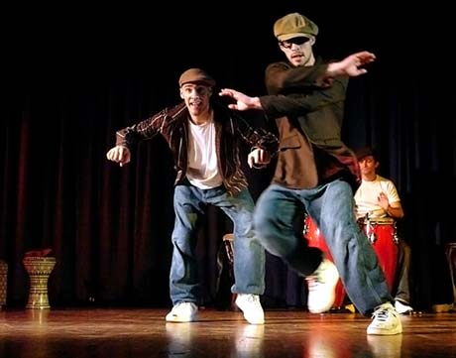
Dance may also be regarded as a form of nonverbal communication between humans or other animals, as in bee dances and behavior patterns such as a mating dances.

Slide 4
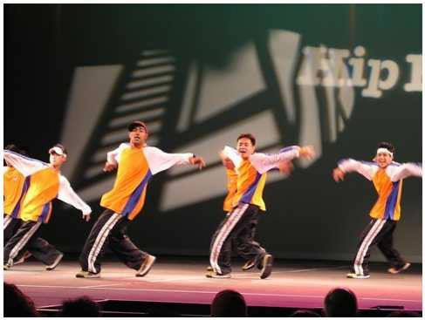
There are many styles and genres of dance. African dance is interpretative. Ballet, ballroom and tango are classical dance styles. Square dance and electric slide are forms of step dance, and breakdancing is a type of street dance. Dance can be participatory, social, or performed for an audience.

Slide 5
A dance can also be ceremonial, competitive or erotic. Dance movements may be without significance in themselves, as in ballet or European folk dance, or have a gestural vocabulary or symbolic meaning as in some Asian dances.

Slide 6
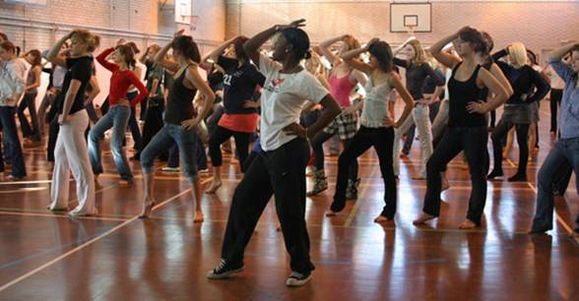
Training before a dance competition

Slide 7
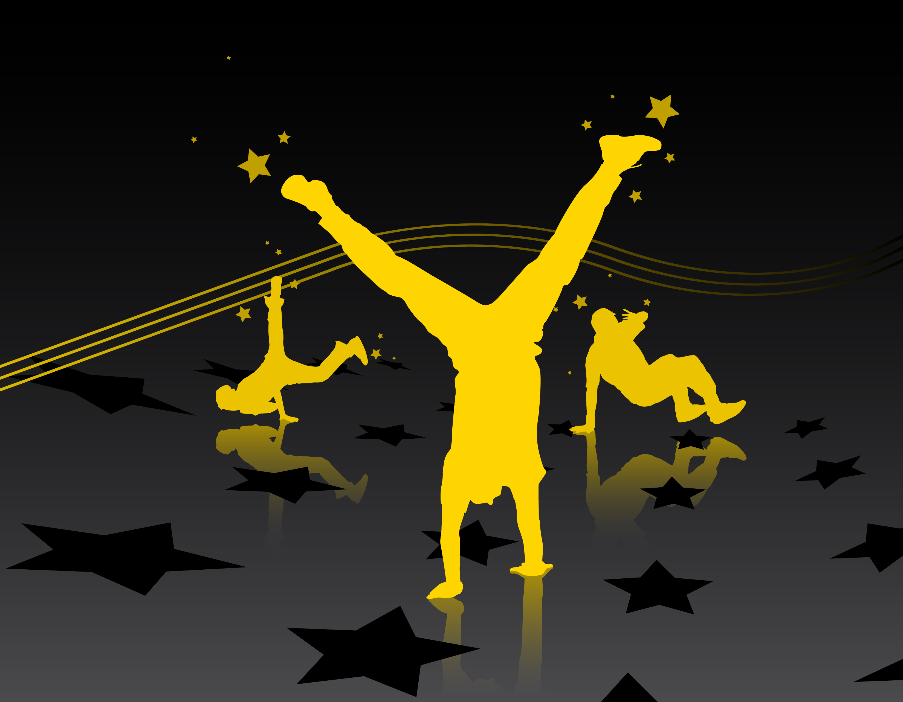
10x 4 wa7ch1n!

