Slide 1
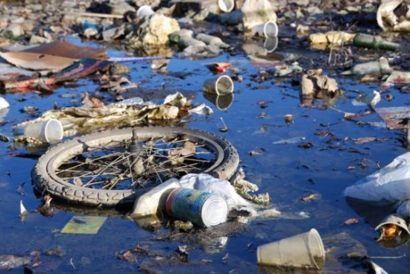
Water problem

Slide 2
Water pollution
Of course water is very important for our society, and if we start saving it.
Water pollution caused industrial waste products released into lakes, rivers and other water bodies, has made marine life no longer hospitable.
Humans pollute water with large scale disposal of garbage ,flowers, ashes and other household waste.
Acid rain further adds to water pollution in the water.

Slide 3
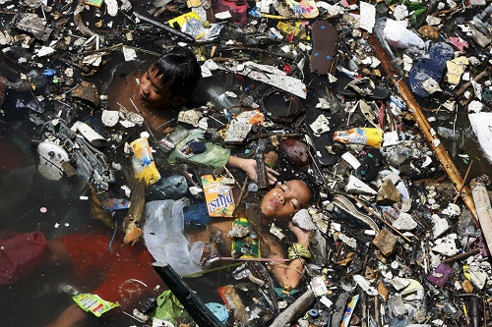
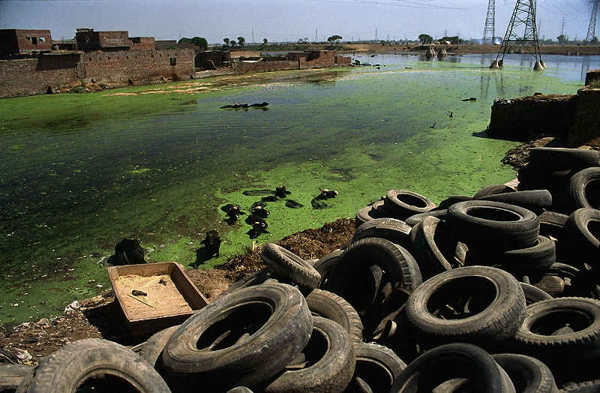
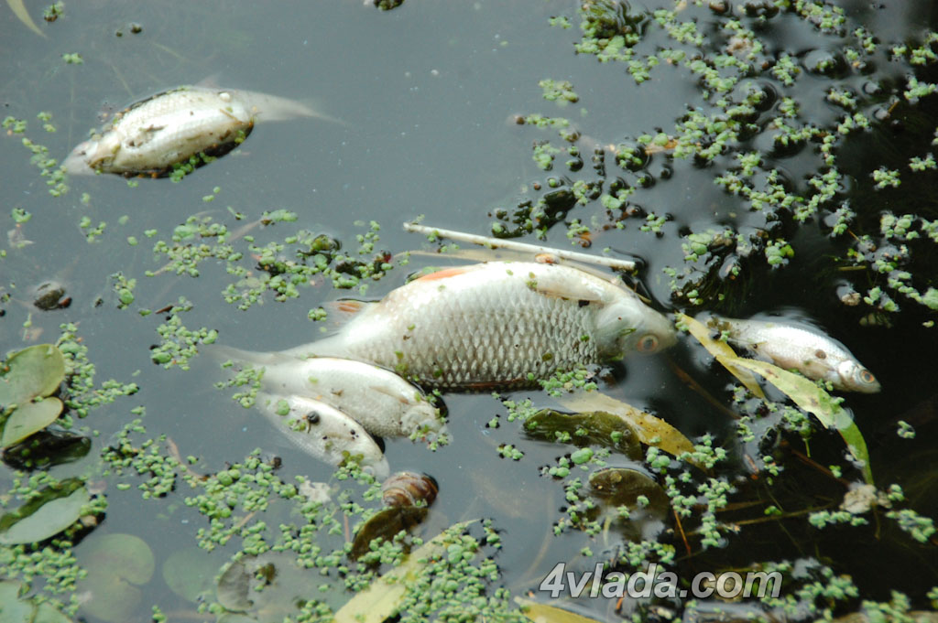

Slide 4
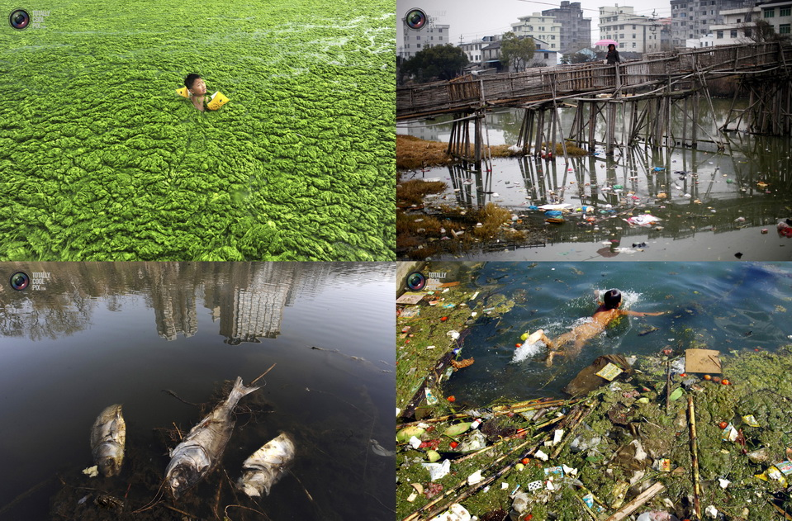

Slide 5
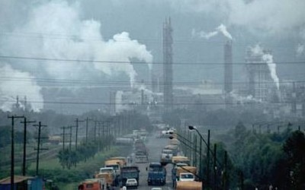
Air problem

Slide 6
Air pollution
Air pollution is by far the most harmful form of pollution in our environment.
Air pollution is cause by the injurious smoke emitted by cars, buses, trains and factories, namely sulphur dioxide, carbone monoxide and nitrogen oxides.
Every smoke from burning leaves and cigarettes are harmful to the environment causing a lot of damage to man and the atmosphere.
Even the most natural phenomenon of migratory birds has been hampered ,with severe air pollution preventing them from reaching their seasonal metropolitan destinations of centuries.
Evidence of increasing air pollution is seen in lung cancer, asthma ,allergies and various breathing problems along with severe and irreparable damage to flora and fauna.

Slide 7
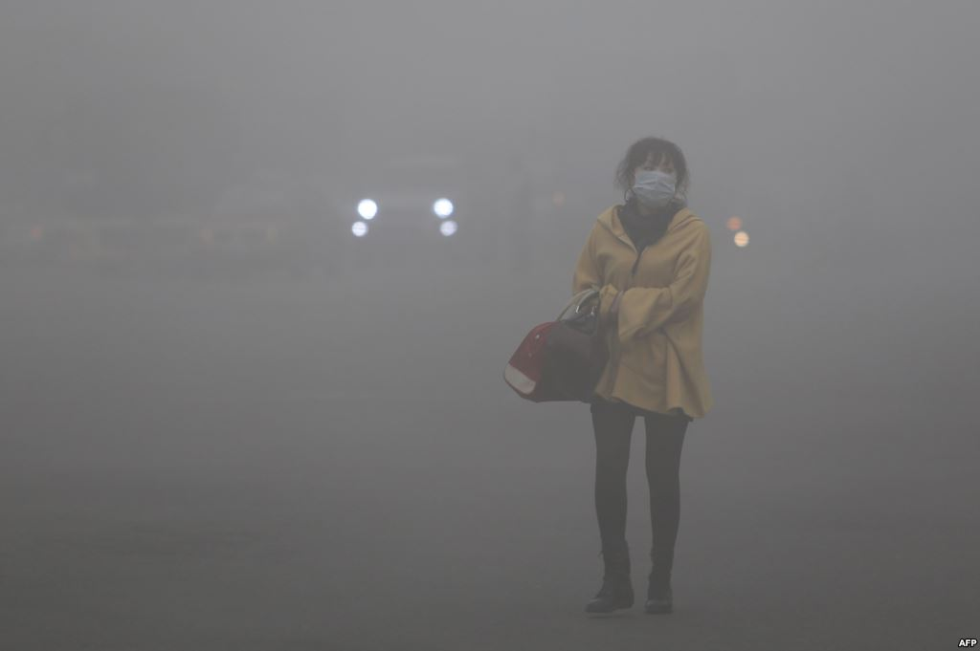
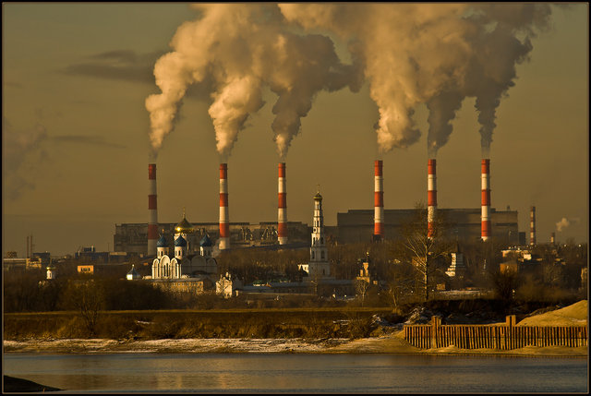
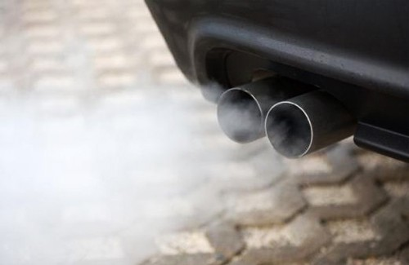

Slide 8
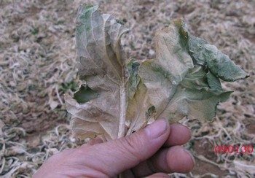
Soil problem

Slide 9
Soil pollution
Soil pollution ,which can also be called soil contamination is a result of acid rain ,polluted water ,fertilizers etc., which leads to bad crops.
These may include hydrocarbons, heavy metals, MTBE, herbicides, pesticides and chlorinated hydrocarbons.
Soil contamination occurs when chemicals are released by spill or underground storage tank leakage which releases heavy contaminants into the soil.

Slide 11
There are many ways we can prevent environmental problems. Common and simple ways we can help save our environment are as follows:
Stop using spray products with CFC’s.
Stop burning wastes especially non-biodegradable.
As individuals, the only thing we can help prevent environmental problems is to keep our environment clean.
Plant more and more trees.
Stop Deforestation.
Use Public transport to Travel as it will save money ,fuel and there will be less air pollution.

