Slide 1
Animals Australia

Slide 2
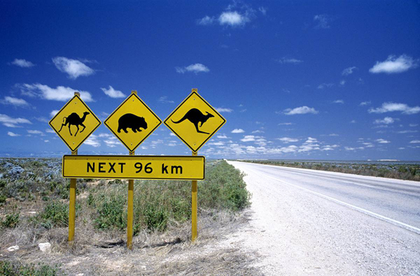
Most Australian marsupial mammals : on his stomach they have a deep fold of skin , which is called bag.

Slide 3
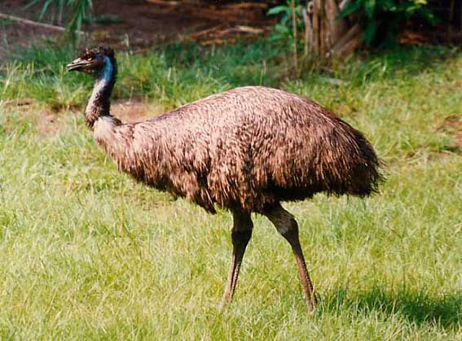
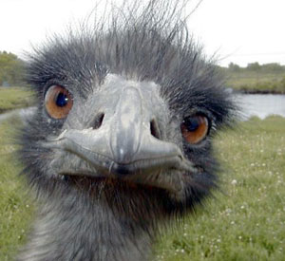
EMU
Bird height of about two meters , the Australian ostrich.

Slide 4
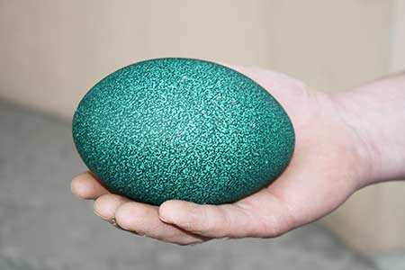
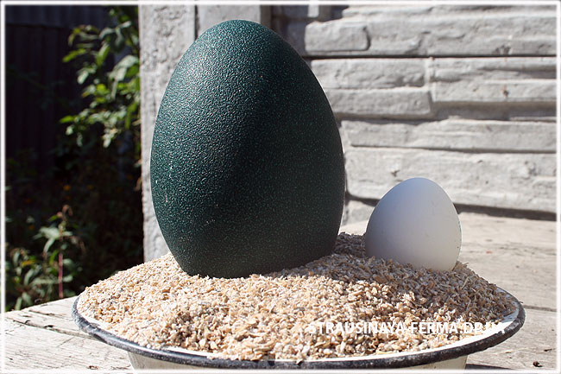
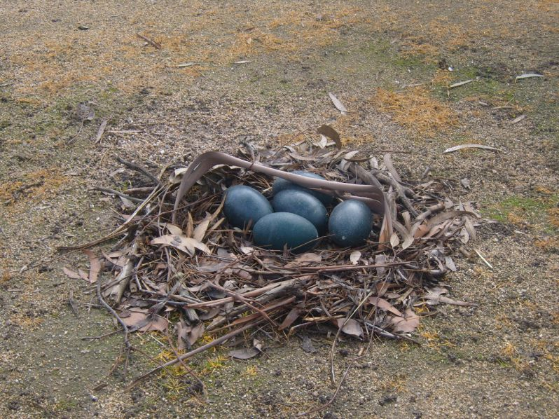
Female emus lay large eggs green.

Slide 5
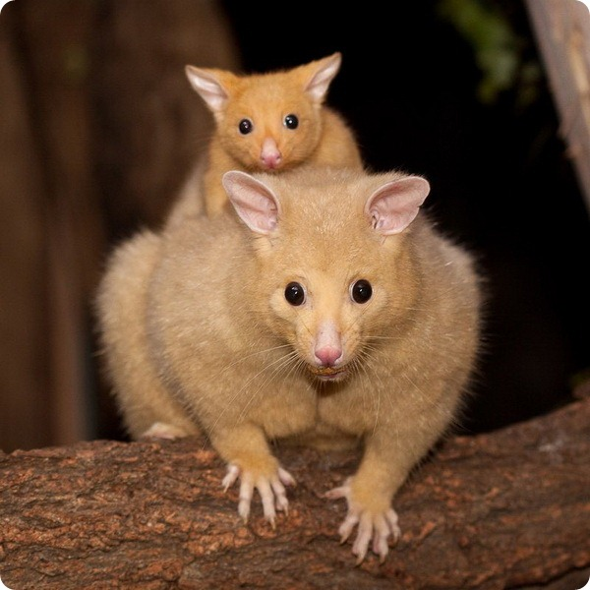
Kuzu
Night too marsupial animal, living mostly in the trees. Eats leaves , flowers and bark.

Slide 6
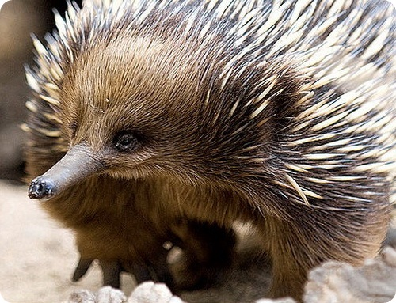
Echidna
The female lays one egg and hatching it in a bag .

Slide 7
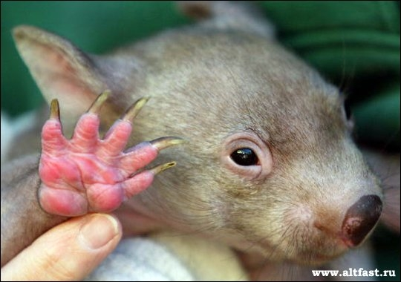
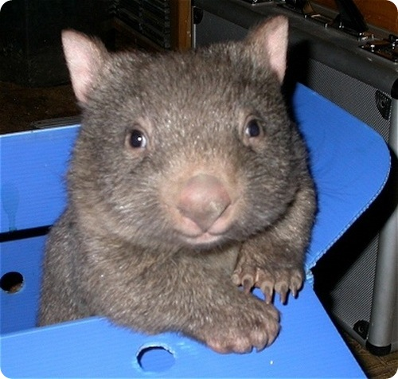
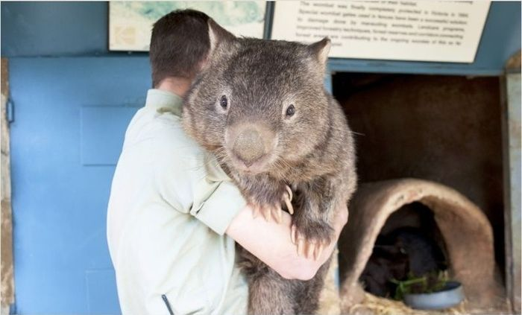
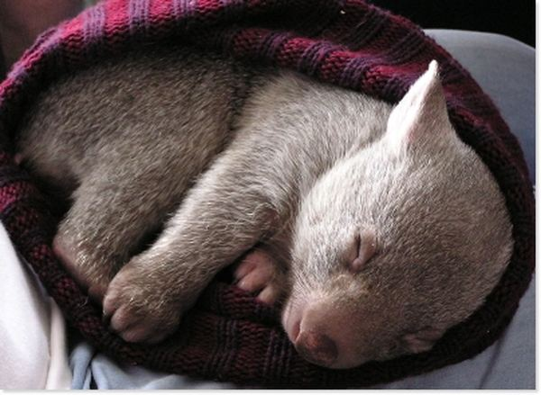
Wombat
Dwells in southern Australia. Digs a deep hole branched . Nourishes the roots, leaves and mushrooms .

Slide 8
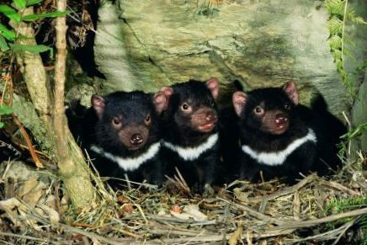
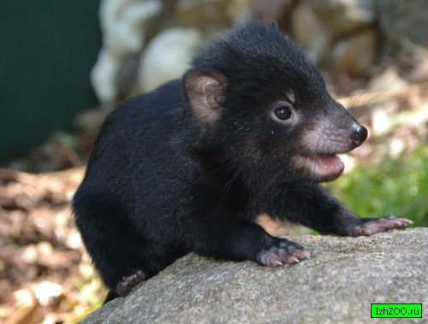
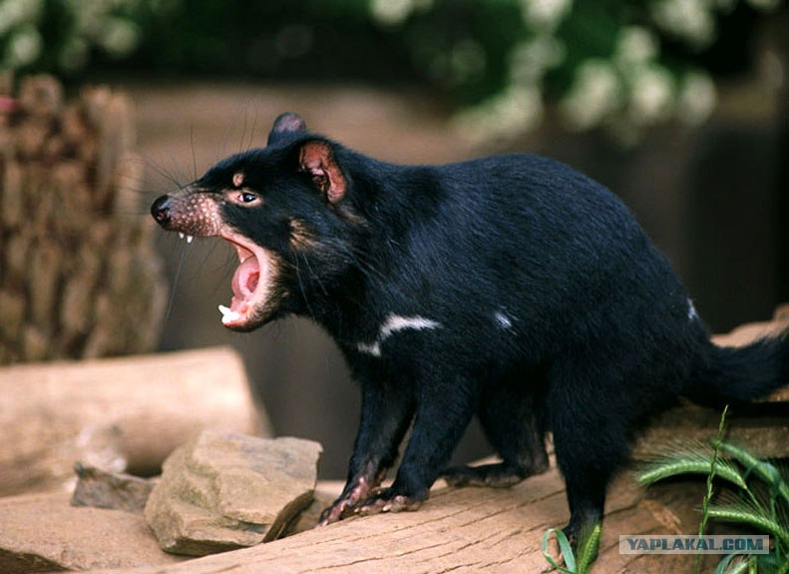
Tasmanian devil
This predator spends the day in the bushes , and the night goes on the hunt .

Slide 9
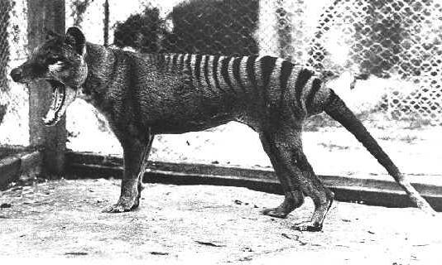
Thylacine or tilatsin
The smallest marsupial is one of the species of the marsupial mouse : it reaches a length of 4.5 cm !

Slide 10
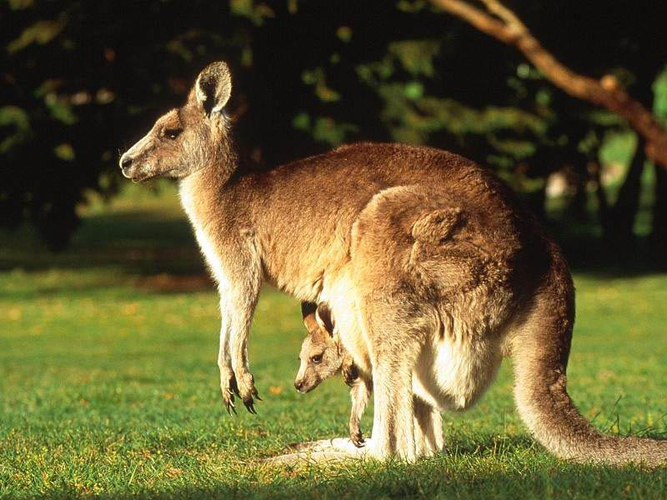
Kangaroo
The appearance of the animal is such that its no one confused . The tail is long and strong.
Before leaving the bag on the mother's belly , baby kangaroo is in it for about eight months
Despite a larger mass - 70 kilograms , they develop high speed.

Slide 11
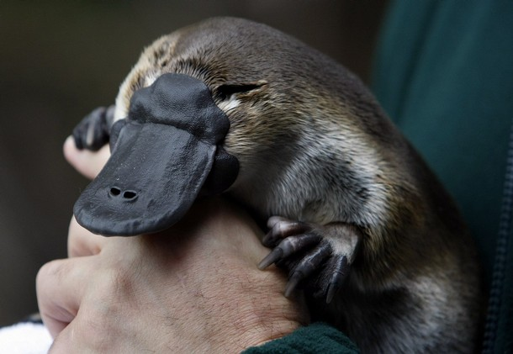
Platypus
The beak of the platypus are broad and flat, looks like a bird . Do platypus has no teeth at all .

Slide 12
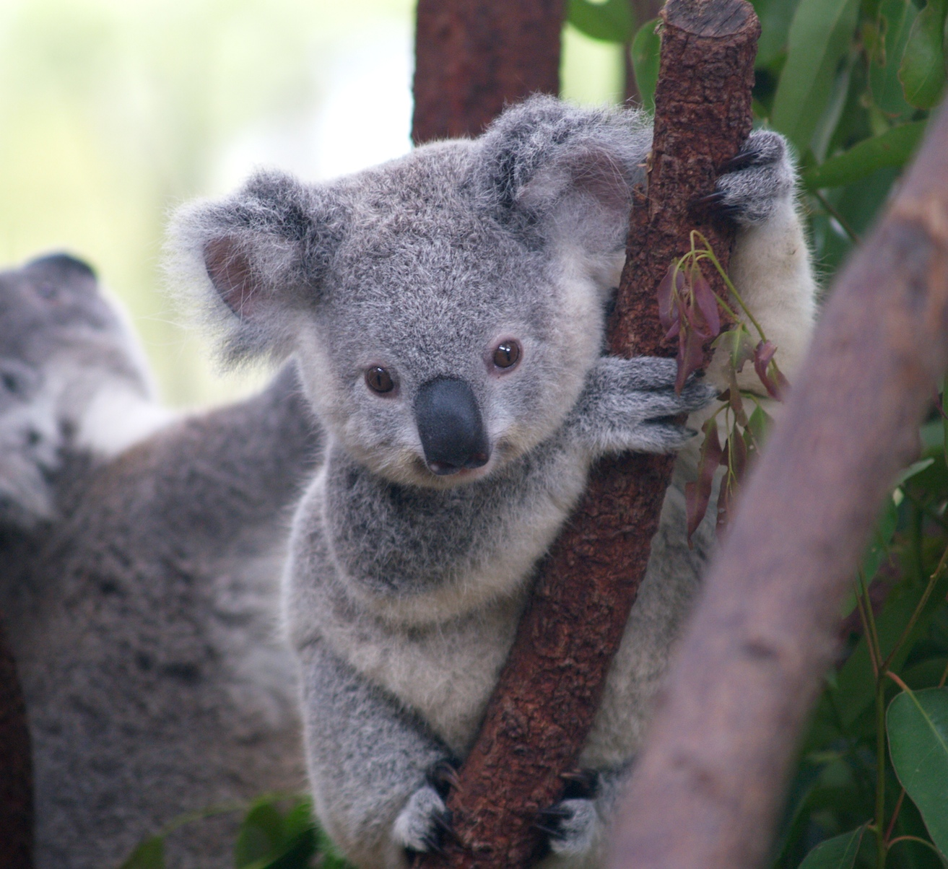
Koala
It looks like a marsupial bear and weighs about 15 pounds.
Every day koala eats about one kilogram of eucalyptus leaves .
Koala on parasites do not start because it smells like eucalyptus fur !

Slide 13
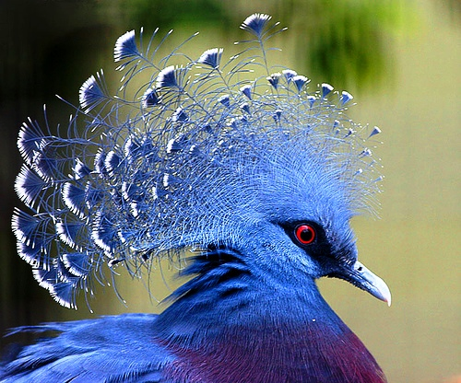
Crowned Pigeon
On her head a crown adorned with feathers , which in the past century have been widely used by people as a decoration.

Slide 14
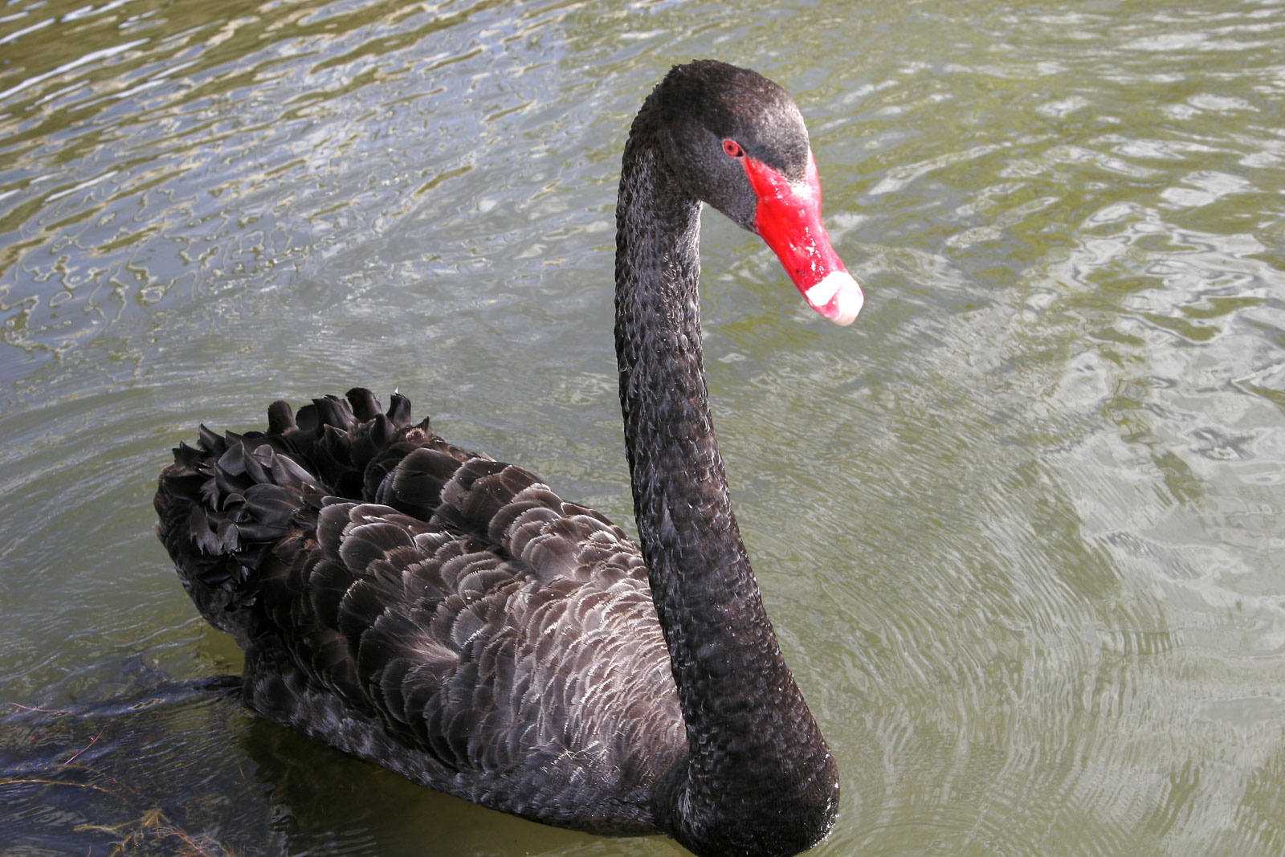
Black Swan
These birds are bred for decorating parks.

Slide 15
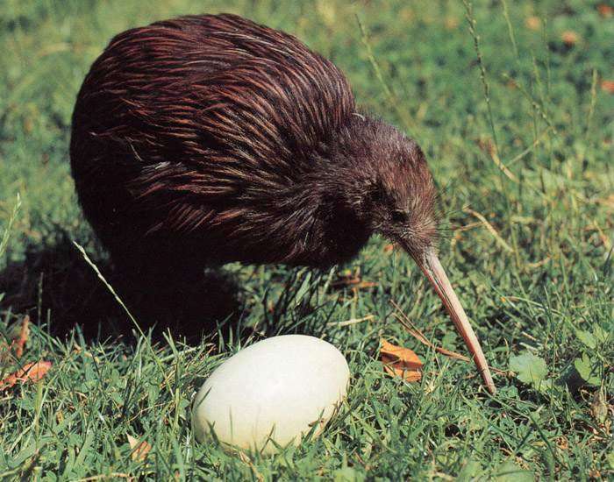
Kiwi
This bird with a very long beak became a symbol of New Zealand. Her wings quite tiny , and it can not fly.

