Slide 1
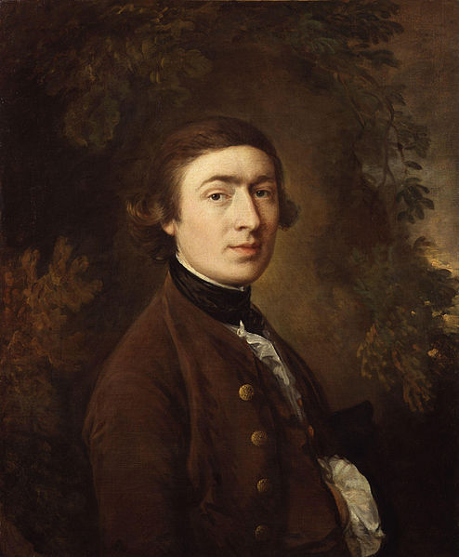
Thomas Gainsborough

Slide 2
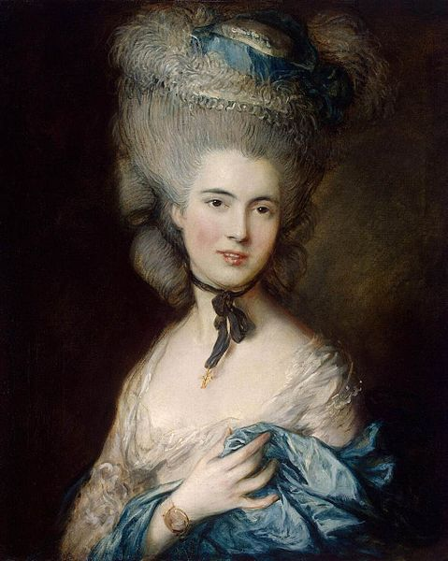
Portrait of a Lady in Blue
The painting is in the collection of Collection of A. Z. Khitrovo, St Petersburg, 1912

Slide 3
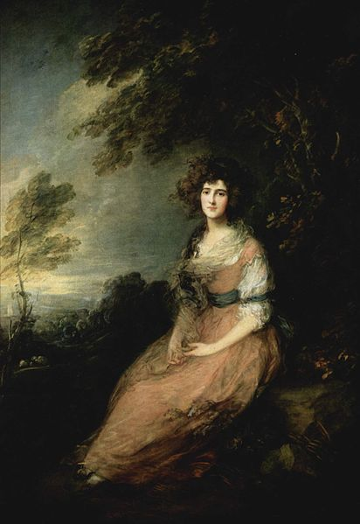
Mrs. Richard Brinsley Sheridan (1785–86)

Slide 4
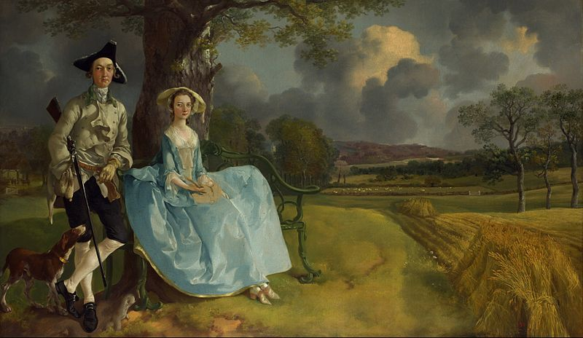
Mr. and Mrs. Robert Andrews, (c. 1748–1750)

Slide 5
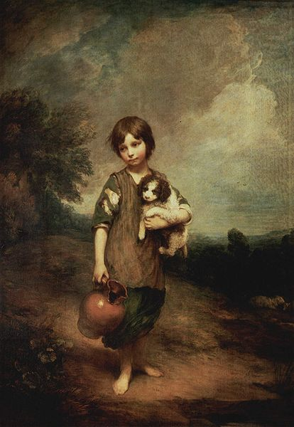
Cottage Girl with Dog and pitcher (1785)

Slide 6
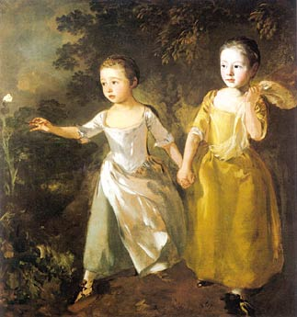
The Painter`s Daughters Chasing a Butterfly, (1756)

Slide 7
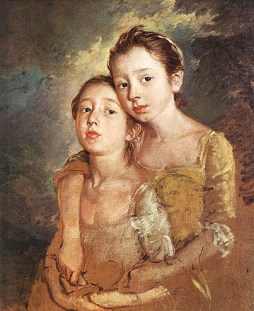
Two Daughters with a Cat (c. 1759)

Slide 8
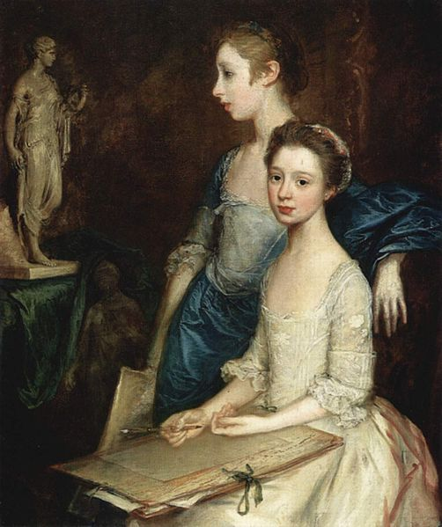
The Artist`s Daughters, Molly and Peggy (1760)

Slide 9
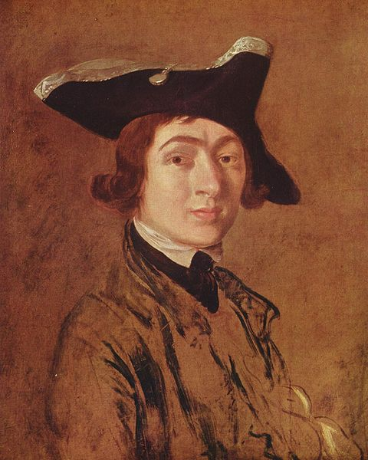
Self-Portrait (1754)

Slide 10
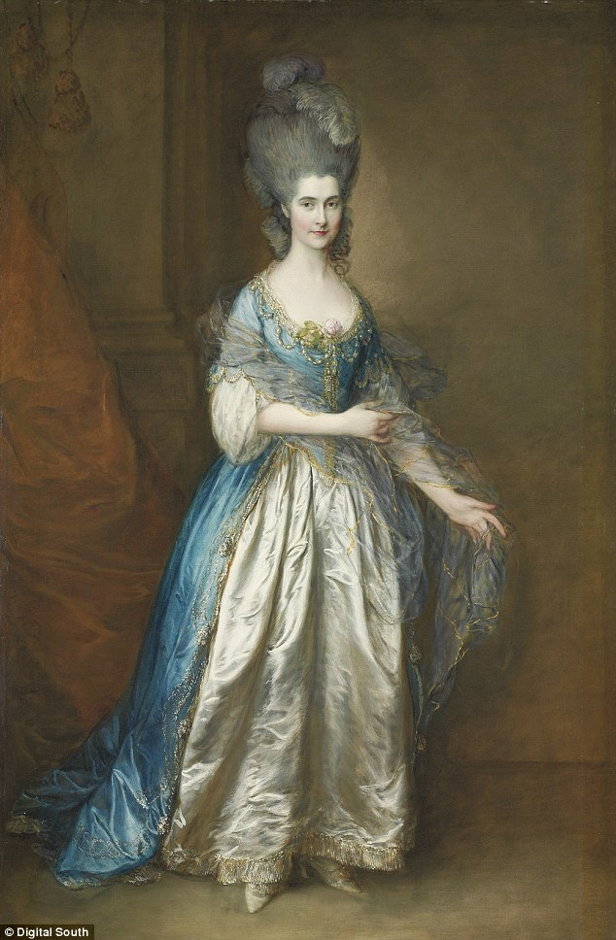
Portrait of Georgiana Cavendish, Duchess of Devonshire (1757-1806)

Slide 11
Thank you for your attention !
By Anastasia Grucik & Ivanna Dmitruk

