Slide 1
Italian Republic
Venice. Pluses and minuses.

Slide 2
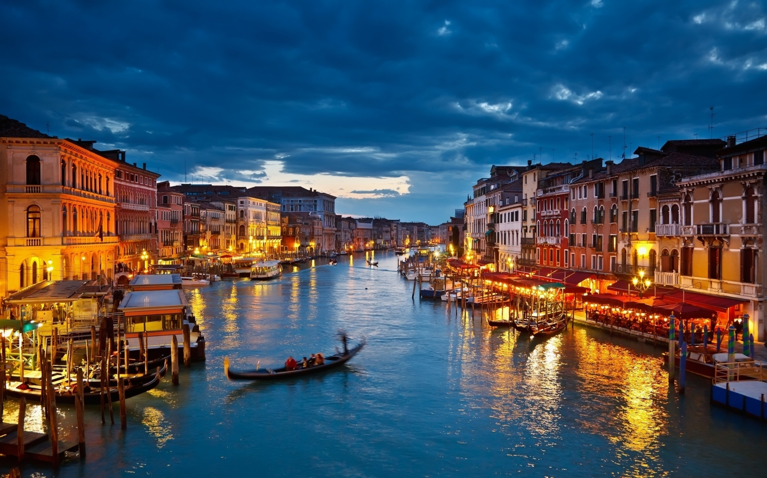

Slide 3
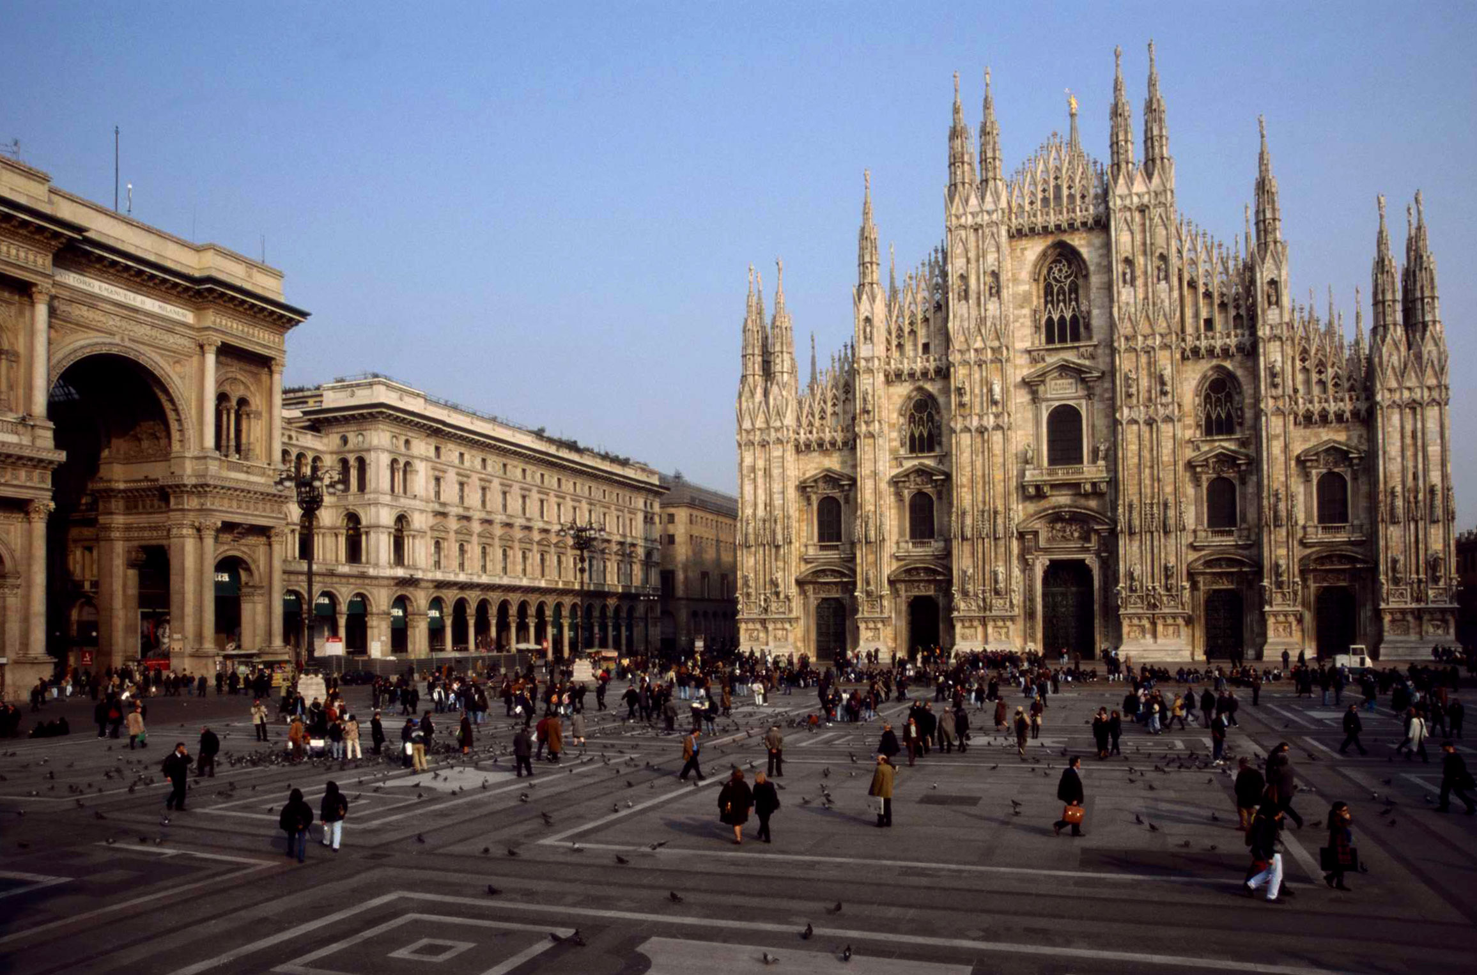
Italy is considered to be a major European power able to exert its influence on a global scale with membership in prominent institutions or groups such as the UN, the EU, the NATO the Union for the Mediterranean, the Latin Union, the Council of Europe. On 1 July 2014, Italy replaced Greece as the seat of the Presidency of the Council of the European Union.

Slide 4
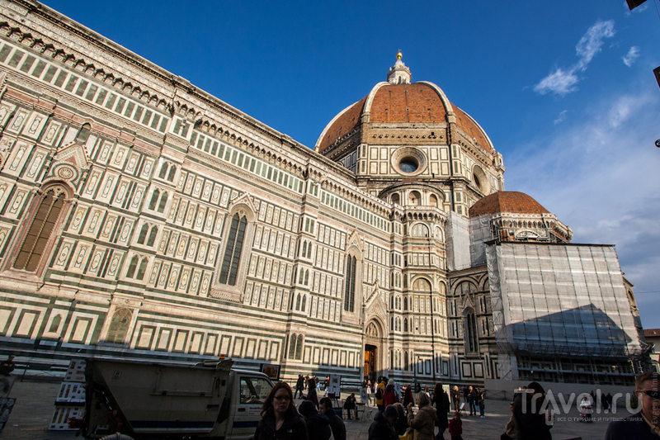
Italy is known for its considerable architectural achievements, such as the construction of arches, domes and similar structures during ancient Rome, the founding of the Renaissance architectural movement in the late-14th to 16th centuries. Architecture is one of the advantages of the city

Slide 5
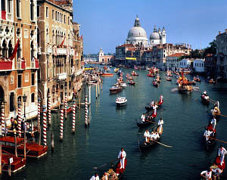
The city is located on 117 small islands in the Venetian lagoon of the Adriatic Sea. There are many channels. Many of stagnant water, so often there stinks. The streets are crowded. This city tourists. Water transport. For me it's all minuses.

Slide 6
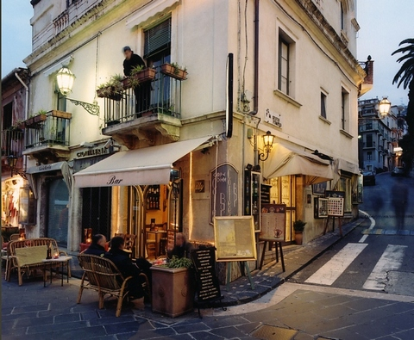
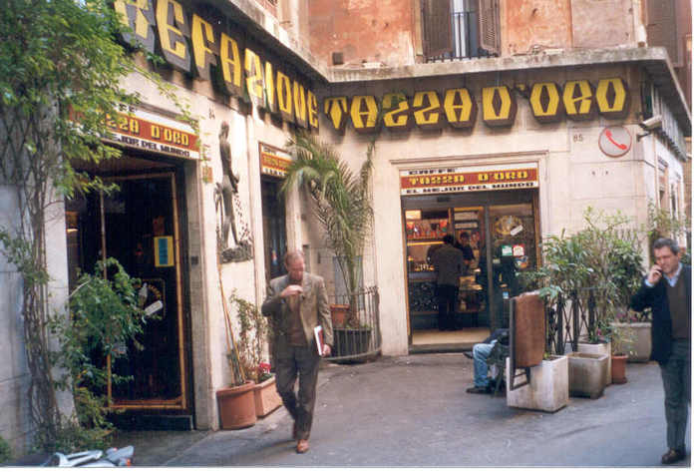
To be a tourist in this place must have a lot of money. expensive hotels, meals and accommodation. It is also minuses

Slide 7
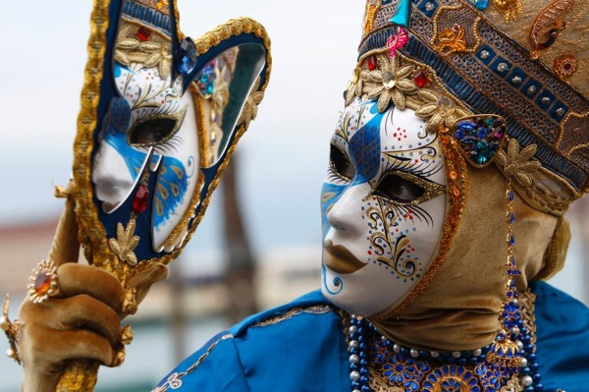
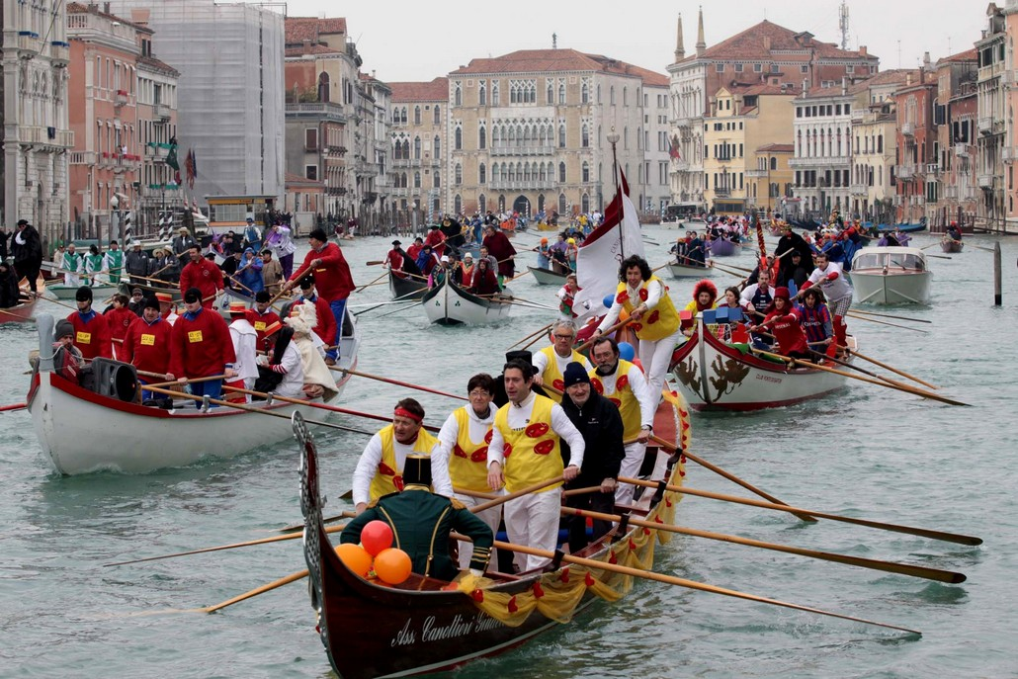
The city draws its action. Are many different holidays. For example Venice Carnival. This is great, nice action, which involves many people and characters.

