Slide 1

Parks and gardens in England
Подготовила Колпакчи Я.

Slide 2
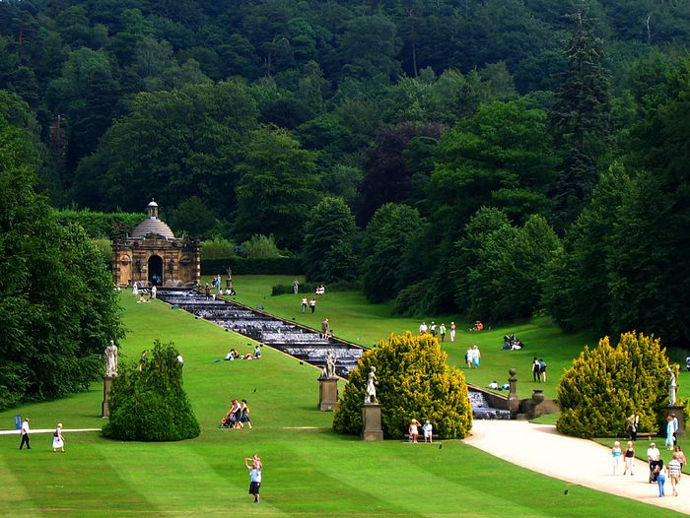
Beauty of nature
Many, very much many people dream about a trip to England. From that there Tauer, bridge, Big-Ben and many other sights, but small part of these people understands only, that also there are beautiful parks, alei, gardens, flowerbeds and simply beautiful plants. But such beauty under a hour is more important than any picture or sculpture! That is why today we will depart in an imaginary round on «natural sights» of England.

Slide 3
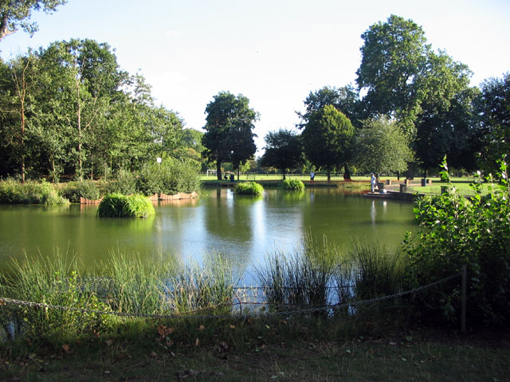
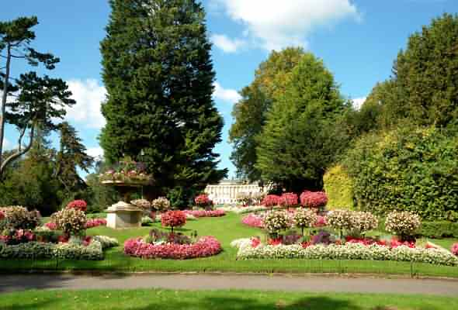
Park of Victoria
The park of Victoria is sometimes named Park of Viki.He is an enormous ground under open-skies, which is located from the east side of London. A park belongs to territory of London small Town of Towers of Gamlet

Slide 4
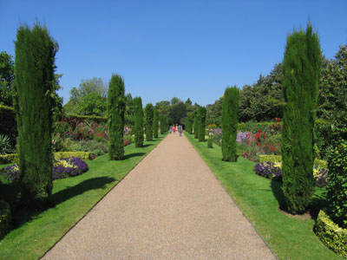
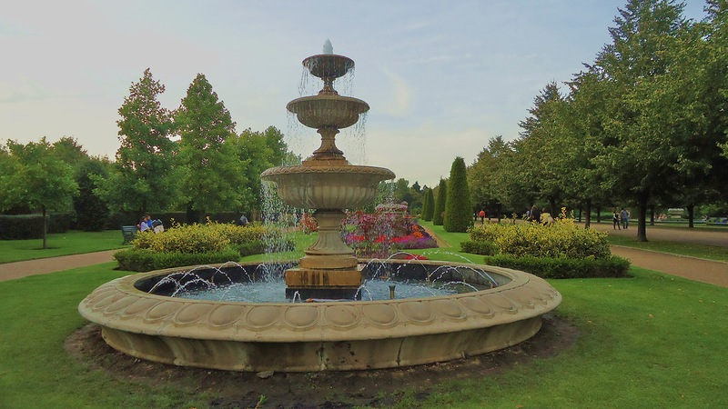
Regent park
Regents Park is a member of the Royal Parks of London. It is located in the north of the city center, partly in Westminster and partly in Camden.

Slide 5
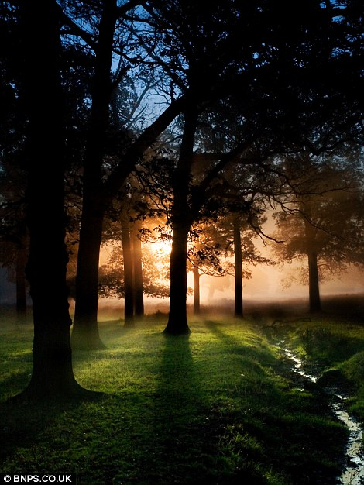
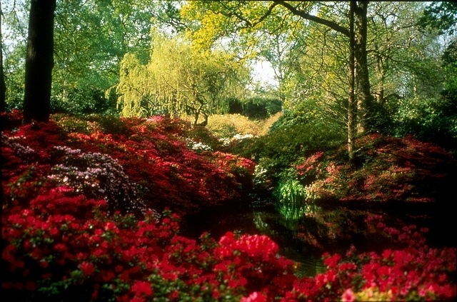
Park Richmond
Territory of Park Richmond is exceeded by 900 hectares and behaves to the city domains of London. The size of this park is exceeded by the area of Central Park of New York almost in three times, he is the greatest English enclosed park and the largest from Royal Parks which are in London.

Slide 6
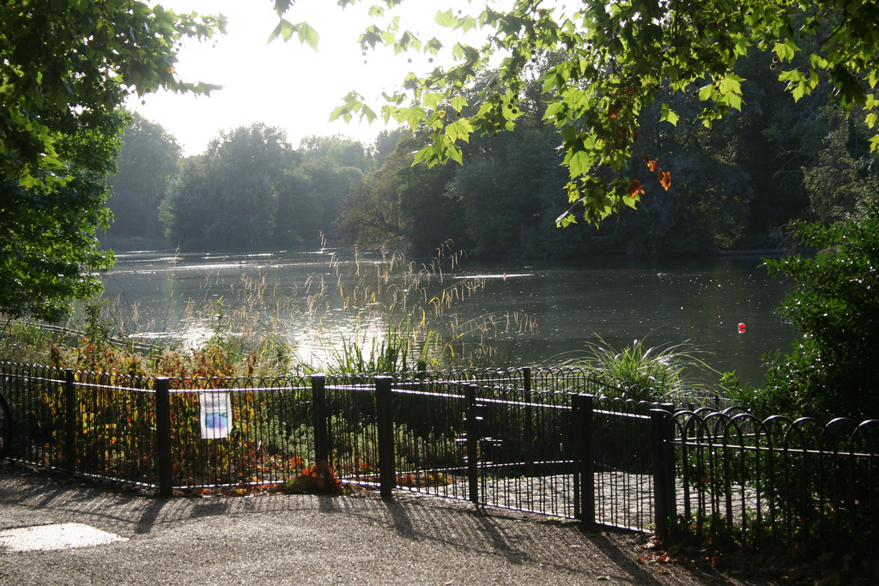
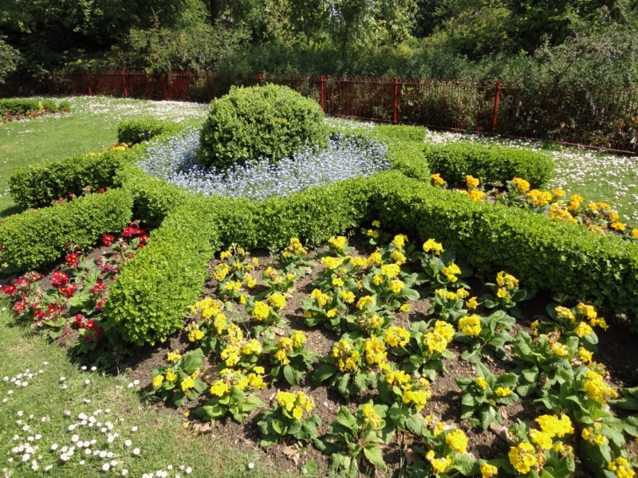
Баттерси Парк
Территория Баттерси Парка составляет около двухсот акров зеленой зоны Баттерси. Этот парк находится на южном берегу Темзы. Его открыли в середине XIX века. Земли парка представляют собой болотистую местность, которая часто привлекает местных жителей.

Slide 7
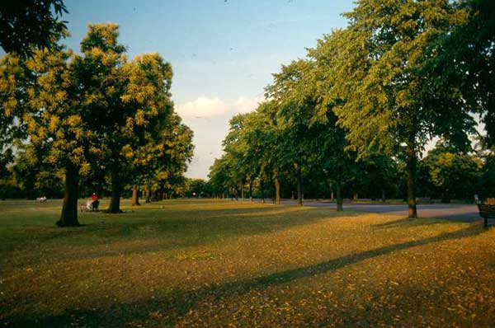
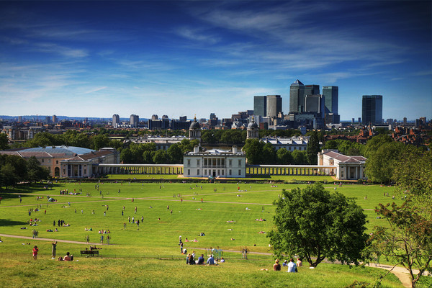
Greenwich-park
A Greenwich-park is a former hunting park in Greenwich. Now he is included in the list of the greatest green belts which are located on the southeast of London. Greenwich park - it one of Royal Parks of city. He was enclosed as early as 1433. A Greenwich-park is included in the complement of World Legacy of Greenwich. Visiting here, it is possible to see chic kinds on Thames, Island of Dogs and central part of London.

Slide 8
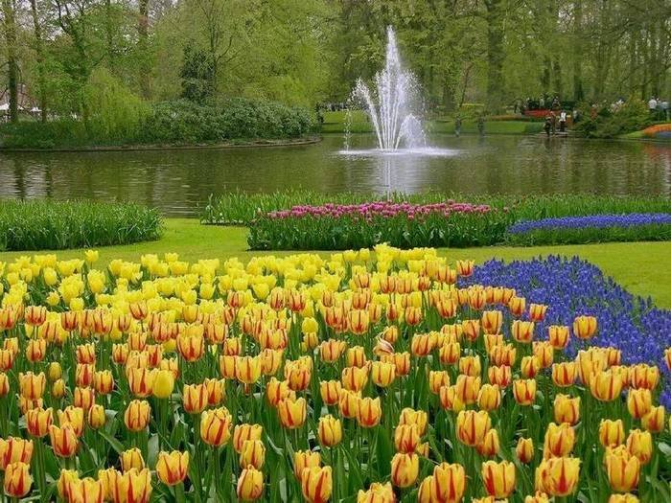
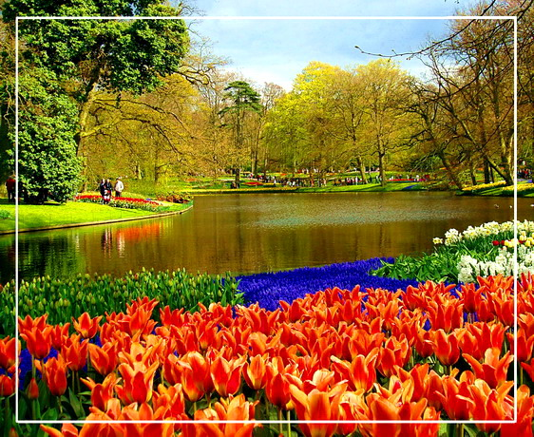
Holland Park
Holland Park is not simply a park, but also the area which lies to the west of central London. Holland Park is a popular romantic spot in London, because it is filled with beautiful vegetation and secluded corners.

Slide 9
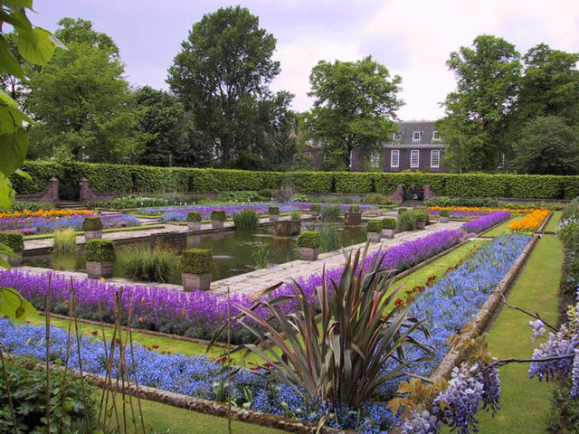
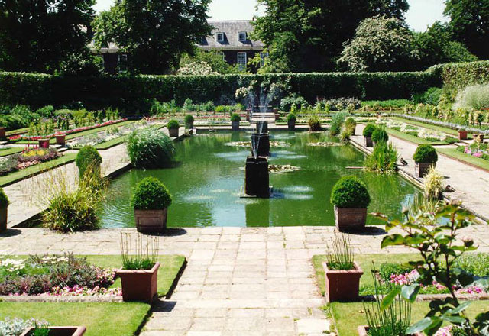
Kensington Gardens
The gardens of Kensingtona before entered in the complement of private gardens of Palace Kensingtona. Now they are one of Royal Parks of London which is to the west of Hyde Park.

Slide 10
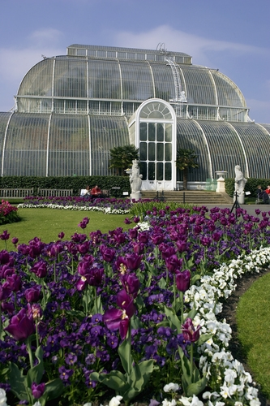
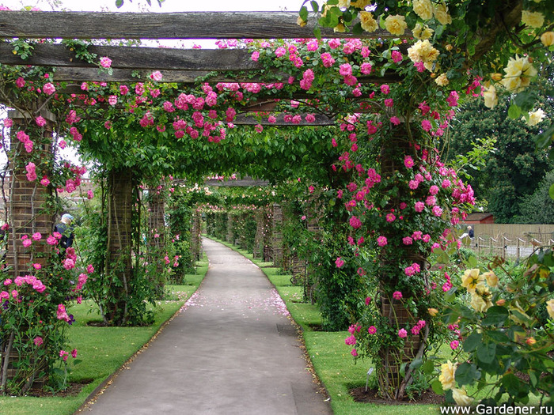
Royal Botanic Gardens in Kew
Are long gardens and greenhouses, which are located near Richmond in south-west London. Now the director is Professor Stephen D. Hopper, who replaced Professor Sir Peter Crane.

Slide 11
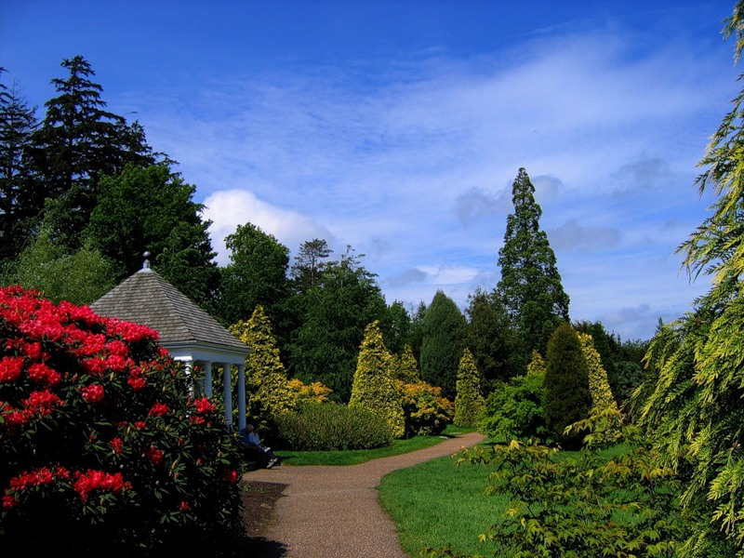
Is not it nature very beautiful? So in England am not only «famous» misty Albion but also wonderful parks and gardens!!!!

