Slide 1
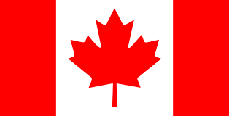
Canada

Slide 2
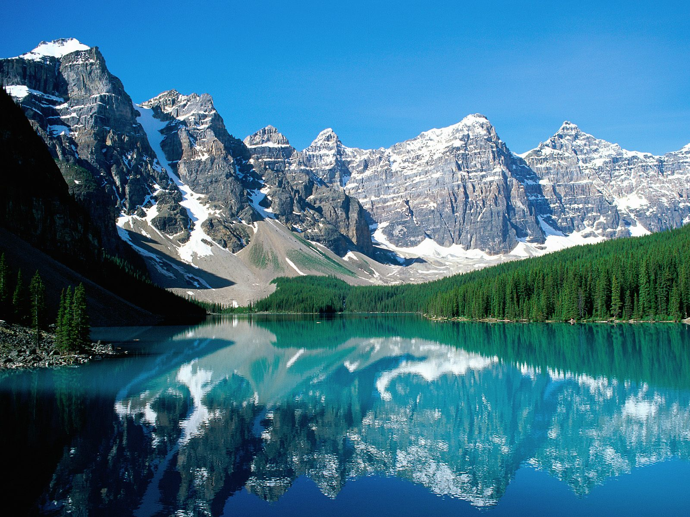
Geographical position
Canada is the second largest country in the world. Only Russia has a greater land area. Canada is situated in North America. Canada is a federation of 10 provinces and 2 territories.

Slide 3
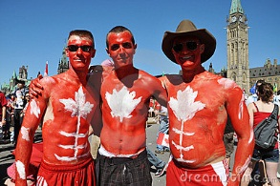
The population
About 28 million of people live in Canada. Canada's people are varied. About 57% of all Canadians have some English ancestry and about 32% have some French ancestry. Native people – American Indians and Eskimos. 77% of Canada's people live in cites or towns. English and French are official language of the Canada.

Slide 4
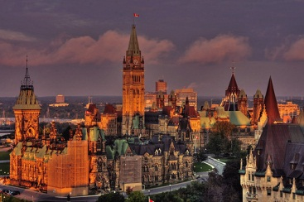
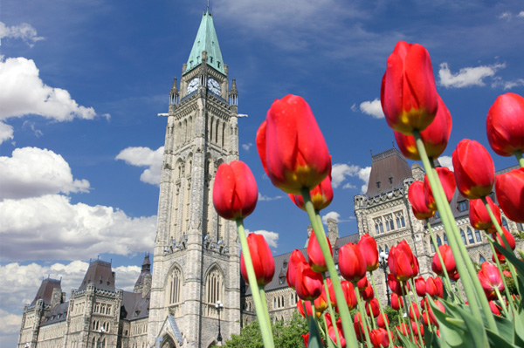
Ottawa is the capital of Canada One third of its people are French-speaking. Ottawa is located on the banks of the Ottawa river. Ottawa also has a high standard of living.

Slide 5
Australia

Slide 6
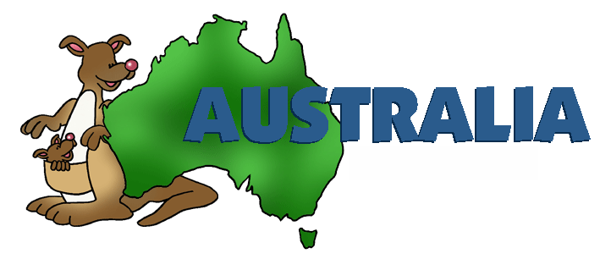
Geographical position
Australia is the only country in the world that is also a continent. Australia lies between the South Pacific Ocean and Indian. It is the earthʼs biggest island and the sixth-largest country in the world in land area. Australia is a constitutional monarchy like Great Britain.

Slide 7
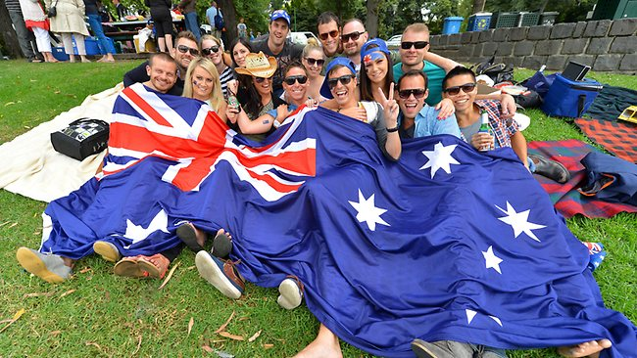
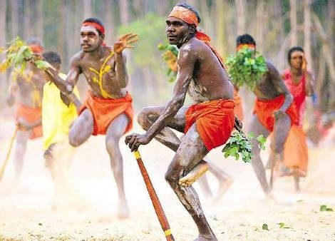
About 21 million people live in Australia. Australian‘s population includes Aboriginal and Torres Strait Islander peoples and migrants from some 200 countries.

Slide 8
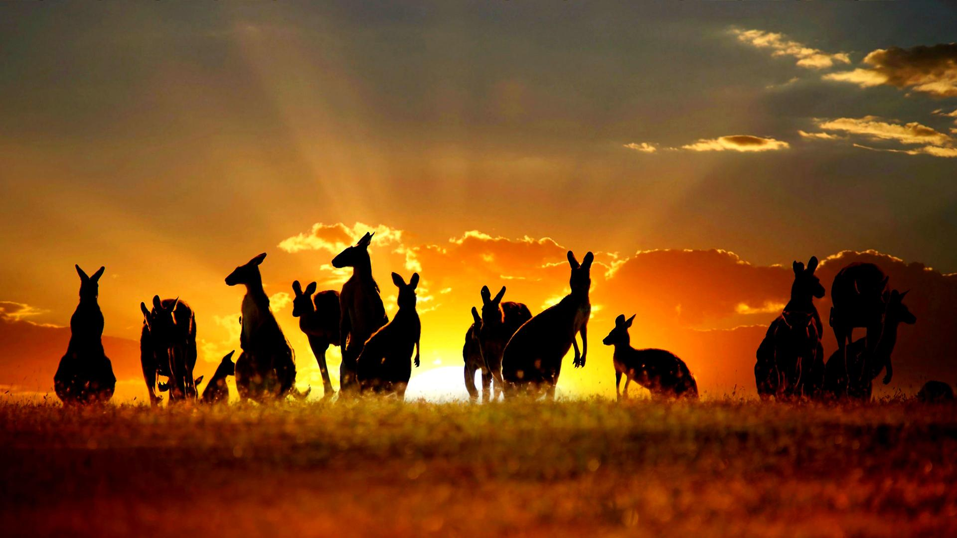
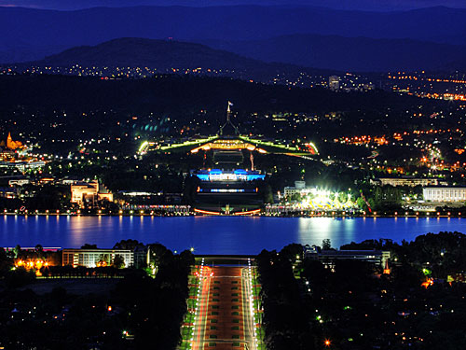
The capital of the country is Canberra.
Sidney and Canberra are the largest city.

Slide 9
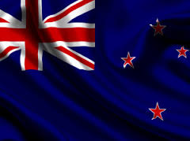

Slide 10
New Zealand is an island country in the Southwest Pacific Ocean. The country is consist of two main islands— the North Island and South Island. Located near the centre of the water hemisphere. New Zealand is a constitutional monarchy

Slide 11
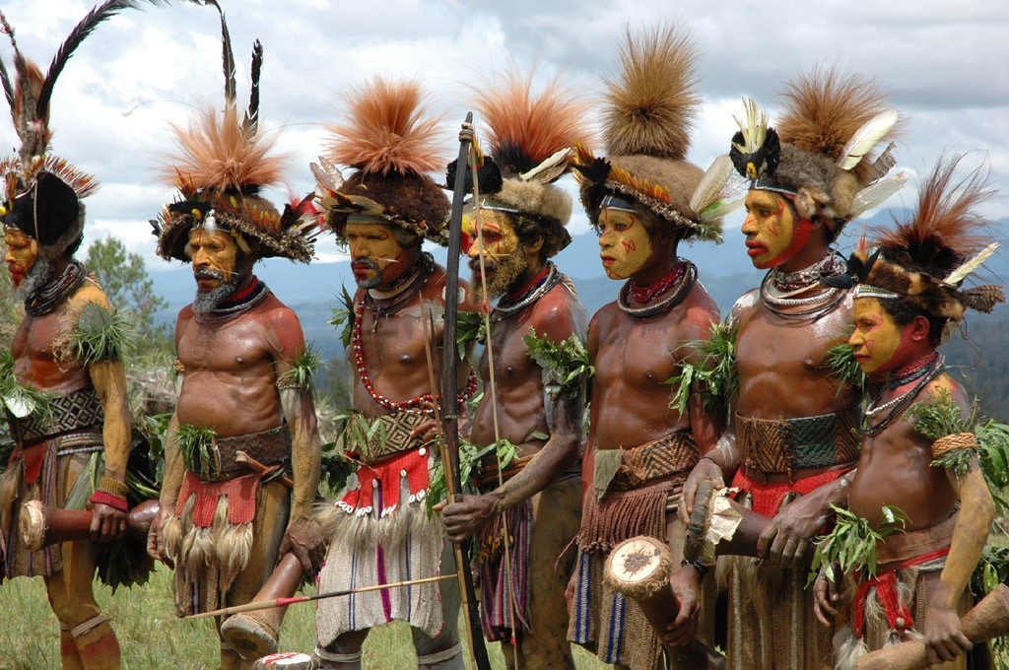
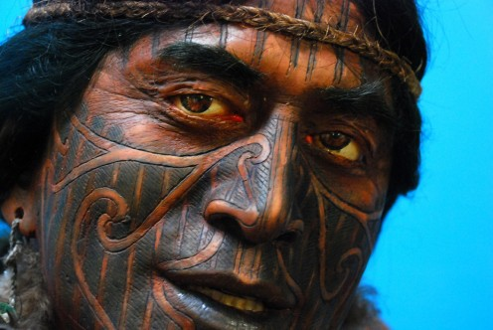
About 4,5 million people live in New Zealand. The first people who settled in New Zealand were a brown-skinned people called Maoris. English and Maori Language are the official languages of the country.

Slide 12
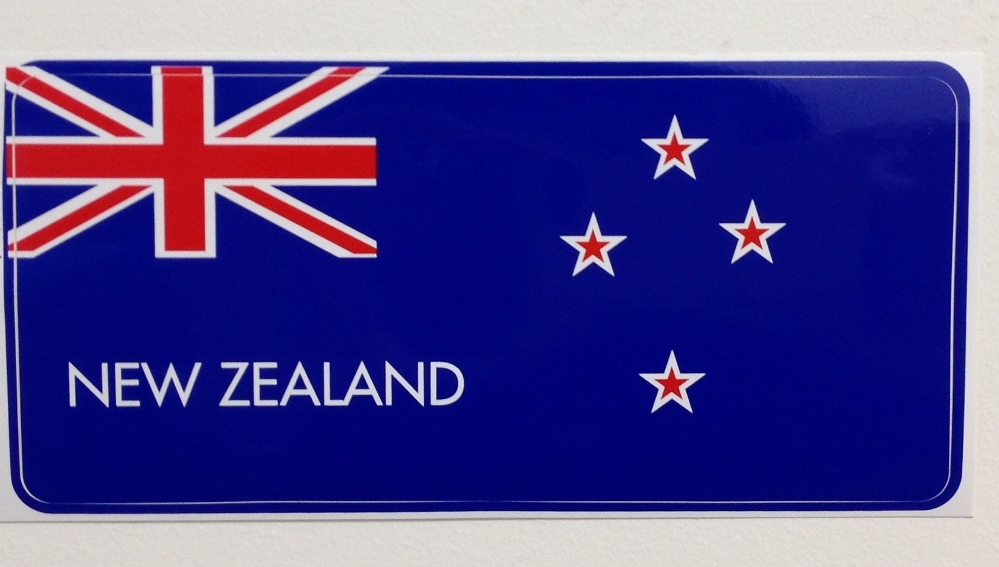
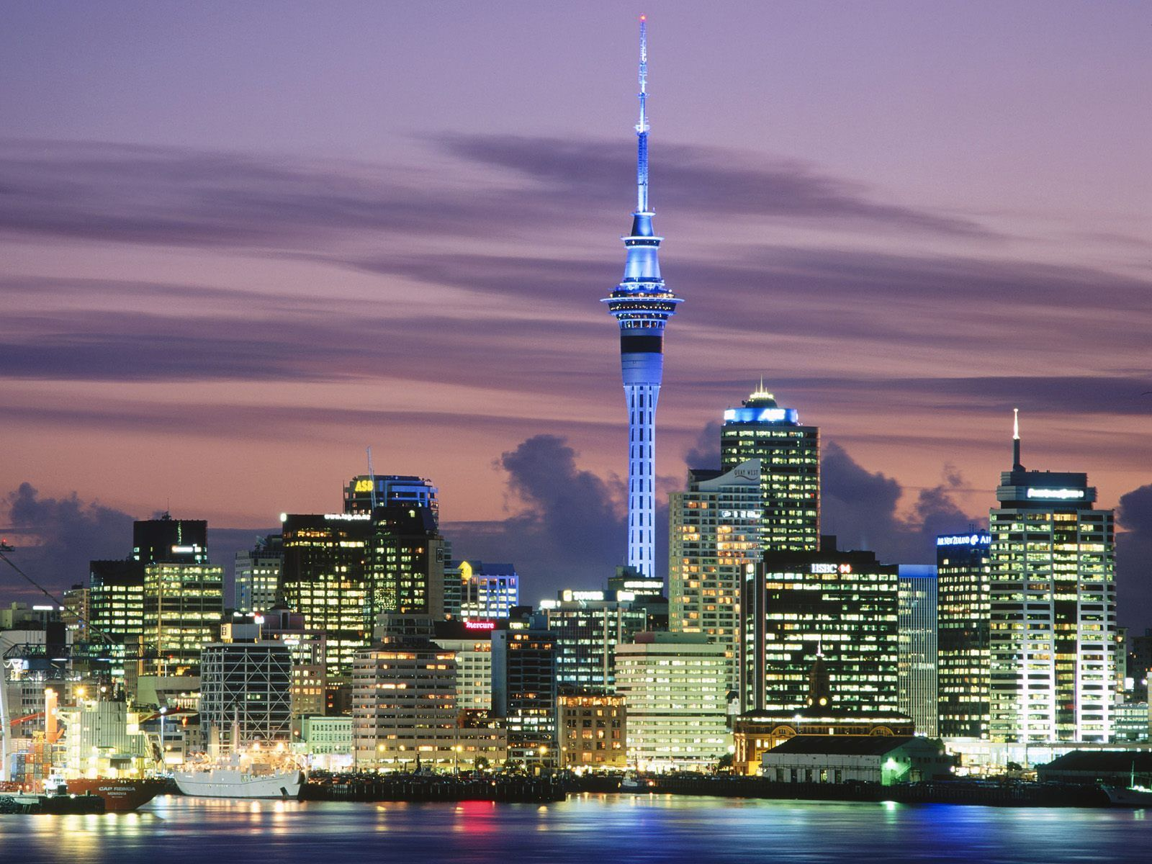
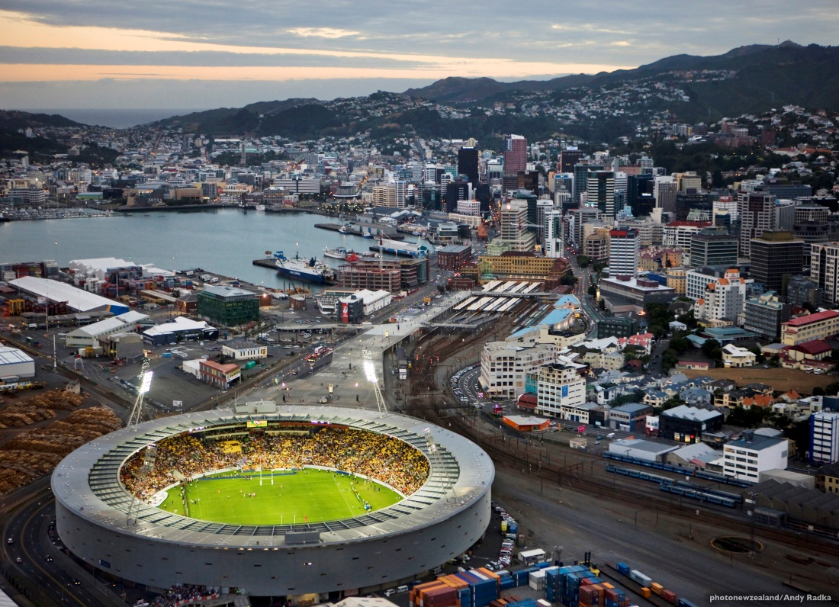
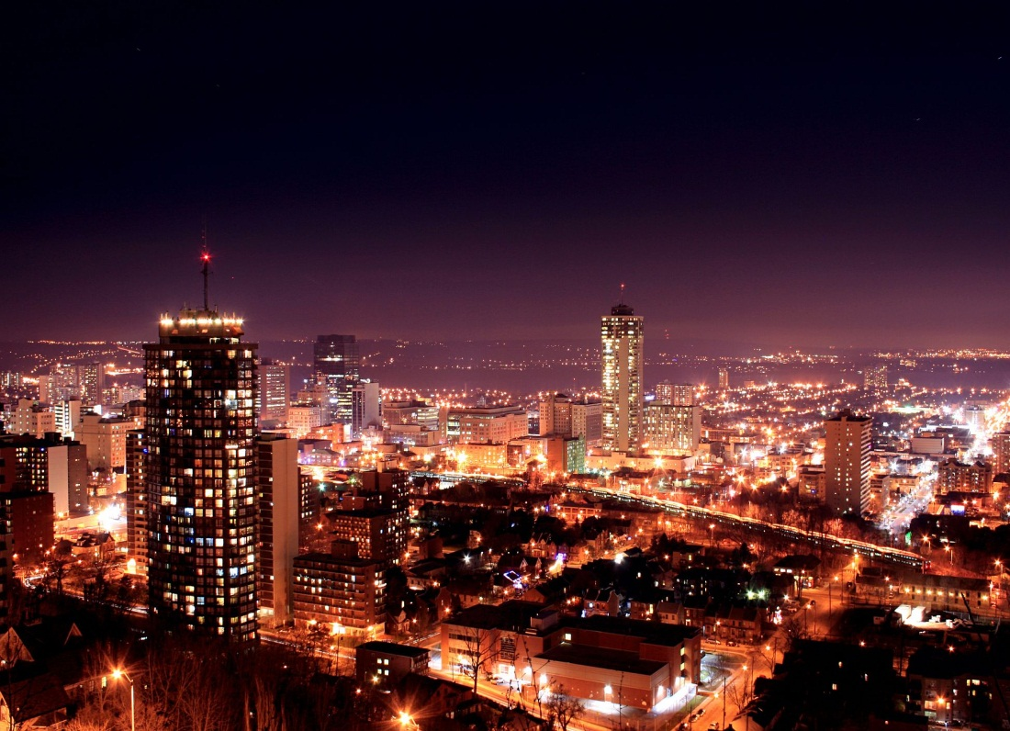
The capital of the country is Wellington.
The largest cities of New Zealand:
Hamilton,
Wellington,
Auckland

Slide 13
Thank you for attention!
Tyshchenko Mykola prepared

