Slide 1
По правилам тут должно быть название учреждения, в котором ты обучаешься 20м шрифтом
Ernest Miller Hemingway
Тут должно быть че-то написано про то что это вообще за работа но че я не втыкаю сам разберись
“The Old Man and the Sea”
Student : жук
Teacher : учитель жука
Kharkiv, 2013.

Slide 2
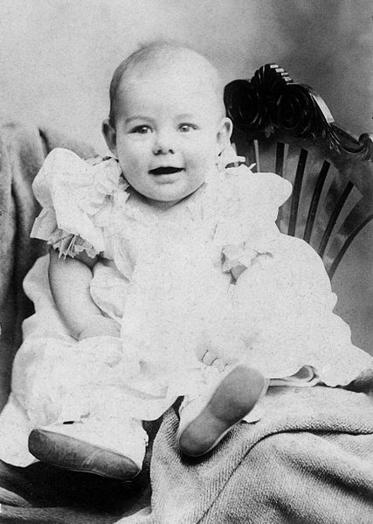
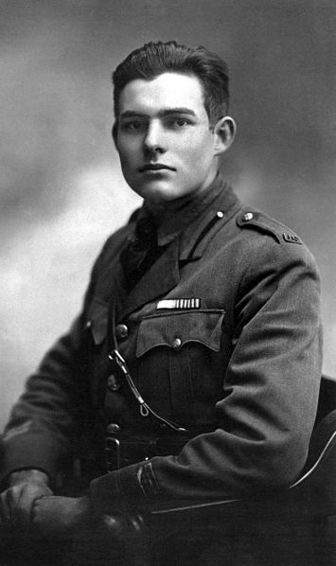
Youth
He was born on 21 June, 1899, in Oak Park. He began to write in a newspaper at the age of seventeen. His military career started with the beginning of the World War I, when he joined a volunteer ambulance unit in the Italian army.

Slide 3
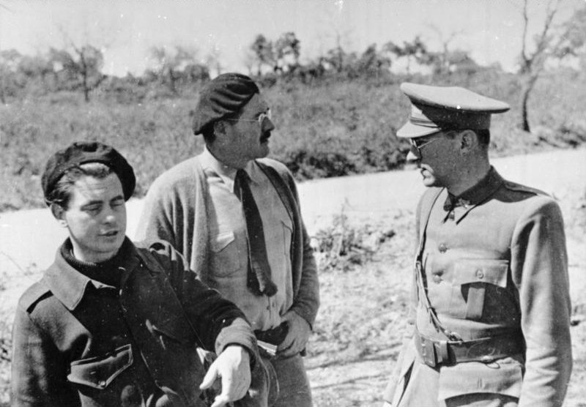
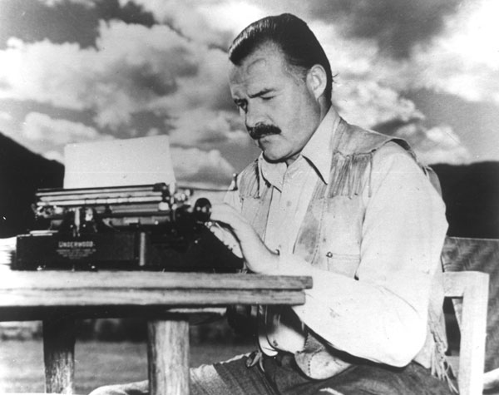
Заголовок
Ernest Hemingway went to Cuba with counter-intelligence mission against Nazi spies in 1941. In 1949 he moved to the island. There he started to write the first pages of his new creation.
He got down to his literary activity and soon he wrote one of his best works “The Old Man and the Sea”. It took him only eight weeks to create the draft.

Slide 4
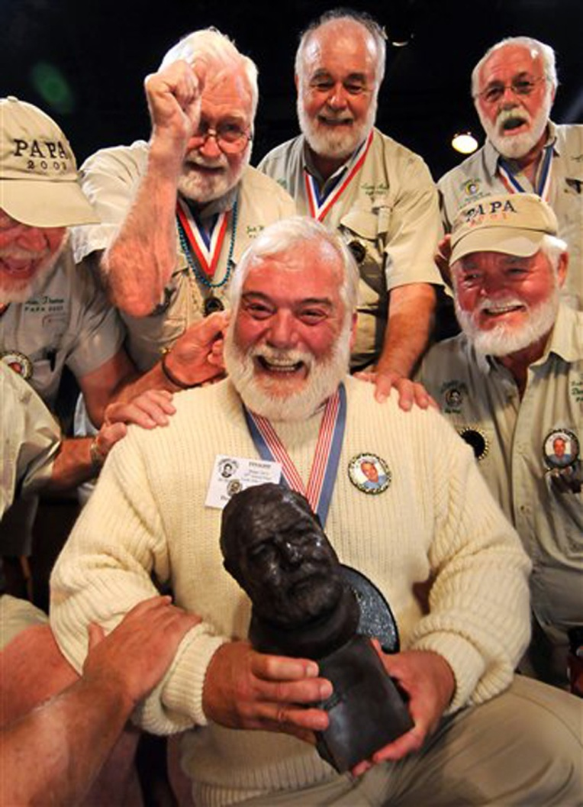
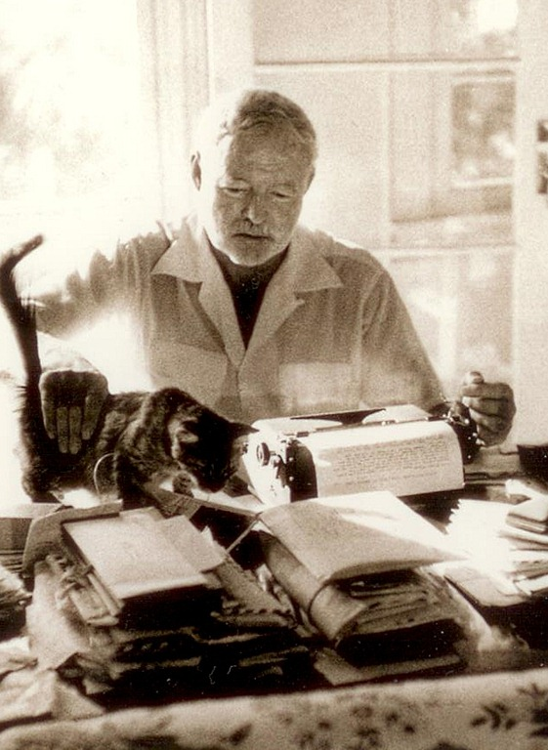
Заголовок
The writer was awarded the Pulitzer Prize in 1953 and the Nobel Prize in Literature in 1954 for this work.
Hemingway himself described this creation as “the best I can write ever for all of my life”.

Slide 5
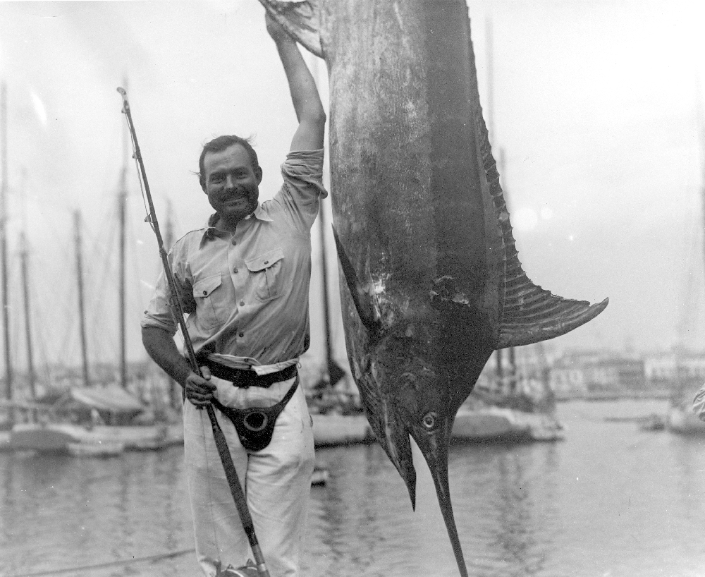
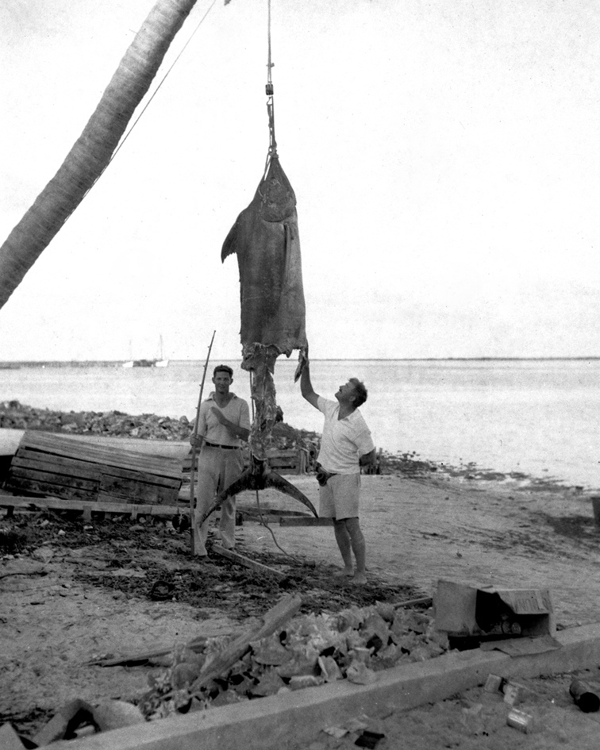
“The Old Man and the Sea”
Буковки много буковог клпекурурдкркдпрПЛУКЗПУФФРДОО

