Slide 1
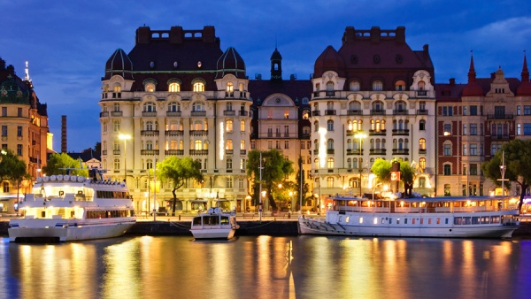
Sweden

Slide 2
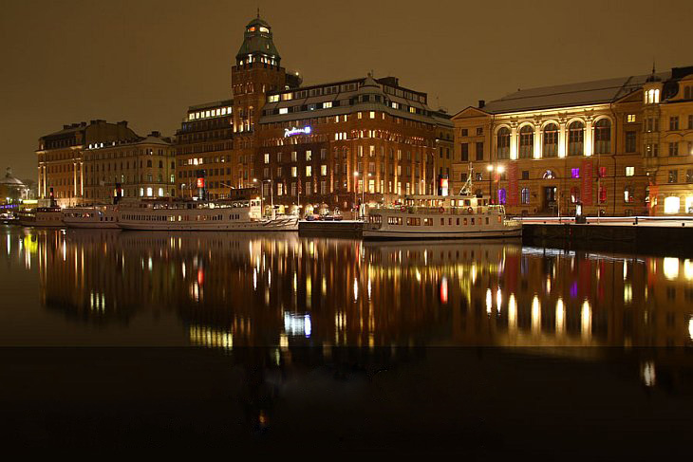
WINTER STOCKHOLM
Scandinavian fairytale

Slide 3
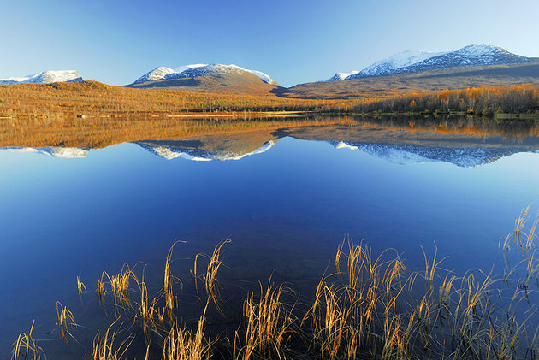
Sweden unspoiled nature

Slide 4
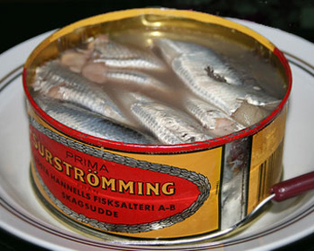
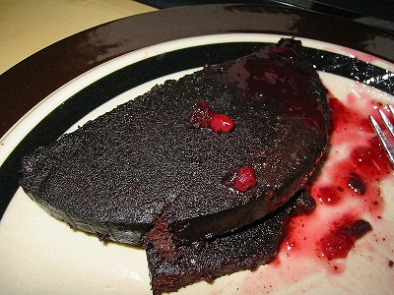
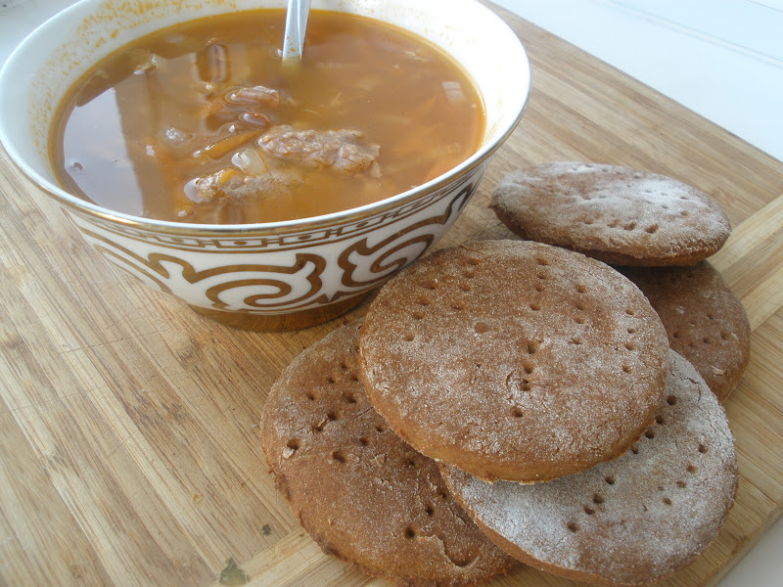
Syurstrёmming
meat with jam
salty soup with sweet cakes

Slide 5
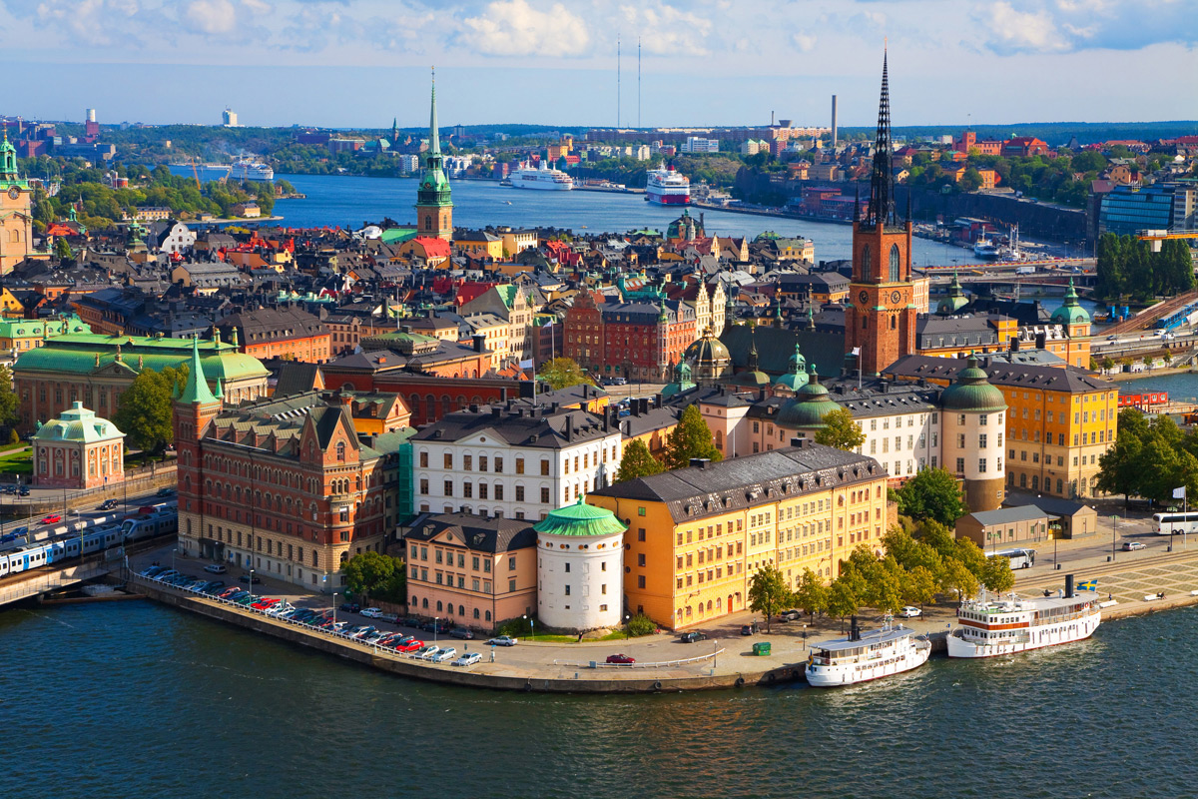

Slide 6
Stockholm

Slide 7
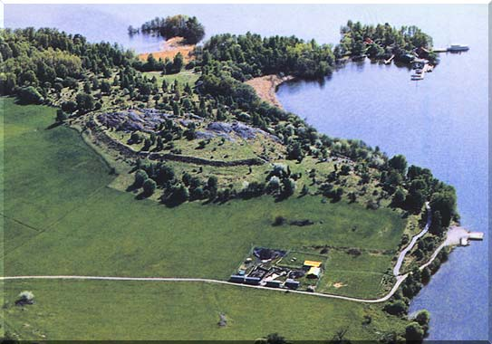
Birka

Slide 8
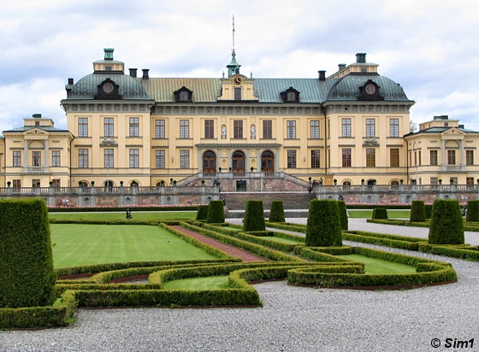
Drottningholm

Slide 9
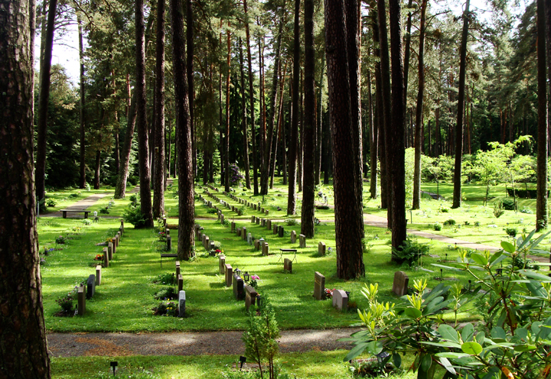
Woodland Cemetery

Slide 10
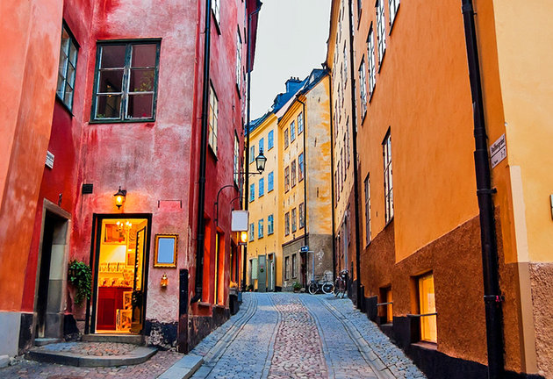
Gamla Stan (Old Town)
Gamla Stan (Old Town)

Slide 11
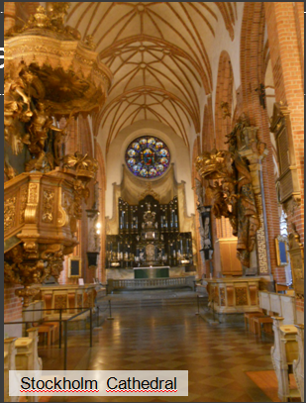
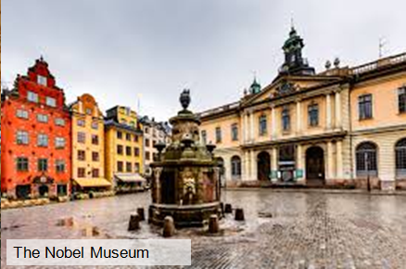
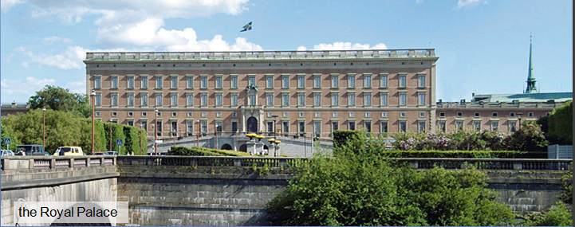
Gamla Stan (Old Town)

Slide 12
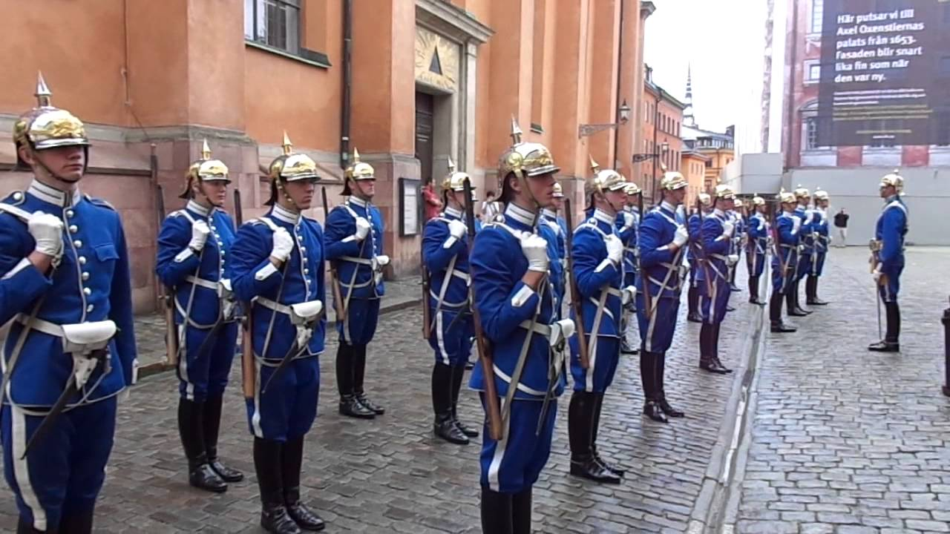
If visiting the Royal Palace be sure to catch the changing of the guard.

Slide 13
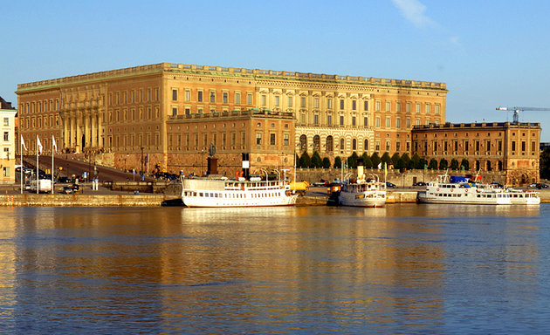

Slide 14
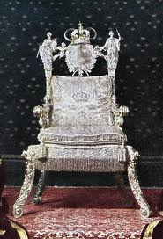
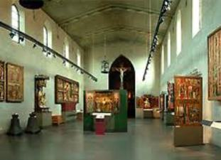
queen kristina's silver throne
the Museum of Antiquities

Slide 15
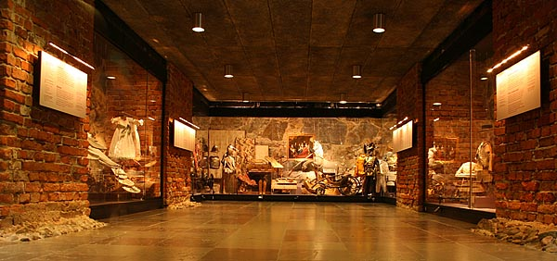
the armoury in Stockholm

Slide 16
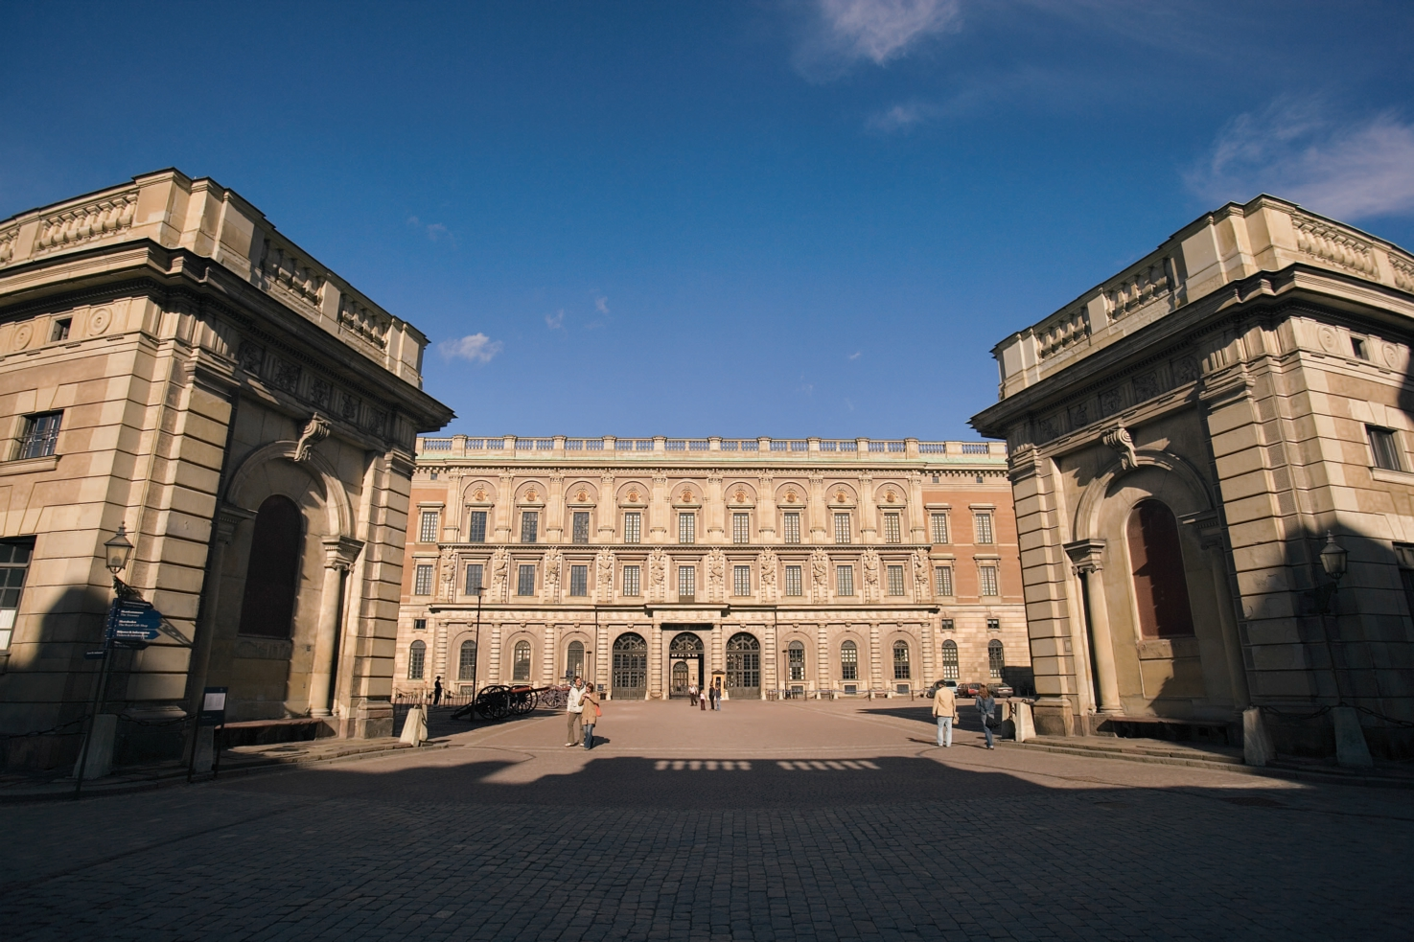
THE TRE KRONOR (THREE CROWNS) MUSEUM

Slide 17
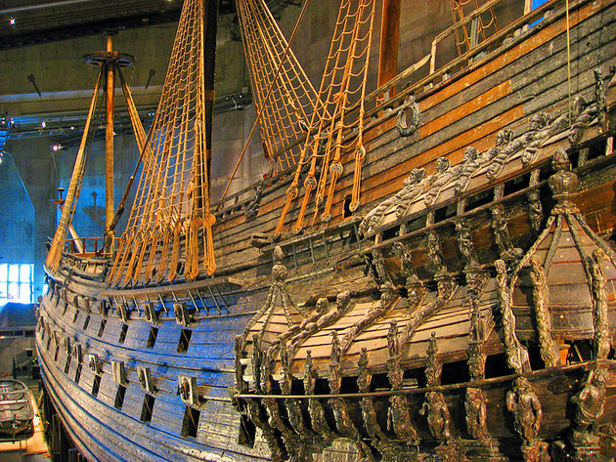
Vasa Museum

Slide 18
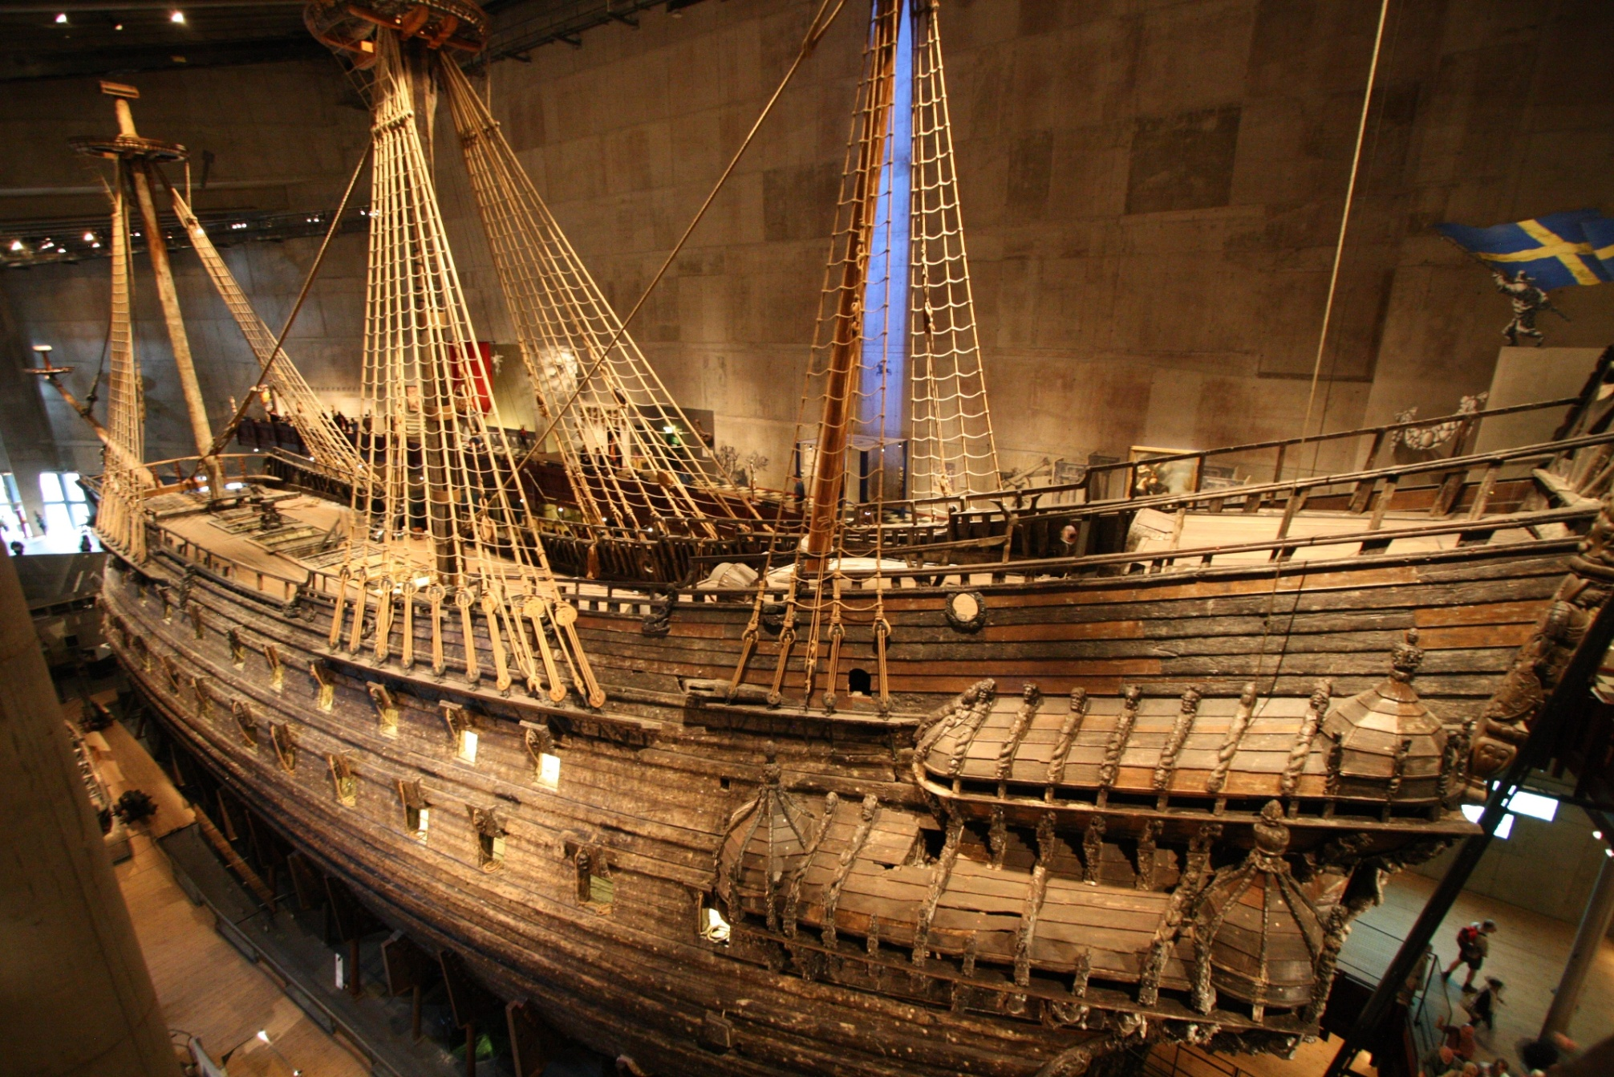
Vasa Museum

Slide 19
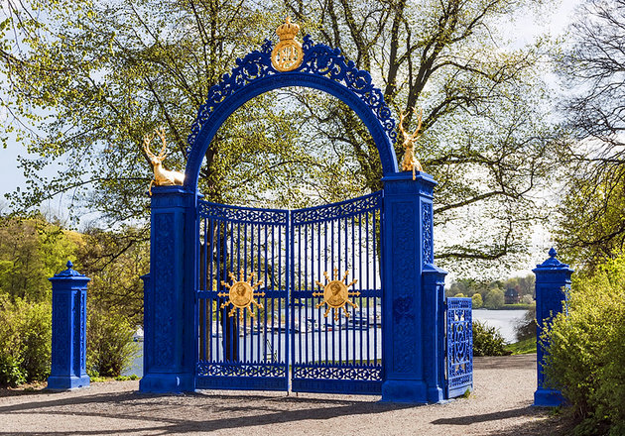
Djurgården

Slide 20
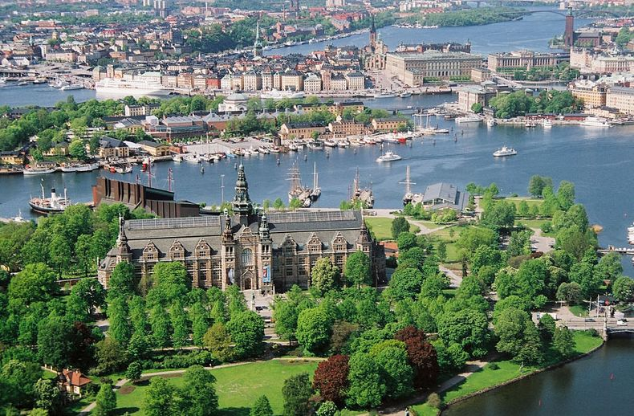
Djurgården

Slide 21
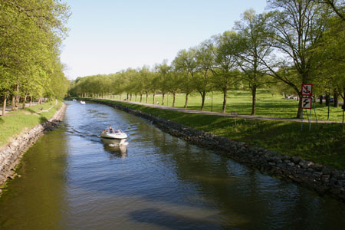
Djurgården

Slide 22
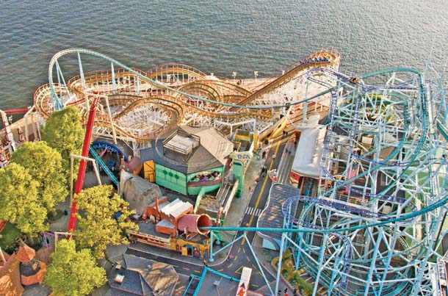
Djurgården
Gröna Lund amusement park

Slide 23
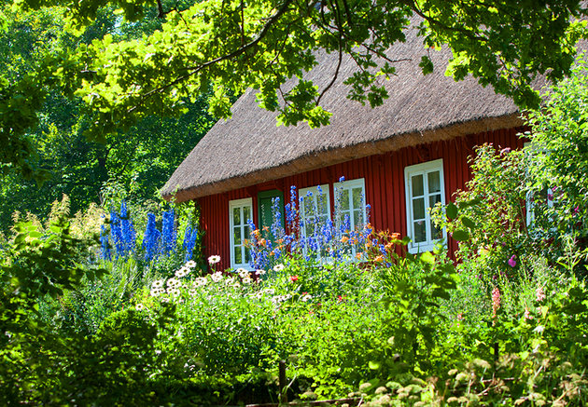
Skansen Open-Air Museum

Slide 24
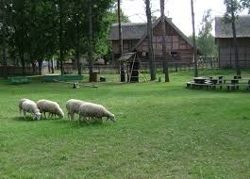
Skansen Open-Air Museum

Slide 25
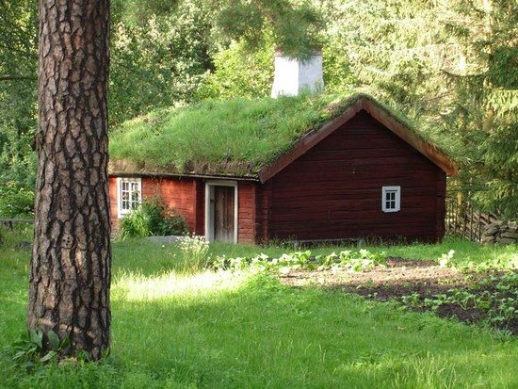
Skansen Open-Air Museum

Slide 26
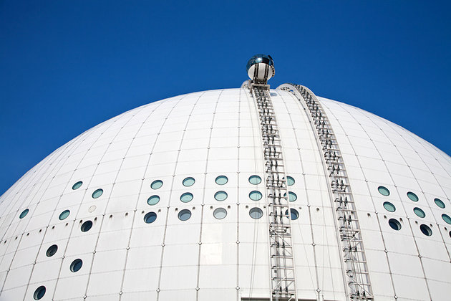
Sky View - The Globe

Slide 27
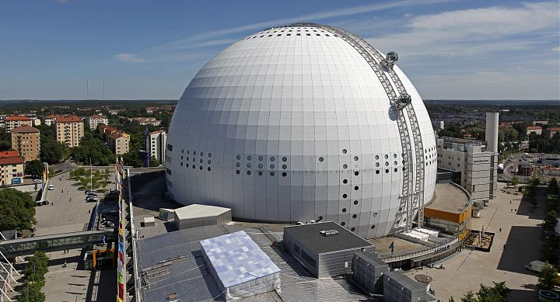
Sky View - The Globe

Slide 28
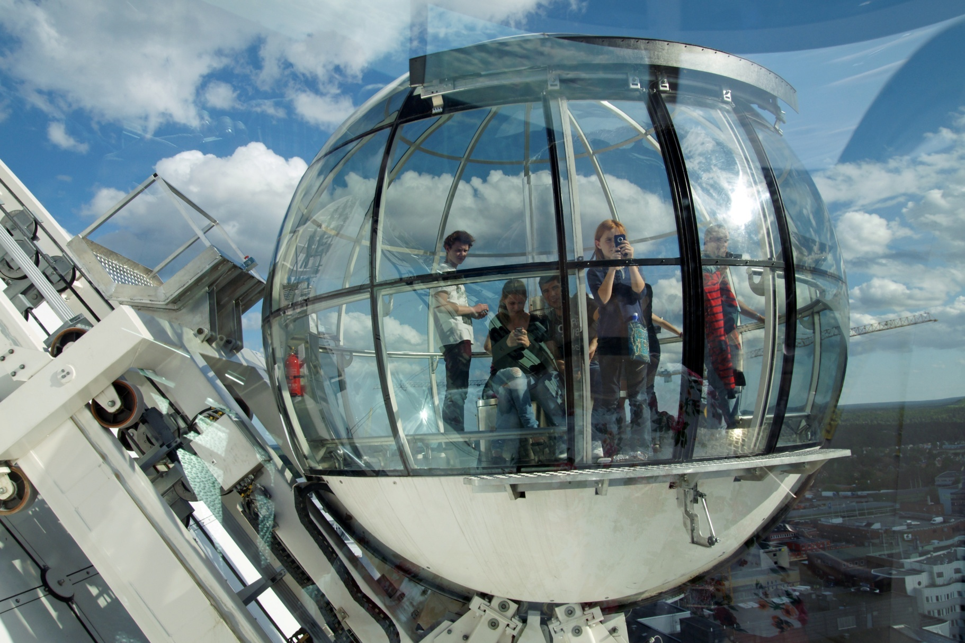
Sky View - The Globe

Slide 29
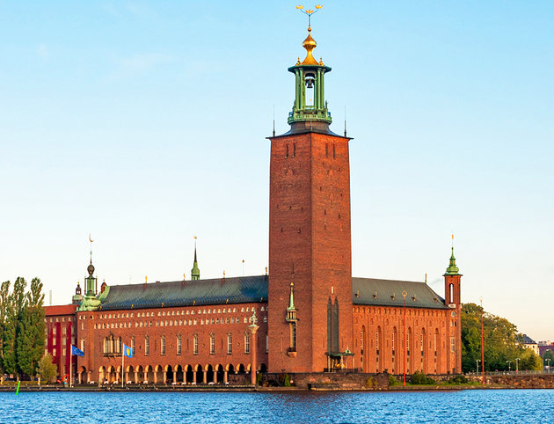
The City Hall (Stadshuset)

Slide 30
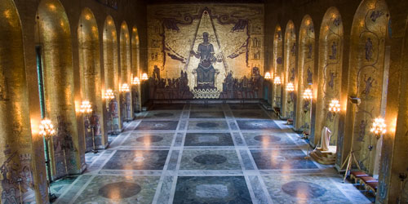
The City Hall (Stadshuset)

Slide 31
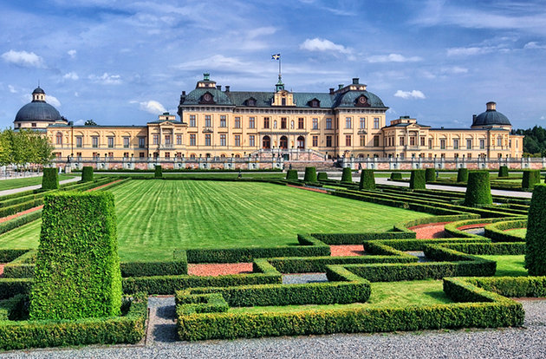
Drottningholm
Drottningholm

Slide 32
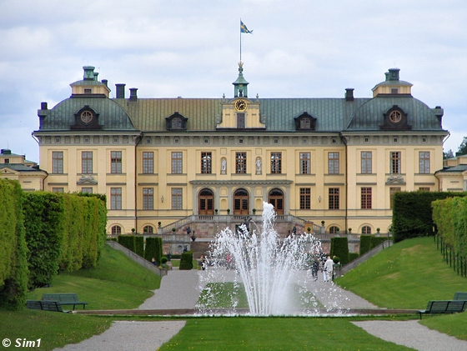
Drottningholm

Slide 33
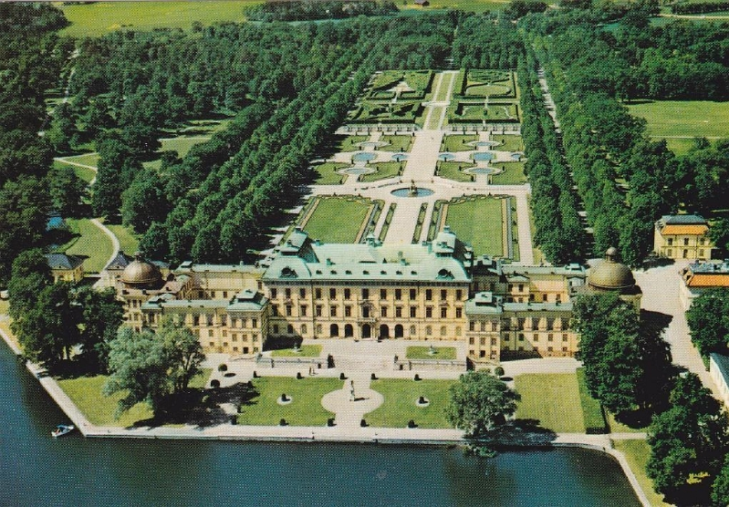
Drottningholm

Slide 34
Stockholm is waiting for you!

