Slide 1
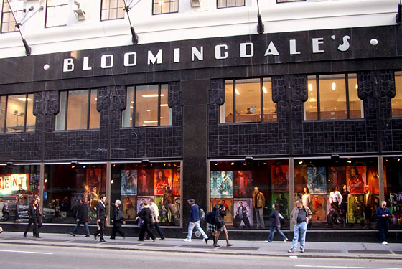

Bloomingdale's is an upscale American department store owned by Macy's, Inc. The chain's biggest competitors are Neiman Marcus, Saks Fifth Avenue, Bergdorf Goodman, Barneys New York, Lord & Taylor and Nordstrom.

Slide 2
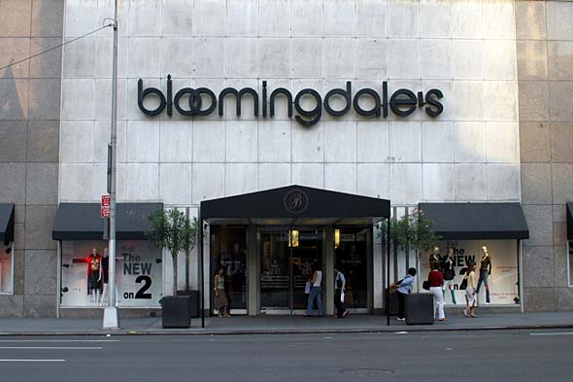
History of

Slide 3
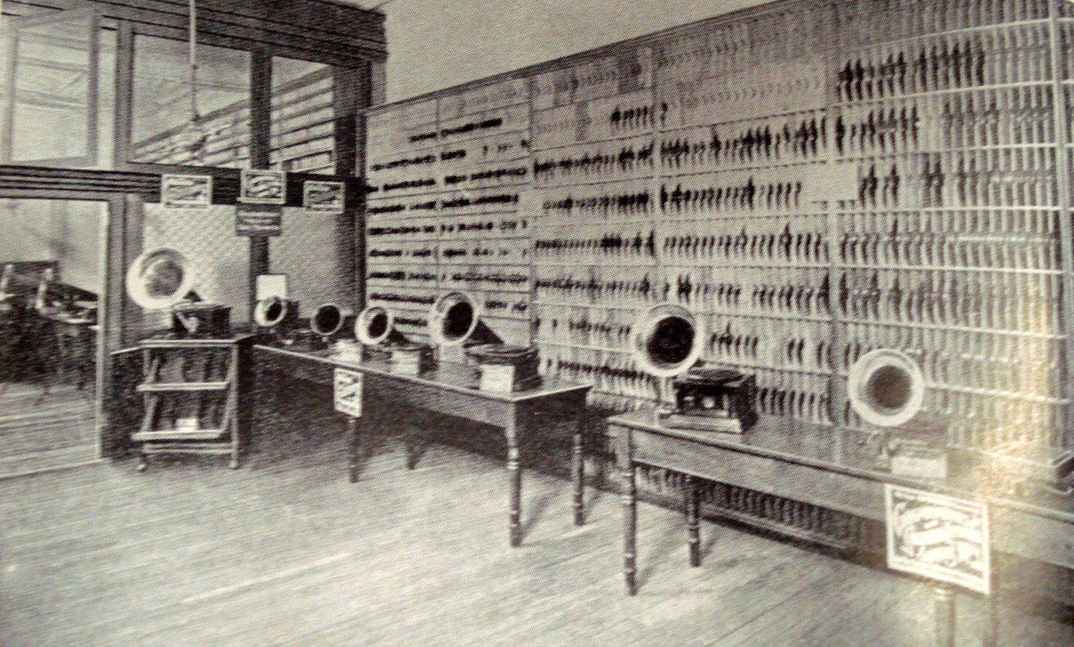
19th century

Slide 4
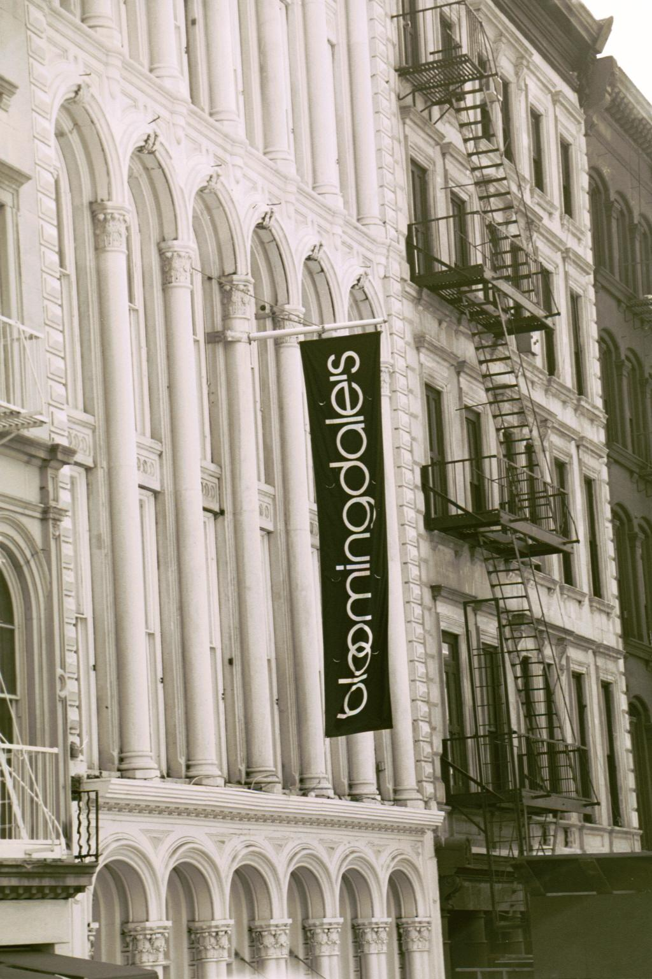
Bloomingdale's started in 1861 when brothers Joseph and Lyman G. Bloomingdale started selling hoop-skirts in their Ladies Notions' Shop on Manhattan's Lower East Side. The pair were sons of Benjamin Bloomingdale who settled in New York City. In 1872, the Bloomingdale brothers opened their first store.

Slide 5

As the popularity of the hoop-skirt was declining, the brothers closed their East Side Bazaar in 1872, selling a variety of garments such as ladies' skirts, corsets, "gent's furnishings", and European fashions. Most of their customers and competitors were in the Upper West Side.

Slide 6
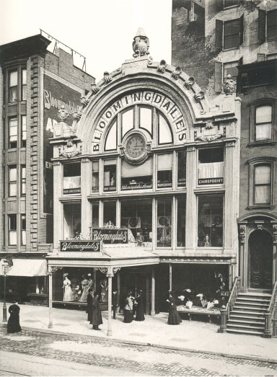
The store moved in 1886 to its current location on 59th Street and Lexington Avenue. It was designed with large plate glass display windows.

Slide 7
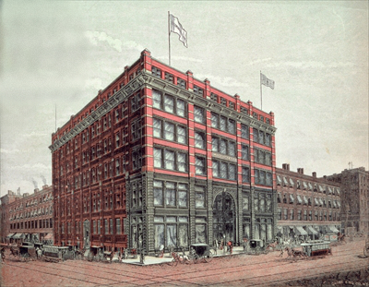
By the start of the 20th century, Bloomingdale's growth greatly increased, facilitated by its convenient location at a hub of New York City's horse-drawn trolley system. Offerings at the time ranged from ladies' stockings at 10¢ a pair to $10 men's wool suits and $149 upright pianos.

Slide 8
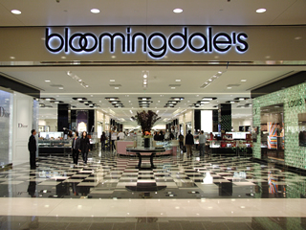
20th century

Slide 9
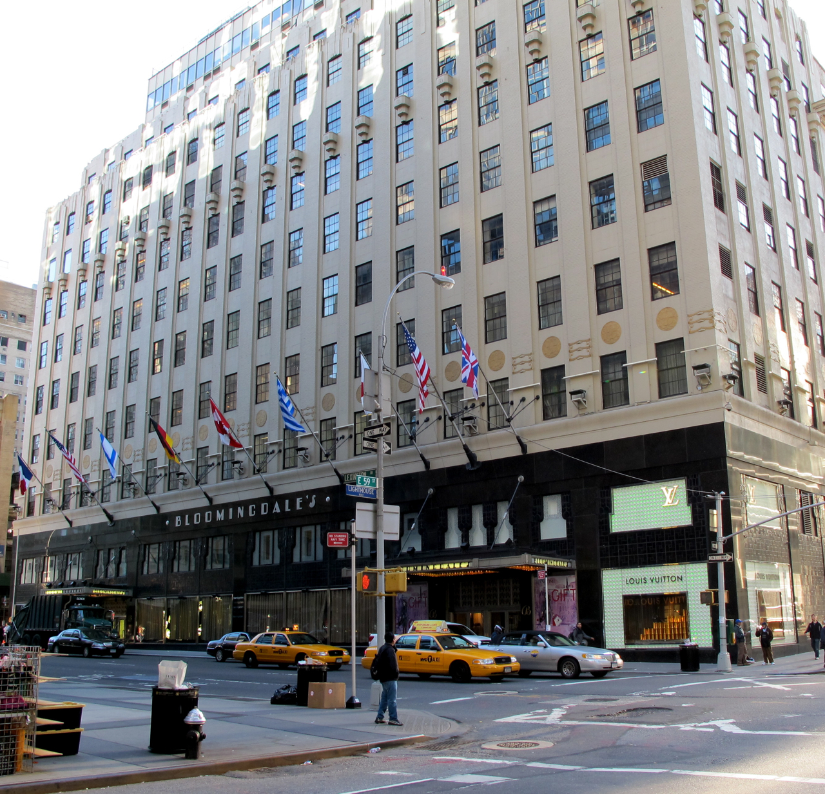
Around 1905, hard times hit. The popular upper class shopping area moved downtown along Sixth Avenue to between 14th and 23rd Streets. In 1913, the 59th Street Station of the Lexington Avenue subway was constructed in Bloomingdale's basement, further reinforcing the "All Cars Transfer to Bloomingdale's" slogan, and business recovered. By the 1920s, the store covered the whole city block.

Slide 10
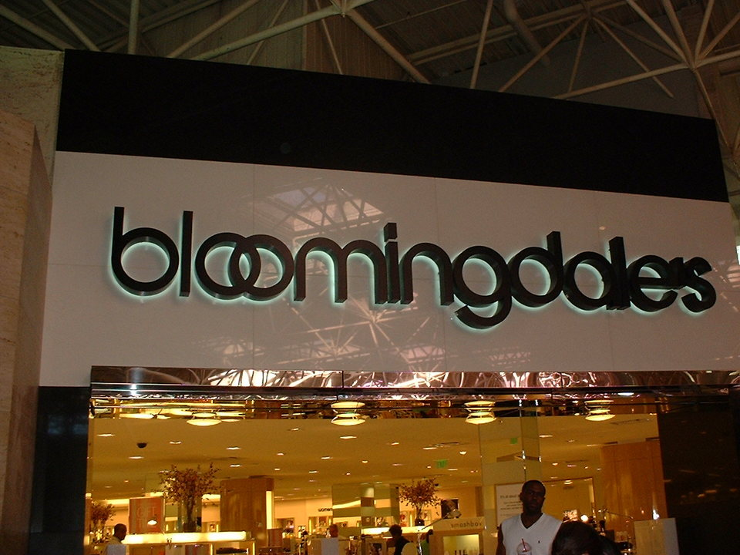
In 1930, Bloomingdale's moved to a new location off of Lexington.

Slide 11
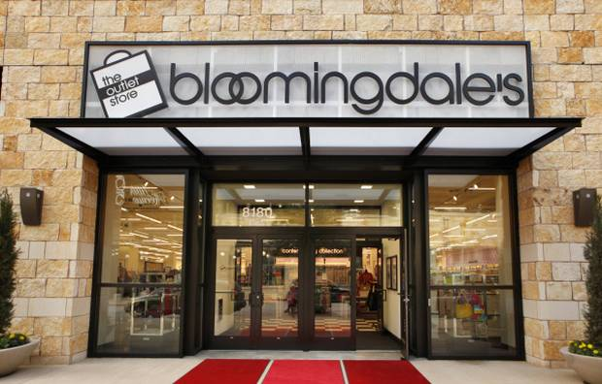
In 1949, Bloomingdale's opened its first branch store in Fresh Meadows, Queens. The same year Bloomingdale's joined Federated Department Stores, now Macy's, Inc.

Slide 12
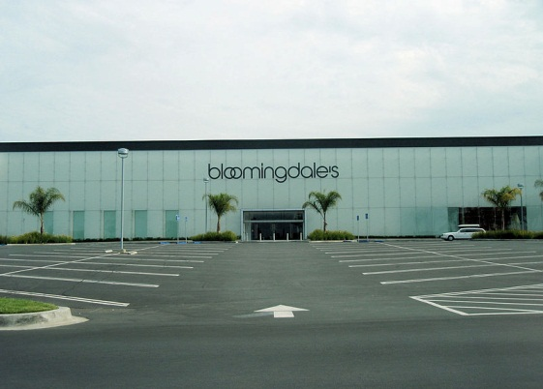
In 1961, the company started using designer shopping bags to promote its "Esprit de France" exhibit. In 1973, the iconic "Brown Bag" appeared.

Slide 13
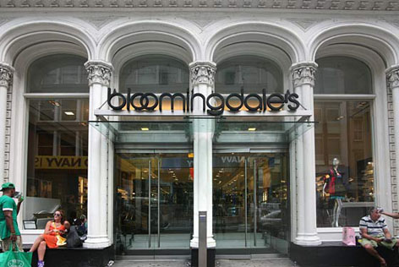
In 1969, Bloomingdale's two branch stores opened in Garden City, New York on Long Island, and Jenkintown, Pennsylvania. Bloomingdale's opened home furnishing stores on the East Coast using products from the flagship's home furnishings department.

Slide 14
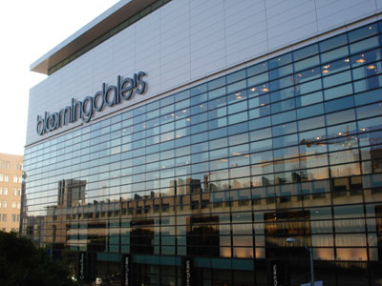
Future

Slide 15
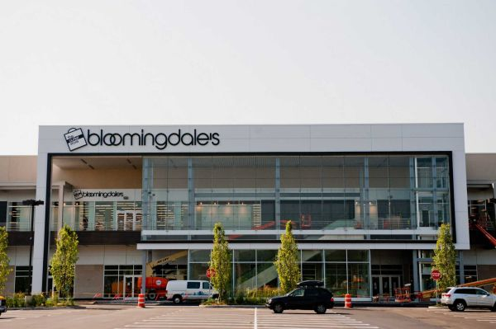
On November 3, 2011, Bloomingdale's announced it will open a new 120,000 sq ft. store in Glendale Galleria in Fall 2013 as part of the mall's remodeling plan.

Slide 16
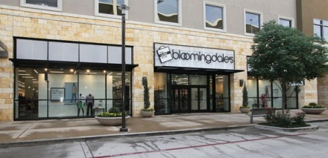
Bloomingdale's announced that they will replace the Bloomingdale's store of 229,000 square feet in Stanford Shopping Center in Palo Alto, CA, with a new 120,000 sq ft store. The store is planned to open in 2014.

Slide 17
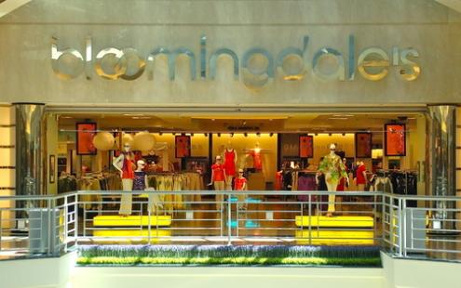
The end

