Slide 1
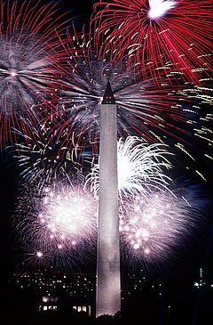
Independence Day
Independence Day, also commonly known as the Fourth of July, is a federal holiday in the United States of America commemorating the adoption of the Declaration of Independence on July 4, 1776, declaring independence from Great Britain (now part of the United Kingdom). Independence Day is commonly associated with fireworks, parades, barbecues, carnivals, fairs, picnics, concerts, baseball games and political speeches and ceremonies, in addition to various other public and private events celebrating the history, government, and traditions of the United States. Independence Day is the National Day of the United States.

Slide 2
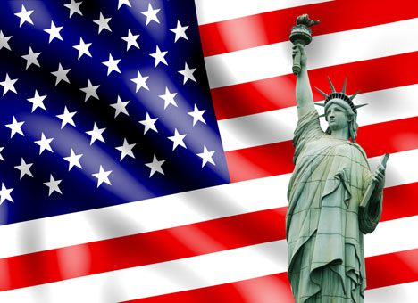
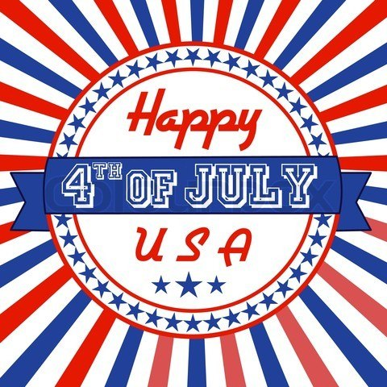
During the American Revolution officially disconnect the 13 British colonies from Great Britain occurred July 2, 1776, when the Second Continental Congress voted in closed session for the Lee Resolution Representative Richard Henry Lee of Virginia, which proclaimed that America became independent. After the vote on this resolution Congress has decided to issue an additional document that would explain this act - the Declaration of Independence. Her project wrote five so-called Committee inled by Thomas Jefferson. After discussing the project to debate amendments and additions Declaration was signed on 4 th July 1776

Slide 3
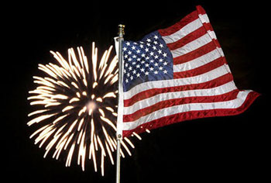
In 1777 the 4th of July in the city. Bristol, Rhode Island 13 rounds were heard in the morning and evening. So Philadelphia celebrated the first anniversary of independence in a manner that is familiar to modern Americans. Boats decorated with red, white and blue ribbons.
.
In 1778, General George Washington marked July 4 th by order give his soldiers a double portion of rum and make an artillery salute. On the other side of the Atlantic Ocean in Paris US Ambassador John Adams and Benjamin Franklin held a gala dinner for expats Americans.
In 1779 July 4th fell on Sunday, so Monday made holiday for celebration

Slide 4
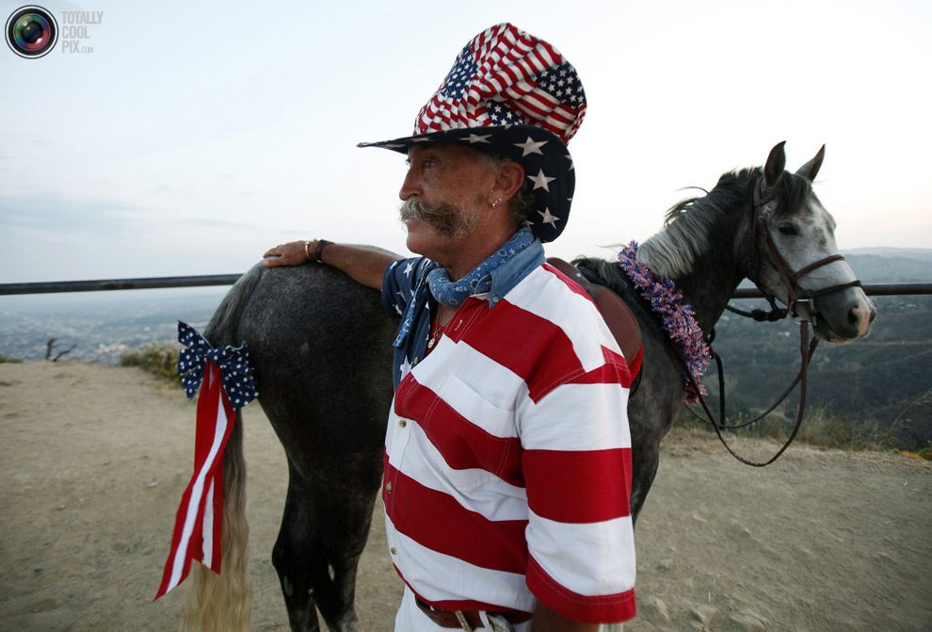
In the 1781 General Meeting of the Massachusetts became the first US legislature, which declared July 4th official holiday.
In 1791 the first recorded use during the celebrations of the name "Independence Day".
In 1820 the most massive celebration of 4th of July took place in the city Istport Maine.
In 1870 the US Congress made Independence Day an unpaid though, but still a holiday for federal employees.
In 1938, the US Congress decided that Independence Day should be paid holiday for all.

