Slide 1


Slide 2
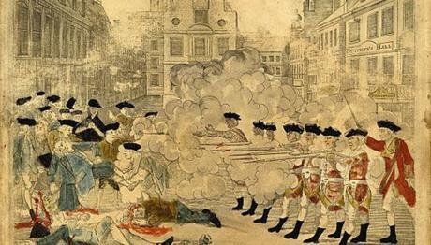
American Revolution of 1775 - 1783
Presentation
Irina Drach
Form 11 B
School 1
Teacher Staneva A.D.

Slide 3
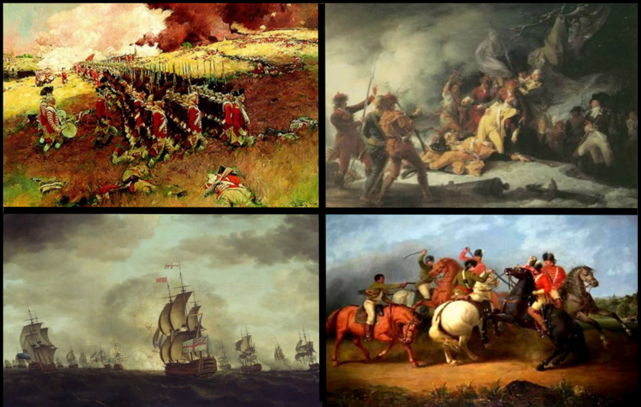
The American Revolutionary War was an armed conflict that lasted eight long years, from 1775 to 1783. It was also a civil war between British subjects and Americans and a rebellion against colonial authorities. It was ultimately a war of "national liberation”, the first in modern history. It caused 25,700 deaths on the American side alone, which ranks it the second bloodiest war ever waged by the United States (after the Civil War).

Slide 4
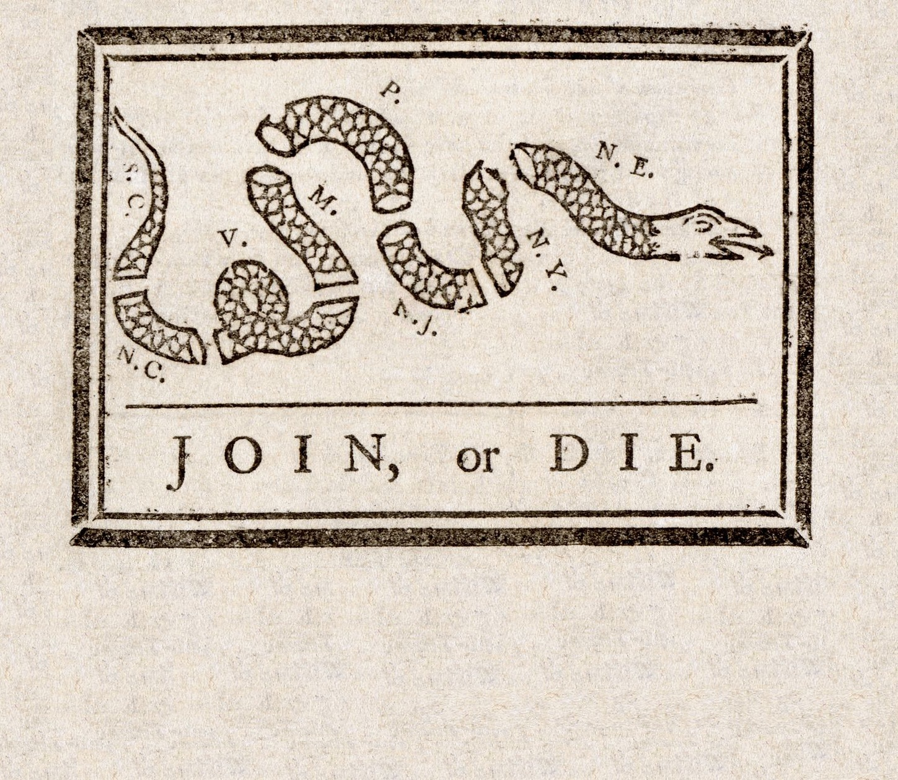
Ideology behind the Revolution
The ideological movement known as the American Enlightenment was a critical precursor to the American Revolution. Chief among the ideas of the American Enlightenment were the concepts of liberalism, republicanism and fear of corruption. Collectively, the acceptance of these concepts by a growing number of American colonists began to foster an intellectual environment which would lead to a new sense of political and social identity.

Slide 5

The American Revolution was predicated by a number of ideas and events that, combined, led to a political and social separation of colonial possessions from the home nation and a coalescing of those former individual colonies into an independent nation.

Slide 6
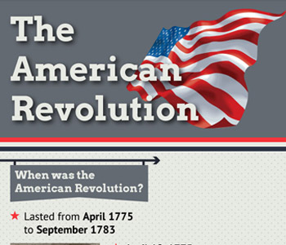


Slide 7
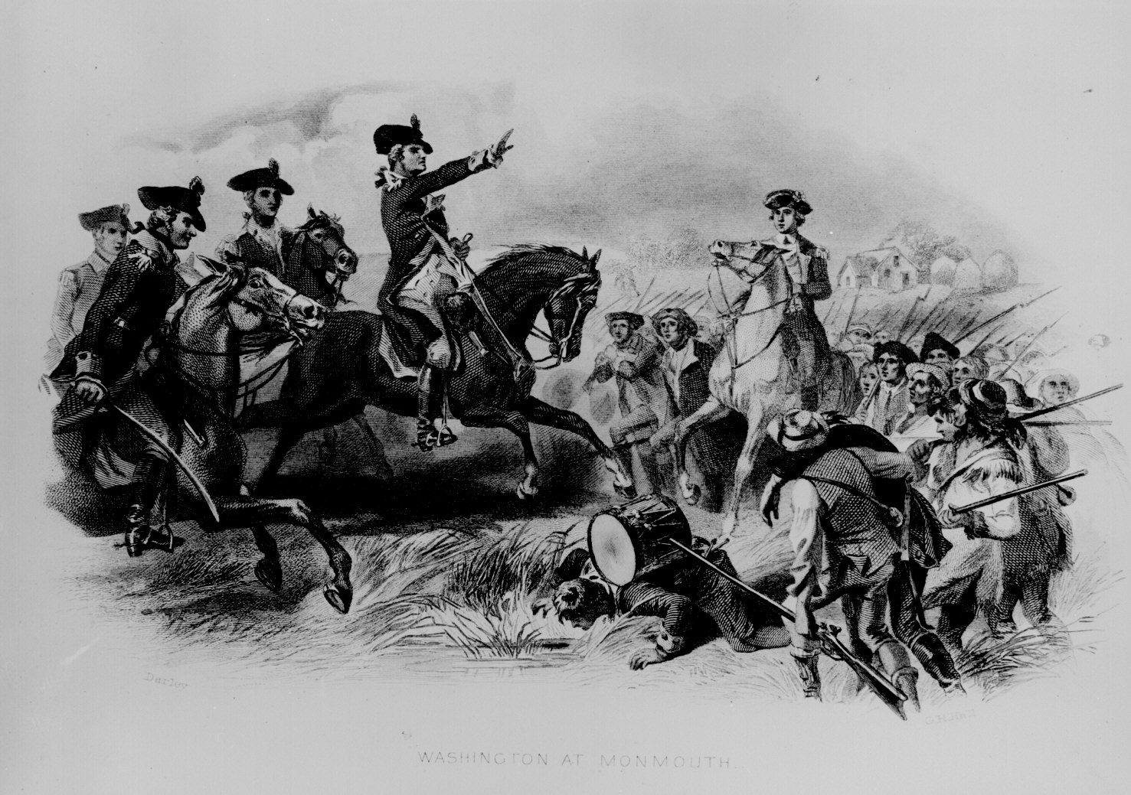
Consequently, the Colonies mobilized their militias, and fighting broke out in 1775. The Patriots quickly expelled royal officials from the colonies and took control.
For the American insurgents, success was far from guaranteed as they had only 18,000 to 20,000 inexperienced men, no navy, and only a small number of well-trained generals. Nevertheless, it was the revolutionists who won the war, by slowly wearing the British into the ground.

Slide 8
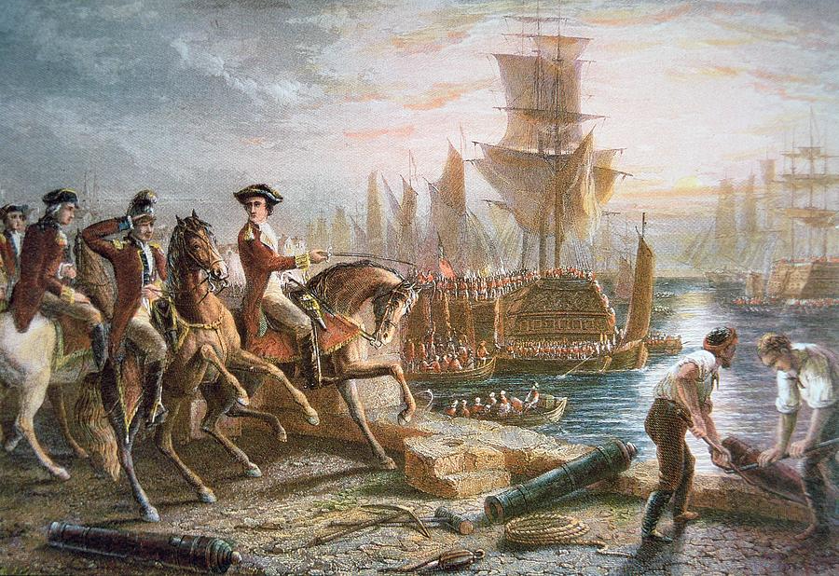

18 March 1774 - British occupied Boston, Massachusetts until evacuated 7 March 1776.
5 September 1774 - First Continental Congress convened.
19 April 1775 - Battle at Lexington and Concord,
Massachusetts.
17 June 1775 -Battle of Bunker Hill,Massachusetts.
4 July1776 - Declaration of
Independence adopted.

Slide 9
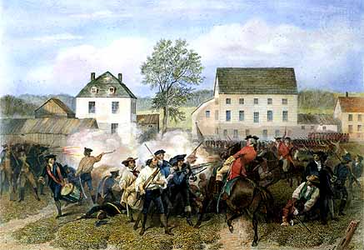
15 September1776 - New York City occupied by the British until 26 November 1783.
26 December 1776 - Attack at Trenton, New Jersey.
3 January 1777 - Attack at Princeton, New Jersey.
11 September 1777 - Battle of Barndywine, Pennsylvania.
19 December 1777 - Washington's army established headquarters at Valley Forge.

Slide 10
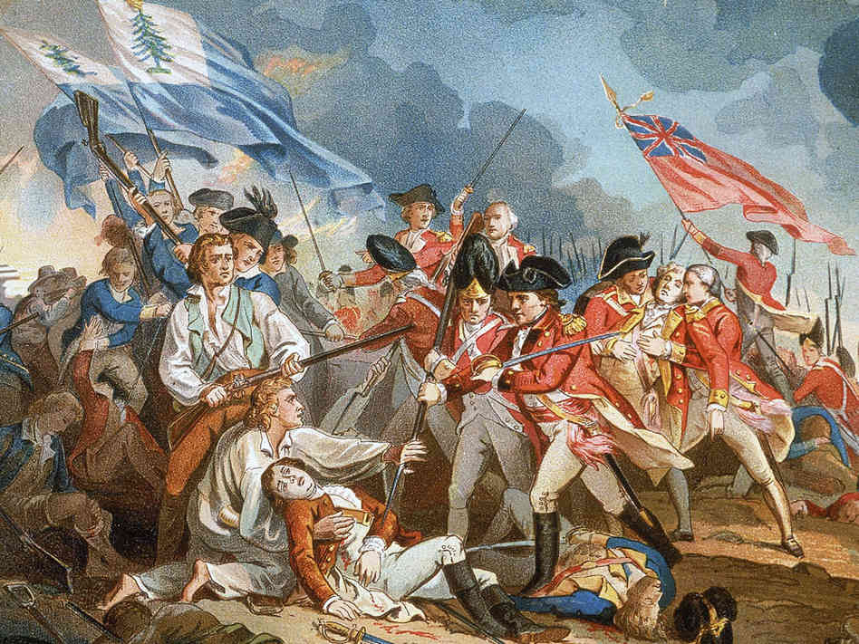
6 February 1778 - U.S. and France entered a military alliance.
28 June 1778 - Battle of Monmouth, New Jersey.
29 December 1778 - Capture of Savannah, Georgia by the British. It was occupied until 11 July 1782.
23 February 1779 - George Rogers Clark and his men took Vincennes, Indiana from the British.

Slide 11
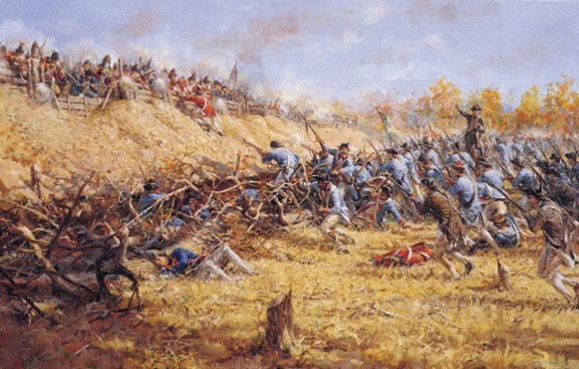
12 May 1780 - Charleston, South Carolina was captured by the British and occupied until 14 December 1782.
16 August 1780 - Battle near Camden, South Carolina.
7 October 1780 - Patriots defeated a group
of Loyalists at Kings Mountain, South Carolina.
17 January 1781 - Battle at Cowpens near the Broad
River in South Carolina.

Slide 12
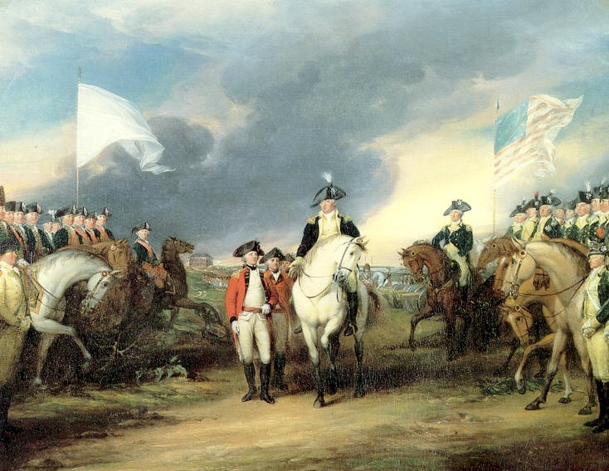
15 March 1781 - Battle at Guilford Co., North Carolina courthouse.
19 October 1781 - Cornwallis surrendered at Yorktown, Virginia.
30 November 1782 - A preliminary peace treaty was signed in Paris, France.
3 September 1783 - The final peace treaty was signed in Paris.

Slide 13


