Slide 1

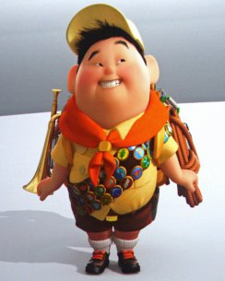
The Boy Scouts

Slide 2
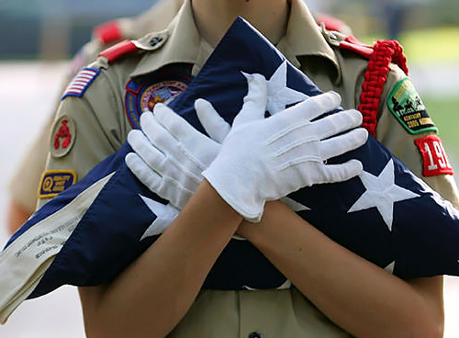
Scouting - worldwide youth movement involved in physical, spiritual and mental development of young people so that young people can take a constructive place in society. The Scout Association is voluntary, apolitical , independent.

Slide 3
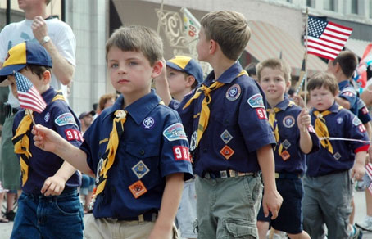
Scout method of education, as does the movement founded in the UK in the early twentieth century by Colonel Robert Baden-Powell.

Slide 4
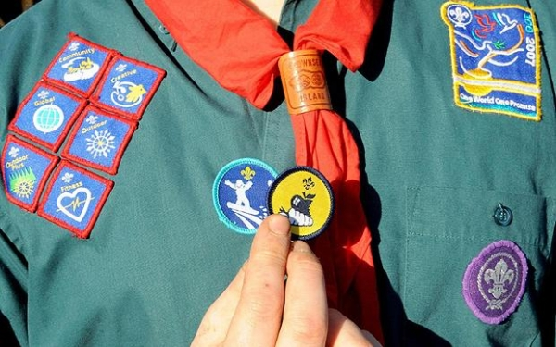
Special signs in the form of patches, which is a scout on your form, indicate its achievements and varying Scout "specialty", for example, in a chef fact, first aid, sports improvement, etc.

Slide 5
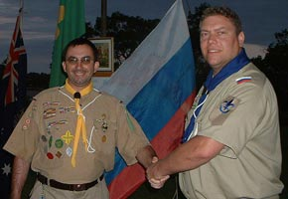
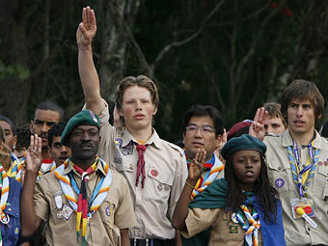
Scouts all over the world shake hands left and not the right hand, which is a sign of special friendship and faith. The reason is that the left hand is closer to the heart.
Scout motto - "Be prepared!"

Slide 6


Scout emblems of different organizations may differ materially. But they all have a mandatory element - lily (trefoil).

Slide 7
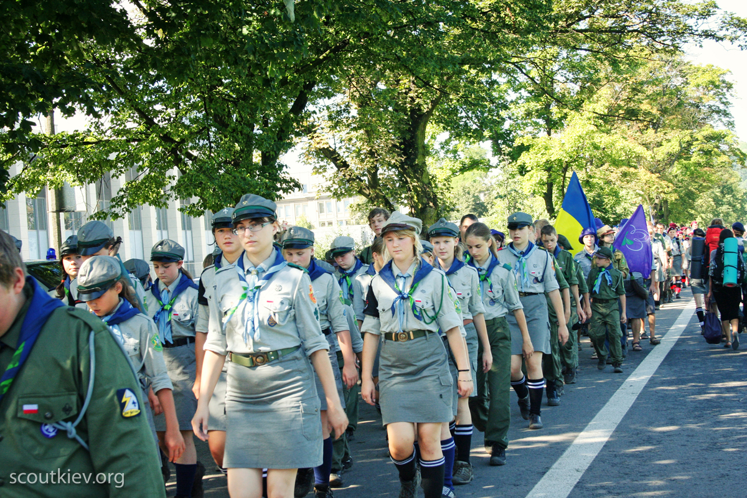
Currently scouting has more than 38 million members in 217 countries and territories represented through several Scout associations at the international level.

Slide 8
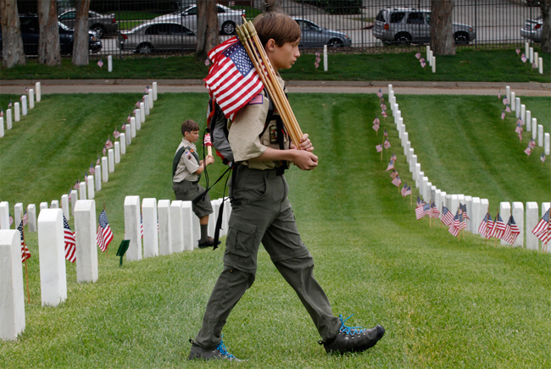

Slide 9
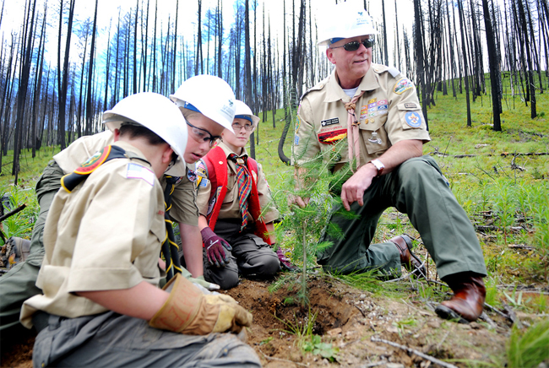

Slide 10
