Slide 1
Presentation 1
Natural disasters

Slide 2
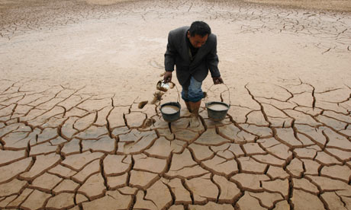
Look at the photos and decide what is happening on each one:

Slide 3
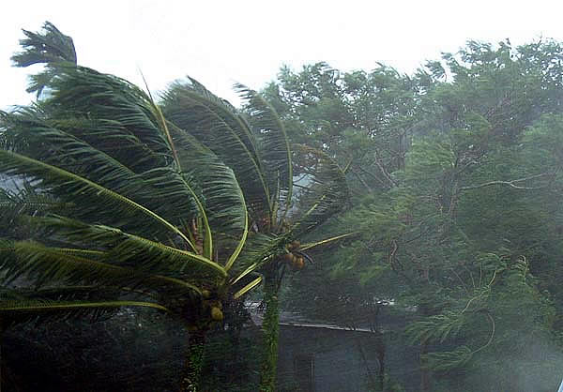
Look at the photos and decide what is happening on each one:

Slide 4
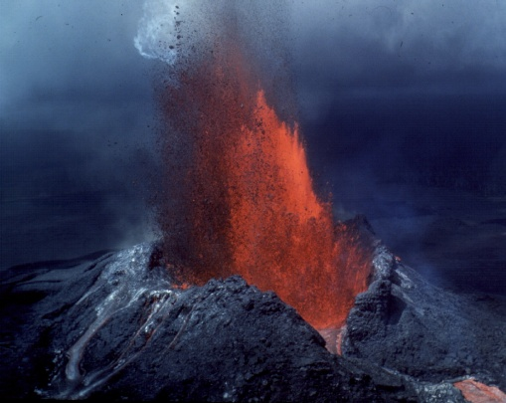
Look at the photos and decide what is happening on each one:

Slide 5
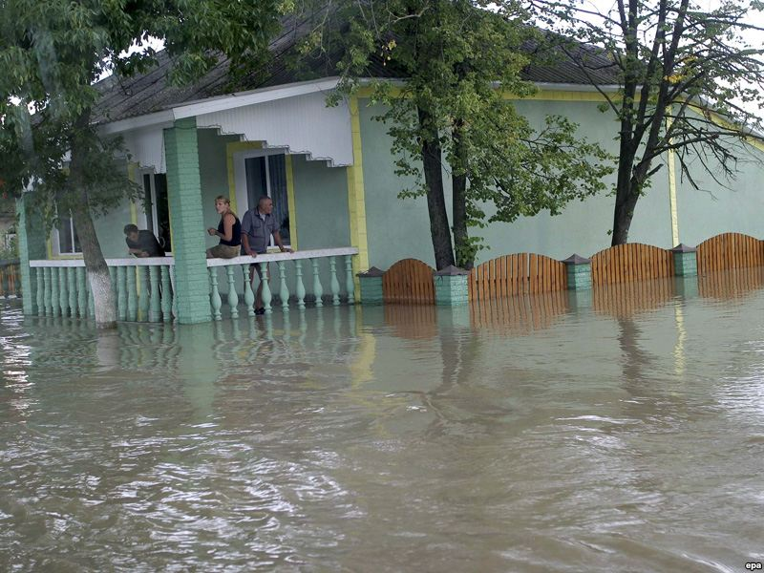
Look at the photos and decide what is happening on each one:

Slide 6
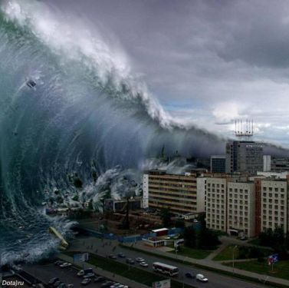
Look at the photos and decide what is happening on each one:

Slide 7
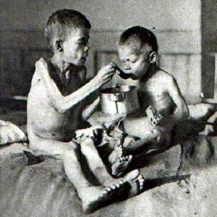
Look at the photos and decide what is happening on each one:

Slide 8
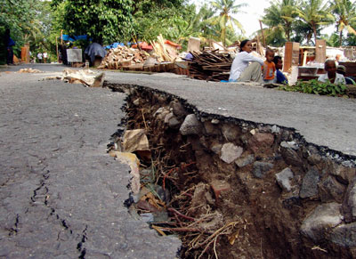
Look at the photos and decide what is happening on each one:

Slide 9
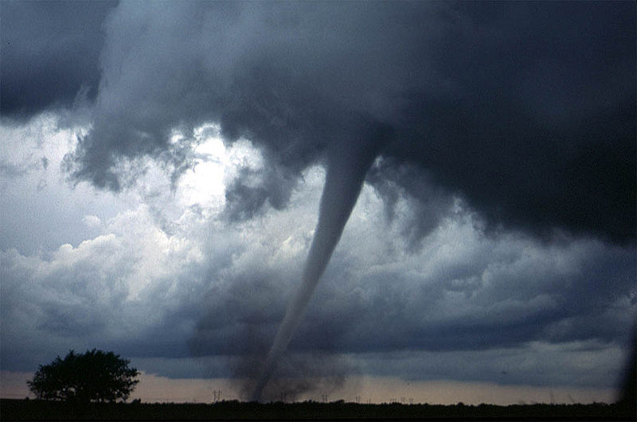
Look at the photos and decide what is happening on each one:

Slide 10
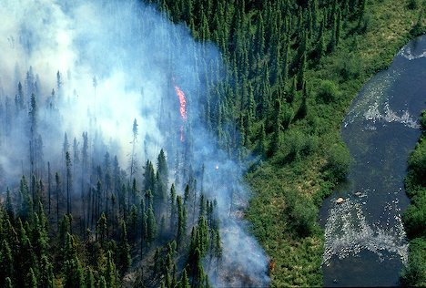
Look at the photos and decide what is happening on each one:

Slide 11
Refer the given words to the photos:
Drought
Typhoon
Volcano eruption
Flood
Tsunami
Earthquake
Tornado
Famine
Forest fire

Slide 12
Look at the photos and decide what is happening on each one:
Drought

Slide 13
Look at the photos and decide what is happening on each one:
Typhoon

Slide 14
Look at the photos and decide what is happening on each one:
Volcano eruption

Slide 15
Look at the photos and decide what is happening on each one:
Flood

Slide 16
Look at the photos and decide what is happening on each one:
Tsunami

Slide 17
Look at the photos and decide what is happening on each one:
Famine

Slide 18
Look at the photos and decide what is happening on each one:
Earthquake

Slide 19
Look at the photos and decide what is happening on each one:
Tornado

Slide 20
Look at the photos and decide what is happening on each one:
Forest fire

