Slide 1
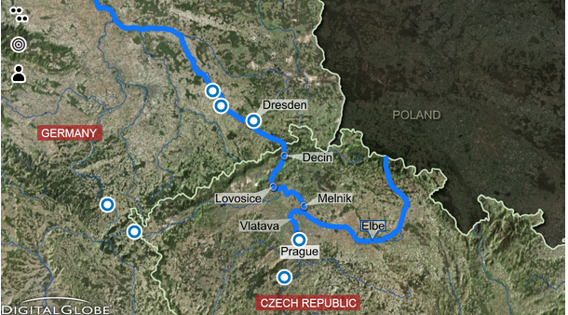
Flooding in Central Europe

Slide 2
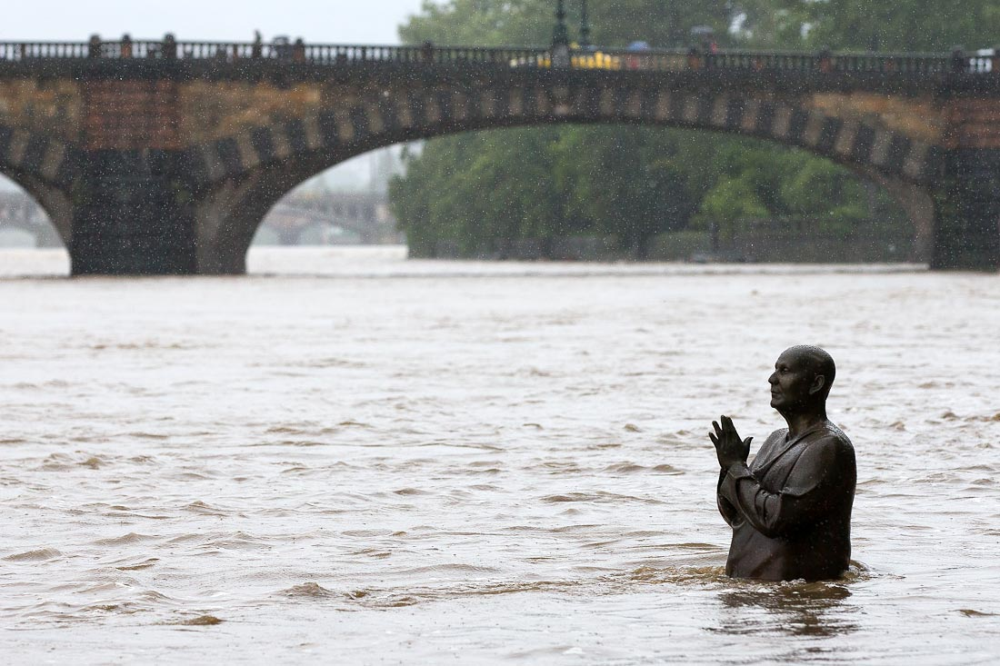
Flooding in Central Europe began after several days of heavy rains in late May - early June 2013.

Slide 3
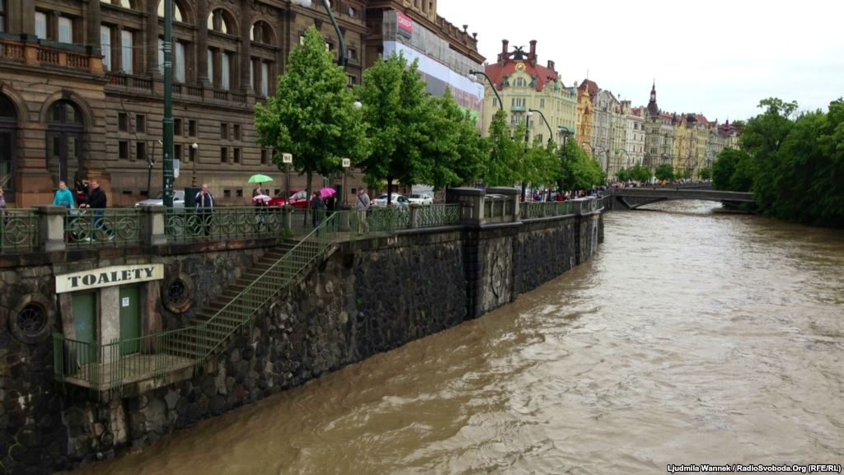
Flooding and destruction of affected mainly the east of Germany, the Czech Republic and Austria

Slide 4
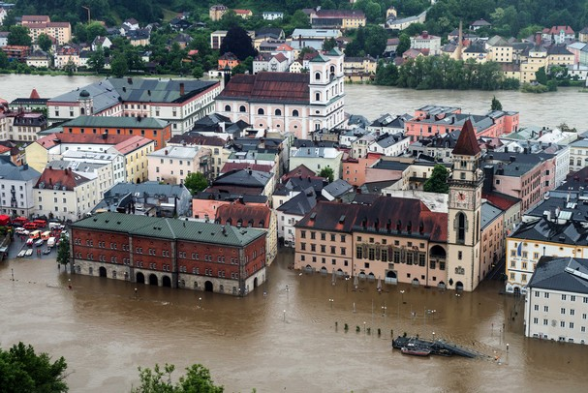
Flooding has spread downstream Elbe, Danube.

Slide 5
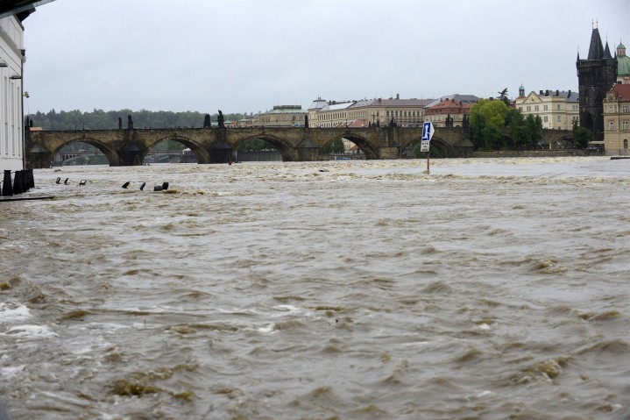
Reported the deaths of at least 15 people.

Slide 6
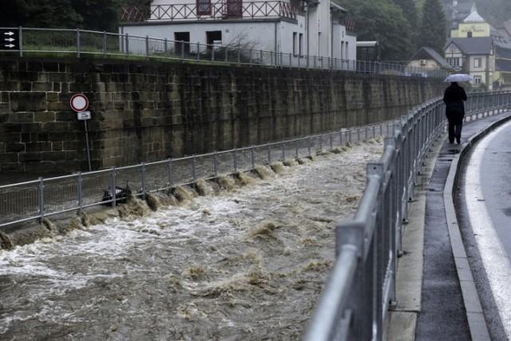
The Czech government declared a state of emergency in the country. This is through the floods in Prague and other cities where rivers burst their banks.

Slide 7
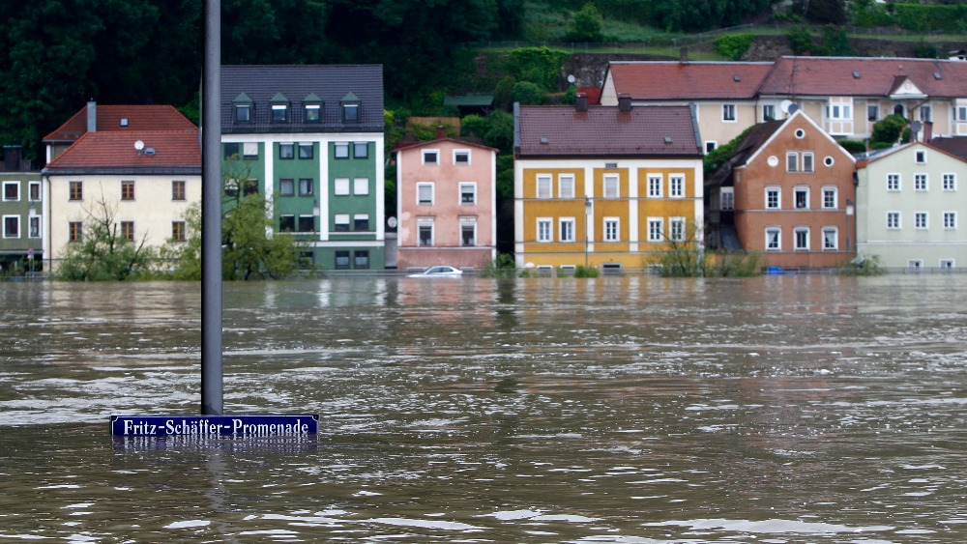
Before flood in Germany joined the military.

Slide 8
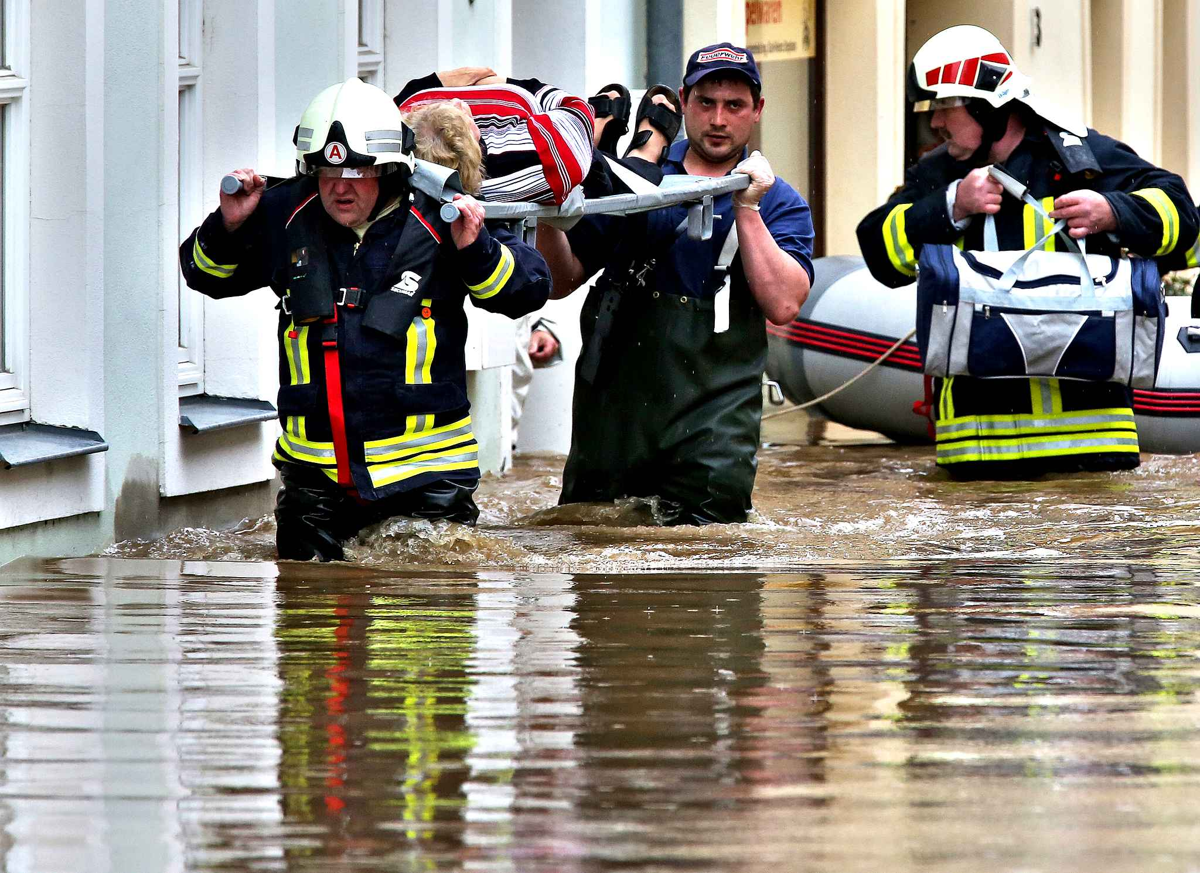
Damage from floods in eastern Germany will make 10-12 billion.

