Slide 1
Сognitive psychology
Memory and attention - without them is impossible?

Slide 2
WHAT IS IT?
Сognitive psychology - it is one of the areas of predominantly American psychology that emerged in the early 60's as an alternative to behaviorism. Cognitive psychology - the section of psychology, cognitive learning, that is, the cognitive processes of the human mind. Research in this area is usually related to issues of memory, attention, feelings, reporting, logical thinking, imagination and the ability to make decisions.

Slide 3
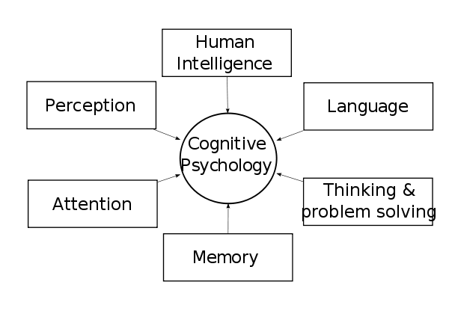
WHAT IS IT?
Cognitive psychology is largely based on the analogy between the transformation of information into a computing device and cognitive processes in humans. So were identified numerous structural components (blocks) of cognitive and executive processes, especially memory (R. Atkinson).
Many of the provisions of cognitive psychology underlie modern psycholinguistics.

Slide 4
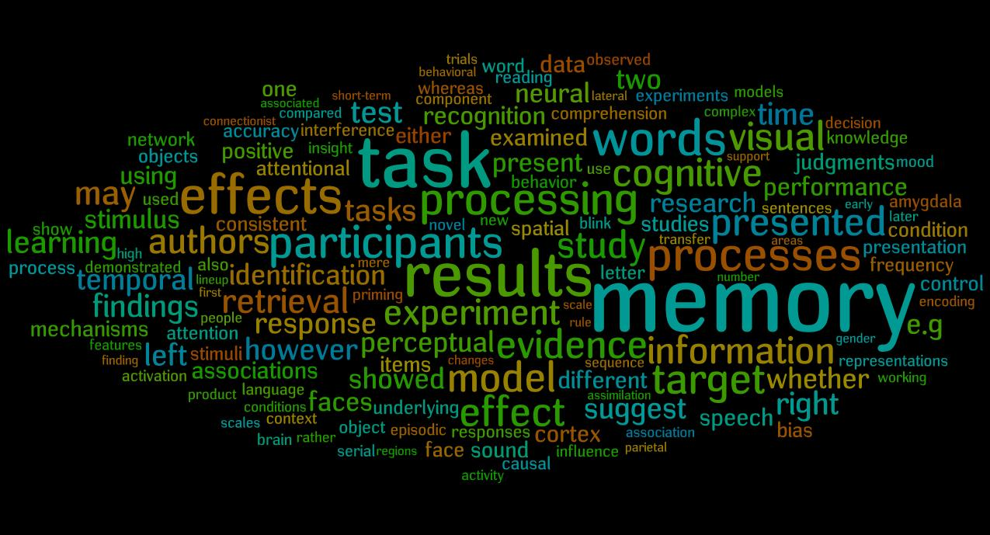
The forums
Modern cognitive psychology consists of 10 main sections: perception, image recognition, attention, memory, imagination, speech, developmental psychology, thinking and problem solving, human intelligence, artificial intelligence.

Slide 5
History
Cognitive word comes from the Latin "to know." Psychologists who adhere to this approach argue that the man is not a machine, blindly and mechanically responsive to internal factors or events in the outside world. On the contrary, the human mind is capable of analyzing information about reality, to make comparisons, make decisions, solve problems rising every minute.

Slide 6
Researches
Swiss psychologist Jean Piaget (1896-1980), trying to figure out how the person perceives the real world, studied the patterns of development of the child's thinking and came to the conclusion that the cognitive development - the result of a gradual process, which consists of a sequence of steps. The development of a child's intelligence is due to the constant search for balance between what the child knows and what he wants to understand. All the children are tested in a single stage of the same sequence, and some of them all, while others develop inhibited or blocked at some point due to the lack of one or more of the essential factors. This advance is determined by the combined effect of the formation of the nervous system, the experience of dealing with different subjects and social factors such as language and education.

Slide 7

Researches
Psychologist Zimbardo, studying forms of antisocial behavior, concluded that most of these negative actions can be explained by analyzing the situational and interpersonal factors rather than dispositional stable personality characteristics of a person ("he's always like that"). On the contrary, even the "good" people can make something negative in difficult circumstances and situations. Latest create potential forces promoting or impeding the implementation of mainstreaming intentions, plans, human relationships. Finding or creating adequate - comfortable - channel situational events, you can achieve a fundamental change in people's behavior by manipulating individual private characteristics of the situation, and vice versa, without finding such, you can avail to spend a lot of effort, organizing external influence on people.
Ellis believes that improper behavior is primarily due to irrational thoughts, generated by "activating the situation." In this case it is necessary to analyze the situation and, where was a man, and the conclusions he drew from it. The task of the therapist is the study of mental processes of the client and to bring to the consciousness of his irrational elements contained in his thoughts. Formulation of the person more objective perception of events leads him to search for new solutions that will work. Thus, maladaptive behaviors will gradually be replaced by new, more efficient, ie, the modification of thought leads to a change in behavior.

Slide 8
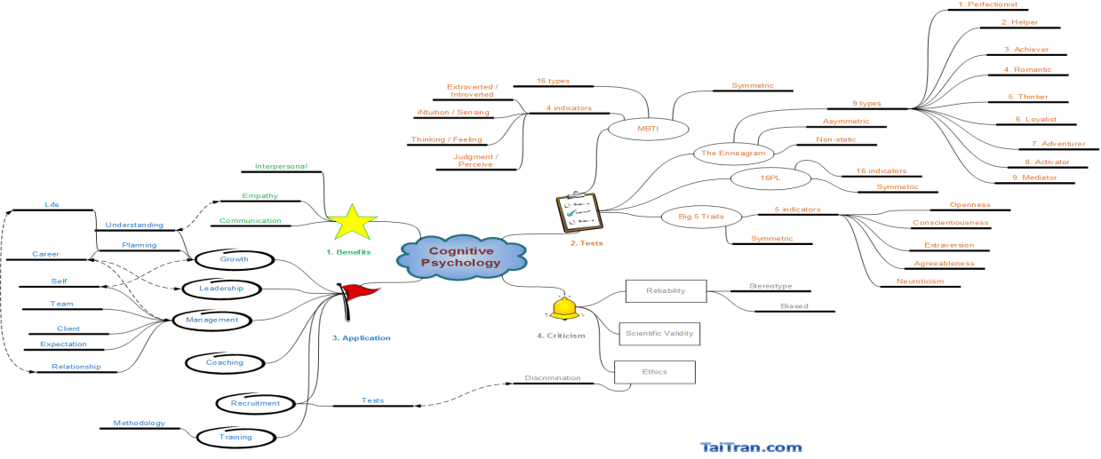
Researches
American psychologist A. Beck stated: "The way people think determines how they feel and act like." Pathological emotional states and inappropriate behavior is the result of "non-adaptive cognitive processes, so the goal of cognitive therapy is to" modification of dysfunctional beliefs and erroneous ways of processing information. " Changing the perception and thinking entails a modification of painful experiences and behavioral responses.
Beck to isolate and describe the phenomenon of automatic thoughts that are associated with the processing of current information - they are involuntary, fleeting, unconscious and directly lead to emotional and behavioral reactions. The scientist notes that the emotional disorders (sadness, anxious affect, irritability), automatic thoughts has a number of specific features. For example, sadness is associated with the idea of ​​loss, anger - a violation of any standard, the anguish - the content of the negative thoughts about themselves, the world, the people, the future (depressive triad), fear - of external threat and the inability to cope with it by virtue of its own insolvency.

Slide 9
The structure of personality in cognitive psychology
In cognitive psychology by J. Kelly personality structure is identified with two types of personal constructs to ensure the accumulation of human knowledge about ourselves and the world around us:
- Basic ("nuclear") - for the interaction with other people;
- Peripheral - to address the current challenges of a smaller level.
Each construct a dichotomous form (eg, "good - evil," "sociable - closed"). The whole system of personal constructs a hierarchical structure, functioning under partly innate, partly acquired by the plans of the information processing - the so-called "schemes". Personality development continues throughout life as the path of accumulation of constructs, and on ways to improve the «schemes».

Slide 10
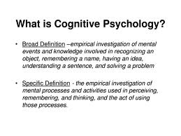
Relationship of consciousness and the unconscious
An interesting is a view of "cognitive scientists" on the relationship of consciousness and the unconscious. First, the rebuilding of the psychoanalytic understanding of the unconscious, they introduced the concept of "unconscious." Unconscious includes not, what is suppressed in the unconscious because of dissatisfaction with congenital instincts (according to Freud), and a condition in which a lack of awareness of existing internal processes. For example, the input data may not be realized, but the cause of human behavior act automatically. Second, cognitive processes occur on conscious and unconscious levels. Moreover, the latter is characterized by a high-speed processing of information.

Slide 11
Conclusion
In a broad sense, cognitive psychology - is the branch of psychology (and the discipline), based on the cognitive paradigm, and its subject - discursive activity, interpretation of data, the emergence and transformation of mental representations, as well as their understanding, extended to the analysis of all types of knowledge or cognition. In a narrow sense, the content of cognitive psychology is broadly consistent with cognitive psychology (cognitive) processes in the national tradition as a branch of general psychology.

