Slide 1
ENGLISH PAINTERS

Slide 2
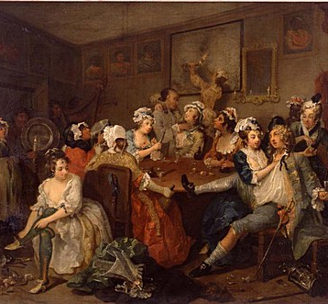
William Hogarth
William Hogarth (1697-1764) was the first great English painter who raised English pictorial art to a high level of importance.
His engravings of modern morality subjects were aimed at a wide public, and their outstanding success established his financial independence.
To safeguard his livelihood against pirated editions, he fought for legislation protecting artists' copyright.
Britain's first copyright act was passed in 1735, the year he published his satirical eight-part series The Rake's Progress.
The Rake's Progress

Slide 3
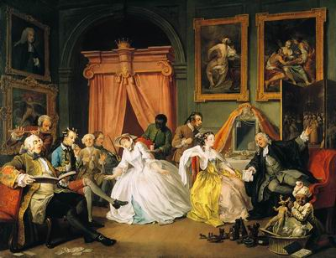
Marriage la Mode

Slide 4
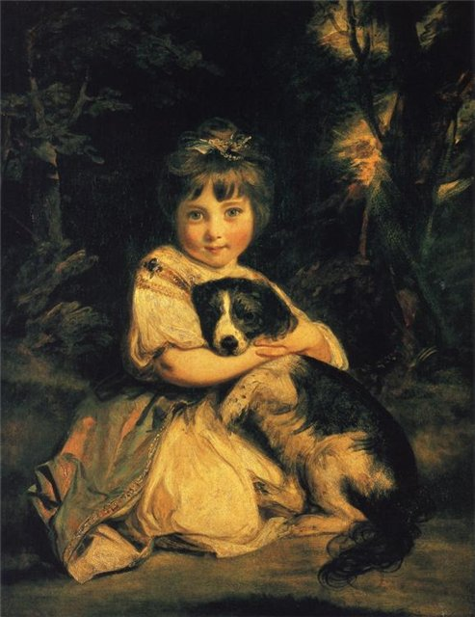
Reynolds Sir Joshua
Sir Joshua Reynolds (1723—1792), the first President of the Royal Academy of Arts, was not only a painter but the founder of the academic principles of the "British school".
Reynolds was the most outstanding portraitist of the 18th century.
In his pictures he did not only paint portraits but produced characters.
Love Me, Love My Dog.

Slide 5
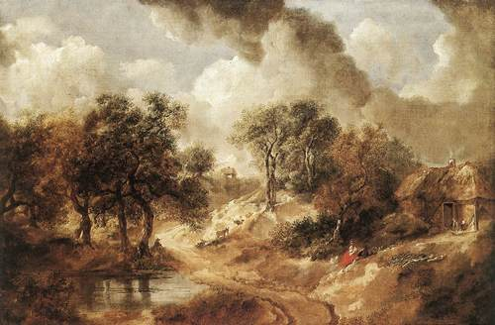
Thomas Gainsborough
Thomas Gainsborough (1727— 1788) was a brilliant portrait painter.
A good amateur violinist and a lover of the drama, he was an artistic person.
T. Gainsborough is the creator of the great English school of landscape painting.
His great love for the English country and his delicate understanding of nature are felt in his pictures.
Landscape

Slide 6
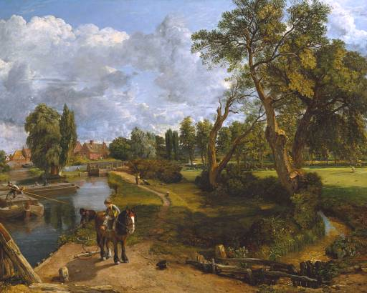
John Constable
John Constable is one of the greatest landscape painters.
He was the first landscape painter who considered that every painter should make his sketches direct from nature, which is working in the open air.
Constable was a realist. The most famous of his works are “Flatford Mill”, “The white horse”, “Waterloo Bridge” and others.
Constable may truly be considered the father of modern landscape painting.
Flatford Mill

Slide 7
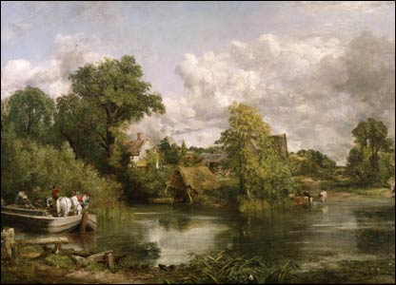
The white horse

Slide 8
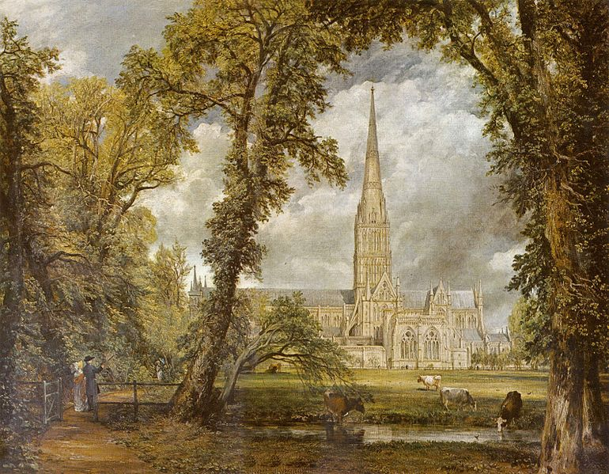
Salisbury cathedral

Slide 9
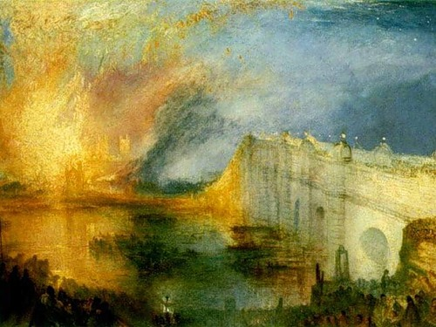
Joseph Turner
Another famous English painter was Joseph Turner (1775—1851), whose business was to paint the light.
He proved that with the help of light it is, possible to show qualities of any subject.
Son of a London barber, he started drawing and painting when he was a little boy.
In 1802 Turner was elected academi­cian of the Royal Academy, where his oil paintings had been exhibited.
He died at the age of seventy-six.
Turner was a representative of Romanticism.
Burning of the Houses of Parliament

Slide 10
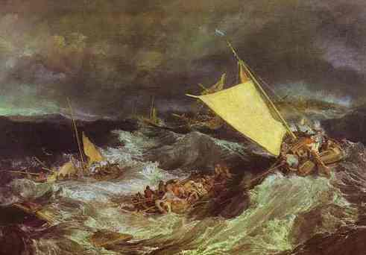
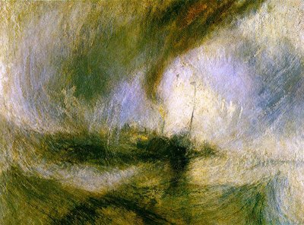
The Shipwreck
Snow Storm

