Slide 1


Nu Virgos
was the name used to promote the group VIA Gra (ВИА Гра) outside of Russia, Ukraine and other nearby countries.

Slide 2


Slide 3
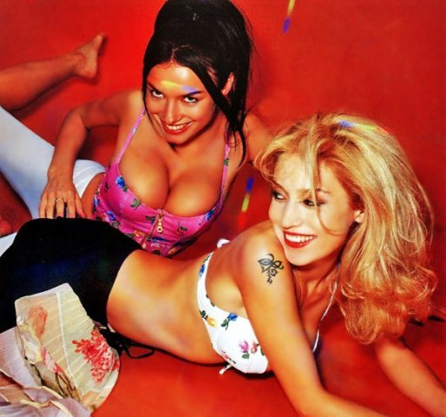
The name VIA Gra is both a reference to the drug Viagra and a play on words, since the first three letters stand for "vocal-instrumental ensemble" in Ukrainian, and "gra" means "game" (or "play") in Ukrainian.

Slide 4
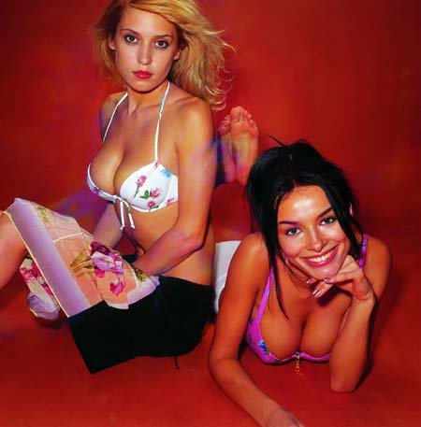

Slide 5
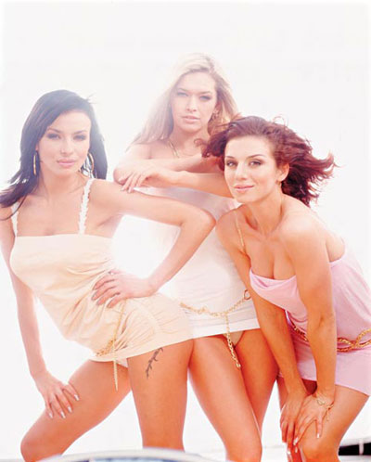
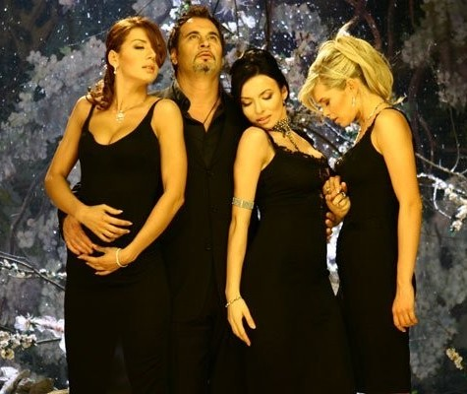
VIA Gra was a Ukrainian girl group that hit the charts in these countries in September 2000 with their first single "Popytka No. 5". Their first success outside the Russian language area was in May 2004 with the single "Stop! Stop! Stop!",an English version of their 2002 Russian song. The group is known for their frequent lineup changes, with 13 different individuals having at one time been in the group. The group was co-created by Dmitriy Kostyuk and Konstantin Meladze.

Slide 6
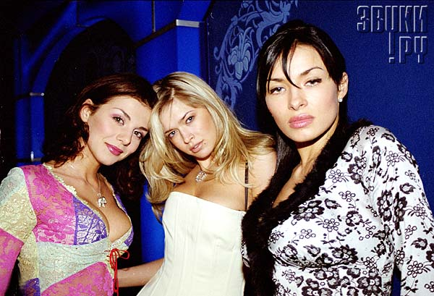
In 2000 Alina and Nadya made "Popytka No. 5" more videos were out on the screens: "Obnimi menya" (Hold me closer), "Bomba" (Bomb), "Ya ne vernus" (I won’t be back).[4] By the end of the year VIA Gra's repertoire comprised 7 songs that were enough to embark on a tour. The group’s first live performance ever took place in Dnipropetrovsk on the stage of the city’s Ledoviy Palace in front of 4,000 spectators.

Slide 7


Slide 8
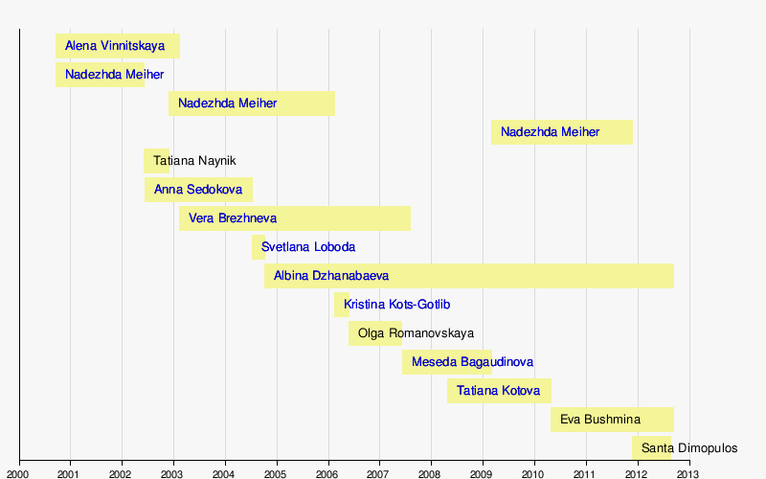
Participants grupy

Slide 9
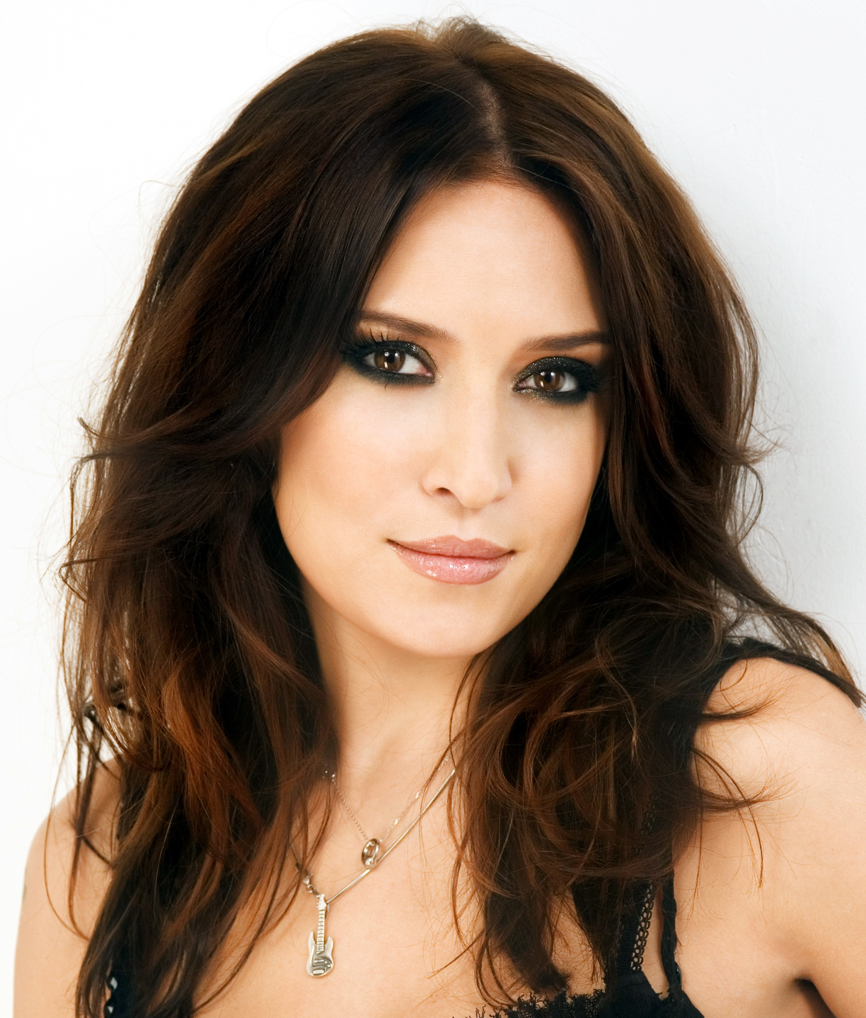
Alеna Vinnitskaya
(1999-2003)

Slide 10

Nadezhda Granovskaya
(2000-2002)
(2002-2006)
(2009-2011)

Slide 11

Tatiana Naynik
(2002)

Slide 12

Anna Sedokova
(2002-2004)

Slide 13

Vera Brezhneva
(2003-2007)

Slide 14

Svetlana Loboda
(2004)

Slide 15

Kristina Kots-Gotlib
(2006)

Slide 16
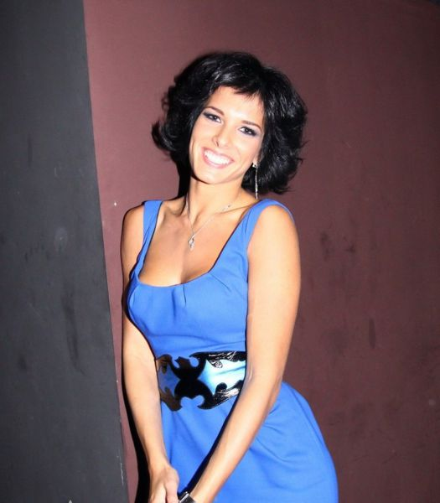
Olga Romanovskaya
(2006-2007)

Slide 17

Meseda Bagaudinova
(2007-2009)

Slide 18

Tatiana Kotova
(2008-2010)

Slide 19
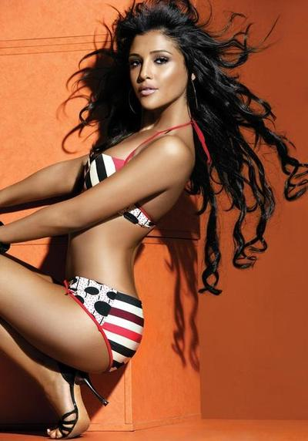
Santa Dimopulos
(2011-2012)

Slide 20

Albina Dzhanabaeva
(2004-2012)

Slide 21

Eva Bushmina
(2010-2012)

