Slide 1
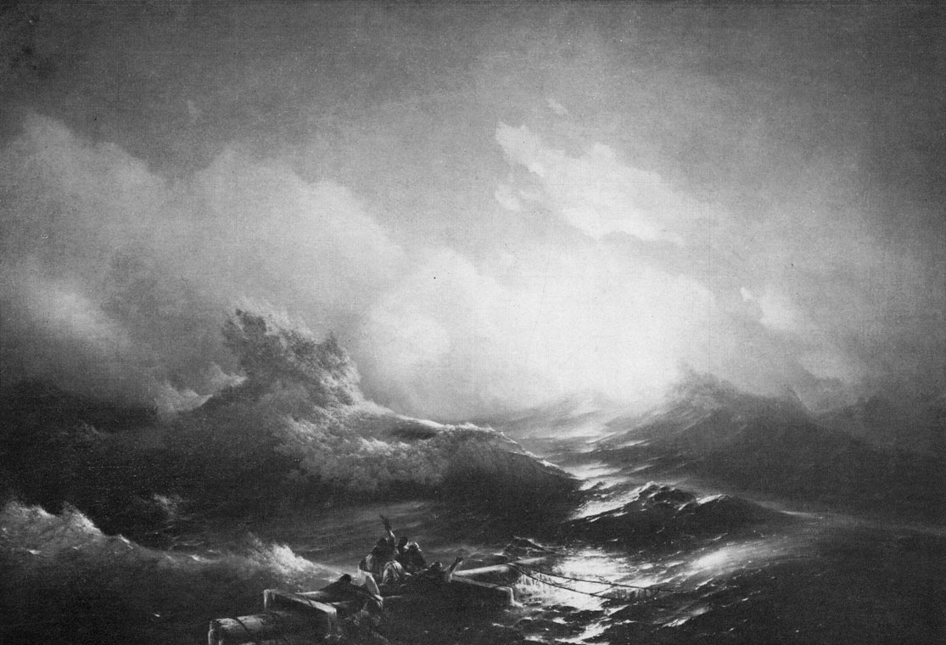
The Ocean Has Issues
or 7 Biggest Problems Facing Our Seas,
and How to Fix Them

Slide 2
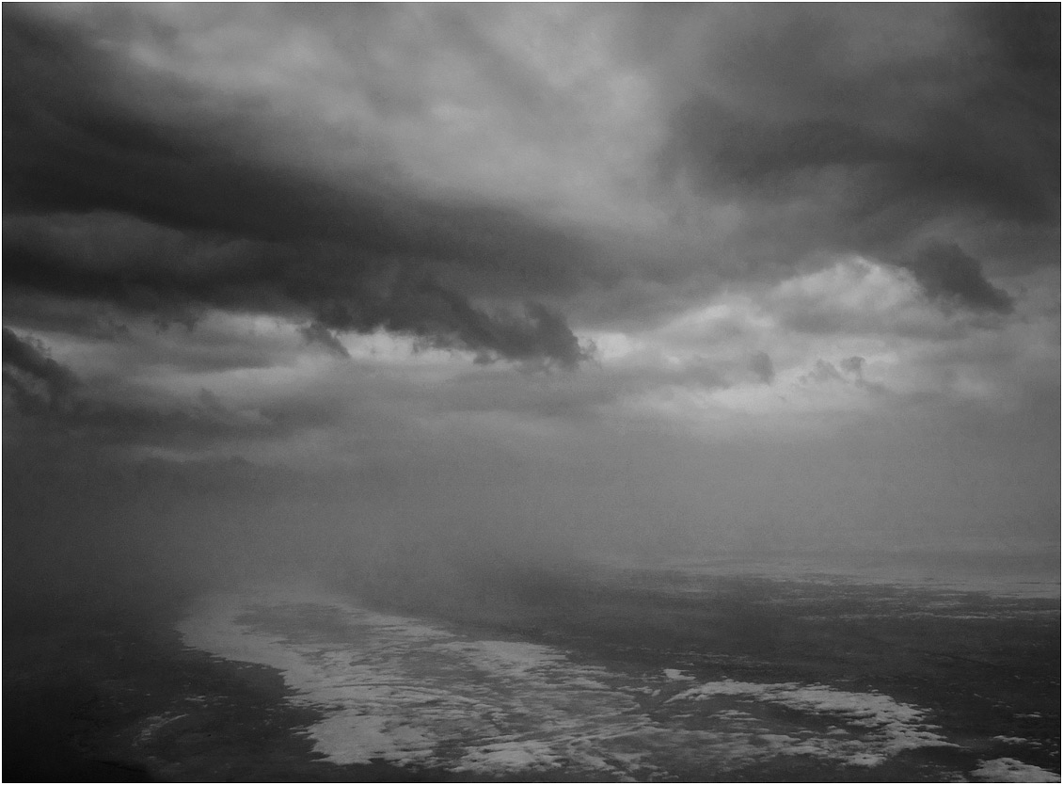
The oceans are among our biggest resource for life on earth, and also our biggest dumping grounds. That kind of paradox could give anyone an identity crisis. We seem to think we can take all the goodies out and put all our garbage in, and then expect them to keep happily ticking away indefinitely. However, while it's true the oceans can provide us with some amazing eco-solutions like alternative energy, they're are undergoing some serious stress factors.
Here are the seven biggest problems, plus some light at the end of the tunnel.

Slide 3
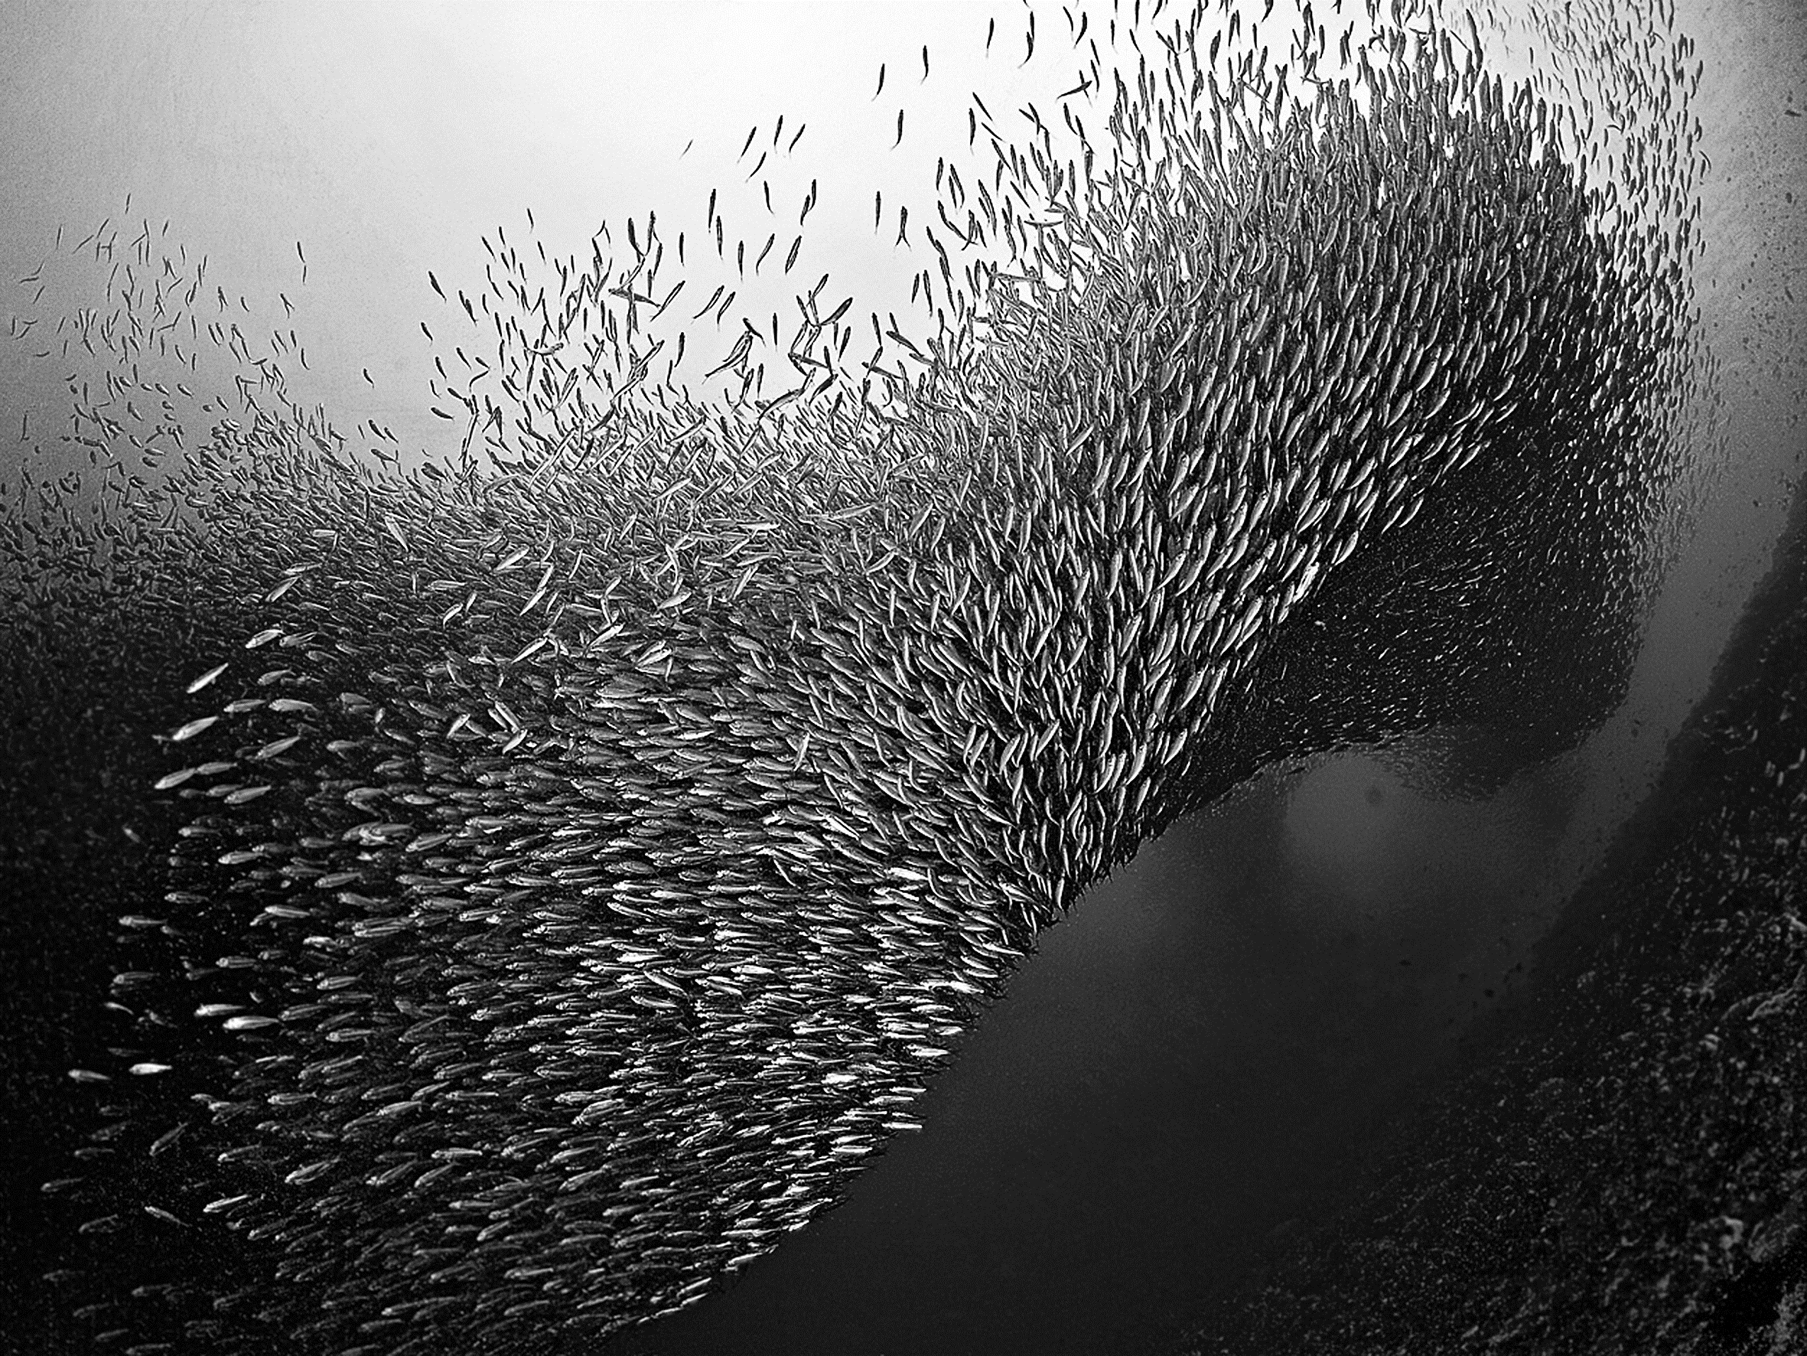
1. Overfishing Is Draining the Life From the Water
Overfishing is having some serious impacts on our oceans. Not only does it work towards wiping out a species, but also the other species of marine animals that are dependent upon those fish for survival. It's been shown that overfishing can cause marine animals to starve, since we're taking food from their mouths in too large of numbers for them to be able to get their fill. It is also estimated that most seas already need long term fishing bans if certain species are to recover at all.
There is much to be desired in the ways we fish. First, we humans use some pretty destructive methods in how we pull catches, including bottom trawling which destroys sea floor habitat and scoops up many unwanted fish and animals that are tossed aside. We also pull far too many fish to be sustainable, pushing many species to the point of being listed as threatened and endangered.

Slide 4
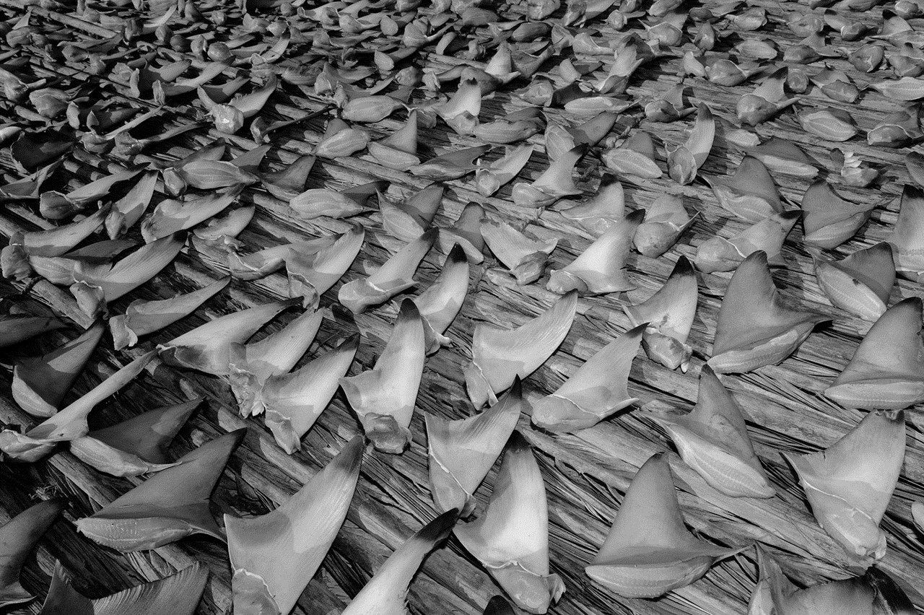
2. Ocean's Most Important Predators Being Killed... But Just for the Fins
Overfishing is an issue that extends beyond familiar species like bluefin tuna and orange roughy. It's also a serious issue with sharks. Sharks are killed in the tens of millions each year, mainly for their fins. It is a common practice to catch sharks, cut off their fins, and toss them back into the ocean where they are left to die. The fins are sold as an ingredient for soup. And the waste is extraordinary.
Sharks are top-of-the-food-chain predators, which means their reproduction rate is slow. Their numbers don't bounce back easily from overfishing. On top of that, their predator status also helps regulate the numbers of other species. When a major predator is take out of the loop, it's usually the case that species lower on the food chain start to overpopulate their habitat, creating a destructive downward spiral of the ecosystem.

Slide 5
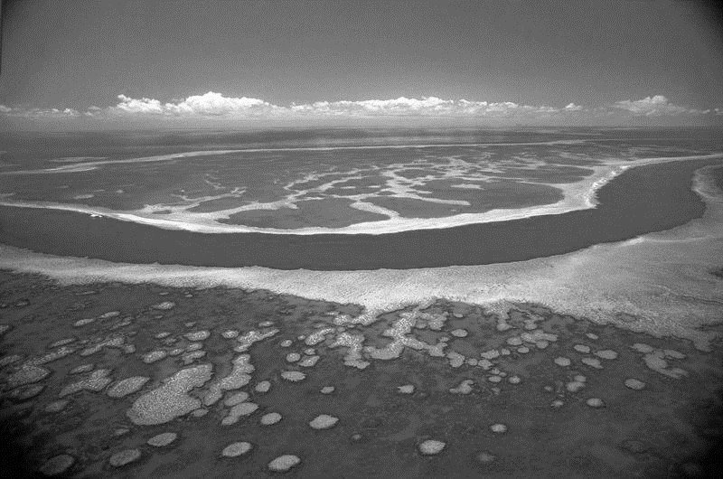
3. Ocean Acidification Sending Us Back 35 Million Years
Ocean acidification is no small issue. The basic science behind acidification is that the ocean absorbs CO2 through natural processes, but at the rate at which we're pumping it into the atmosphere through burning fossil fuels, the ocean's pH balance is dropping to the point where life within the ocean is having trouble coping.
"Ocean acidification is more rapid than ever in the history of the earth and if you look at the pCO2 (partial pressure of carbon dioxide) levels we have reached now, you have to go back 35 million years in time to find the equivalents" said Jelle Bijma, chair of the EuroCLIMATE programme Scientific Committee and a biogeochemist at the Alfred-Wegener-Institute Bremerhaven.
Freaky, right? At some point in time, there is a tipping point where the oceans become to acidic to support life that can't quickly adjust. In other words, many species are going to be wiped out, from shellfish to corals and the fish that depend on them.

Slide 6
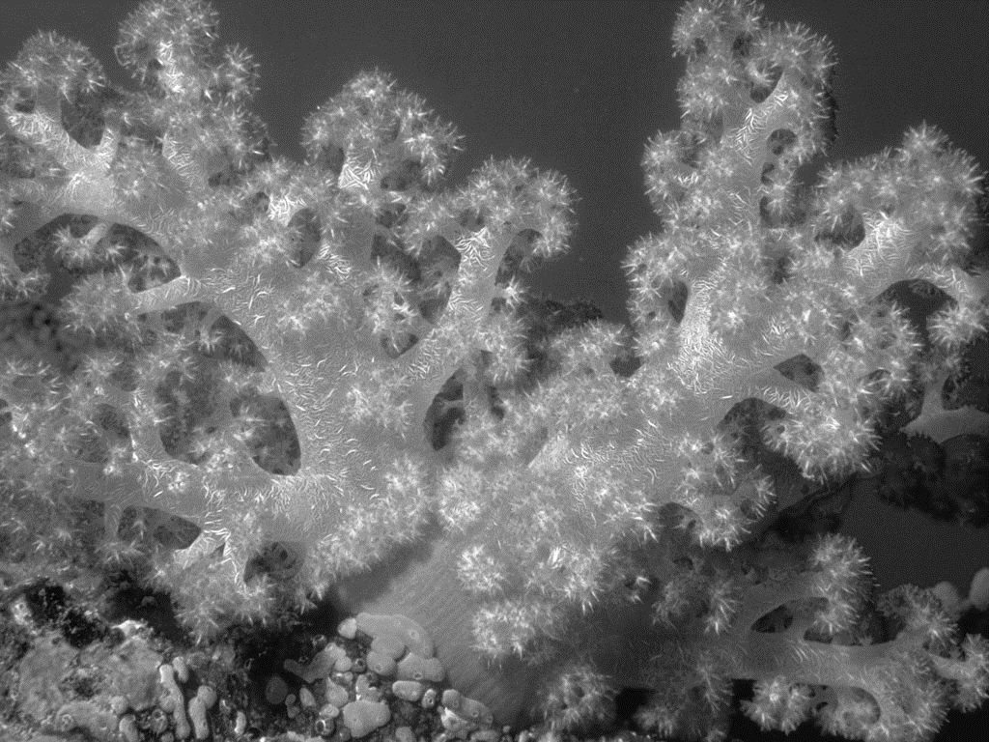
4. Dying Coral Reefs and A Scary Downward Spiral
Keeping the coral reefs healthy is another major buzz topic right now. A focus on how to protect a coral reef is important considering coral reefs support a huge amount of small sea life, which in turn supports both larger sea life and people, not only for immediate food needs but also economically.
Global warming is a primary worse of coral bleaching, but there are other causes as well. Science is working on ways, but it also is a matter of setting aside marine conservation areas. Figuring out ways to protect this “support system” is a must for the overall health of the oceans.

Slide 7
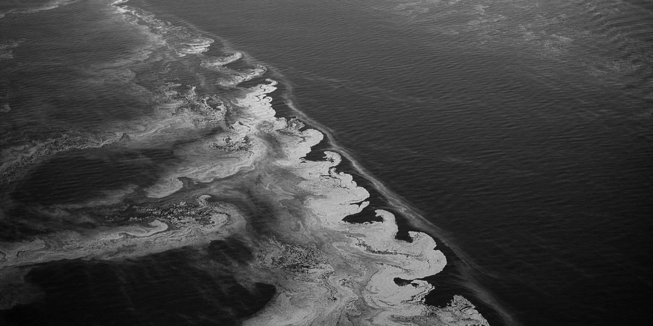
5. Ocean Dead Zones Are Everywhere, and Growing
Dead zones are swaths of ocean that don't support life due to a lack of oxygen, and global warming is a prime suspect for what's behind the shifts in ocean behavior that cause dead zones. The number of dead zones is growing at an alarming rate, with over 400 known to exist, and the number is expected to grow.
Dead zone research underscores the interconnectedness of our planet. It appears that crop biodiversity on land could help prevent dead zones in the ocean by reducing or eliminating the use of fertilizers and pesticides that run off into the open ocean and are part of the cause of dead zones. Knowing what we dump into the oceans is important in being aware of our role in creating areas of lifelessness in an ecosystem upon which we depend.

Slide 8
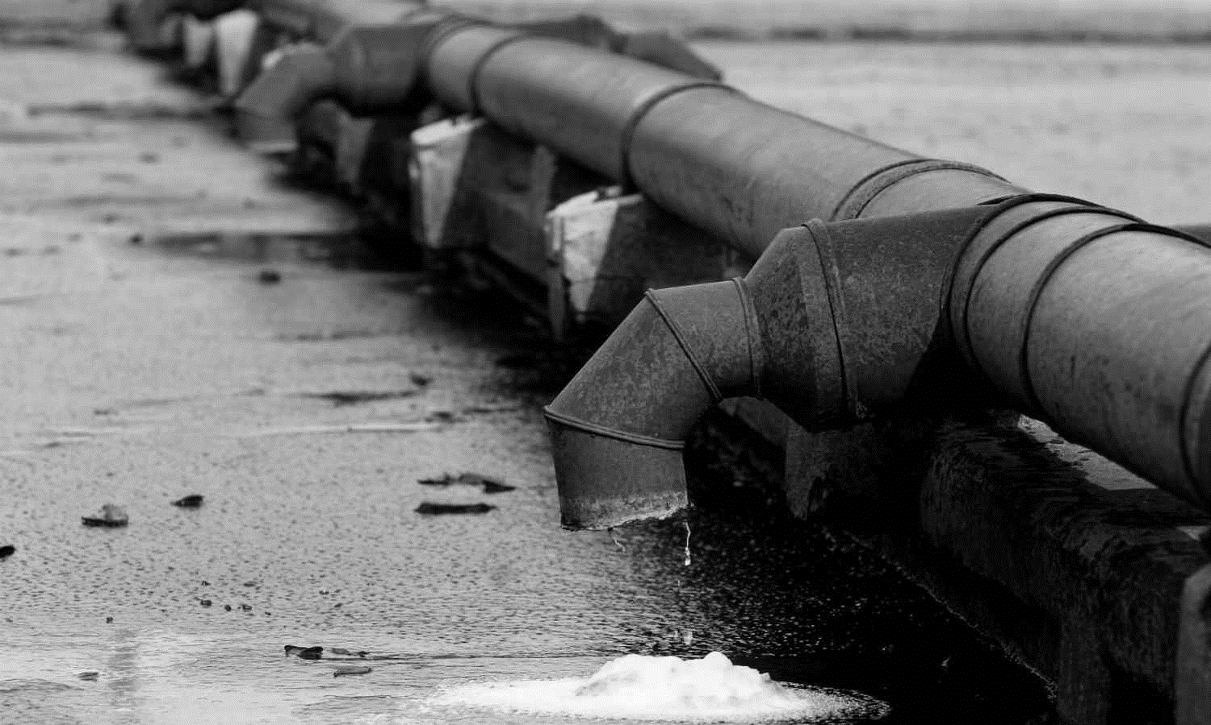
6. Mercury Pollution Going from Coal to Oceans to Fish to Our Dinner Table
Pollution is running rampant in the oceans but one of the scariest pollutants is mercury because, well, it ends up on the dinner table. The worst part is mercury levels in the oceans are predicted to rise. So where does the mercury come from? You can probably guess. Mainly coal plants. In fact, according to the Environmental Protection Agency, coal-fired power plants are the largest industrial source of mercury pollution. And, mercury has already contaminated water bodies in all 50 states, let alone our oceans. The mercury is absorbed by organisms on the bottom of the food chain and as bigger fish eat bigger fish, it works its way back up the food chain right to us, most notably in the form of tuna.
You can calculate how much tuna you can safely eat, and while the though that calculating your fish intake to avoid poisoning is really depressing, at least we're aware of the dangers so that we can, hopefully, straighten up our act.

Slide 9
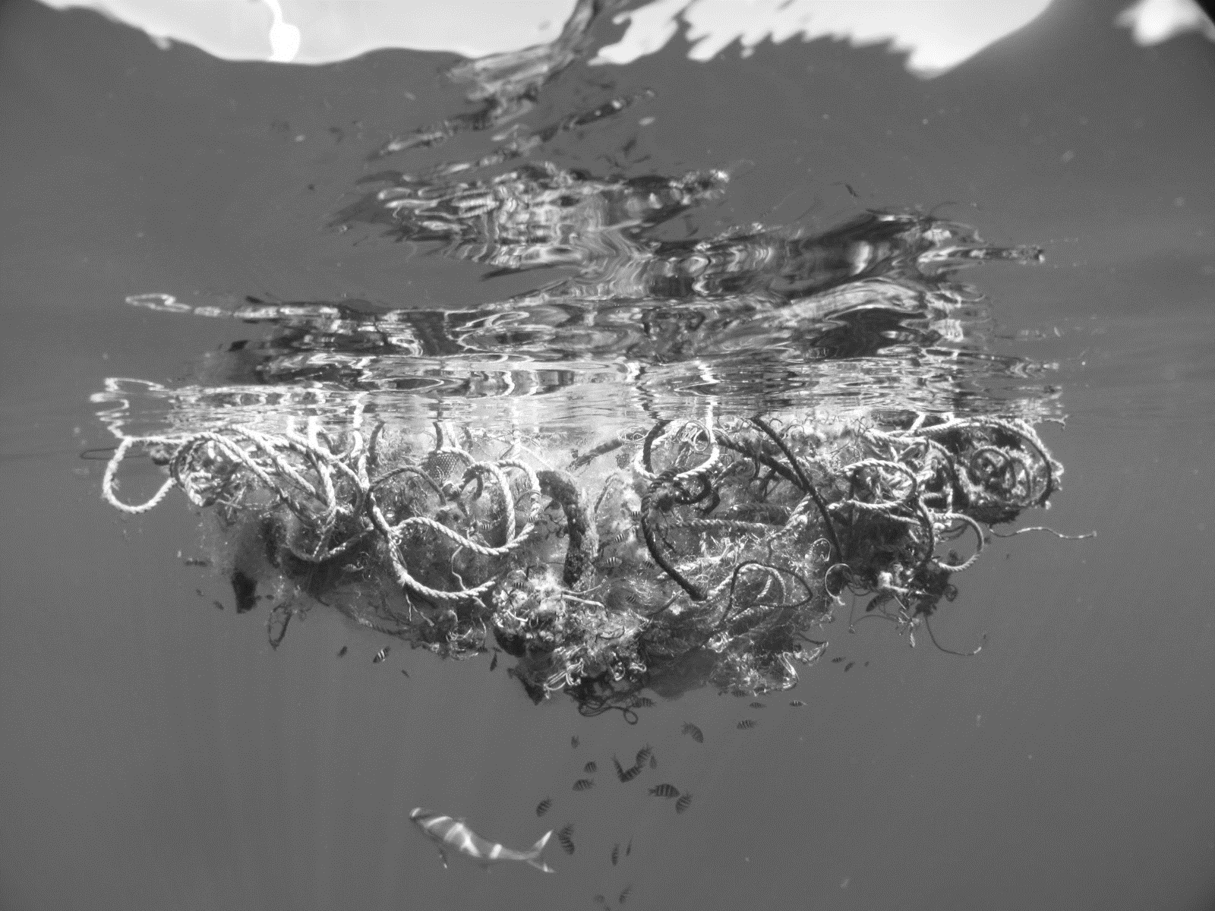
7. The Great Pacific Garbage Patch a Swirling Plastic Soup You Can See from Space
Luckily, the Great Pacific Garbage Patch getting a lot of attention from eco-organizations, including Project Kaisei, which is launching the first clean-up effort and experimentation, and David de Rothschild who will sail a boat made of plastic out to the patch to bring awareness to it.
We certainly can't ignore a giant patch of plastic soup the size of Texas sitting smack dab in the middle of the Pacific ocean.
Taking a look at the Great Pacific Garbage Patch is a sobering way to realize there is no "away" when it comes to trash, especially trash that lacks the ability to decompose. The patch was discovered by Captain Charles Moore, who has been actively vocal about it ever since.

Slide 10
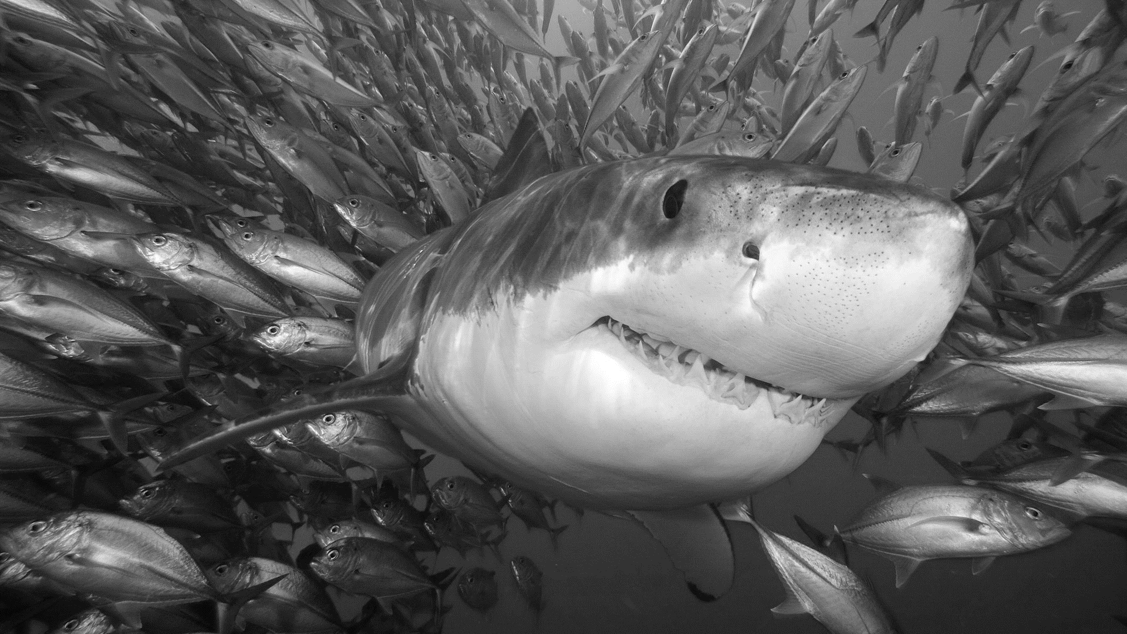
Sticking To What We Do Know - Conservation
Of course, good old fashioned conservation efforts will help us out. Though, looking at the big picture and the extent of the effort required, it might take a lot of gumption to stay optimistic. But optimistic we should be!
It's true that conservation efforts are lagging, but that doesn't mean they're non-existent. Records are even being set for how much marine area is being conserved. It's all just a head nod if we don't implement and enforce the regulations we create, and get even more creative with them. But when we look at what can happen for our oceans when conservation efforts are taken to the max, it's well worth the energy.

