Slide 1
United Nations (UN)

Slide 2
It was created for many reasons: • There should be peace and security in the world after the Second World War. • Countries should be friendly to each other. • Countries should help each other solve problems. • Human rights should be respected everywhere in the world.

Slide 4
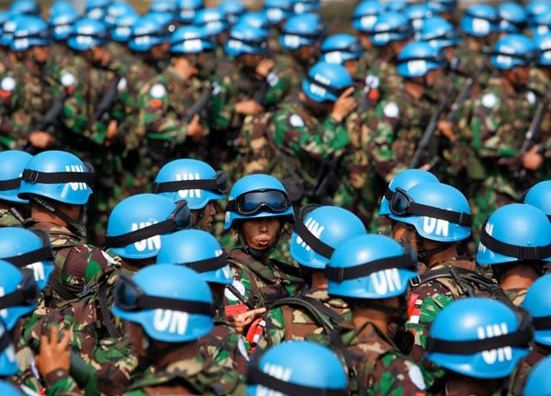
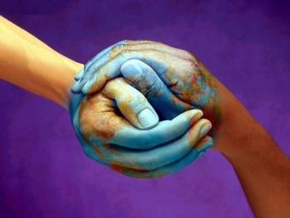
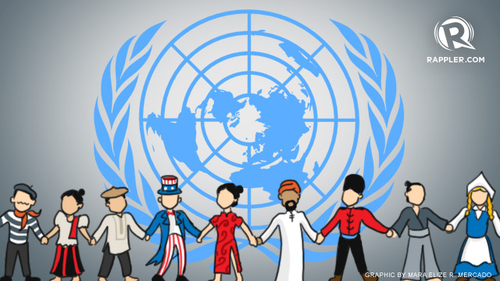
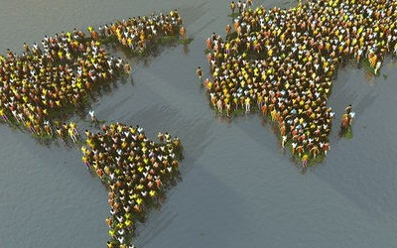

Slide 5
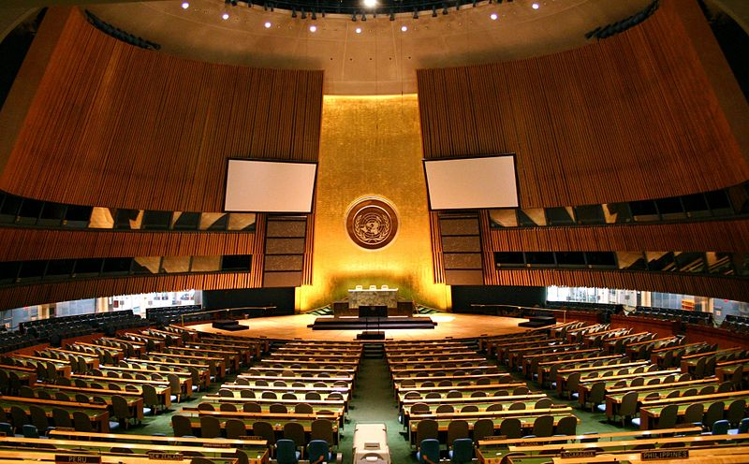
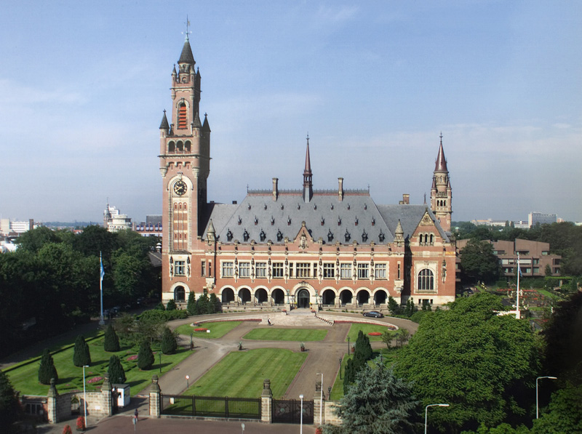
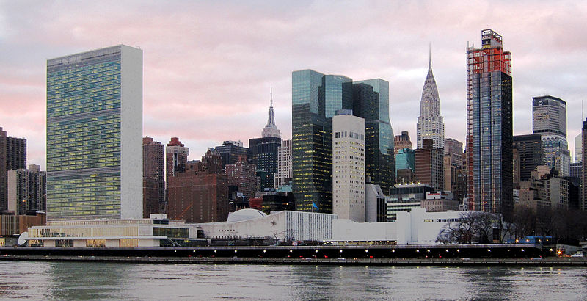
UN General Assembly
International Court of Justice
UN Secretariat

Slide 6
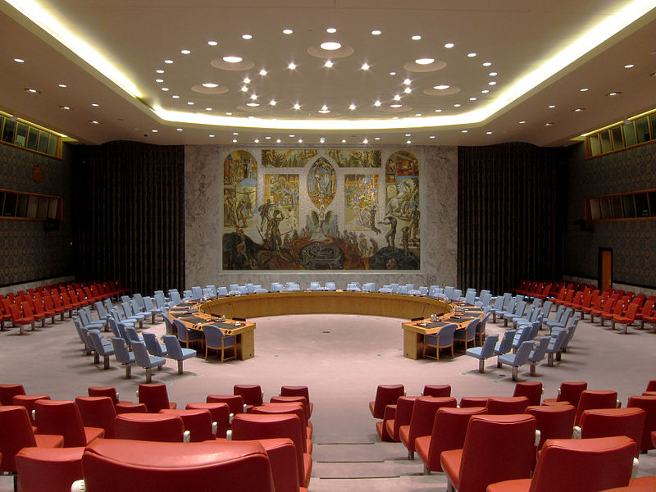
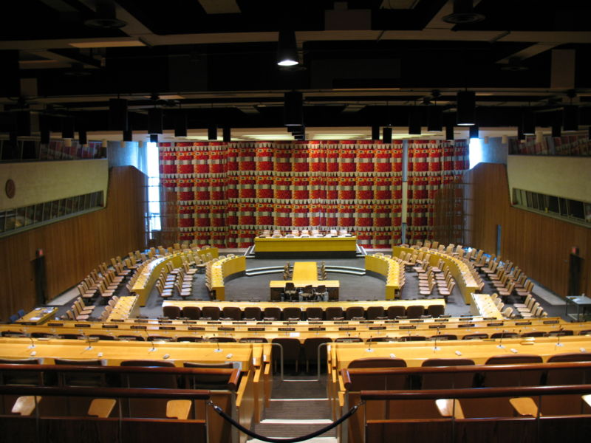
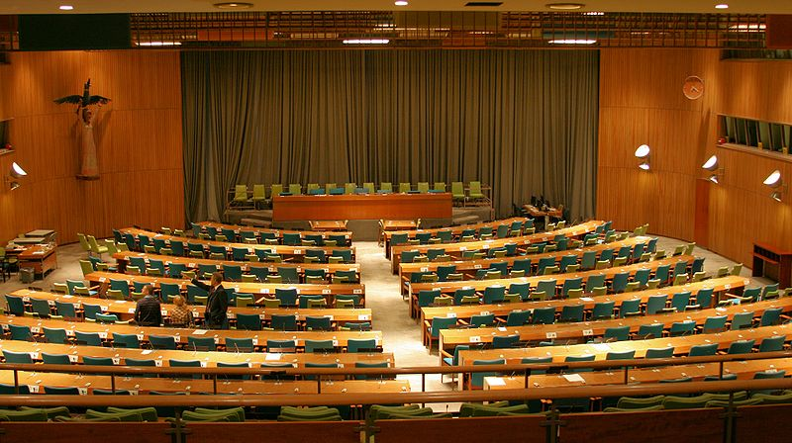
UN Security Council
UN Economic and Social Council
UN Trusteeship Council

