Slide 1
My Favorite
TV Channels

Slide 2
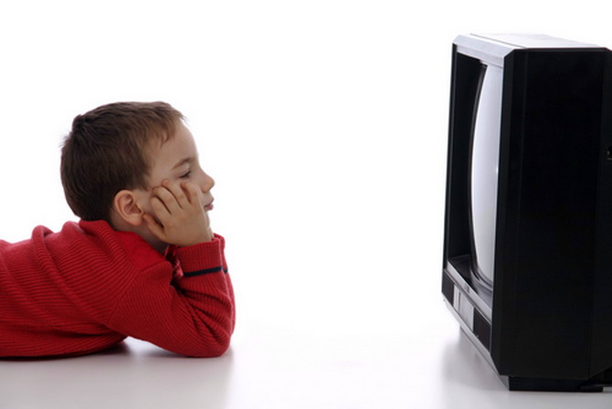
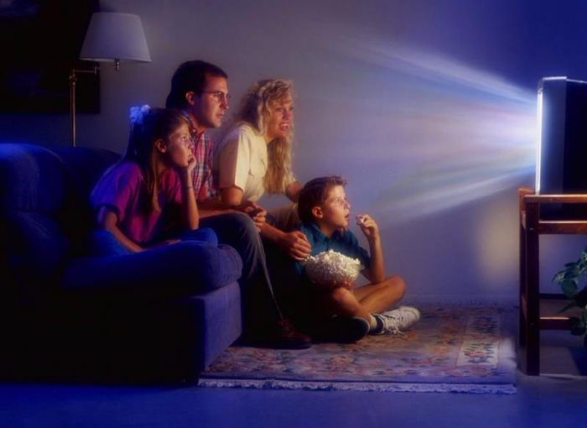
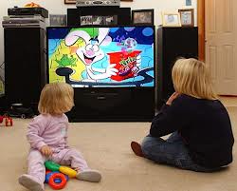
The most popular entertainment in our home life is television. Many people watch TV at leisure.

Slide 3
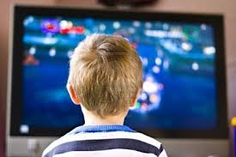
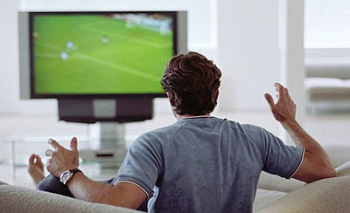
One can choose the program, which likes best. Those, who like music, can listen concerts. Sports fans can watch football or hockey matches.

Slide 4


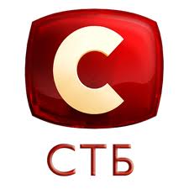

Television extends our knowledge about the world when we live. I like watch Ukrainian channels such as STB, Inter, New channel, QTV.
My favorite channel is STB. I watch this channel every day with pleasure.

Slide 5



I enjoy interesting programs such as “Everything will be fine”(“Все буде добре»), “Master Chief”(“Мастер Шеф») and “Ukraine has talent”(«Україна має талант”).

Slide 6

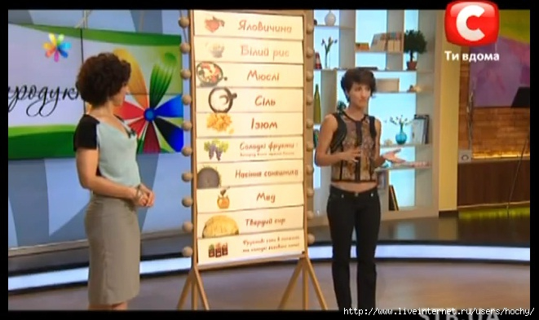
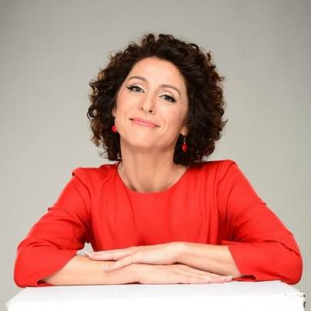
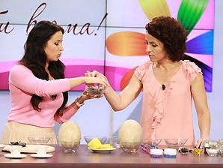
«EVERYTHING WILL BE FINE»
Leading – Nadezhda Matveeva
I think, this show is very popular
among Ukrainian, because there are many helpful advices, recipes, horoscopes in this show.

Slide 7

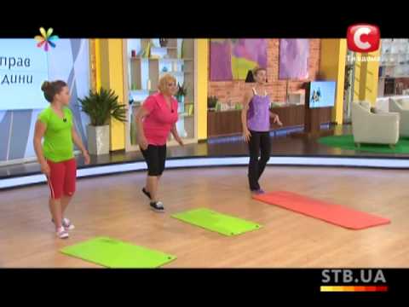
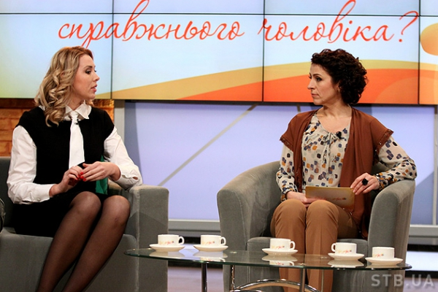
Also famous people, celebrities visit to the TV studio. Often can see sports exercises and advise on diet. I found a lot of useful things in this show.

Slide 8

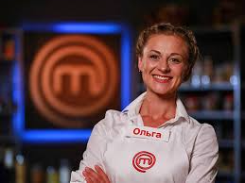

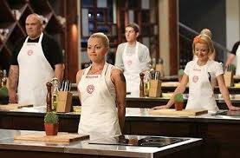
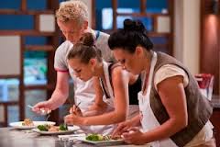
«MASTER CHIEF»
This is the show about cookery. Participants complete with each other in a battle of Cooks. They have a some jobs, which should they do during a some time.

Slide 9
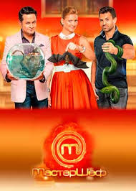
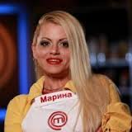
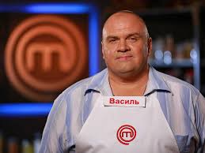
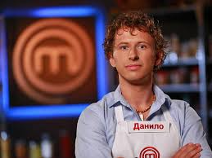
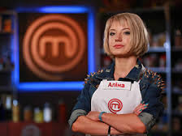
I find it interesting observe the work of the participants. More than all I like Marina Shevchenko. The job of a participants check three judges : Ector, Tatiana Litvinova and Nikolay Tishchenko.

Slide 10
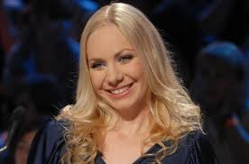
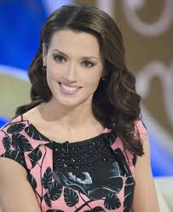
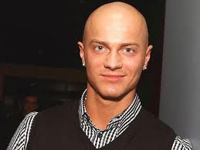
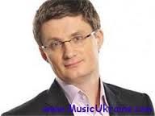
«UKRAINE HAS TALENT»
Leading – Oksana Marchenko
Judges : Vlad Yama, Igor Kondratuk,
Slava Frolova.

Slide 11
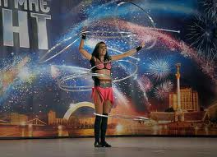
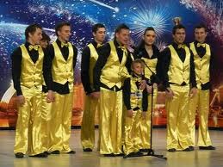
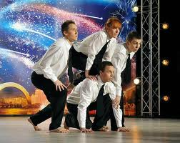
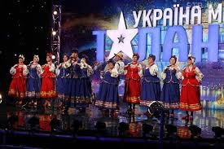
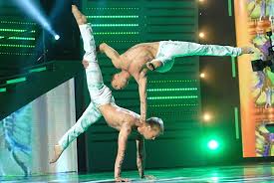
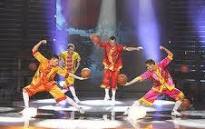
This is the show, which has casting, where participants show to judges their talents. It may be singing, playing a musical instruments, dancing, magic tricks, different abilities, street workout and other.

Slide 12
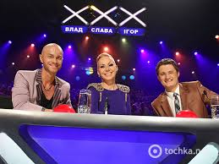
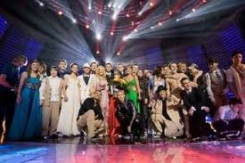
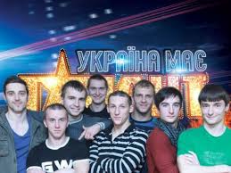
With each season more and more difficult to surprise the judges. At the and of the season they determine the winner who will receive a million for the most amazing talent.

Slide 13
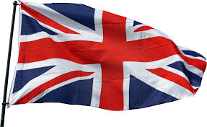
THE END
Thanks you for attention
by Tanchik Margaret,
9 Form

