Slide 1
"Cloud services" - what it is.

Slide 2
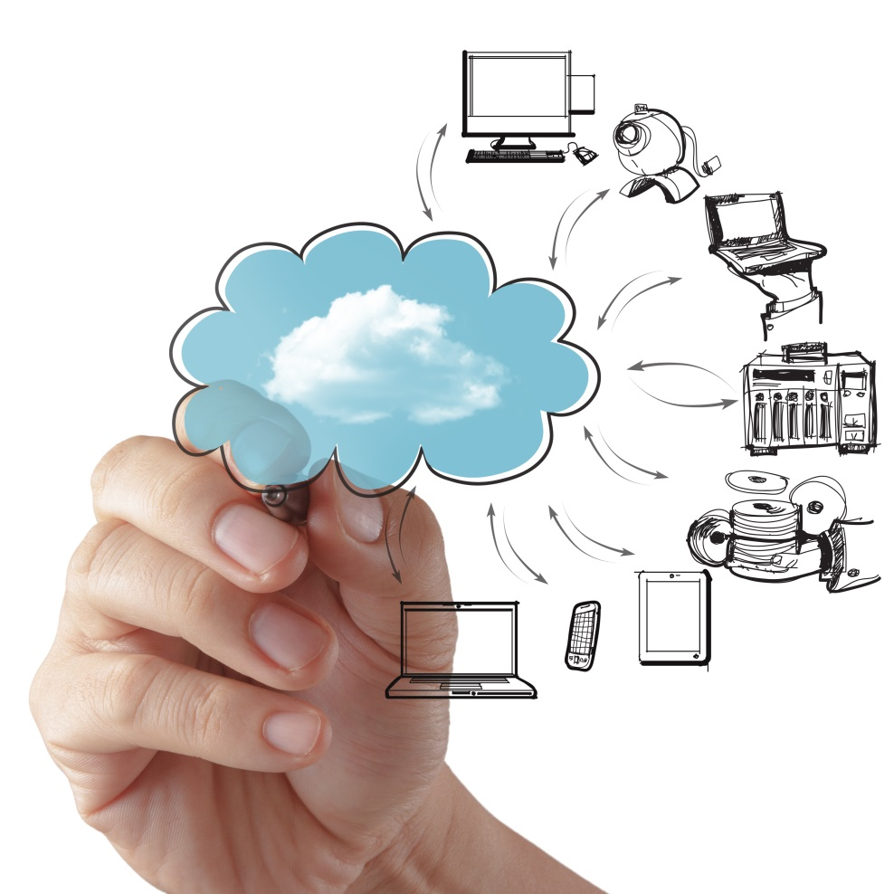
First of all – it is innovative online services. They provide an opportunity to use the enormous potential of the Internet of resources (disk space, memory, processing power, and more). These technologies offer great opportunities for entrepreneurs, enterprises of different ownership and direction, and for ordinary computer users. Working with the new Internet services does not involve the purchase of a super-powerful computers (for settlement), expensive programs and software, all of it you will find in service at any time convenient for you. And that is much important that the company absolutely no need to create a new unit to retrain staff to work with cloud services. The main condition for this type of service is the access to the Internet.
Let us see what are the different types of cloud services by type of service.

Slide 3
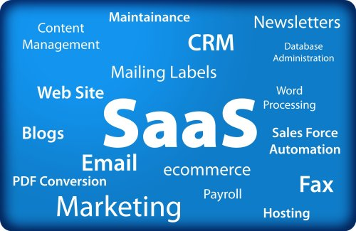
Saas – Software as a service
The main difference and advantage of this type of service is the ability to simultaneously provide a large number of users to access the same application. SAAS - is a kind of business model. Provider he develops web application performs debugging and management. The client receives the right to access the software using the Internet. In addition, the client does not need to monitor the operating status of the equipment, software upgrades. Client does not need to buy a license for the software, it only pay for its use, that is for rent. And if at some time in any program or software is needed for the client, it may suspend its use and does not pay for it.
Briefly the SaaS model can be described so:
The application is debugged under the remote user;
Using applications from a large number of users;
Payment is made as a payment, from month to month, or as payment for the volume of transactions;
Provide technical support without additional payment;
Updating and upgrading applications without compromising customer.

Slide 4
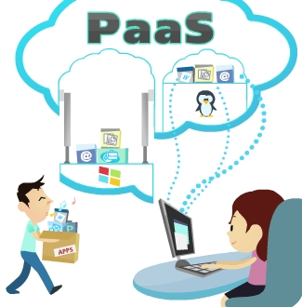
Paas – Platform as a service
In this case, the provider shall provide access to the use of information and technology platforms. What is meant by such platforms and what access gets the consumer: different operating systems; technological software; database systems and their administration; various testing tools; all kinds of tools. All of this is located on the servers of the cloud provider. Management of all information technology structure itself implements the provider. Just provider decides to which platform open access to the client. The consumer receives the right to use the platform to install the application programs to test and exploit them, if necessary, to change the consumption of computing resources and their amount. Payment for the use of cloud-based platform can be calculated on a few principles:
The level of consumption;
During the work of the various applications of the consumer;
For the volume of the data, the number of operations on them;
As well as the network traffic.

Slide 5
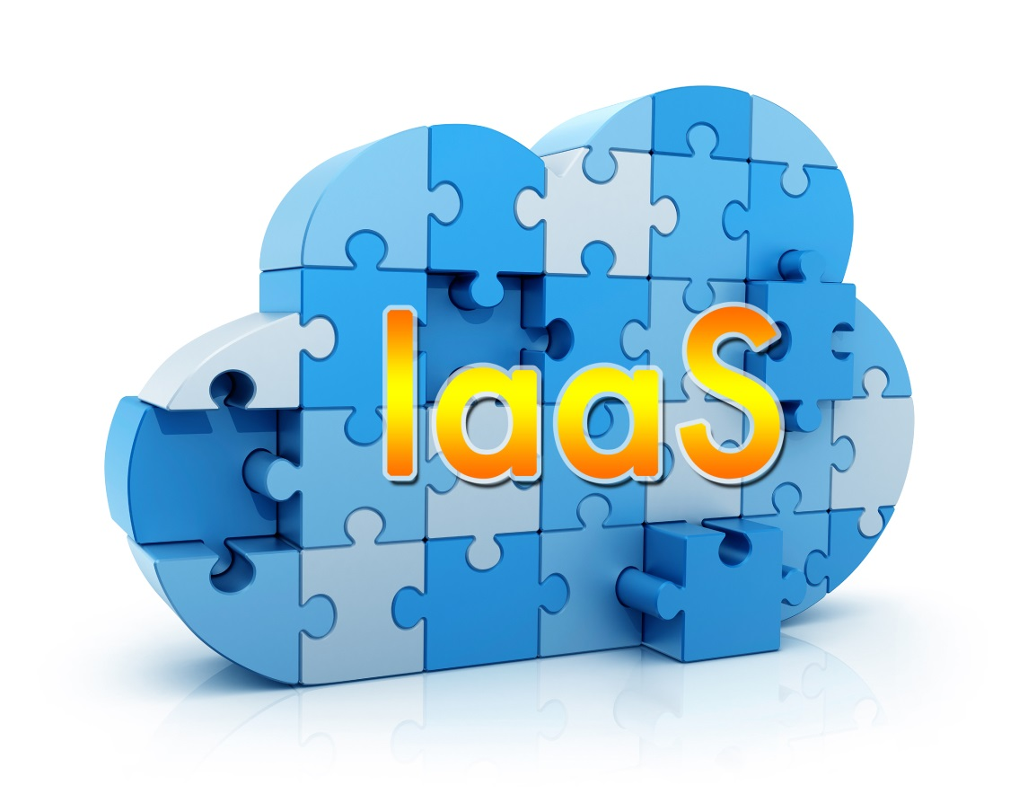
Iaas – Infastructure as a service
That is, providing the client in the use of ready-made cloud infrastructure. This means that the user has the right to dispose of and manage all the resources. Process and store data, install and run by a different software, operating systems. The user is able to control himself all the actions performed. Provider shall monitor and control all of the cloud, as it is a physical component, so the virtual infrastructure.
The special features of IaaS include:
Virtualization technologies.
Integrated Management Systems.
The reality of using the best architectures and frameworks.

Slide 6
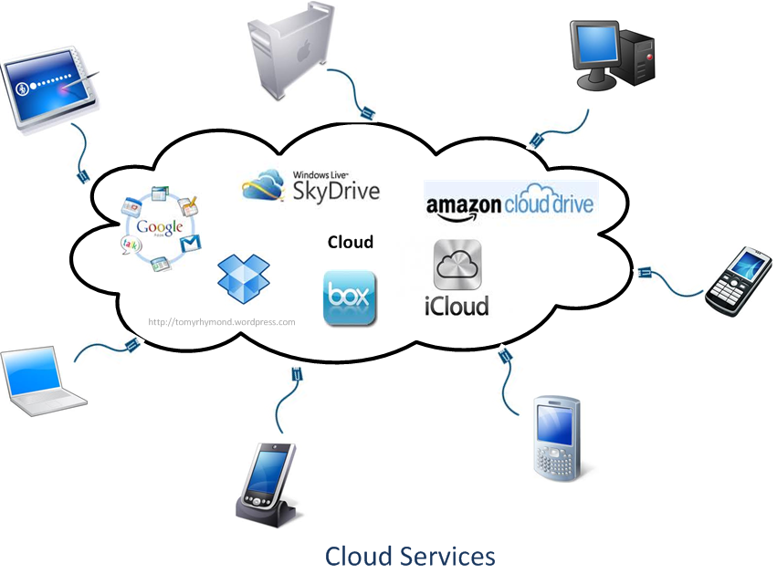
Kinds of «cloud»
But the kind of cloud service does not end there. There are also:
Cloud web services;
Managed Service, this service can be considered a veteran of cloud services;
Platforms commercial services - they can order certain types of services, such as secretarial services and a guided tour, and so on;
Internet integration - Bus in the cloud, combining several providers for integrated solutions and deliver them to users.

Slide 7
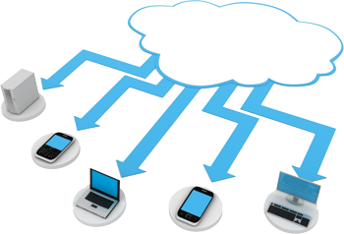
Purpose and use of cloud service
The main purpose of any cloud service is the provision of services to clients for the storage and processing of various data. These services help computer users get rid of the use of external media. No longer necessary to carry a flash card (which is very often lost or out of order, at the wrong time), external hard drives and other similar storage media. For example, doing some work on the computer, you do not wait too long to finish it in the workplace and decided to continue the task at home. But for this I need to get all the information and data necessary to perform the task, were on hand. This problem will be much easier to decide if all the work you performed, using the capabilities and resources of cloud services. After all, access to them can be made from any computer that has an Internet connection.
Advantages of using these services:
Data Warehouse, full access to the data from any computer connected to the network;
Perform all calculations and data processing does not depend on the power of your computer's disk space. All operations are carried out at the facilities of a cloud service, remotely, and if necessary, you can display only the result;
The cost of these services is very accessible and there is a tendency for their constant decline.

Slide 8

Thank you for your attention!☺

