Slide 1
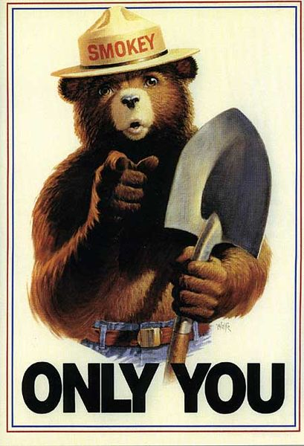
Wildfire
From Wikipedia, the free encyclopedia

Slide 2
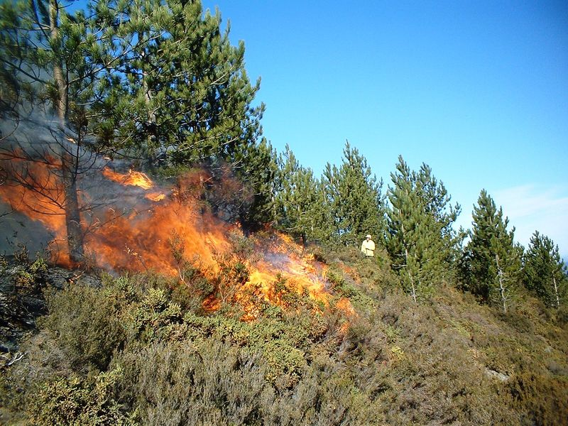
A wildfire is an uncontrolled fire in an area of combustible vegetation that occurs in the countryside or a wilderness area. A wildfire differs from other fires by its extensive size, the speed at which it can spread out from its original source, its potential to change direction unexpectedly, and its ability to jump gaps such as roads, rivers and fire breaks.

Slide 3
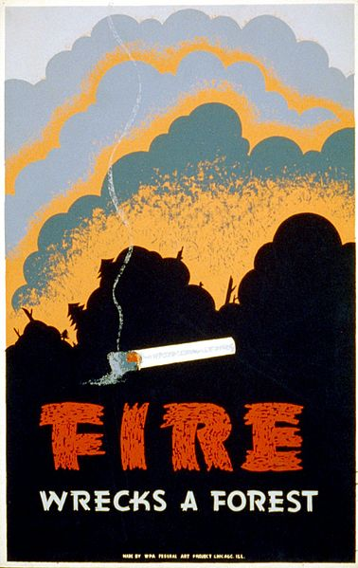
Wildfires are a common occurrence in Australia; because of the generally hot and dry climate, they pose a great risk to life and infrastructure during all times of the year, though mostly throughout the hotter months of summer and spring. In the United States, there are typically between 60,000 and 80,000 wildfires that occur each year, burning 3 million to 10 million acres of land depending on the year.

Slide 4
The most common cause of wildfires varies throughout the world. In the Canada and northwest China, for example, lightning is the major source of ignition. In other parts of the world, human involvement is a major contributor. In Mexico, Central America, South America, Africa, Southeast Asia, Fiji, and New Zealand, wildfires can be attributed to human activities such as animal husbandry, agriculture, and land-conversion burning. Human carelessness is a major cause of wildfires in China and in the Mediterranean Basin. In the United States and Australia, the source of wildfires can be traced to both lightning strikes and human activities such as machinery sparks and cast-away cigarette butts.

Slide 5

Plants in wildfire-prone ecosystems often survive through adaptations to their local fire regime. Such adaptations include physical protection against heat, increased growth after a fire event, and flammable materials that encourage fire and may eliminate competition.

Slide 6
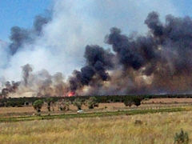
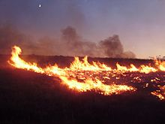
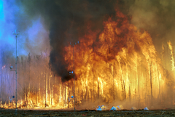
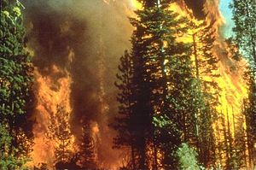
Wildfires can affect climate and weather and have major impacts on atmospheric pollution. Wildfire emissions contain fine particulate matter which can cause cardiovascular and respiratory problems. Atmospheric models suggest that these concentrations of sooty particles could increase absorption of incoming solar radiation during winter months by as much as 15%

Slide 7
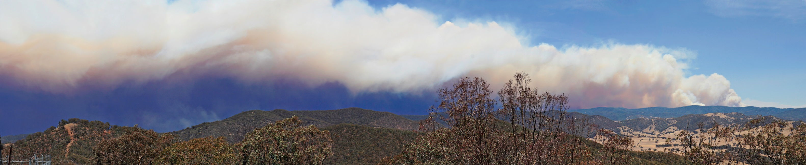
Effective prevention techniques allow supervising agencies to manage air quality, maintain ecological balances, protect resources and to limit the effects of future uncontrolled fires. However, prevention policies must consider the role that humans play in wildfires, since, for example, 95% of forest fires in Europe are related to human involvement. Sources of human-caused fire may include arson, accidental ignition, or the uncontrolled use of fire in land-clearing and agriculture such as the slash-and-burn farming in Southeast Asia.

Slide 8
Thank you for your attention

