Slide 1
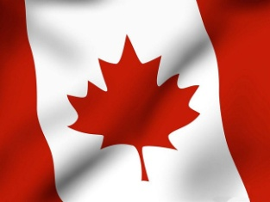
Canada
Olga Novik
10-B form

Slide 2
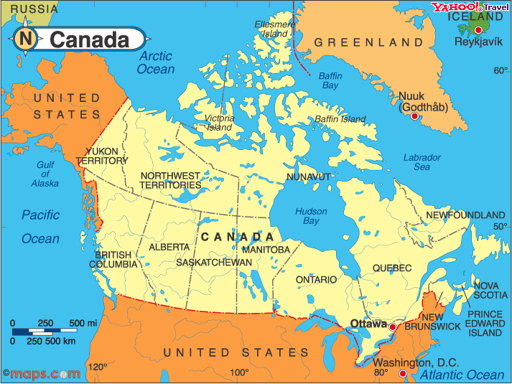
Canada is situated on the North American continent. It is the second largest country in the world after Russia. Canada is washed by three oceans: the Atlantic, the Pacific and the Arctic ones

Slide 3
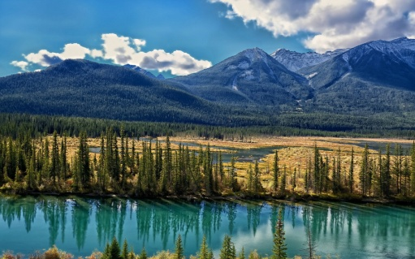
The interior of the country is a plain. Canada shares four of the five Great Lakes — Superior, Huron, Erie and Ontario, with the USA.

Slide 4
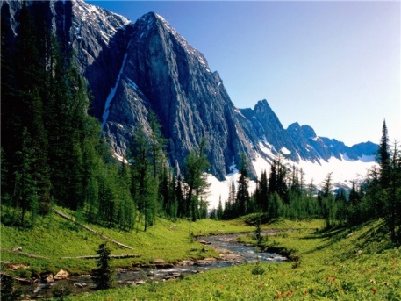
Geography
Canada occupies a major northern portion of North America, sharing land borders with the contiguous United States to the south and the US state of Alaska to the northwest. Canada stretches from the Atlantic Ocean in the east to the Pacific Ocean in the west; to the north lies the Arctic.

Slide 5
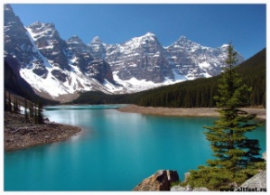
The Great Lakes
The Great Lakes are a chain of freshwater lakes located in eastern North America, on the Canada – United States border.

Slide 6
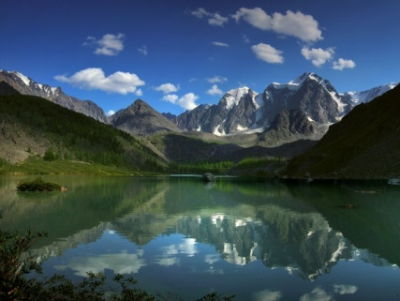
Lake Superior
Lake Superior is the largest of the five Great Lakes of North America. It is the largest freshwater lake in the world by surface area and is the world's third-largest freshwater lake by volume.

Slide 7
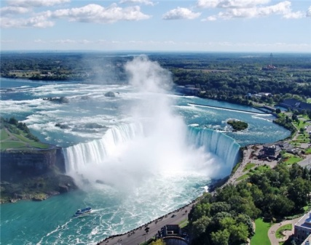
The Niagara Falls
The Niagara Falls are voluminous waterfalls on the Niagara River, straddling the international border between the Canadian province of Ontario and the U.S. state of New York. The falls are 17 miles north-northwest of Buffalo, New York and 75 miles south-southeast of Toronto, Ontario, between the twin cities of Niagara Falls, Ontario, and Niagara Falls, New York.

Slide 8
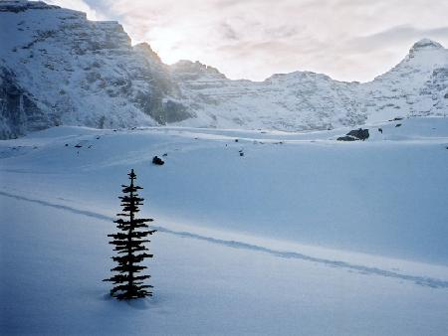
Climate
Average temperatures in January and July are different for each area. Winter can be very severe in some regions of the country, average temperatures can reach 15 ˚ C below zero in the southern part of the country, and sometimes -45 ˚ C with strong winds of. The lowest temperature ever observed in Canada is -63 ˚ C.Winters in Canada last from 4 to 5 months with heavy snowfalls.

